Slide 1
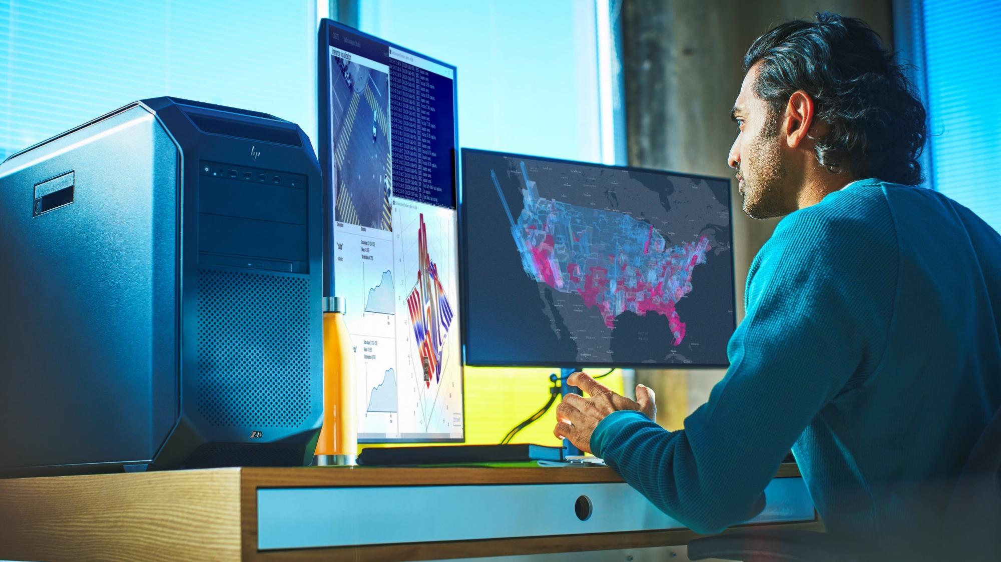


Z8 Fury G5
Extreme performance. Infinite possibilities.

Slide 2
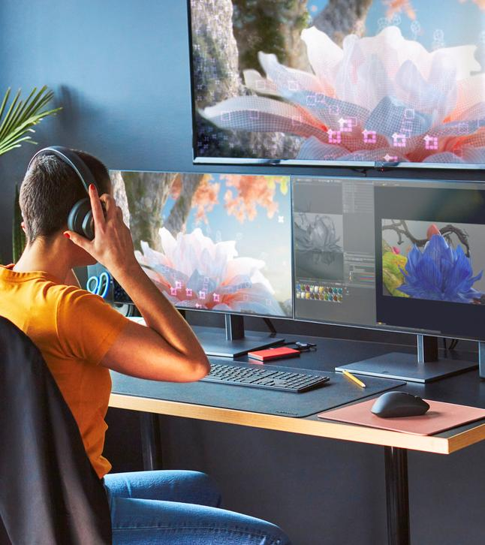

Table of Contents
Introduction | 06
Our customers | 09
Product family overview | 12
New product experiences | 15
Innovations | 21
Top segments | 29
Comparisons | 45
Privacy and security | 48
Services | 54
Sustainability | 59
Ecosystem | 62
Technical details | 69
Disclaimers | 76
2 I Z8 Fury G5 I HP Confidential. For use by HP or Partner with Customers under HP CDA only.

Slide 3

Equipping the New Era of AI
Cutting Edge Solutions for Creative & Technical Pros
2024
HP Confidential. For use by HP or Partner with Customers under HP CDA only.
Notes:
Hello, [provide a brief introduction of yourself].
Today, we will be talking about the impact of AI and how Z by HP can help equip your teams to capitalize on the possibilities of AI. [Tailor this overview based on customer relationship, needs, industry, etc.]

Slide 4

Z by HP equips power users to be future-ready.
To some, the explosion of Artificial Intelligence may feel like an overnight phenomenon.
But Z by HP has been powering world-class, innovative companies that have been at the forefront of AI for years.
Equipping the New Era of AI
HP Confidential. For use by HP or Partner with Customers under HP CDA only.
Notes:
To some, the explosion of AI may feel like an overnight phenomenon. For Z, AI has been part of our DNA for years.
For example, years ago:
NASA’s used Z tech to analyze 15 daily terabytes of solar flare data¹
American Airlines used Z tech to make more accurate predictions through advanced machine learning models²
And customers like Araya who have been AI leaders for over a decade in a wide range of sectors, choose Z³
As much as AI is not new-news to us, the acceleration and adoption of AI has never been greater. And our Z by HP portfolio delivers the solutions you need to equip your teams to be future-ready and keep pace with this rate of change.
_________________________________________________________________________________________________________________________________________________________________________________________________
Source: https://www.hp.com/us-en/workstations/learning-hub/nasa.html
Source: https://www.hp.com/us-en/workstations/learning-hub/american-airlines-delivers-goods.html
Source: https://h20195.www2.hp.com/v2/GetDocument.aspx?docname=4AA8-1651ENW

Slide 5
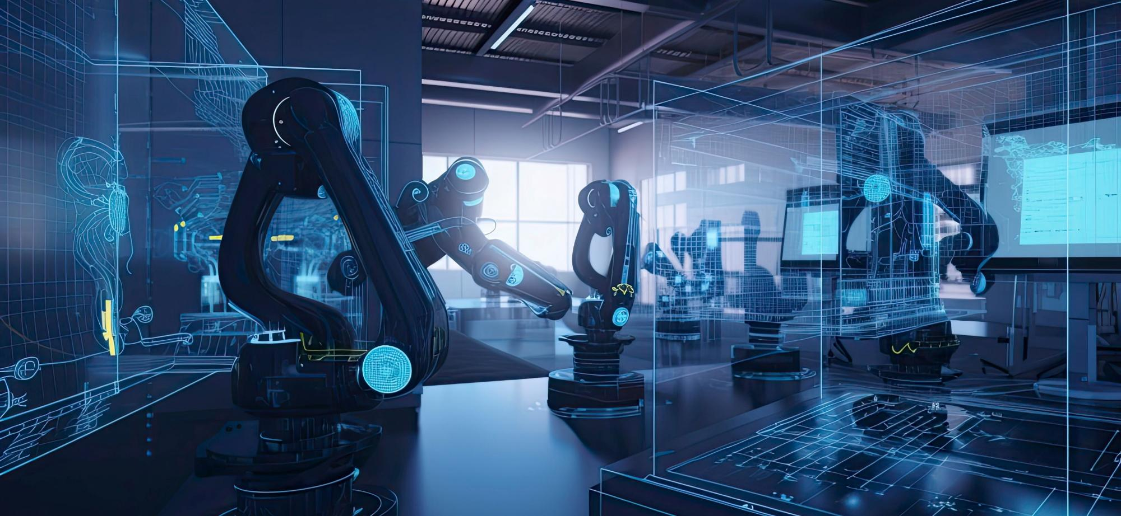
The advantage of Z AI Workstations
Power &
Performance
Security &
Reliability
ISV Certifications
Future -
Proofed
Discrete graphics, advanced processors and large memory and storage configurations
Hardware-enforced security protection¹ and up to 360,000 hours of rigorous testing²
Tested and certified for optimized performance
Upgrade graphics, memory and storage³—without any tools
Equipping the New Era of AI
HP Confidential. For use by HP or Partner with Customers under HP CDA only.
Notes:
Let's click one layer deeper into the benefits of Z AI workstations.
Power & Performance: Our AI workstations are high-performance computers with pro-grade components like discrete graphics, advanced processors and large memory and storage configurations, making them ideal for mission-critical work.
[NOTE: As Z’s AI Workstation narrative evolves with Mint/Chiron, so will our narrative. It’s intentional that we callout “discrete graphics” today given our 2024 portfolio.]
Security & Reliability:
Unlike alternatives that only protect above to operating system, HP takes a full-stack approach with HP Wolf Security—building security layer by layer, from the motherboard hardware and firmware, through the OS, to application execution. And with local data processing, your risks associated with cloud computing are lowered.
Our AI Workstations also undergo up to 360,000 hours of rigorous testing as well as military-standard testing, giving you peace-of-mind that these devices are built to endure heavy, mission-critical work.
ISV Certifications: We work with leading software vendors to test and certify our hardware, ensuring optimized performance across advanced AI-powered applications. With more ISVs optimizing their AI experiences for the GPU, choose our AI Workstations that offer a range of powerful discrete GPU options.
Future-Proofed: Easily adapt and evolve to meet increasing demands of AI software as it continues to evolve. Upgrade the graphics, memory and storage on all Z desktop workstations and memory and storage on the ZBook Fury G11. As AI itself expands and evolves, so should your tech setup.
_________________________________________________________________________________________________________________________________________________________________________________________________
HP Wolf Security for Business requires Windows 10 or 11 Pro and higher, includes various HP security features and is available on HP Pro, Elite, RPOS and Workstation products. See product details for included security features.
HP Total Test Process testing is not a guarantee of future performance under these test conditions. Damage under the HP Total Test Process test conditions or any accidental damage requires an optional HP Accidental Damage Protection Care Pack. Military standard testing is not intended to demonstrate fitness of U.S. Department of Defense (DoD) contract requirements or for military use.
Graphics, memory and storage are AMO for all Z desktop workstations. Memory and storage are AMO for the ZBook Fury G11.

Slide 6
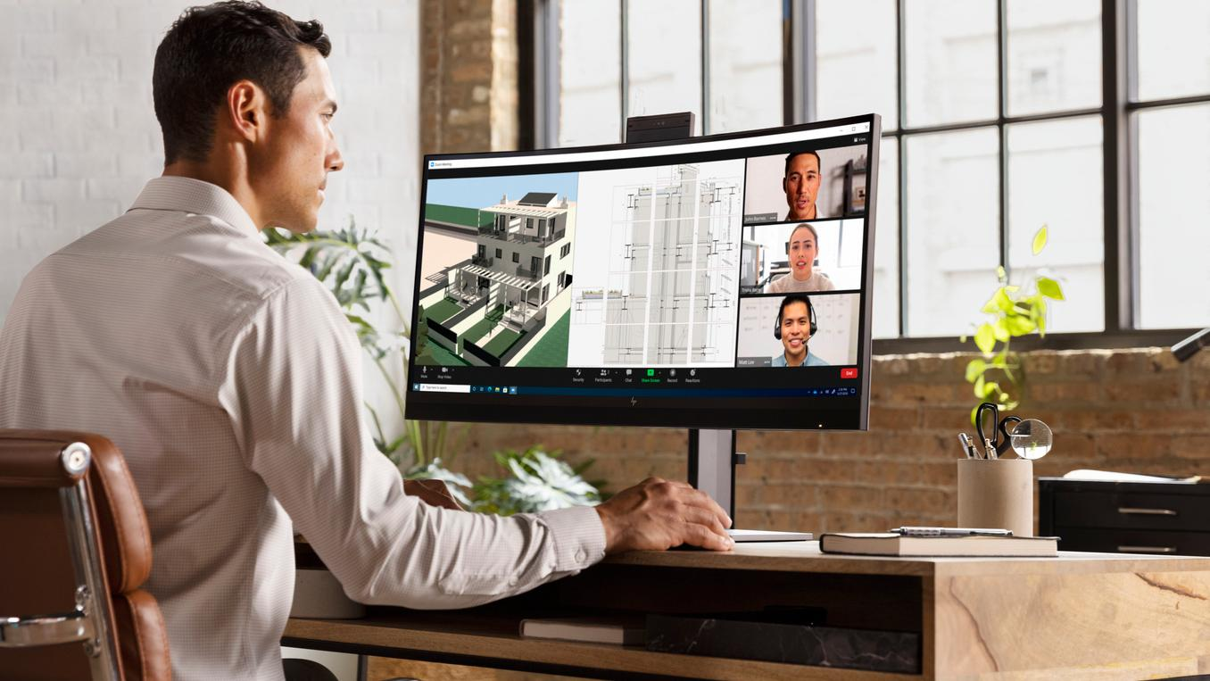

Our customers
6 I Z8 Fury G5 I HP Confidential. For use by HP or Partner with Customers under HP CDA only.

Slide 7
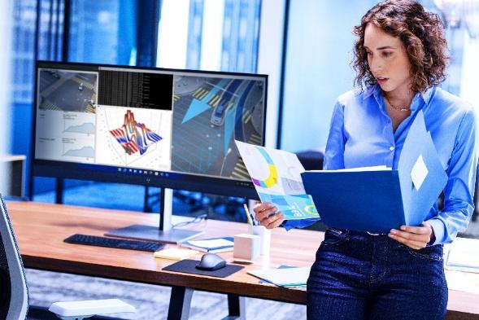
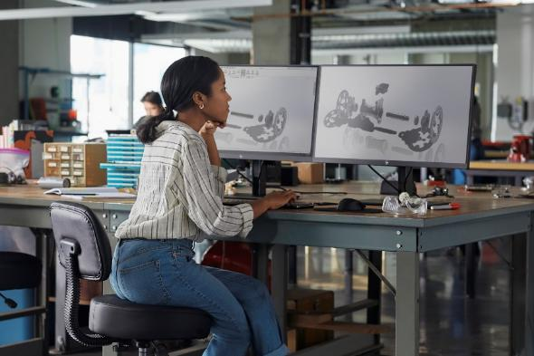
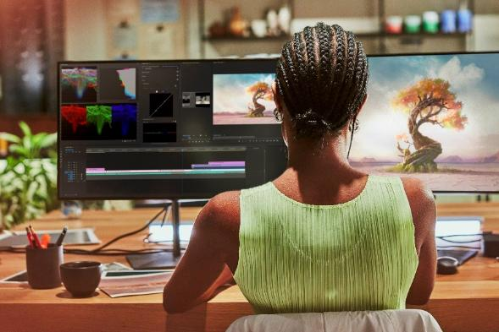
Our customers
Data scientists
Model training
Data analysis
Simulation
AI developers
Product developers
Engineering
Design
Simulation analysis
Virtual walk-throughs
M&E creators
Compositing
Editing and finishing
Developing VFX tools
7 I Z8 Fury G5 I HP Confidential. For use by HP or Partner with Customers under HP CDA only.
Notes:
Customer insights:
The explosion of AI development, complexity of workflows and pressure to accelerate outcomes drive customers to seek solutions to improve speed, accuracy, and efficiencies.
This forces us to innovate enabling systems to ingest and digest extremely large amounts of data, locally and in the cloud.
Powerful edge systems are needed to effectively handle the compute.
Compute needs are moving from CPU to GPU.

Slide 8


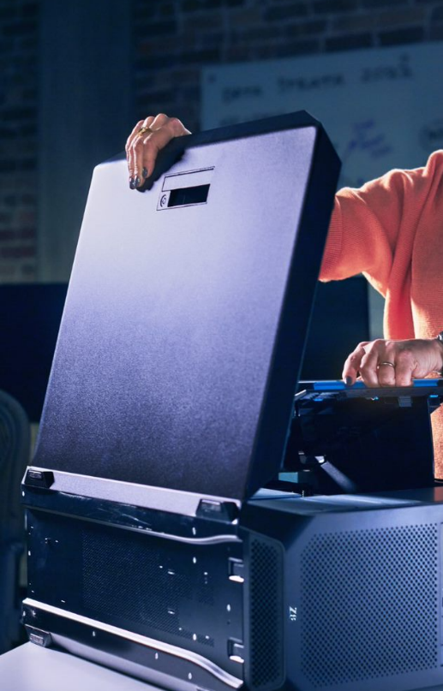
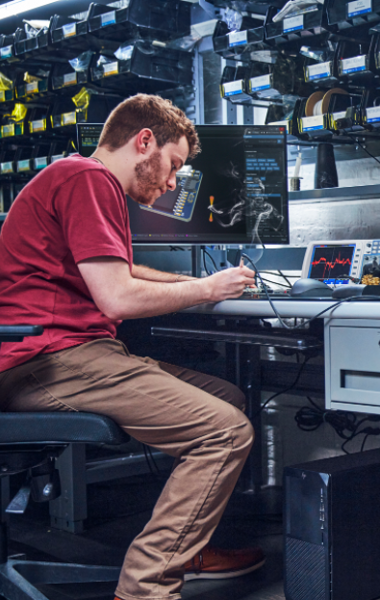
These power users face greater challenges
AI expansion is driving new technology requirements
Explosion of data
Complexity of workflows
Pressure to accelerate outcomes
New security threats
Local compute
Tested, certified and optimized
Advanced performance and reliability
Full-stack protection
Equipping the New Era of AI
HP Confidential. For use by HP or Partner with Customers under HP CDA only.
Notes:
It cannot be overstated how broad-reaching the impact of AI is. And as AI continues to evolve and expand in its use cases and impact, creative and technical professionals must be properly equipped.
In the recent accelerations of AI, the challenges of power users have changed. Let’s talk about the main challenges power users are faced with today:
Explosion of data: Current projections are that the amount of data that will be in the world by the end of next year (2025) will be in the range of 175 zeta-bytes.¹ Now that’s a lot of data. Did you know that one zettabyte is equal to a trillion gigabytes? A quick mental exercise to demonstrate just how massive this is... Do you know how many 4K Netflix movies would fit into one zettabyte? [pause for response] Almost seven trillion. Let that sink in for a moment – seven trillion 4K Netflix movies fit into one zettabyte and the current projection is that by the end of 2025 there will be 175 zettabytes¹ of data in the world. This is mind blowing and makes it abundantly clear just how critical it is to have access to local compute for performance, security and cost benefits.
Complexity of workflows: As work entails additional data sources, iterations, and stakeholders than ever before, AND as AI applications are becoming more advanced (and still being optimized for the GPU), it’s crucial to have hardware that’s tested, certified and optimized for software-driven workflows.
Pressure to accelerate outcomes: Compounding the challenges of workflows that continue to grow more and more complex is the never-ending pressure to accelerate outcomes, while also bound by time. Power users need advanced, professional-grade performance to be able to ideate, iterate and deliver work faster—and to do this without system lags or failures.
New security threats: Last, but certainly not least, there are new risks that must be addressed through secure technology solutions to protect company data and privacy.
_________________________________________________________________________________________________________________________________________________________________________________________________
Source: Data Age 2025: The Digitization of the World from Edge to Core. An IDC White Paper. https://www.seagate.com/files/www-content/our-story/trends/files/idc-seagate-dataage-whitepaper.pdf

Slide 9
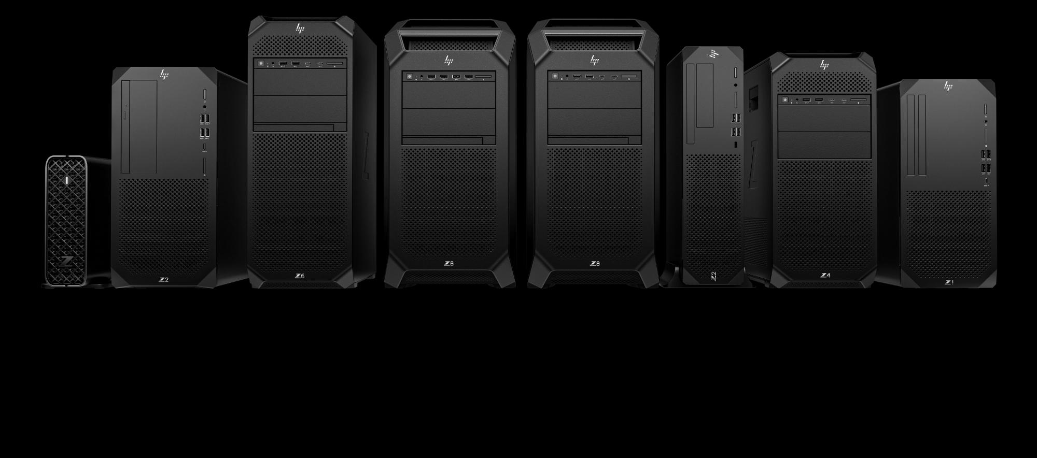
Product family overview

Slide 10




Advanced compute and solutions
Purpose-built professional solutions for high-performance workflows
Pro-level performance
HP-only experiences in performance for complex jobs heavy files
World-class remote access solutions for high-performance workflows
Built-in security
Hardware roots of trust with solutions that can self-monitor and self-heal from the ground up
Layers of protection that proactively prevent threats below, in, and above the OS
Customized solutions
HP solutions to improve management and collaboration
Seamless workflow experiences for data science, 3D, and creative
HP color accuracy, viewing comfort, and HP audio experiences
Configurability, versatility, and long lifecycles
Innovative design
Red Dot Awards for sleek and high-quality designs
Precision-crafted lightweight aluminum that is extremely durable and recyclable
Contemporary aesthetic to complement a variety of environments
10 I Z8 Fury G5 I HP Confidential. For use by HP or Partner with Customers under HP CDA only.
Notes:
Redefining high-performance, hybrid compute. The Z Portfolio is a high-performance compute solution powering people to be their best wherever and however they are working.
Who is the customer and what do they care about?
Workflow-oriented
Highest performance and reliability
Getting in the Zone wherever they are
Personas:
Next-gen power users:
Data analysts: Working with large Excel files and visualization applications like Tableau
Graphic designers: The faster they can iterate a design, the more work they can take on, the more design
Mission-critical users: Comprehensive testing helps ensure security and reliability in medical, financial, aerospace, and other mission-critical environments
Creative professionals: Artists, designers, developers, editors, and architects pushing the boundaries of what is possible. Emerging workflow in 3D, XR, AI, data science, visualization, and simulation.
Customer insights:
50% of the global workforce still works remotely
77% of knowledge workers want a hybrid work model
66% of educators expect blended learning to continue
Offers high-performance solutions tailored to what I want to do
Supports the way I work/my processes with the tools I need
Understands my workflows and offers the products I am proud to be seen with
Offers beautifully designed products
Is a leader in high performance computers tailored to the work I do
Unique and differentiating experiences:
Supports heavy workflows in the office, at home, or on the go with pro-grade performance.
Staying connected wherever they work with advanced HP collaboration solutions, VR, and a portfolio of remote compute solutions including ZCentral, Teradici, and Omniverse.
Protected and mission-critical reliability 7x24x365 with HP Wolf Security, ISV certifications, and additional reliability testing supporting continuous operation, uninterrupted performance, and multi-tasking.
Beautiful and innovative designs that can be personalized for and reflect the status of the user while in the office, at home, or on the go.

Slide 11
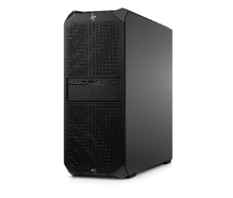
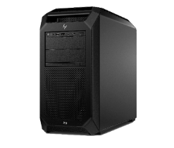
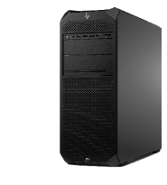
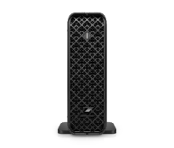
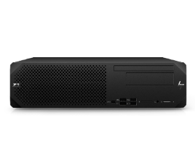
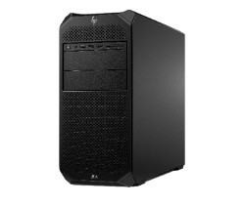
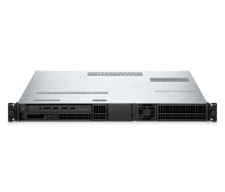
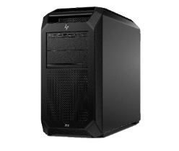
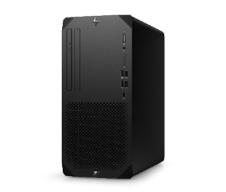
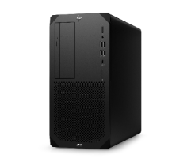
Z desktop portfolio
Best option within
the 2024 Z desktop portfolio
Best performance
Z2 Mini & Z2 SFF
Z6, Z6 A & Z8 Fury
Best for design and entry 3D
Best for AI development, data science and
advanced visualization
Z8 2S
Best for CPU rendering and simulation
Z4 Rack G5
Z4
Highest density solution
The standard for 3D design and rendering
Z1
Z2 Tower
Best condensed compute
Best for entry design
Best for design and
entry VR
Best cost/performance
11 I Z8 Fury G5 I HP Confidential. For use by HP or Partner with Customers under HP CDA only.
Notes:
[Talking track]
The Z by HP desktop portfolio offers a broad range of performance, to offer the perfect solution for any professional customer, from AEC and product development to media and entertainment, from customers working at small and medium businesses and enterprises alike.
Starting in the middle of these three qualities is the Z4. The Z4 is the balance between frequency, cores, performance, and budget. It is for those who need to render models and see them updated in real-time. If in a space-conscious location while needing high performance, the ZCentral 4R is a 1U rackable workstation that condenses the power you need into a small form factor. Access the power with our ZCentral software, which I will further explain later on.
But if you need even more power, the Z6 and Z8 are monster desktops that can calculate billions of data rows and also can render your projects with speed and accuracy. If you need a desktop that will significantly increase the efficiency of your workflow, these are the desktops to get.
For more space-optimized solutions, our most versatile workstations, the Z2 Mini and Z2 SFF, are small form factors that are great for people who are space-conscious, like in a classroom setting or in a place where every available desk space is appreciated. Especially with the Mini, you can mount it behind your display, under your desk, or rack it as a racked solution. These small yet powerful devices are also able to power your 2D designs and multi-threaded workflows.
Moving to our value ladder, customers who need a professionally certified desktop but are limited in budget can start with the Z1 Entry Tower. This device is our most affordable desktop workstation and is certified for many professional applications. For our more price-conscious customers who need a bit more power and want to be involved with design and VR, we have the Z2 Tower. This device is for the 3D designer who has begun to integrate VR into their work.
Looking at what your needs are in versatility, performance, and value, this portfolio will be able to address and provide what you need!
Positioning:
Z2 Mini and Z2 SFF
Personas: Professional creator / student (architect, product designer, designer student)
Needs:
More room on desk for blueprints and other content
Certified for professional applications
Use cases:
2D edit/design (Avid, Premiere Pro, Photoshop, InDesign)
Entry 3D design (SOLIDWORKS, AutoCAD)
Z1 Entry Tower
Personas: STEAM Student (e.g., architect, design student; K-12 and higher ed)
Needs:
Affordable price point
Professional performance for soon to be professional creators
Use cases:
CAD drawings, design and engineering (AutoCAD)
Editing and video (Photoshop, Premiere Pro)
Z2 Tower
Personas: Professional creator (e.g., engineer, architect, video editor)
Needs:
Scalable pro performance to work on any pro app from video to architecture
Quicker design visualization to meet deadlines
Use cases:
Manufacturing/PD (SOLIDWORKS)
4K videography (Avid, Premiere Pro)
Experience/software design in XR (Unity, Unreal Engine)
Z4
Personas: Professional creator (e.g., product designer, architect, engineering, video editor)
Needs:
Advanced performance for projects
Fast rendering
Use cases:
3D design/engineering (Revit, SOLIDWORKS)
4K and 8K videography (Premiere Pro, Avid)
Experience/software design (Unity, Unreal Engine)
Z6 and Z8
Personas: Power user (e.g., data scientist, model development) and professional creator (e.g., engineer, architect, designer, data scientist)
Needs:
Ultimate performance
Complex real-time visualization and analysis
Use cases:
Simulation, real-time design and visualization (Revit, Siemens PLM, Catia)
Animation (Flame, Foundry Nuke, DaVinci Resolve)
Data science (Anaconda, CUDA)
XR design (Unity, Unreal Engine)

Slide 12
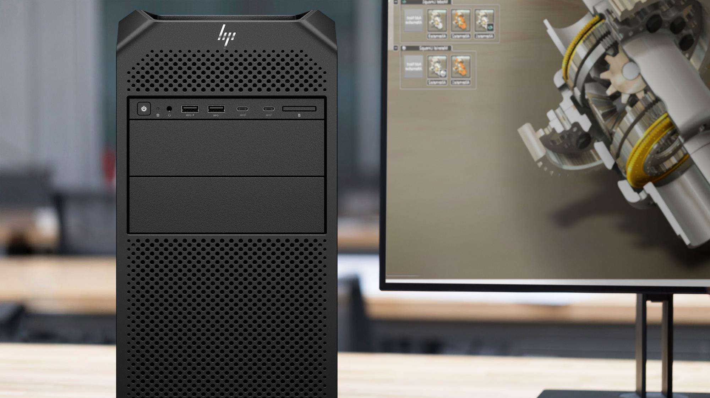
Z8 Fury G5
New product experiences
12 I Z8 Fury G5 I HP Confidential. For use by HP or Partner with Customers under HP CDA only.

Slide 13
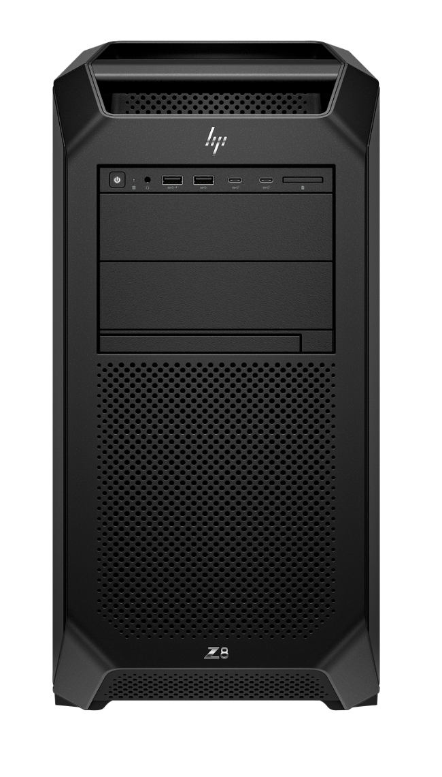
The world’s most
advanced data
science workstation²
13 I Z8 Fury G5 I HP Confidential. For use by HP or Partner with Customers under HP CDA only.
Notes:
DISCLAIMERS
2. Based on Based on HP’s internal analysis of workstations with a minimum 3 ISV certs, configurable professional graphics, and a dedicated workstation brand as of Feb 2023. Most advanced based on the ability to configure four professional NVIDIA RTX A6000 graphics cards and data science management software with a graphical user interface compatible with both Ubuntu and WSL 2.
This slide contains a superlative claim/s that cannot be used in all countries:
EMEA use restrictions:
DO NOT USE the superlative claim in the following countries:
Romania, Slovakia, Turkey, UAE, Russia, CIS countries (Armenia, Belarus, Kazakhstan, Kyrgyzstan, Moldova, Russia, Tajikistan, Turkmenistan, Ukraine, and Uzbekistan)
APJ use restrictions:
China, Vietnam, Indonesia, Malaysia—DO NOT USE
LAR use restrictions:
Brazil, Mexico—DO NOT USE

Slide 14
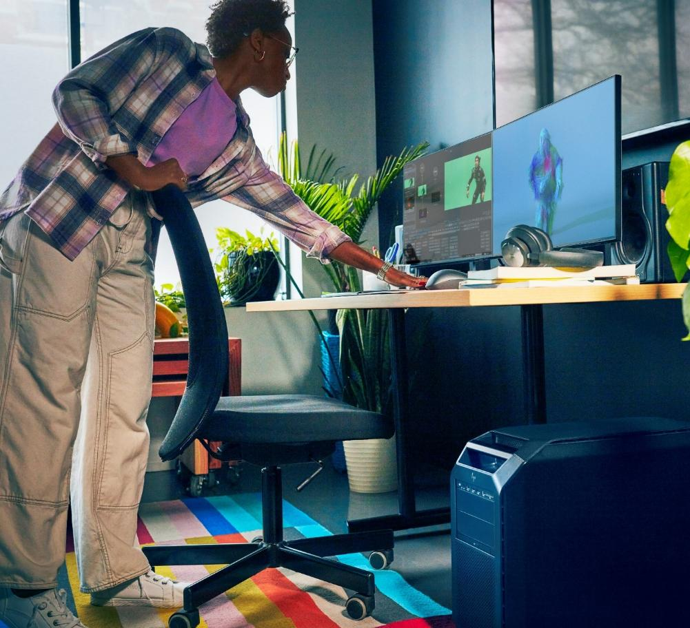





Extreme performance for workflow breakthroughs​
Relentless power. Extraordinary expandability.
Engineered to stay cool and quiet,
Your AI powerhouse, in-house.
Part of the world’s most sustainable PC portfolio.¹
14 I Z8 Fury G5 I HP Confidential. For use by HP or Partner with Customers under HP CDA only.
Notes:
[TALKING POINTS]
Unlock your potential with the most powerful Z AI workstation. The Z8 Fury delivers performance with up to 60 cores in a single CPU to also unleash the power of 4 high-end GPUs. Now you can breeze through even the most complex machine learning and data science projects, virtual production, and VFX.
This slide contains a superlative claim/s that cannot be used in all countries:
EMEA use restrictions:
DO NOT USE the superlative claim in the following countries:
Romania, Slovakia, Turkey, UAE, Russia, CIS countries (Armenia, Belarus, Kazakhstan, Kyrgyzstan, Moldova, Russia, Tajikistan, Turkmenistan, Ukraine, and Uzbekistan)
APJ use restrictions:
China, Vietnam, Indonesia, Malaysia—DO NOT USE
LAR use restrictions:
Brazil, Mexico—DO NOT USE
1. Applies to HP PCs, Workstations, and Displays manufactured after January 2019. Based on most Gold and Silver (including Climate+) EPEAT® registrations. Status varies by country. Visit www.epeat.net for more information

Slide 15
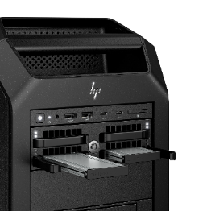
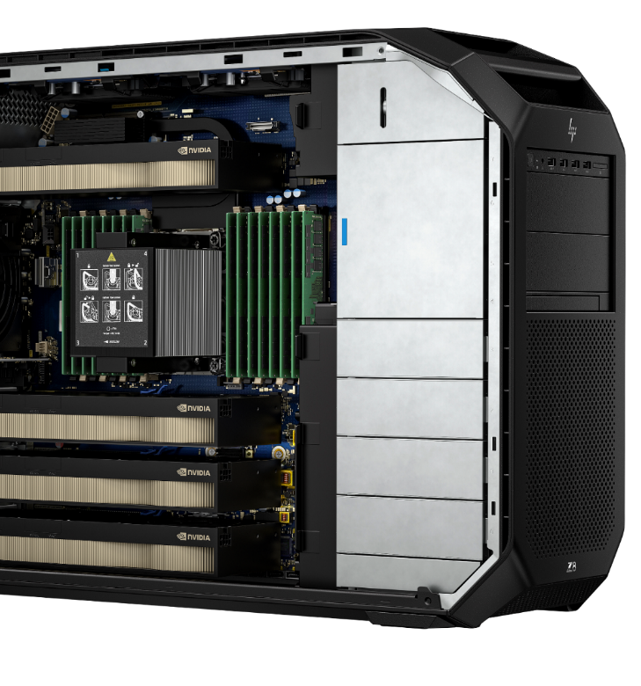
Relentless power. Extraordinary expandability.
Tackle the most complex workflows with up to
four NVIDIA® RTX™ 6000 Ada high-end GPUs^{4,}
60-core Intel® Xeon® W processor¹,
2TB DDR5 RAM⁵
120TB storage⁶
2250w power supply⁷
Never worry that your system will fail mid-project
Dual power supply for redundancy
Or switch to aggregate⁷ power for 2,250Wr when you need it.
Expand performance with eight PCIe slots
Tool-less design with four front-accessible NVMe slots
15 I Z8 Fury G5 I HP Confidential. For use by HP or Partner with Customers under HP CDA only.
Notes:
Tackle the most complex workflows with up to
four NVIDIA® RTX™ 6000 Ada high-end GPUs^{4,}
60-core Intel® Xeon® W processor¹,
2TB DDR5 RAM⁵
120TB storage⁶
2250w power supply⁷
Never worry that your system will fail mid-project
Dual power supply for redundancy in power to stay up and running during critical workflows.
Or switch to aggregate⁷ power to combine two power supplies for 2,250W power when you need it.
Easily expands as work evolves with eight PCIe slots
Tool-less design with four front-accessible NVMe slots
DISCLAIMERS
Multicore is designed to improve performance of certain software products. Not all customers or software applications will necessarily benefit from use of this technology. Performance and clock frequency will vary depending on application workload and your hardware and software configurations. Intel’s numbering, branding and/or naming is not a measurement of higher performance.
Intel vPro® Enterprise technologies are available only on Intel® Xeon® W-3500 and Intel® Xeon® W-2500 processors. Intel vPro® requires Windows 10 Pro 64 bit or higher, a vPro supported processor, vPro enabled chipset, vPro enabled wired LAN and/or Wi-Fi 6E WLAN and TPM 2.0. Some functionality requires additional 3rd party software in order to run. Features of vPro®️ Essentials and Enterprise vary. See http://intel.com/vpro
Error Correction Code (ECC) memory enables enhanced data reliability. ECC memory is only available on Intel® Xeon® processor options.
NVIDIA RTX™ 6000 and AMD Radeon™ Pro W6800 GPUs are sold separately or as an optional feature.
120TB storage is optional, configurable feature. For storage drives, 1GB = one billion bytes; 1TB = one trillion bytes. Actual formatted capacity is less. Up to 35GB is reserved for system recovery software.
Configuration for 89TB requires after-market purchase. Two front accessible NVMe bays require a 5.25 bay carrier. For storage drives, GB = 1 billion bytes. TB = 1 trillion bytes. Optional, configurable features..
Redundant and aggregate power requires configuring two 1125W power supplies at hardware purchase.
This slide contains a superlative claim/s that cannot be used in all countries:
EMEA use restrictions:
DO NOT USE the superlative claim in the following countries:
Romania, Slovakia, Turkey, UAE, Russia, CIS countries (Armenia, Belarus, Kazakhstan, Kyrgyzstan, Moldova, Russia, Tajikistan, Turkmenistan, Ukraine, and Uzbekistan)
APJ use restrictions:
China, Vietnam, Indonesia, Malaysia—DO NOT USE
LAR use restrictions:
Brazil, Mexico—DO NOT USE

Slide 16
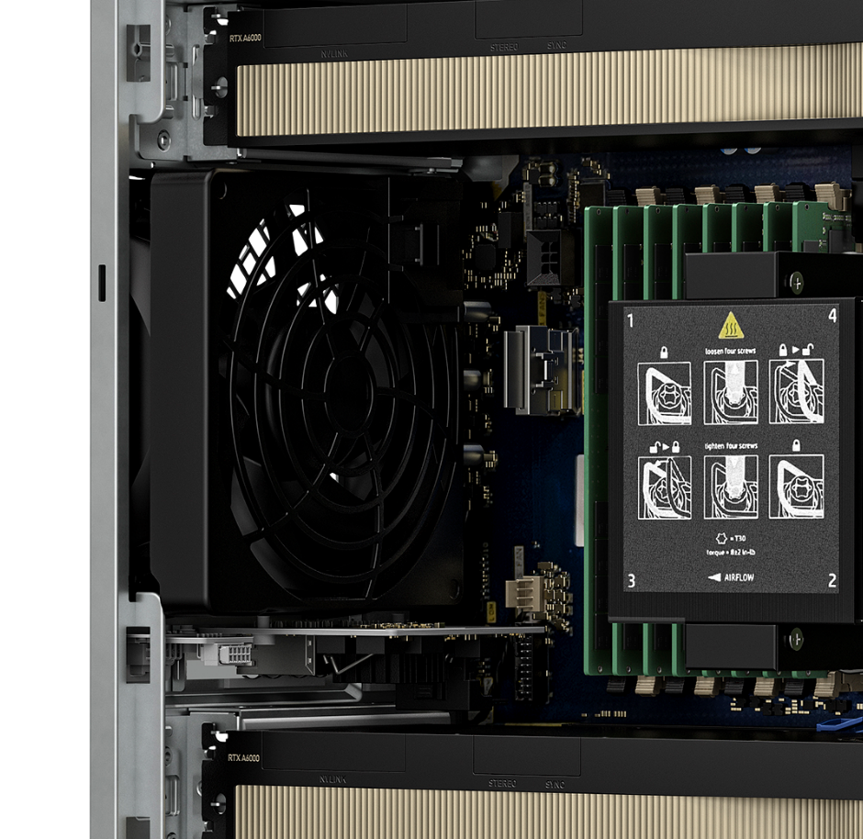
Engineered to stay cool and quiet.
Push your PC to the max without disruptive noise
Smart fan control keeps the system whisper-quiet
Over 20 temperature sensors tune fan speeds to workload in real time
Precisely placed vents and ducts streamline airflow and heat removal
16 I Z8 Fury G5 I HP Confidential. For use by HP or Partner with Customers under HP CDA only.
Notes:
Push desktop workstation performance without disruptive noise.
Smart fan control keeps the system whisper-quiet by tuning fan speeds in real-time using over 20 temperature sensors.
Precisely placed vents and ducts streamline airflow and heat removal.

Slide 17
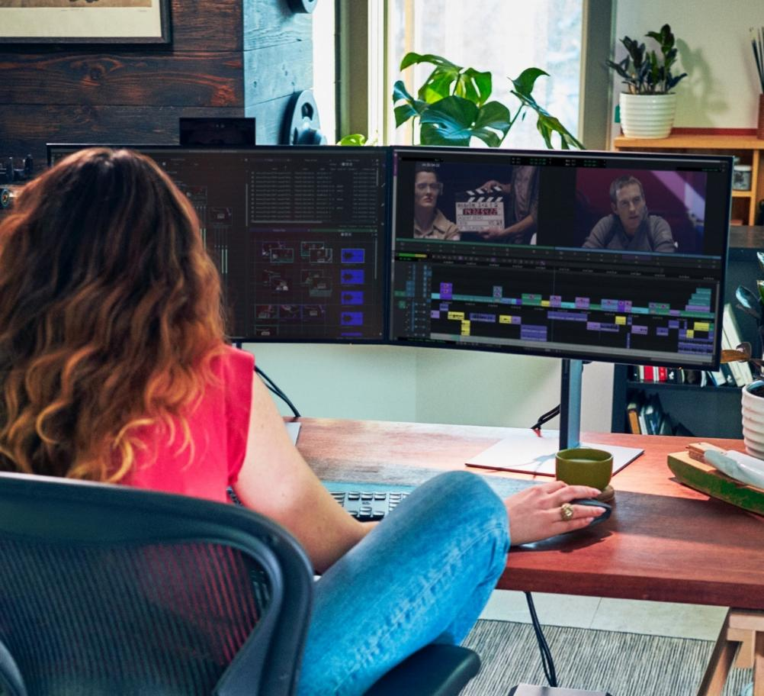
Your AI powerhouse, in-house
Accelerate AI development and inferencing
Up to 4 NVIDIA RTX™ 6000 Ada GPUs¹ deliver a combined 5,800 TOPS,
Process and manage proprietary data securely on a local workstation to gain insights and make decisions faster.
Remotely access the power of your Z with HP Anyware²
Save time with WSL 2 enabling Linux to run in Windows³
Easily access tools from the Z by HP Data Science Stack Manager⁴
Connect data, people and compute with Z by HP AI Studio⁵ an AI development platform for teams and IT
17 I Z8 Fury G5 I HP Confidential. For use by HP or Partner with Customers under HP CDA only.
Notes:
Notes: WSL2 is pre-installed on Windows 10 and 11.
[TALKING POINTS]
Accelerate AI development and inferencing with the Z8 Fury AI workstation. And with a whopping TOPS, trillions of operations per second, of 5,800 on 4 NVIDIA RTX 6000 Ada GPUs, this AI workstation delivers and enables your teams to imagine new compute, graphics, and AI development solutions on performance rarely found on workstation.
With HP Anyware, a user can access the power of your Z from any device with HP Anyware. This remote access software delivers fast responsiveness and image quality, even in film editing and data visualizations.
Z by HP Data Science Stack Manager and Z by HP Data Science Software Stack, pre-loaded on select models provides easy access to popular data science tools with easy-to-use graphical user interface for analyzing data and creating powerful models. It's curated, managed, and continually updated by HP. Developer utilities allow for easy creation and deployment of data science applications, while managing data science tools and libraries.
Z by HP AI Studio provides a single platform to create centralized projects to streamline data management, share tools and configurations, and manage compute resources enabling teams to use the right compute for the right job. Unique to HP, this is the only solution available to manage DS/AI projects across the full hybrid spectrum – from local workstations, to Edge/Datacenter, to Cloud/Super-Cloud, and it is a great opportunity to drive new growth while also differentiating our core with the solution.
DISCLAIMERS
NVIDIA RTX™ 6000 and AMD Radeon™ Pro W6800 GPUs are sold separately or as an optional feature.
Network access required. HP Anyware supports Windows®️, Linux®️ and MacOS®️ host environments and Window, Linux, MacOS, iOS®️, Android®️, and Chrome OS®️ end-user devices. For more on the system requirements for installing HP Anyware, refer to the Admin Guides at: https://docs.teradici.com/find/product/cloud-access-software. HP Anyware is based on the Teradici CAS software and licensing platform and is available through a 1- and 3-year subscription. HP Anyware subscriptions are based on the number of concurrent PCoIP connections used (pay for the number of host connections, not the software) with a minimum order quantity of 5. HP Anyware subscriptions gives you a license key to activate a connection to a hosted desktop as well as support and updates to the PCoIP Agents, PCoIP Clients and the Anyware Manager available for download here: https://docs.teradici.com/find/product/cloud-access-software. For a limited time, an HP Anyware subscription also includes access and support for ZCentral Remote Boost and ZCentral Connect and is available for purchase through an HP Teradici seller or by contacting sales at: hp.com/Anyware
WSL 2 is an optional, configurable feature. WSL 2 requires Windows 10 or higher, Intel Core i5 processor or higher, and is available on select Z workstations. You must be running Windows 10 version 21H2 and higher (Build 19044 and higher) or Windows 11.
Z by HP Data Science Stack Manager requires Windows 10 version 21H2 (Build 19044) and higher or 64-bit Ubuntu 20.04 and is available on select Z workstations.
Z by HP AI Studio requires Windows 11 OS, Intel Core™ i5 12th gen or higher, AMD Ryzen™ 9 or higher processors, minimum 50 GB of available storage, 16GB of RAM, and Internet access. To enable GPU compute, Z by HP AI Studio requires any NVIDIA® GPU compatible with driver version 528.49 or newer. Join waitlist for access to Z by HP AI Studio early access program.
TOPS (Trillions of Operations Per Second) is a metric used to describe the theoretical maximum computational capability of AI accelerators. It shows relative performance in performing AI-based functions on AI accelerators like NPUs, CPUs, and GPUs. Real-world performance can be significantly lower than the theoretical TOPS.” ¹

Slide 18
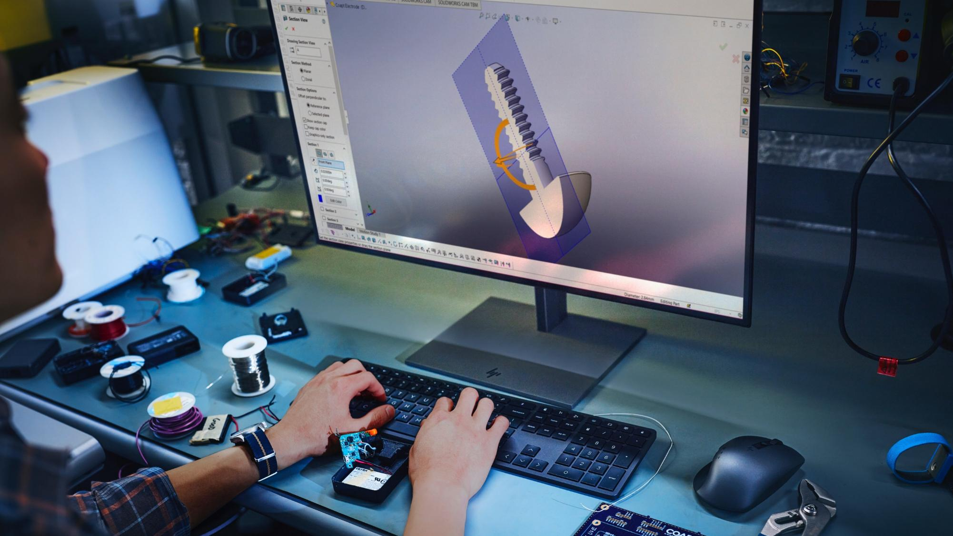
Innovations
18 I Z8 Fury G5 I HP Confidential. For use by HP or Partner with Customers under HP CDA only.

Slide 19
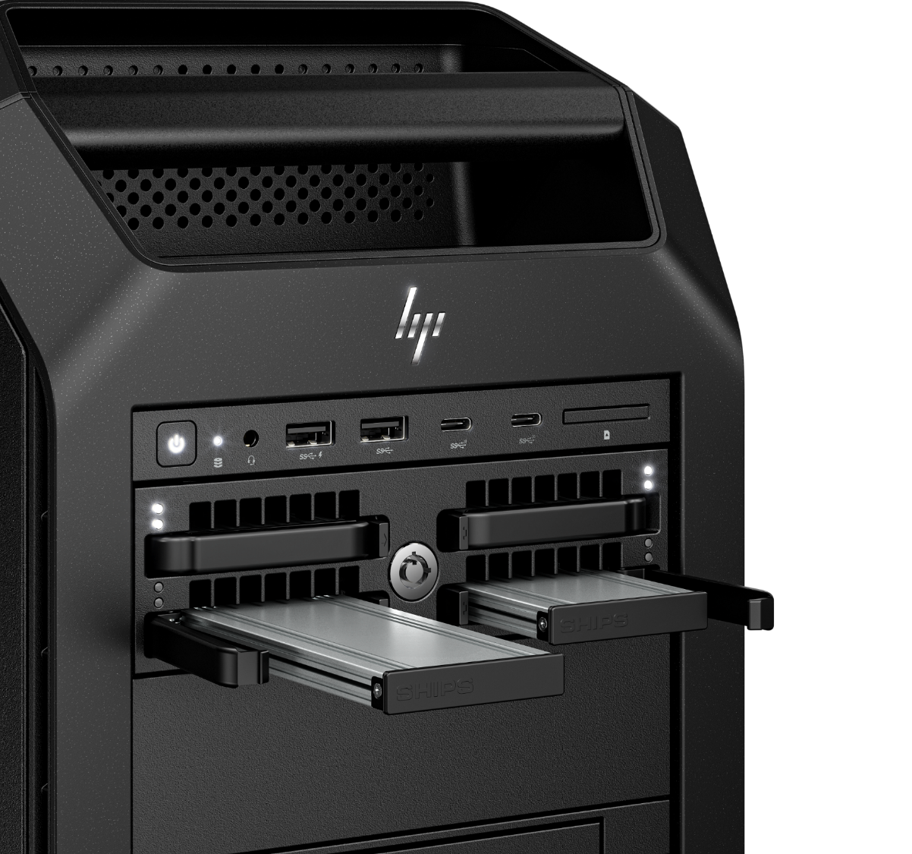

Key HP Innovations
Hot-swappable NVMe bays with status information via external LED and email notifications
Improved thermal and acoustic design to handle complex workloads easily
Redundant or aggregate power supplies for backup or boosted power when you need it
up to 4 NVIDIA® RTX™ 6000 Ada GPUs* for the most complex workflows
Uniquely spaced PCIe ports for maximum performance
19 I Z8 Fury G5 I HP Confidential. For use by HP or Partner with Customers under HP CDA only.

Slide 20
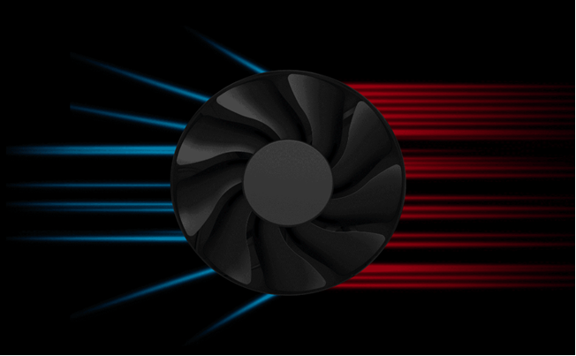
Keeping cool through the most challenging projects
The Z8 Fury G5's chassis was built with the goal of providing users the most power possible while also utilizing reliable thermal cooling solutions.
A larger form factor allows for optimized PCIe slot spacing to deliver more airflow.
Its single CPU design enables HP to create a split PCIe slot layout on the system board to distance the high-heat generating components like GPUs for better overall system cooling efficiency.
Despite running high powered programs, whisper quiet acoustics keep users from getting distracted or fatigued.
20 I Z8 Fury G5 I HP Confidential. For use by HP or Partner with Customers under HP CDA only.
Notes:
[TALKING POINTS]
Workstation customers demand workstations that deliver performance, safety, reliability, and low noise.
Monitoring and maintaining component temperatures is vital to performance, safety, and reliability. Quiet acoustics (through effective thermal management techniques) allows workstation customers to stay focused and in the zone as they work on critical and demanding workflows. Low noise is essential to reducing user fatigue, maximizing productivity, and minimizing distractions.
Please refer to whitepaper on Performance Desktops (G5) at www.hp.com/z

Slide 21

Custom Performance Modes
Choose 3 pre-set modes from the BIOS
Optimize performance with High Performance, Performance and Quiet modes.
With Intel®️ Adaptix™️ Technology¹ (including Dynamic Tuning Technology or DTT framework)
HP’s proprietary cooling and power designs enable performance gains in multi-threaded applications
21 I Z8 Fury G5 I HP Confidential. For use by HP or Partner with Customers under HP CDA only.
Notes:
[TALKING POINTS]
HP’s High-Performance Mode utilizes Intel® Adaptix™ Technology (including Intel® Dynamic Tuning Technology or DTT framework)
HP has taken Intel’s innovation to the next level leveraging our proprietary thermal solution, maximizing CPU clock speed to provide performance gains. User will experience increased performance in multi threaded applications and work flows.
High Performance Mode kicks in before the job starts, adjusting to the rapid increase in CPU usage that comes with heavy work loads and starts cooling immediate in advance of higher temperatures that come with heavy workloads.
Intel® Adaptix™ Technology requires Windows 10 and BIOS set to High Performance Mode.

Slide 22
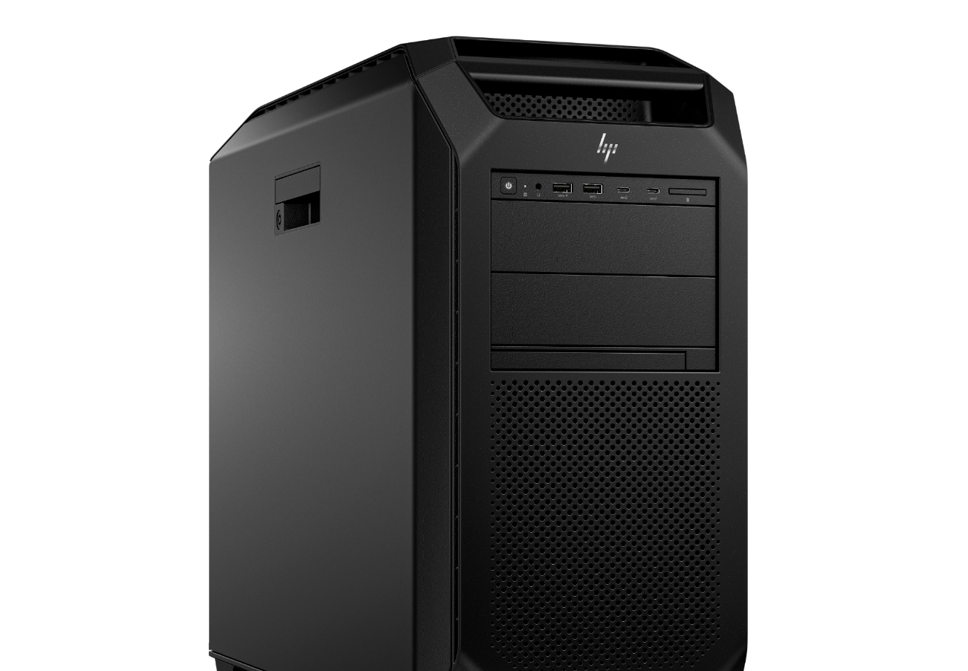
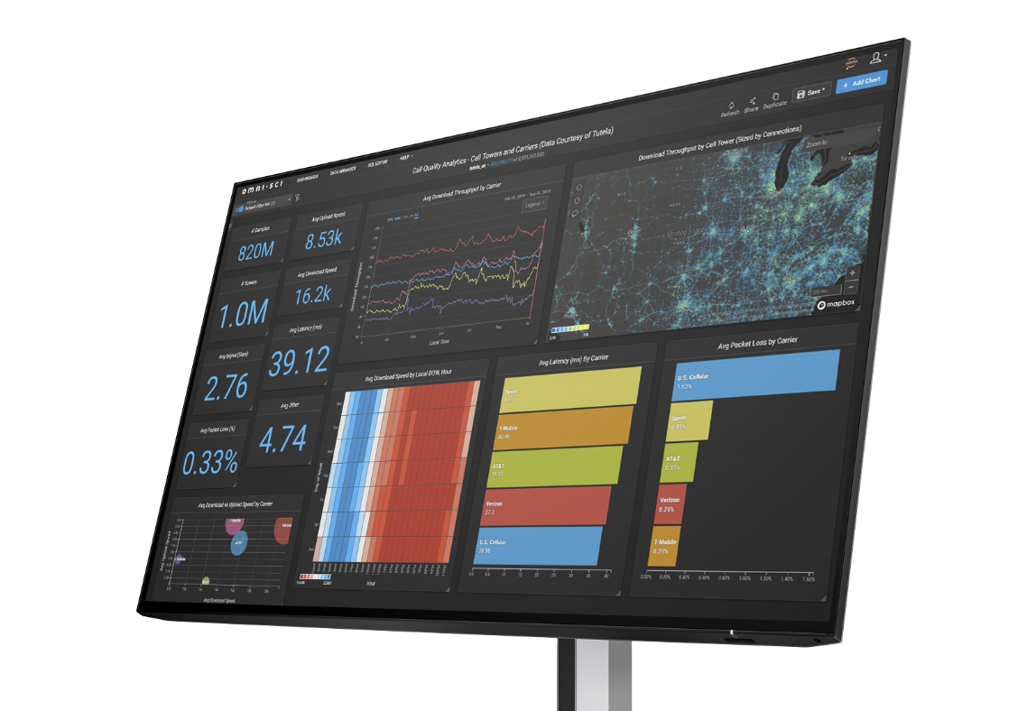


Intel® Xeon® changes
Intel® Core™ refresh brings new experiences to life plus a up to 10% higher multi-threaded performance upgrade from prior Intel® Core™ version.¹
Up to 60 cores in a single processor³
Increased expandability to support PCIe cards with 112 PCIe lanes
PCIe support for up to four high-end GPUs
DDR5 memory with up to 2TB configs¹⁰
22 I Z8 Fury G5 I HP Confidential. For use by HP or Partner with Customers under HP CDA only.
Notes:
DISCLAIMERS
1. Based on Intel SPR-Refresh QS Performance Guide
3. Multicore is designed to improve performance of certain software products. Not all customers or software applications will necessarily benefit from use of this technology. Performance and clock frequency will vary depending on application workload and your hardware and software configurations. Intel’s numbering, branding, and/or naming are not measurements of higher performance.
10. 2TB DDR5 memory is planned to be available mid-2023.

Slide 23
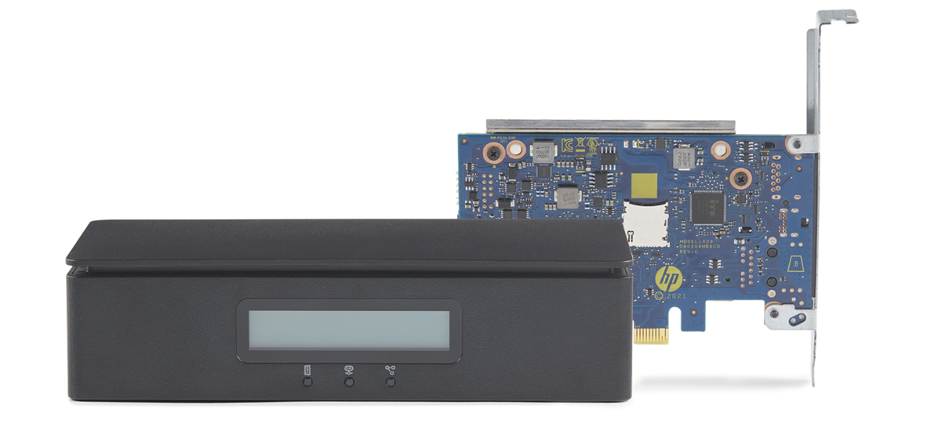
Complete Out of Band Remote Workstation Management
Workstation Fleet Management⁴⁸ – From Anywhere.
Manage and monitor your fleet of workstations from any location.^{41,42}
HP Remote System Controller⁴⁹
The world’s most advanced remote management peripheral⁵²
One console. All access.
Perform out of band management tasks through a single interface—remotely.²
Multiple Options for Easy Deployment. ⁴³
Unleash your ability to deploy distributed workstations with an easy to deploy solution.⁴⁴
Security You Need. Control You Want.
Based on a zero-trust model with extensive testing, HP Remote System Controller is a secure, browser based remote IT management access to workstations.
23 I Z8 Fury G5 I HP Confidential. For use by HP or Partner with Customers under HP CDA only.
Notes:
[TALKING POINTS]
HP Remote System Controller can claim that it’s the world’s most advanced remote management peripheral.
This remote out-of-band management solution gives you the power to monitor and manage a workstation fleet without compromising control, all from a single interface. Quick-to-deploy, scalable, and with strong security— now you can provide support and maintenance from anywhere.
Remotely launch a KVM session and perform out-of-band management tasks such as pre-boot access, BIOS updates, and re-imaging.² Without compromising control, deploy a fleet of workstations and give power users dedicated access to high performance devices.
Consolidate workstation fleet management into a single dashboard--anywhere. Provide maintenance and support while receiving reports and insights at a glance. Optimize your infrastructure and resolve issues before they affect end users.
Deploy an ideal solution with flexible options across hardware and software. Choose an internal or external controller—compatible with Z by HP workstations and other compute devices—and embedded or browser-based public cloud management software.
Security is your top priority, so we designed the hardware and software based on high security industry standards, completed extensive testing, third-party reviews, and certifications to ensure maximum security.
This slide contains a superlative claim/s that cannot be used in all countries:
EMEA use restrictions:
DO NOT USE the superlative claim in the following countries:
Romania, Slovakia, Turkey, UAE, Russia, CIS countries (Armenia, Belarus, Kazakhstan, Kyrgyzstan, Moldova, Russia, Tajikistan, Turkmenistan, Ukraine, and Uzbekistan)
APJ use restrictions:
China, Vietnam, Indonesia, Malaysia—DO NOT USE
LAR use restrictions:
Brazil, Mexico—DO NOT USE
Disclaimers:
41. Internet access required.
42. Internet access required. Fleet management requires HP Anyware Remote System Management.
43. HP Remote System Controller not compatible with Z2 Mini platforms and not recommended for non-Z devices.
44. HP service and support not available for non-Z devices.
48. Fleet Management requires HP Remote System Management. Access to HP Remote System Management is included with the purchase of the HP Remote System Controller. Visit https://rsm.hp.com to open your account.
49. Access to HP Remote System Management is included with the purchase of the HP Remote System Controller. Visit https://rsm.hp.com to open your account.
52. Based on HPs internal Analysis of peripheral hardware IP KVMs as of Feb 2023. Most advanced based on ability to directly access the BIOS without a KVM Session, Power Button, Automated Bare Metal Imaging, Health Alerts/Diagnostics from the Host, and available Fleet Management Software when used with Z2 G9, Z4, Z6, Z8, Z8 Fury G5, and above

Slide 24
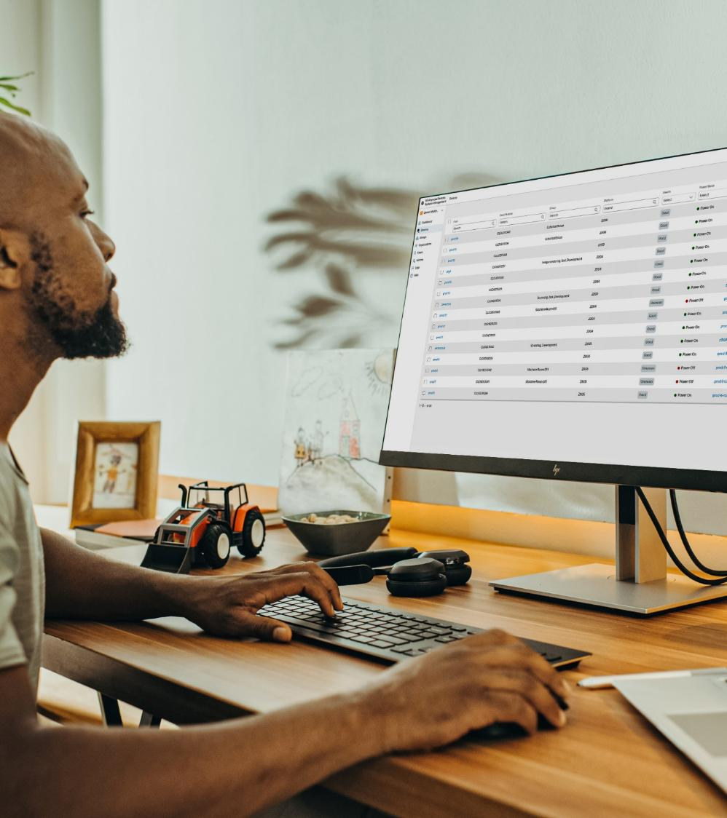
Workstation Fleet Management – From Anywhere
Remotely launch a KVM session and perform out-of-band management tasks for an entire fleet such as:
Remote Power Control⁵
BIOS Settings and Updates⁶
Bare Metal Imaging¹
Remote Virtual Storage
24 I Z8 Fury G5 I HP Confidential. For use by HP or Partner with Customers under HP CDA only.
Notes:
Remotely launch a KVM session and perform out-of-band management tasks such as pre-boot access, BIOS updates, and re-imaging.² Without compromising control, deploy a fleet of workstations and give power users dedicated access to high performance devices.
Remote Power Control: Manage centralized hardware remotely with direct control of the power button signal, giving you the ability to power on, off, or reboot individual workstations or pools of systems from any state.
Bare Metal Imaging: Deploy workstations without any pre-configurations, and with HP Anyware Remote System Controller, completely image, configure, or re-image the operating system and software from any location.
Remote Virtual Storage: With up to 4.7GB of virtual storage* and the ability to save encrypted read-only files, HP Anyware Remote System Controller⁴⁷ allows for OS installation images and software to be installed on workstations and data can be transferred to the workstation, without having to be on-site.
Disclaimers:
1. Internet access required
5. Remote Power Control feature only available when HP Anyware Remote System Controller or HP Anyware Integrated Remote System Controller is paired with select Z desktop workstations. See datasheet for details.
6. Viewing system information is only available when paired with select Z desktop workstations. See datasheet for details.
47. Fleet Management requires HP Remote System Management. Access to HP Remote System Management is included with the purchase of the HP Remote System Controller. Visit https://rsm.hp.com to open your account.

Slide 25

Top segments
25 I Z8 Fury G5 I HP Confidential. For use by HP or Partner with Customers under HP CDA only.

Slide 26
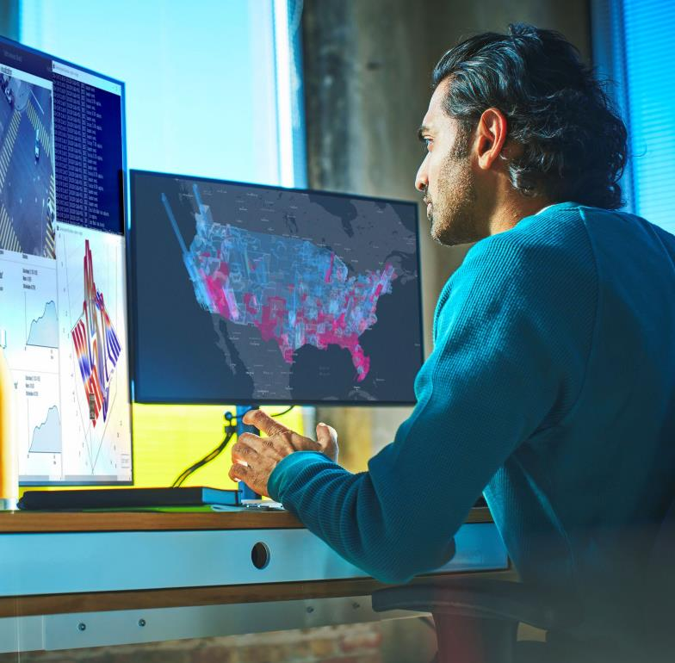

The Z advantage for AI and data science
AI and data science are now employed across nearly every industry segment.
Get rapid results on your most challenging projects with Z data science solutions designed to accelerate data science and AI development workflows.
Certified Ubuntu¹ and Windows—along with Microsoft WSL 2²—enable data science in any environment.
Z by HP Data Science Software Stack and Z by HP Data Science Stack Manager³ provide convenient access to popular tools with automatic updates.
Z by HP AI Studio will provide fast and easy access to tools, templates, and models to collaborate on AI, machine learning, and data science⁵.
Seamless and highly secure interaction with the cloud—toggle back and forth with ease.
HP Anyware software provides access to workstation power from anywhere.⁴
Data Analytics
AI Development
Machine Learning
Deep Learning
Computer Vision
Natural Language Processing
26 I HP Confidential. For use by HP or Partner with Customers under HP CDA only.
Notes:
[TALKING POINTS]
Select Z by HP workstation PCs are designed to meet the demands of advanced analytics—right out of the box.
Our desktops and notebooks are packed with industry-leading hardware and software innovations designed to accelerate your data science workflow.
What you do.
AI and data analytics are now employed for business advantage in nearly every industry segment. Get rapid results with complex data on your most challenging projects with Z data science desktop and mobile workstations – purpose-built for this demanding work.
Purpose-built and optimized for data science
We start with enterprise-class components and work closely with partners like Intel® and NVIDIA® to test and certify them on our Z workstations.
We run our Z devices through actual data science workflows and then adjust the component mix until we find the configurations that deliver the best experience.
We perform extensive testing on the curated software and all Z workstations undergo rigorous MIL-STD4 durability tests.
OS offering—Ubuntu and Windows—plus WSL 2
All our workstations come available with the latest version of Microsoft Window Pro as well as certified Ubuntu.1
Ubuntu comes certified and preinstalled. We’ve partnered with Canonical to extensively test and certify the latest version of Ubuntu OS, so it performs at its best.1
Microsoft WSL 22 also comes preinstalled. Experience the best of both Windows and Ubuntu with Microsoft Windows Subsystem for Linux 2. WSL 2 is a simple and fast way to run a Linux environment directly in Windows.2
Z by HP Data Science Software Stack and Z by HP Data Science Stack Manager³ (Pre-loaded on select models)
Provides easy access to popular data science tools on Ubuntu 20.04 or Windows via WSL 2. 2
Offers the flexibility to quickly adapt data science environments based on project needs with the easy-to-use graphical user interface.
It’s curated, managed, and continually updated by HP so there are no concerns with software dependencies or version control.
The software stack provides the most popular tools for analysing data and creating powerful models.
Developer utilities allow for easy creation and deployment of data science applications, while managing data science tools and libraries.
Enhanced cloud experience
With Z workstations, you can interact seamlessly and with strong security with your main cloud environment using cloud command line access. Toggle between your local workstation and the cloud with ease.
Security-packed:
Equipped with rigorous, multi-layered security protecting data and device from various cyber threats. HP's security features like HP Sure Start and HP Sure Recover help the end user work with confidence and peace of mind, knowing their workstation is protected from unauthorized access, tampering, or theft. ​
HP Anywhere software
HP Anyware software provides fully manageable remote access to workstation performance wherever needed.⁴
Z by HP AI Studio
A centralized data science platform bringing data, people, and compute together.5 Get fast and easy access to tools, templates, and models to collaborate on AI, machine learning, and data science on-prem projects, while spending less time on operational tasks.
Just what you need.
Customize now or plan to add later additional GPUs/memory/storage for the performance you need to future proof your investment as workflows evolve and software demands more workstation performance and efficiency. Visit HP Product Finder to configure by workflow or specs at hp.com/go/z, “help me choose”.
Designed for your workflows.
Data analytics
Ingest, clean, analyze, and visualize data in near real-time, providing the critical insights for your business, right when you need them.
AI / Machine Learning / Deep Learning
Increase inference throughput and quickly create better models by training with larger data sets and less latency.
Computer Vision
Perform object detection, image classification, and image segmentation with speed and accuracy on large image and video files.
Natural language processing
Achieve greater precision and recall for both audio and text NLP models by running more iterations and decreasing model run time.
----
[DISCLAIMERS]
Select HP Workstations are available with certified Ubuntu. For detailed Linux OS/hardware support information, see: http://www.hp.com/support/linux_hardware_matrix.
WSL 2 is an optional feature available on select Z workstations. You must be running Windows 10 version 21H2 and higher (Build 19044 and higher) or Windows 11.
Z by HP Data Science Stack Manager requires Windows 10 version 21H2 (Build 19044) and higher or 64-bit Ubuntu 20.04 and is available on select Z workstations.
Network access required. HP Anyware software and licensing are available through a 1- or 3-year subscription. Renewal is required after the subscription term. HP Anyware subscriptions are based on the number of concurrent PCoIP connections used (pay for the number of host connections, not the software) with a minimum order quantity of 5. For a limited time, an HP Anyware Professional subscription also includes access and support for ZCentral Remote Boost and ZCentral Connect and is available for purchase through an HP reseller or contact sales at hp.com/Anyware. ZCentral Remote Boost Sender requires Windows 10 and 11, RHEL/CentOS (7 or 8), or UBUNTU 18.04 or 20.04 LTS operating systems. macOS (10.14 or newer) operating system and ThinPro 7.2 are only supported on the receiver side. ZCentral Connect requires Windows (10 or 11) or Windows Server (2016 or 2019) operating system, Microsoft Active Directory and Intel Active Management Technology for select features. For system requirements and to install HP Anyware and Anyware Manager, refer to the Admin Guides at: https://docs.teradici.com/find/product/hp-anyware.
Z by HP AI Studio requires Windows 11 OS, Intel Core™ i5 12th gen or higher, AMD Ryzen™ 9 or higher processors, minimum 50 GB of available storage, 16GB of RAM, and Internet access. To enable GPU compute, Z by HP AI Studio requires any NVIDIA® GPU compatible with driver version 528.49 or newer. Join waitlist for access to Z by HP AI Studio early access program - https://reinvent.hp.com/LP=10935?jumpid=va_6fsqyhva81. Visit hp.com to learn more: https://www.hp.com/us-en/workstations/ai-studio.html?jumpid=va_6fsqyhva81

Slide 27
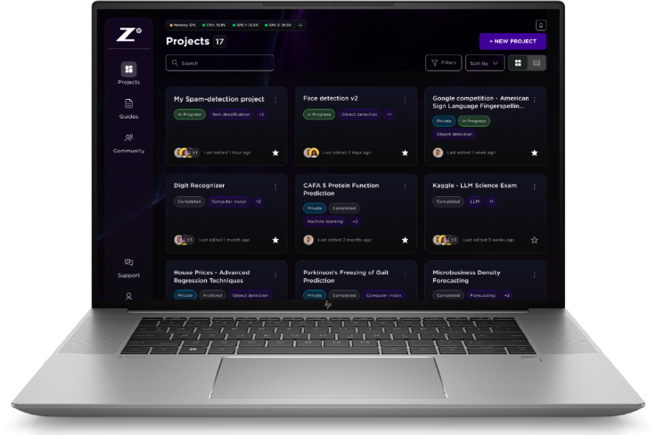



HP AI Studio: Connecting Data, People and Compute
Customer challenges today:
Data located in multiple cloud databases
Team members using different tools
No visibility to compute resources
With Z by HP AI Studio⁵
customers can:
CENTRALIZE
Simplify access to critical tools, compute, and data.
COLLABORATE
Efficiently share images with teammates and collaborate in real-time.
ACCELERATE
Create local AI projects in minutes, not days/weeks.
27 I Z8 Fury G5 I HP Confidential. For use by HP or Partner with Customers under HP CDA only.
Notes:
Select Z by HP workstation PCs are designed to meet the demands of advanced analytics—right out of the box.
Our desktops and notebooks are packed with industry-leading hardware and software innovations designed to accelerate your data science workflow.
OS offering—Ubuntu and Windows—plus WSL 2
•All our workstations come available with the latest version of Microsoft Window Pro as well as certified Ubuntu.1
•Ubuntu comes certified and preinstalled. We’ve partnered with Canonical to extensively test and certify the latest version of Ubuntu OS, so it performs at its best.1
•Microsoft WSL 22 also comes preinstalled. Experience the best of both Windows and Ubuntu with Microsoft Windows Subsystem for Linux 2. WSL 2 is a simple and fast way to run a Linux environment directly in Windows.2
Pre-loaded Z by HP Data Science Stack Manager3 makes it easier to customize data science environments
•Provides easy access to popular data science tools on Ubuntu 20.04 or Windows via WSL 2. 2
•Offers the flexibility to quickly adapt data science environments based on project needs with the easy-to-use graphical user interface.
•It’s curated, managed, and continually updated by HP so there are no concerns with software dependencies or version control.
•The software stack provides the most popular tools for analysing data and creating powerful models.
•Developer utilities allow for easy creation and deployment of data science applications, while managing data science tools and libraries.
Enhanced cloud experience
With Z workstations, you can interact seamlessly and with strong security with your main cloud environment using cloud command line access. Toggle between your local workstation and the cloud with ease.
Purpose-built and optimized for data science
•We start with enterprise-class components and work closely with partners like Intel® and NVIDIA® to test and certify them on our Z workstations.
•We run our Z devices through actual data science workflows and then adjust the component mix until we find the configurations that deliver the best experience.
•We perform extensive testing on the curated software and all Z workstations undergo rigorous MIL-STD4 durability tests.
Disclaimers
Select HP Workstations are available with certified Ubuntu. For detailed Linux OS/hardware support information, see: http://www.hp.com/support/linux_hardware_matrix.
WSL 2 is an optional, configurable feature. WSL 2 requires Windows 10 or higher, Intel Core i5 processor or higher, and is available on select Z workstations. You must be running Windows 10 version 21H2 and higher (Build 19044 and higher) or Windows 11.
Z by HP Data Science Stack Manager requires Windows 10 version 21H2 (Build 19044) and higher or 64-bit Ubuntu 20.04 and is available on select Z workstations.
Network access required. HP Anyware software and licensing are available through a 1- or 3-year subscription. Renewal is required after the subscription term. HP Anyware subscriptions are based on the number of concurrent PCoIP connections used (pay for the number of host connections, not the software) with a minimum order quantity of 5. For a limited time, an HP Anyware Professional subscription also includes access and support for ZCentral Remote Boost and ZCentral Connect and is available for purchase through an HP reseller or contact sales at hp.com/Anyware. ZCentral Remote Boost Sender requires Windows 10 and 11, RHEL/CentOS (7 or 8), or UBUNTU 18.04 or 20.04 LTS operating systems. macOS (10.14 or newer) operating system and ThinPro 7.2 are only supported on the receiver side. ZCentral Connect requires Windows (10 or 11) or Windows Server (2016 or 2019) operating system, Microsoft Active Directory and Intel Active Management Technology for select features. For system requirements and to install HP Anyware and Anyware Manager, refer to the Admin Guides at: https://docs.teradici.com/find/product/hp-anyware.
Z by HP AI Studio requires Windows 11 OS, Intel Core™ i5 12th gen or higher, AMD Ryzen™ 9 or higher processors, minimum 50 GB of available storage, 16GB of RAM, and Internet access. To enable GPU compute, Z by HP AI Studio requires any NVIDIA® GPU compatible with driver version 528.49 or newer. Join waitlist for access to Z by HP AI Studio early access program.

Slide 28




Z8 Fury G5 advantage for data science
Deliver fast, accurate insights from your most challenging deep learning projects. The Z8 Fury is optimized to run complex models with unstructured data. Or, set your team up to run simultaneous workflows on up to 4 GPUs.
Deep Learning
Run complex deep learning models involving unstructured data without having to reduce file, sample, or batch sizes
Real-Time Data Analytics
Capture and train data at the edge, in real time, for faster data insights
Parallel Workflows
Save time by running multiple workflows simultaneously
(on different GPUs)
28 I Z8 Fury G5 I HP Confidential. For use by HP or Partner with Customers under HP CDA only.

Slide 29

Deep Learning
Z8 Fury G5 for Data Science
Deliver fast, accurate inferences – without compromise – on your most challenging deep learning projects
With the power of a Z8 Fury G5, you can train your largest, most complex deep learning models faster and more accurately, while managing cloud costs.
Train on massive unstructured data sets without constraint – larger batch sizes and full-size files will enable more accurate models.
Faster training means faster results – or iterate more for increased accuracy.
Manage cloud costs by training on-prem.
How the Z8 Fury G5 delivers:
Up to 4 NVIDIA® RTX™ 6000 Ada 48 GB GPUs¹ provide the highest level of computational performance, increasing the speed of model training.
Up to 2TB DDR5 RAM² removes potential bottlenecks for flawless GPU code execution.
Up to 120TB storage^{3.a} allows data to be stored locally and securely, optimizing performance.
Single-socket Intel® Xeon® CPU processor (up to 60 cores)⁴ and dual power supplies (aggregate up to 2250W)⁵ enable the 4 GPUs.
Tools used:
PyTorch and TensorFlow, NVIDIA Rapids and CUDA for GPU acceleration
29 I Z8 Fury G5 I HP Confidential. For use by HP or Partner with Customers under HP CDA only.
Notes:
The Z8 Fury G5 is optimally suited for on-prem training of deep learning models, which is an extremely computationally intensive workflow.
The average deep learning model trains on a petabyte of data before deploying to production.
Training these models can take hours, days or up to weeks of round-the clock computation and multiple candidate models must be trained before the best candidate can be chosen.
By training on-prem with a Z8 Fury G5, you can deliver fast, accurate inferences on your most challenging deep learning projects – without compromise.
Train with massive unstructured data such as multi-megapixel images, high-definition videos, or large documents without reducing file or sample sizes – to produce higher quality models.
With the time saved by the Z8 Fury G5, you can product faster results or spend more time iterating for extra accuracy. In other words, re-invest the time savings by training models more within a fixed period of time or train more candidate models.
And, finally, by bringing the most computationally intensive portion of the deep learning workflow on-prem, you’ll reduce your cloud costs .
Examples of deep learning workflows involving unstructured data include computer vision (object detection, image segmentation, image classification), natural language processing and research.
Applications include self-driving cars, manufacturing defect detection, medical imaging, language translation, customer support bots, AI rendering etc.
Tools commonly used include PyTorch and TensorFlow, NVIDIA Rapids and CUDA for GPU acceleration
How the Z8 Fury G5 delivers:
Deep Learning computation happens almost exclusively on the GPU. 4x NVIDIA RTX A6000 GPUs¹ provide the highest levels of computational performance. This drastically reduces the time it takes to train these models.
2TB of DDR5 RAM² removes any potential bottlenecks for flawless GPU code execution.
120 TB of storage³ allows training data to be stored locally and securely, optimizing performance.
Single-socket Intel® Xeon® CPU processor (up to 56 cores)⁴ and dual power supplies (aggregate up to 2250W)⁵ enable the 4 GPUs
A Data Scientist with an unlimited budget can achieve the same time savings by spending tens and hundreds of thousands of dollars on cloud compute resources. This is a variable and incremental cost, requiring more money every time a new model must be trained or re-trained. The Z8 Fury G5, as a fixed cost, can help an ITDM or Data Science team lead control cloud spend by bringing the most computationally intensive portion of the deep learning workflow on-prem.
DISCLAIMERS:
1. NVIDIA graphics are an optional, configurable feature.
2. 2TB DDR5 memory is planned to be available by the first half of 2023.
3. Storage memory is an optional, configurable feature.
3.A Configuration for 120TB requires separate additional purchase. For storage drives, GB = 1 billion bytes. TB = 1 trillion bytes. Actual formatted capacity is less. Up to 35GB is reserved for system recovery software.
4. Multicore is designed to improve performance of certain software products. Not all customers or software applications will necessarily benefit from use of this technology. Performance and clock frequency will vary depending on application workload and your hardware and software configurations. Intel’s numbering, branding, and/or naming are not measurements of higher performance.
5. 2250W power supply is an optional, configurable feature.

Slide 30
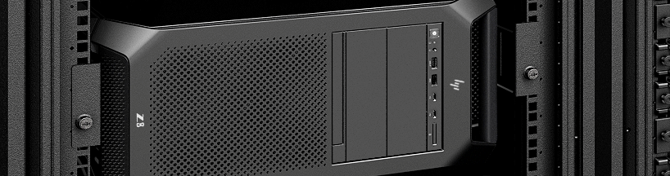
Simultaneous workflows in parallel with 4 GPUs
Z8 Fury G5 for Data Science
Save time on your data science projects by running multiple workflows simultaneously
Increase the GPU density within any given footprint, whether it’s a single system or a data closet.
Run up to 4 workflows concurrently – on different GPUs – to optimize your productivity and save time on projects.
With HP Anyware⁴ remote access software, a Z8 Fury G5 can serve as a computing hub for a data science team.
Allocate individual GPUs to either different users or different workflows.
Train multiple machine learning model candidates in parallel, getting to model selection sooner.
Or devote up to 4 GPUs to one workflow for maximum speed.
Manage cloud costs by training on-prem.
How the Z8 Fury G5 delivers:
Up to 4 NVIDIA® RTX™ 6000 Ada 48 GB GPUs¹ can enable up to 4 different concurrent projects or workflows.
Up to 2TB DDR5 RAM² and 120TB storage³ enable multi-tasking with no bottlenecks.
Single-socket Intel® Xeon® CPU processor (up to 60 cores)⁴ and dual power supplies (aggregate up to 2250W)⁵ enable the 4 GPUs.
Tools used:
Python, R, MiniConda, and NVIDIA Rapids, HP Anyware⁶
30 I Z8 Fury G5 I HP Confidential. For use by HP or Partner with Customers under HP CDA only.
Notes:
DISCLAIMERS:
1. NVIDIA graphics are an optional, configurable feature.
2. 2TB DDR5 memory is planned to be available by the first half of 2023.
3. Storage memory is an optional, configurable feature.
3.A Configuration for 120TB requires separate additional purchase. For storage drives, GB = 1 billion bytes. TB = 1 trillion bytes. Actual formatted capacity is less. Up to 35GB is reserved for system recovery software. Two front-accessible NVMe bays require a 5.25 bay carrier.
4. Multicore is designed to improve performance of certain software products. Not all customers or software applications will necessarily benefit from use of this technology. Performance and clock frequency will vary depending on application workload and your hardware and software configurations. Intel’s numbering, branding, and/or naming are not measurements of higher performance.
5. 2250W power supply is an optional, configurable feature.
6 Network access required. HP Anyware supports Windows®️, Linux®️ and MacOS®️ host environments and Window, Linux, MacOS, iOS®️, Android®️, and Chrome OS®️ end-user devices. For more on the system requirements for installing HP Anyware, refer to the Admin Guides at: https://docs.teradici.com/find/product/cloud-access-software. HP Anyware is based on the Teradici CAS software and licensing platform and is available through a 1- and 3-year subscription. HP Anyware subscriptions are based on the number of concurrent PCoIP connections used (pay for the number of host connections, not the software) with a minimum order quantity of 5. HP Anyware subscriptions gives you a license key to activate a connection to a hosted desktop as well as support and updates to the PCoIP Agents, PCoIP Clients and the Anyware Manager available for download here: https://docs.teradici.com/find/product/cloud-access-software. For a limited time, an HP Anyware subscription also includes access and support for ZCentral Remote Boost and ZCentral Connect and is available for purchase through an HP Teradici seller or by contacting sales at: hp.com/Anyware.

Slide 31

Real-Time Data Analytics
Z8 Fury G5 for Data Science
Get the insights you need, right when you need them – in real-time and on your largest data sets.
For complex data analytics demanding the highest performance, the Z8 Fury G5 offers a comprehensive range of CPU core counts/clock speeds and GPUs to provide the balance of computing you need.
Ingest, store, and process your largest data sets at the edge – with near-zero latency – for fast insights.
Capture and analyze more data from diverse streaming sources to enable rapid decision making.
Describe, diagnose, and perform prescriptive analysis and predictive modeling on larger data sets.
Work on-prem to avoid upload latency and manage cloud costs.
How the Z8 Fury G5 delivers
Wide range of CPU/GPU configurations for the ideal balance of core counts and clock speeds with low latency.
For example, configurations are available that offer 28-cores at 2.5 GHz or 16-cores at 3.1 GHz.¹
up to 4 NVIDIA® RTX™ 6000 Ada 48 GB GPUs² offer highest GPU density for workload balancing.
Up to 2TB DDR5 RAM and 120TB storage⁴ enable co-location for direct capture, real-time analysis, and data security.
Dual power supplies (aggregate up to 2250W)⁵ provide built-in back up to avoid mid project fail.
Tools used:
Python, R, MiniConda, and NVIDIA Rapids
31 I Z8 Fury G5 I HP Confidential. For use by HP or Partner with Customers under HP CDA only.
Notes:
As you likely know, as CPU core counts increase, clock speeds generally decrease. Higher core counts can handle larger amounts of data, while higher clock speeds can perform a given task faster. So for workflows that require real-time analysis of large datasets, it’s important to have proper balance of core counts and clock speeds.
Use cases:
Real-time data analytics workflows include descriptive analysis, regression, predictive analytics, and visualization.
Applications:
Applications include algorithmic trading, fraud detection, eCommerce, healthcare, and sports analytics.
Suggested Ecosystem
Pair with a color accurate or HDR 400 display such as HP Z27xs G3 4K DreamColor Display or HP Z24q G3 QHD Display
ALTERNATE USE CASE & BENEFIT:
Capture and train data at the edge, in real-time for immediate data insights. Perform continuous, real-time processing of massive data sets to enable instant transactions and operational decisions.
DISCLAIMERS:
1. Multicore is designed to improve performance of certain software products. Not all customers or software applications will necessarily benefit from use of this technology. Performance and clock frequency will vary depending on application workload and your hardware and software configurations. Intel’s numbering, branding, and/or naming are not measurements of higher performance.
2. NVIDIA graphics are an optional, configurable feature.
3. --
4. Storage memory is an optional, configurable feature. Two front-accessible NVMe bays require a 5.25 bay carrier. Configuration for 120TB requires separate additional purchase. For storage drives, 1GB = one billion bytes; 1TB = one trillion bytes. Actual formatted capacity is less. Up to 35GB is reserved for system recovery software.
5. 2250W power supply is an optional, configurable feature.

Slide 32
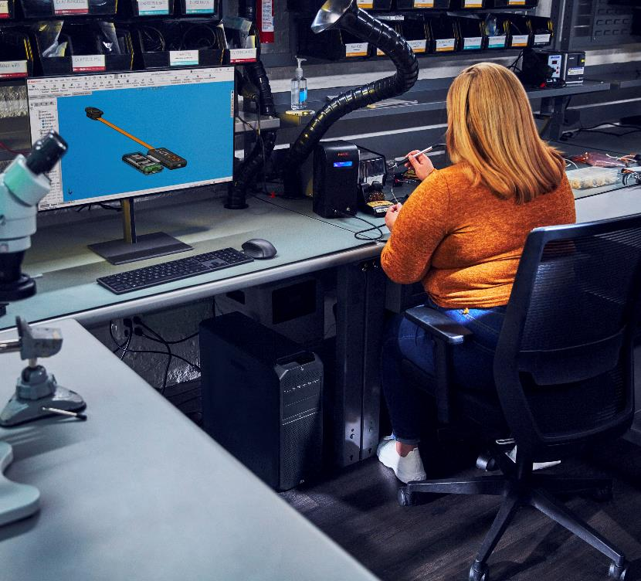

The Z advantage for product design and manufacturing
Z by HP accelerates product development workflows, helping designers and engineers iterate faster, accelerate time to production, increase quality, and shorten delivery times.
Built with professional applications in mind: SOLIDWORKS and CATIA, Fusion 360 and Inventor, NX and Solid Edge, CATIA, and Creo.
From generative design and 3D modeling to simulation and visualization, power through your most demanding workflows with Z desktop or laptop workstations.
Work hard knowing your workstation has undergone MIL-STD¹ durability tests and will stand the test of time.
Customize for now or choose expandability to future proof your investment.
Secure access to workstation power from any mix of infrastructure, anywhere with HP Anyware² software.
Conceptual Design
3D Modeling & Rendering
Rendering & Visualization
Simulation and Analysis
Digital Manufacturing
AI, ML &
Data Science
Certified on professional independent software for Z workstation compatibility
32 I HP Confidential. For use by HP or Partner with Customers under HP CDA only.
Notes:
[TALKING POINTS]
We work closely with top software providers to ensure peak performance for your most complex projects.
Realize your vision. From 2D/3D concepting and simulation to visualization and additive manufacturing, power through your most demanding workflows with Z desktop or laptop workstations.
Security while working from anywhere. Secure access to workstation power from any mix of infrastructure, anywhere with HP Anyware² software.
Reliability. We work closely with top software providers to ensure peak performance for your most complex projects.
Durability: Work hard knowing your workstation has undergone MIL-STD1 durability tests¹ and will stand the test of time.
Just what you need.
Customize now or plan to add later additional GPUs/memory/storage for the performance you need to future proof your investment as workflows evolve and software demands more workstation performance and efficiency. Visit HP Product Finder to configure by workflow or specs at hp.com/go/z, “help me choose”.
Designed for your workflows.
2D & 3D Concepting
Quickly generate 2D or 3D models with Z devices. With the latest high-frequency processing technology, you get advanced performance and real-time interactivity.
3D Modeling and Rendering
Rendering & Visualization
Easily manipulate 3D shapes and render photorealistic models. Move your projects to a virtual reality environment with VR-ready Z devices, and then experience them in high fidelity with the HP Reverb headset.
Simulation
Iterate fast. Experiment more. High-frequency processing, multiple cores, and powerful GPUs help you stress test your designs before production.
Additive manufacturing.
Bring your designs to market faster with HP’s Multi Jet Fusion 3D printing technology.
AI & Machine Learning – whether building and training models or simply using software that is accelerated by machine learning, HP data science solutions come with the software stack and OS you need – Windows, Linux or WSL2³
Data analytics - Ingest, clean, analyze, and visualize data in near real-time, providing the critical insights for your business, right when you need them.
Machine / Deep Learning - Increase inference throughput and quickly create better models by training with larger data sets and less latency.
Computer Vision - Perform object detection, image classification, and image segmentation with speed and accuracy on large image and video files.
Natural language processing - Achieve greater precision and recall for both audio and text NLP models by running more iterations and decreasing model run time.
[DISCLAIMERS]
Testing is not intended to demonstrate fitness of U.S. Department of Defense (DoD) contract requirements or for military use. Test results are not a guarantee of future performance under these test conditions. Accidental damage requires an optional HP Accidental Damage Protection Care Pack.
Network access required. HP Anyware supports Windows®️, Linux®️ and MacOS®️ host environments and Window, Linux, MacOS, iOS®️, Android®️, and Chrome OS®️ end-user devices. For more on the system requirements for installing HP Anyware, refer to the Admin Guides at: https://docs.teradici.com/find/product/cloud-access-software. HP Anyware is based on the Teradici CAS software and licensing platform and is available through a 1- and 3-year subscription. HP Anyware subscriptions are based on the number of concurrent PCoIP connections used (pay for the number of host connections, not the software) with a minimum order quantity of 5. HP Anyware subscriptions gives you a license key to activate a connection to a hosted desktop as well as support and updates to the PCoIP Agents, PCoIP Clients and the Anyware Manager available for download here: https://docs.teradici.com/find/product/cloud-access-software. For a limited time, an HP Anyware subscription also includes access and support for ZCentral Remote Boost and ZCentral Connect and is available for purchase through an HP Teradici seller or by contacting sales at: hp.com/Anyware
WSL 2 is an optional, configurable feature. WSL 2 requires Windows 10 or higher, Intel Core i5 processor or higher, and is available on select Z workstations. You must be running Windows 10 version 21H2 and higher (Build 19044 and higher) or Windows 11.

Slide 33
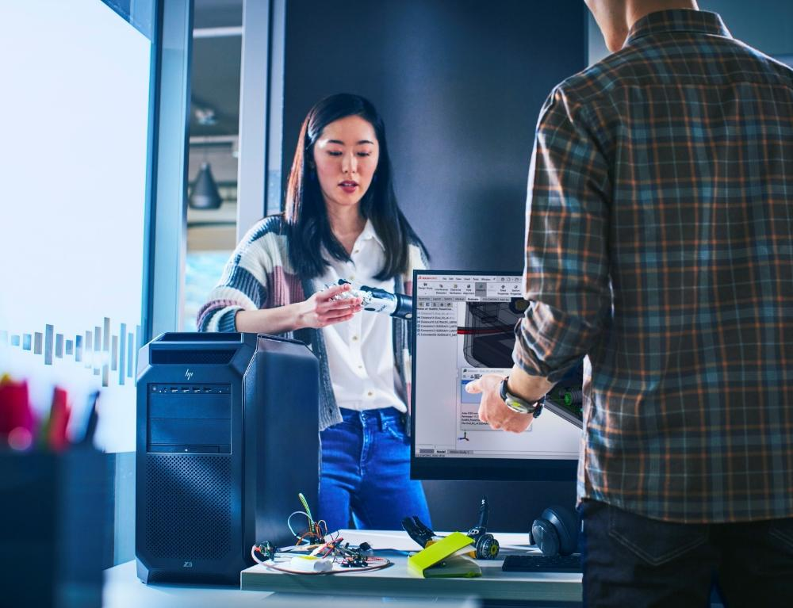
Z8 Fury G5
Product design and manufacturing
PD challenge | Z solution
Simulate parts and airflow without lag to stay in the creative zone | High-core-count Intel® Xeon® CPU processor with up to 60 cores³
Real-time ray tracing in SolidWorks with complex models | Up to four NVIDIA® RTX™ 6000 Ada GPUs⁹
Complete high-performance tasks simultaneously with no impact on workflow | HP Z Thermal Solution with AI performance management, OS, and application optimizations
33 I Z8 Fury G5 I HP Confidential. For use by HP or Partner with Customers under HP CDA only.
Notes:
DISCLAIMERS
3. Multicore is designed to improve performance of certain software products. Not all customers or software applications will necessarily benefit from use of this technology. Performance and clock frequency will vary depending on application workload and your hardware and software configurations. Intel’s numbering, branding, and/or naming are not measurements of higher performance.
9. NVIDIA graphics are an optional, configurable feature.

Slide 34
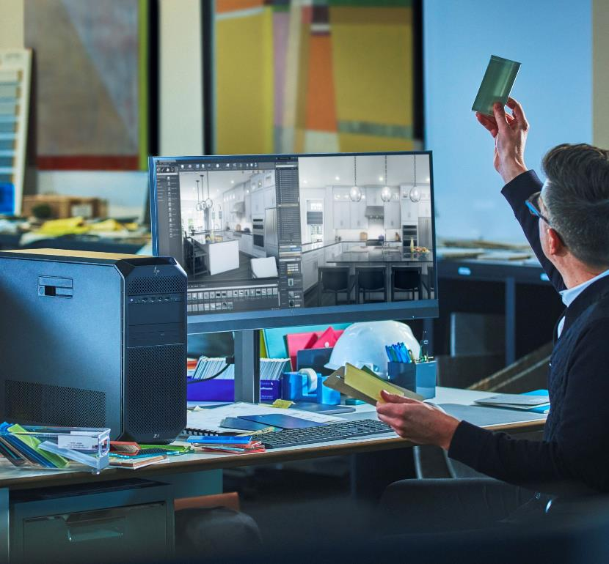
The Z advantage for architecture, engineering & construction
Z by HP accelerates workflows to move from design and planning to construction faster and more efficiently.
Built with professional applications in mind: Autodesk Revit, Bentley, Unreal Engine and Twinmotion, Archicad, SketchUp, Vectorworks.
From 2D and 3D concepting to simulation & clash detection to 3D site scanning and more, power through your most demanding workflows.
Secure access to workstation power from any mix of infrastructure, anywhere with HP Anyware² software.
2D & 3D Concepting
3D Modeling, Rendering, & Visualization
AI & Machine Learning
Simulation & Clash
Detection
3D Site Scanning
Printing Site Plans
34 I Z4 G5 I HP Confidential. For use by HP or Partner with Customers under HP CDA only.
Certified on professional independent software for Z workstation compatibility
Notes:
[TALKING POINTS]
Top software applications. Build with professional applications in mind: Autodesk Revit | Bentley | Unreal Engine & Twinmotion | Archicad | SketchUp | Vectorworks
Build the future. From 3D modeling and simulation to visualization in VR and more, power through your most demanding workflows.
Security while working from anywhere. Secure access to workstation power from any mix of infrastructure, anywhere with HP Anyware² software.
Reliability. We work closely with top software providers to ensure peak performance for your most complex projects.
Durability. Work hard knowing your workstation has undergone MIL-STD1 durability tests¹ and will stand the test of time.
Just what you need.
Customize now or plan to add later additional GPUs/memory/storage for the performance you need to future proof your investment as workflows evolve and software demands more workstation performance and efficiency. Visit HP Product Finder to configure by workflow or specs at hp.com/go/z, “help me choose”.
Designed for your workflows.
2D & 3D Concepting
Quickly generate 3D models from 2D drawings with Z devices certified for CAD software.
With the latest high-frequency processing technology, you get advanced performance and real-time interactivity.
3D Modeling & Rendering
Easily manipulate 3D shapes and render photorealistic models in real time with certified NVIDIA® RTX™ graphics and high-frequency, multi-core CPUs optimized for multi-threaded applications.
Visualization
Easily move your projects to a virtual reality environment with VR-ready Z devices, and then experience them in high fidelity with the HP Reverb headset..
Simulation & Clash Detection
Forget waiting for your structural and energy simulations to run. Z devices have all the graphics, storage and memory you need to analyze in real time.
3D Site Scanning
Process complex LIDAR point cloud data and create accurate 3D models with Z devices — packed with massive memory, multi-core Intel® Xeon® processors and high-end NVIDIA® RTX™ graphics.
Printing Site Plans
Seamlessly move your final project from your Z device to HP’s large format printer for detailed and accurate construction drawings.
AI & Machine Learning – whether building and training models or simply using software that is accelerated by machine learning, HP data science solutions come with the software stack and OS you need – Windows, Linux or WSL2³
Data analytics - Ingest, clean, analyze, and visualize data in near real-time, providing the critical insights for your business, right when you need them.
Machine / Deep Learning - Increase inference throughput and quickly create better models by training with larger data sets and less latency.
Computer Vision - Perform object detection, image classification, and image segmentation with speed and accuracy on large image and video files.
Natural language processing - Achieve greater precision and recall for both audio and text NLP models by running more iterations and decreasing model run time.
[DISCLAIMERS]
Testing is not intended to demonstrate fitness of U.S. Department of Defense (DoD) contract requirements or for military use. Test results are not a guarantee of future performance under these test conditions. Accidental damage requires an optional HP Accidental Damage Protection Care Pack.
Network access required. HP Anyware supports Windows®️, Linux®️ and MacOS®️ host environments and Window, Linux, MacOS, iOS®️, Android®️, and Chrome OS®️ end-user devices. For more on the system requirements for installing HP Anyware, refer to the Admin Guides at: https://docs.teradici.com/find/product/cloud-access-software. HP Anyware is based on the Teradici CAS software and licensing platform and is available through a 1- and 3-year subscription. HP Anyware subscriptions are based on the number of concurrent PCoIP connections used (pay for the number of host connections, not the software) with a minimum order quantity of 5. HP Anyware subscriptions gives you a license key to activate a connection to a hosted desktop as well as support and updates to the PCoIP Agents, PCoIP Clients and the Anyware Manager available for download here: https://docs.teradici.com/find/product/cloud-access-software. For a limited time, an HP Anyware subscription also includes access and support for ZCentral Remote Boost and ZCentral Connect and is available for purchase through an HP Teradici seller or by contacting sales at: hp.com/Anyware
WSL 2 is an optional, configurable feature. WSL 2 requires Windows 10 or higher, Intel Core i5 processor or higher, and is available on select Z workstations. You must be running Windows 10 version 21H2 and higher (Build 19044 and higher) or Windows 11.

Slide 35

Z8 Fury G5
Architecture, engineering, and construction
AEC challenge | Z solution
3D modeling in Revit with complex rendering and additive manufacturing | Single-socket Intel® Xeon® CPU with up to 60 cores³
Complex visualization including VR, real-time ray tracing, and clash detection | Up to four NVIDIA® RTX™ 6000 Ada GPUs⁹
Complete high-performance tasks simultaneously with no impact on workflow | HP Z Thermal Solution with AI performance management, OS, and application optimizations
35 I Z8 Fury G5 I HP Confidential. For use by HP or Partner with Customers under HP CDA only.
Notes:
DISCLAIMERS
3. Multicore is designed to improve performance of certain software products. Not all customers or software applications will necessarily benefit from use of this technology. Performance and clock frequency will vary depending on application workload and your hardware and software configurations. Intel’s numbering, branding, and/or naming are not measurements of higher performance.
9. NVIDIA graphics are an optional, configurable feature.

Slide 36
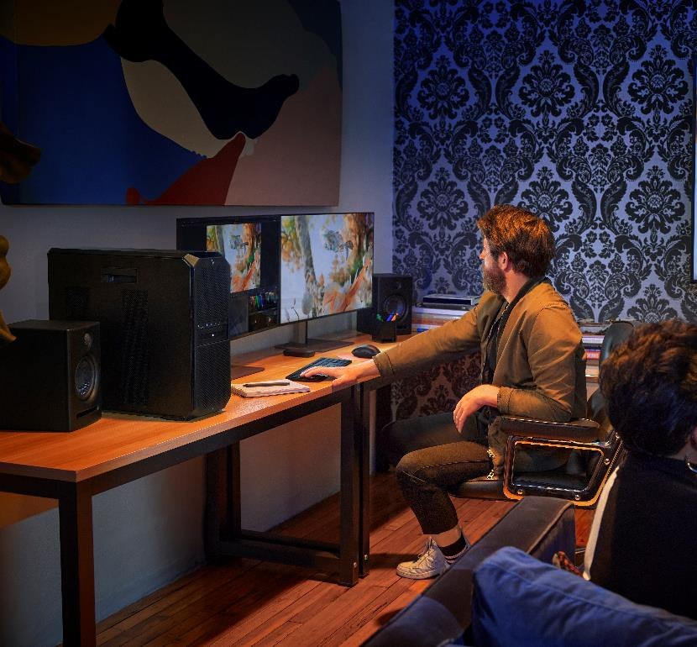
The Z advantage for media & entertainment
From video editing and 3D animation to virtual production and in-camera VFX — reach peak creative flow on your heaviest projects with Z Workstations.
Built with professional applications in mind: Avid Media Composer, Adobe Premiere Pro, Autodesk Maya, Autodesk Flame, DaVinci Resolve and Unreal Engine.
Customize and expand as your workflows evolve with toolless access allowing easy expansion of CPU, GPU, memory and storage.
Create from on set, on location, or from home with HP Anyware² software.
Benefit from sensors that adjust temperature for whisper-quiet acoustics on well-placed quality components streamlining airflow for cooling and reliability.
Video Editing & Motion Graphics
3D Modeling & VFX
ICVFX & Real-Time Rendering
AI & Machine Learning
Graphic Design & Photography
Certified on professional independent software for Z workstation compatibility
36 I HP Confidential. For use by HP or Partner with Customers under HP CDA only.
Notes:
[TALKING POINTS]
Create without compromise. From video editing and motion graphics to in camera VFX and real-time rendering, AI & machine learning, and graphic design and photography — reach peak creative flow on your heaviest projects with Z Workstations.
Reliability. We work closely with top software providers to ensure peak performance for your most complex projects.
Certifications: Build confidence with independent service provider certification like AutoDesk (Flame) and Avid (Media Composer & Pro Tools).
Durability: Work hard knowing your workstation has undergone MIL-STD1 durability tests¹ and will stand the test of time.
Just what you need. Customize now or plan to add later additional GPUs/memory/storage for the performance you need to future proof your investment as workflows evolve and software demands more workstation performance and efficiency. Visit HP Product Finder to configure by workflow or specs at hp.com/go/z, “help me choose”.
Designed for your workflows. Visit hp.com for M&E: Z by HP for Creative Pros | HP® Official Site
Video Editing and Finishing - Whether you're cutting together spots, shorts or features, adding lower thirds or motion graphics, or refining your piece with the final ‘look and feel’, we have an extensive line of powerhouse devices to help you edit and finish in less time so you can hit your deadlines.
3D Modeling & VFX - From character animation and environment creation to physics simulations and effects, Z is built ready for whatever your project demands. Explore new dimensions, build bigger worlds, tell richer stories, and render it all with industry driving performance.
In-Camera Visual Effects & Real-Time Rendering – Whether making on-the-go environment tweaks, rendering your LED volume, or synchronizing multiple nodes, Z provides the power and reliability you need to work in real time with confidence
VFX, Compositing & Finishing - Create, alter or enhance imagery for live-action content – from the obvious monsters & explosions to the most subtle​ of effects; integrate live-action footage with CG assets; and refine each shot with the final ‘look and feel’
AI & Machine Learning – whether building and training models or simply using software that is accelerated by machine learning, HP data science solutions come with the software stack and OS you need – Windows, Linux or WSL2 ³
Data analytics - Ingest, clean, analyze, and visualize data in near real-time, providing the critical insights for your business, right when you need them.
Machine / Deep Learning - Increase inference throughput and quickly create better models by training with larger data sets and less latency.
Computer Vision - Perform object detection, image classification, and image segmentation with speed and accuracy on large image and video files.
Natural language processing - Achieve greater precision and recall for both audio and text NLP models by running more iterations and decreasing model run time.
Graphic Design & Photography - From print layouts and typography treatments to editing and managing thousands of photos, Z helps you iterate and design faster while ensuring color accuracy and image quality.
[DISCLAIMERS]
Testing is not intended to demonstrate fitness of U.S. Department of Defense (DoD) contract requirements or for military use. Test results are not a guarantee of future performance under these test conditions. Accidental damage requires an optional HP Accidental Damage Protection Care Pack.
Network access required. HP Anyware supports Windows®️, Linux®️ and MacOS®️ host environments and Window, Linux, MacOS, iOS®️, Android®️, and Chrome OS®️ end-user devices. For more on the system requirements for installing HP Anyware, refer to the Admin Guides at: https://docs.teradici.com/find/product/cloud-access-software. HP Anyware is based on the Teradici CAS software and licensing platform and is available through a 1- and 3-year subscription. HP Anyware subscriptions are based on the number of concurrent PCoIP connections used (pay for the number of host connections, not the software) with a minimum order quantity of 5. HP Anyware subscriptions gives you a license key to activate a connection to a hosted desktop as well as support and updates to the PCoIP Agents, PCoIP Clients and the Anyware Manager available for download here: https://docs.teradici.com/find/product/cloud-access-software. For a limited time, an HP Anyware subscription also includes access and support for ZCentral Remote Boost and ZCentral Connect and is available for purchase through an HP Teradici seller or by contacting sales at: hp.com/Anyware
WSL 2 is an optional, configurable feature. WSL 2 requires Windows 10 or higher, Intel Core i5 processor or higher, and is available on select Z workstations. You must be running Windows 10 version 21H2 and higher (Build 19044 and higher) or Windows 11.

Slide 37
Z8 Fury G5 advantage for media & entertainment
Create, iterate and render faster so you can tell your story better
Z8 Fury G5 optimized use cases
Build environments and render in real time, for faster iteration.
Drive render nodes – quietly – for in-camera visual effects in an LED volume.
Create and apply visual effects to make the impossible real, wherever you are.
Gain an edge on your competitors by making creative decisions in real time.
Tackle massive data sets or extremely complex workflows locally—and quickly.
Control unpredictable costs and increase productivity by reducing dependency on the cloud.
Increase the density of GPUs—and the compute power—over current gen machines.
Protect against data loss or restarts with redundant power supply.
37 I Z8 Fury G5 I HP Confidential. For use by HP or Partner with Customers under HP CDA only.

Slide 38

The Z advantage for government agencies
Z by HP solutions accelerate workflows and modernize processes, helping government agencies to be more secure, productive and efficient.
Customizable solutions for unique government requirements.
MIL STD¹ tested to withstand harsh environments.
Designed and tested to run always for ultimate reliability.
Equipped with rigorous, multi-layered security to meet government required cybersecurity needs.
HP Anyware software provides access to workstation power from anywhere.²
IT Modernization
Geospatial Intelligence
Data Strategy
AI/Machine Learning
Scientific Computing
Certified on professional independent software for Z workstation compatibility
38 I HP Confidential. For use by HP or Partner with Customers under HP CDA only.
Notes:
[TALKING POINTS]
HP Federal LLC, a subsidiary of HP, Inc. headquartered in Washington, DC, recognizes the unique requirements of our federal customers. The knowledge in working with customers and the partners of civilian agencies, defence agencies, intelligence communities, and systems integrators, has enabled HP workstations to deliver purpose-build solutions specific to this space that meet government requirements while ensuring the end user can accomplish their task, job, or mission.
Fully customizable solutions offering purpose-built options that meet the unique requirements of both civilian agencies, defense agencies, and the intelligence community. Whether you need high-performance computing, advanced graphics, or data at rest storage solutions, HP workstations can deliver the optimal solution that meet government requirements, like TAA, while getting the job done
MIL STD tested: HP’s workstations are known for their durability because our solutions are MIL STD tested and certified to withstand harsh environments, such as extreme temperatures, humidity, dust, shock, and vibration. You can trust HP workstations to operate reliably in any situation or environment, even in the most demanding and mission-critical scenarios
Tested to run always for ultimate reliability with mission critical tasks : HP workstations are tested to run always on for ultimate reliability with mission-critical tasks. You can count on HP workstations to handle complex workloads and applications without compromising performance or stability
Equipped with rigorous, multi-layered security to meet government required cybersecurity needs : HP workstations are equipped with rigorous, multi-layered security features to meet government required cybersecurity needs. From self-encrypting drives and self-healing BIOS to secure remote access and endpoint protection, HP workstations provide comprehensive security solutions that safeguard your data and devices from threats
Whether in the office, field, or home, you can work from anywhere without losing productivity –with HP Anyware software : HP Anyware is a software that lets you access workstations from any device, anywhere. It is based on the PCoIP® protocol, which provides high security and performance. You can enjoy faster performance, lower bandwidth consumption, and higher security without a VPN. HP Anyware also supports a variety of IT infrastructure options in addition to workstations including, on-prem data centers, edge, private or public clouds1. HP Anyware has several federal certifications that prove its reliability and compliance, including FIPS 140-2 level 1 and 2.
Designed for your workflows:
IT Modernizations
As agencies work to transform and innovate their legacy processes and systems, our powerful workstations can help develop and provide innovative solutions such as the implementation of AI and ML to meet user experience goals securely
Geospatial Intelligence
HP workstations can provide faster, more reliable, and increased accuracy of large and complex data sets by providing a customized high performance solution that supports ISVs and applications for analysis, remote sensing, and computer vision
Data Strategy
Our HP workstations can support the development and deployment of data standards, policies, and governance mechanisms enhancing the consistency, quality and security of federal data. HP workstations can also enable federal employees to access, analyze, and use data more efficiently and effectively, thus improving the delivery of mission and services to the public
Artificial Intelligence and Machine Learning
Our data science solutions can handle large and complex data sets, run algorithms, and train and deploy models all with our secure and reliable workstations, protecting sensitive data and systems from cyber threats. With multiple configuration options, our workstations can support a variety of AI and ML use cases, including NLP, ML engineering, and computer vision
[DISCLAIMERS]
Testing is not intended to demonstrate fitness of U.S. Department of Defense (DoD) contract requirements or for military use. Test results are not a guarantee of future performance under these test conditions. Accidental damage requires an optional HP Accidental Damage Protection Care Pack.
Network access required. HP Anyware supports Windows®️, Linux®️ and MacOS®️ host environments and Window, Linux, MacOS, iOS®️, Android®️, and Chrome OS®️ end-user devices. For more on the system requirements for installing HP Anyware, refer to the Admin Guides at: https://docs.teradici.com/find/product/cloud-access-software. HP Anyware is based on the Teradici CAS software and licensing platform and is available through a 1- and 3-year subscription. HP Anyware subscriptions are based on the number of concurrent PCoIP connections used (pay for the number of host connections, not the software) with a minimum order quantity of 5. HP Anyware subscriptions gives you a license key to activate a connection to a hosted desktop as well as support and updates to the PCoIP Agents, PCoIP Clients and the Anyware Manager available for download here: https://docs.teradici.com/find/product/cloud-access-software. For a limited time, an HP Anyware subscription also includes access and support for ZCentral Remote Boost and ZCentral Connect and is available for purchase through an HP Teradici seller or by contacting sales at: hp.com/Anyware

Slide 39

The Z advantage for education
Z by HP solutions are designed to meet the diverse needs of students, faculty, and staff enabling optimal learning through reliability, performance and innovations.
Customizable​ to support programs and curriculum around STEM and e-Sports
Designed and tested for always-on reliability​.
MIL-STD¹ tested to withstand challenging campus environments​.
Equipped with rigorous, multi-layered security to protect students and their intellectual property​.
Sustainably designed and manufactured to responsibly fuel student learning​.
Work on complex projects from anywhere – in the classroom, field, or from home – with HP Anyware² software.
E-Sports
AI/Machine Learning
Visualization
STEM
Digital Media
Certified on professional independent software for Z workstation compatibility
39 I HP Confidential. For use by HP or Partner with Customers under HP CDA only.
Notes:
[TALKING POINTS]
​
Customizable HP workstations offer multiple options around form factor, processors, graphics, and storage enabling peak performance needed to support a wide variety of academics and research​.
Reliable: ​
Tested with always on reliability to support long days of learnings and lab usage​.
MIL-STD tested1 and passed to withstand harsh campus environments and longer refresh cycles to keep students, faculty, and staff productive through out their time at university​.
Security-packed: Equipped with rigorous, multi-layered security protecting student, faculty, and staff's identity, data, and device from various cyber threats. HP's security features like HP Sure Start and HP Sure Recover help the end user work with confidence and peace of mind, knowing their workstation is protected from unauthorized access, tampering, or theft. ​
Work where you need, together. Have flexibility to work on complex projects with peak performance from anywhere – in the classroom, field, or from home – with HP Anyware2 software​.
Sustainable: Today's students and academics want a device that is responsibly built while giving an experience that gets the job done. HP has done this with our workstation portfolio by using ocean bound plastics and building fully recyclable solutions allowing HP to continue on their way to becoming the world's more sustainable and just company by 2030. ​
Designed for your workflows.​
STEM
Digital media​
Quickly generate 3D models from 2D drawings with Z devices certified for CAD software. ​
With the latest high-frequency processing technology, you get advanced performance and real-time interactivity. Whether you’re cutting together spots, shorts or features, you push your system to the max. That’s why we’ve developed an extensive line of powerhouse devices to help you edit in less time so you can hit your deadlines.​
E-Sports
AI/Machine learning​
HP Data Science solutions offer fully customizable workstations plus additional tools to help any student, faculty, or staff complete complex projects around AI and ML.
With HP's WSL2³ allowing for easy access to both Windows and Linux on the same device, cloud interoperability for seamless experience with cloud computing, and HP's data science sw stack manager – which includes top tools that data scientists use – the end user is all ready to start their AI or ML journey from Day 1​.
Visualization​
HP workstations are built for every step of the development process with powerful graphics to 3D render an entire universe.
[DISCLAIMERS]
Testing is not intended to demonstrate fitness of U.S. Department of Defense (DoD) contract requirements or for military use. Test results are not a guarantee of future performance under these test conditions. Accidental damage requires an optional HP Accidental Damage Protection Care Pack.
Network access required. HP Anyware supports Windows®️, Linux®️ and MacOS®️ host environments and Window, Linux, MacOS, iOS®️, Android®️, and Chrome OS®️ end-user devices. For more on the system requirements for installing HP Anyware, refer to the Admin Guides at: https://docs.teradici.com/find/product/cloud-access-software. HP Anyware is based on the Teradici CAS software and licensing platform and is available through a 1- and 3-year subscription. HP Anyware subscriptions are based on the number of concurrent PCoIP connections used (pay for the number of host connections, not the software) with a minimum order quantity of 5. HP Anyware subscriptions gives you a license key to activate a connection to a hosted desktop as well as support and updates to the PCoIP Agents, PCoIP Clients and the Anyware Manager available for download here: https://docs.teradici.com/find/product/cloud-access-software. For a limited time, an HP Anyware subscription also includes access and support for ZCentral Remote Boost and ZCentral Connect and is available for purchase through an HP Teradici seller or by contacting sales at: hp.com/Anyware
WSL 2 is an optional, configurable feature. WSL 2 requires Windows 10 or higher, Intel Core i5 processor or higher, and is available on select Z workstations. You must be running Windows 10 version 21H2 and higher (Build 19044 and higher) or Windows 11.

Slide 40




The right choice
For small and medium business
High performance with Intel® Xeon® CPUs and NVIDIA® Ada graphics
World’s most secure and manageable workstations¹⁴
Built to last with 368k hours of testing
Hybrid support for the evolving workforce with HP Anyware⁴
40 I Z8 Fury G5 I HP Confidential. For use by HP or Partner with Customers under HP CDA only.
Notes:
DISCLAIMERS
4. Network access required. HP Anyware supports Windows®️, Linux®️ and MacOS®️ host environments and Window, Linux, MacOS, iOS®️, Android®️, and Chrome OS®️ end-user devices. For more on the system requirements for installing HP Anyware, refer to the Admin Guides at: https://docs.teradici.com/find/product/cloud-access-software. HP Anyware is based on the Teradici CAS software and licensing platform and is available through a 1- and 3-year subscription. HP Anyware subscriptions are based on the number of concurrent PCoIP connections used (pay for the number of host connections, not the software) with a minimum order quantity of 5. HP Anyware subscriptions gives you a license key to activate a connection to a hosted desktop as well as support and updates to the PCoIP Agents, PCoIP Clients and the Anyware Manager available for download here: https://docs.teradici.com/find/product/cloud-access-software. For a limited time, an HP Anyware subscription also includes access and support for ZCentral Remote Boost and ZCentral Connect and is available for purchase through an HP Teradici seller or by contacting sales at: hp.com/Anyware.
14. Based on HP’s unique and comprehensive security capabilities at no additional cost and HP Manageability Integration Kit’s management of every aspect of a PC including hardware, BIOS, and software management using Microsoft System Center Configuration Manager on HP Elite PCs and HP Workstations with Windows and 8th Gen and higher Intel processors or AMD Ryzen 4000 processors and higher.
This slide contains a superlative claim/s that cannot be used in all countries:
EMEA use restrictions:
DO NOT USE the superlative claim in the following countries:
Romania, Slovakia, Turkey, UAE, Russia, CIS countries (Armenia, Belarus, Kazakhstan, Kyrgyzstan, Moldova, Russia, Tajikistan, Turkmenistan, Ukraine, and Uzbekistan)
APJ use restrictions:
China, Vietnam, Indonesia, Malaysia—DO NOT USE
LAR use restrictions:
Brazil, Mexico—DO NOT USE

Slide 41
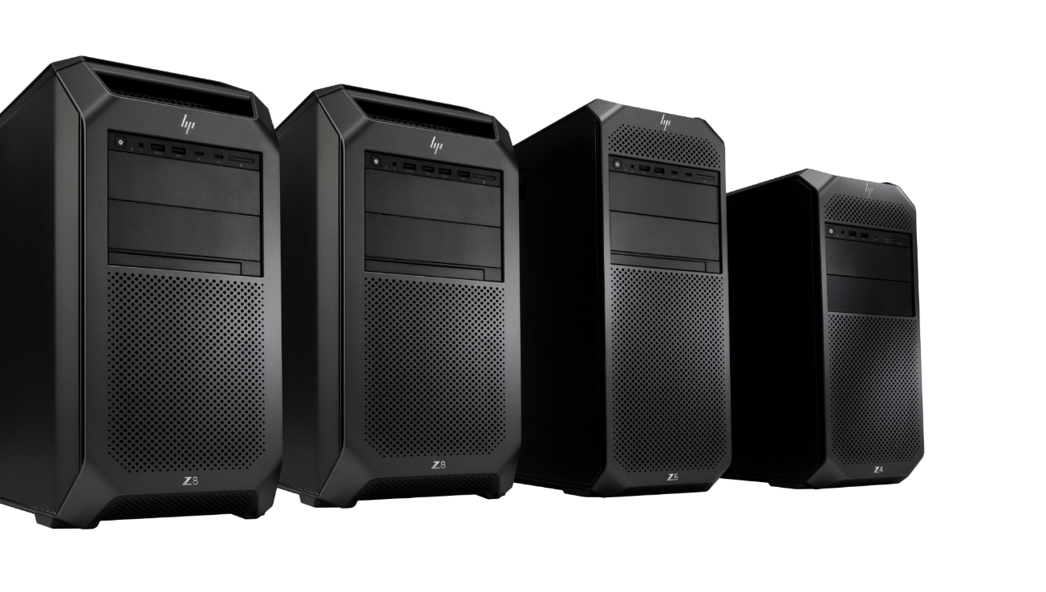
Comparisons

Slide 42
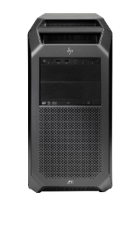
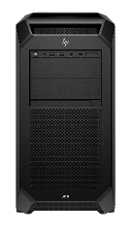
Gen-to-gen spec comparison
 | Z8 G4 | Z8 Fury G5
Processor | Cascade Lake, two-socket | Intel® Xeon® W-3500 (Intel’s refresh)
Graphics | 2x high-end GPUs | 4x high-end GPUs
Memory | 1.5TB DDR4 @ 2933MHz | 2TB DDR5 @ 4800MHz
Front storage | 1 PCIe Gen 3 drive | 4 hot-swappable, PCIe Gen 4 drives
Expandability | 88 PCIe lanes 7 PCIe Gen 3 slots | 112 PCIe lanes 3 PCIe Gen 5, 4 PCIe Gen 4, 1 PCIe Gen 3
Power supply | 1450W | 2250W or redundant power supply unit
42 I Z8 Fury G5 I HP Confidential. For use by HP or Partner with Customers under HP CDA only.

Slide 43
Z8 Fury G5 vs Dell Precision 7960 Tower
 | Dell Precision 7960 | Z8 Fury G5
Processor | Sapphire Rapids, Xeon W-3400, up to 56C | Sapphire Rapids Refresh , Xeon W-3500, up to 60C
Graphics | Up to 4x high end DW (NVIDIA RTX A6000) 2x AMD Radeon Pro W6800 | Up to 4x NVIDIA RTX 6000 Ada Up to 2x AMD Radeon Pro W6800
Memory | Up to 4TB max 8 channels, 2 DIMMs per channel (DPC) up to 4800MHz 1DPC, 4400MHz 2DPC | Up to 2TB DDR5 8 channels, 2 DIMMs per channel (DPC) up to 4800MHz 1DPC, 4400MHz 2DPC
Storage | Up to 152 TB | Up to 120 TB
Volume | 53.8L | 53L
Power supply | 1100W/1400W Gold (15A) 1500W/2200W Platinum (20A)* [*uses C20 cord and requires 20A circuit @115V or 220V circuit | 1125W Gold/1450W Platinum (15A) 1125W Gold/1450W Platinum (15A) redundant, hot swap 2250W Gold aggregate (15A)
PCIe | 8 PCIe SLOTS Slot 1: x16 Gen5 Slot 2: x16 Gen5 Slot 3: x16 Gen4 Slot 4: x16 Gen4 Slot 5: x8 Gen4 Slot 6: x8 Gen4 Slot 7: x8 Gen4 (x4 electrically) Slot 8: x8 Gen4 (x4 electrically) | 8 PCIe Slots Slot 1: PCIe x16 Gen5 Slot 2: PCIe x4 Gen5 Slot 3: PCIe x16 Gen5 Slot 4: PCIe x4 Gen4 Slot 5: PCIe x16 Gen4 Slot 6: PCIe x8 Gen3 Slot 7: PCIe x16 Gen4 Slot 8: PCIe x4 Gen4
Connectivity | 1GbE, 10 GbE Qualcomm® WCN6856-DBS, 2x2 MIMO, 3571Mbps, 2.4GHz/5GHz/6GHz, Wi-Fi 6E (Wi-Fi 802.11ax), Bluetooth 5.2 | 1 AMT 1GbE, 10GbE 1x 1GbE (AMT), 1x 1GbE Optional: dual 10GbE module, dual 10/25GbE ConnectX-6 WiFi 6 and 6E via PCIe slot AiC w/ external antenna
43 I Z8 Fury G5 I HP Confidential. For use by HP or Partner with Customers under HP CDA only.
Notes:
Source:
HP Z8 Fury G5 home page: HP Z8 Fury Desktop Workstation | HP® Official Site
HP Z8 Fury G5 technical specifications: HP Z8 Fury Desktop Workstation – Specs & Resources | HP® Official Site
Dell Precision 7960 technical specs: Dell Precision 7960 Tower Workstation - Dell Workstations | Dell USA
Dell Precision 7960 home page: Dell Precision 7960 Tower Workstation - Dell Workstations | Dell USA

Slide 44

Privacy and security
44 I Z8 Fury G5 I HP Confidential. For use by HP or Partner with Customers under HP CDA only.

Slide 45

HP endpoint security portfolio
Right-sized security for customers
Small and medium business |  | Medium business and enterprise
HP Wolf Pro Security* Complete endpoint security offering Simple, cloud-based management optimized for limited security expertise or managed services (MSSP) |  | HP Sure Click Enterprise and Sure Access Enterprise Enterprise-class threat containment and credential protection (SCE) Privileged activity protection (SAE)
Preinstalled on “Edition” PCs (select Pro, Elite, and Z models) or software installable on HP and non-HP PCs |  | Software installable on HP and non-HP PCs
Protect and Trace (locate, lock, and erase PC)
PC Platform Security | Built-in hardware enforced security | Built-in hardware enforced security
 | Supports critical business outcomes for IT and security included with every HP Pro, Elite, and Z PC | Supports critical business outcomes for IT and Security included with every HP Pro, Elite, & Z PC
45 I Z8 Fury G5 I HP Confidential. For use by HP or Partner with Customers under HP CDA only.
Notes:
*HP Wolf Pro Security Edition is available preloaded on select SKUs, and, depending on the HP product purchased, includes a license with a term length communicated to you at purchase and in your order confirmation email. The HP Wolf Pro Security Edition software is licensed under the license terms of the HP Wolf Security Software - End-User license Agreement (EULA) that can be found at: https://support.hp.com/us-en/document/ish_3875769-3873014-16 as that EULA is modified by the following: Term. Unless otherwise terminated earlier pursuant to the terms contained in this EULA, the license for the HP Wolf Pro Security Edition is effective upon 4 months after the date the HP Product was shipped by HP and will continue for the term communicated to you at purchase and in your order confirmation email (“Initial Term”). At the end of the Initial Term you may either (a) purchase a renewal license for the HP Wolf Pro Security Edition from HP.com, HP Sales or an HP Channel Partner, or (b) continue using the standard versions of HP Sure Click and HP Sure Sense at no additional cost with no future software updates or HP Support. Notwithstanding the foregoing, the license shall expire no later than one year after the fixed term of the subject license ends.

Slide 46

HP Wolf Security for Business⁶
 | Device | Identity/privacy | Data
Above the OS |  | HP Sure View^{13,14} Built-in privacy screen HP Privacy Camera¹⁵ / HP Sure Shutter¹⁶ Built-in webcam privacy shutter
In the OS | Microsoft Secured-Core PC¹⁷ Best-in-class OS security | HP Presence Aware Auto login/logoff | HP Sure Click¹⁸ Hardware-enforce secure browsing/viewing solution HP Sure Sense¹⁹ Protect from never-before-seen malware
Below the OS | HP BIOSphere²⁰ Comprehensive bios management HP Sure Start²¹ Self-healing endpoint security controller protection HP Sure Run²² Protect applications with persistence and kill prevention HP Sure Recover^{23,24} Embedded image recovery |  | HP Secure Erase²⁵ Permanent data removal on HDD/SSD Certified Self-Encrypting Drives HW Data encryption
 | HP Sure Admin²⁶ Cryptographically secure BIOS management
 | HP TamperLock²⁷ Tamper protection
 | HP Client Security Manager: local security management (HP Sure Run and HP Sure Recover)^{22,23,28}
 | HP Endpoint Security Controller
Hardware-enforced protection
46 I Z8 Fury G5 I HP Confidential. For use by HP or Partner with Customers under HP CDA only.
Notes:
[TALKING POINTS]
This may be a familiar slide for a lot of you—the HP Wolf Security for Business portfolio reflects how HP solutions help protect our customer’s DEVICES, IDENTITY, and DATA with hardware-enforced protections that span from BELOW THE OS, IN THE OS, and ABOVE THE OS.
In 2021, we’re making several upgrades and new additions across the portfolio.
HP Tamper Lock provides protection from physical intrusion, including tampering with components of a Notebook or Desktop PC.
HP Sure Admin is continuing to advance a cryptographically secure BIOS management solution.
HP Sure Recover with embedded reimaging, ideal for today’s workforce, is now Corporate Image Ready.
Plus, you’ll notice the Wolf name throughout the advanced threat protection portfolio, including HP Wolf Pro Security and HP Wolf Enterprise Security.
DISCLAIMERS
6. HP Wolf Security for Business requires Windows 10 or 11 Pro or higher, includes various HP security features, and is available on HP Pro, Elite, RPOS, and Workstation products. See product details for included security features.
13. HP Sure View Gen3 integrated privacy screen is an optional feature that must be configured at purchase and is designed to function in landscape orientation.
14. HP Sure View Reflect integrated privacy screen is an optional feature that must be configured at purchase and is designed to function in landscape orientation.
15. HP Privacy Camera only available PCs equipped with HD or IR camera and must be installed at the factory.
16. HP Sure Shutter only available PCs equipped with HD or IR camera and must be installed at the factory.
17. Microsoft Secured Core requires an Intel vPro®, AMD Ryzen™ PRO, or Qualcomm® processor with SD850 or higher and requires 8GB or more system memory. Secured Core PC functionality can be enabled from the factory.
18. HP Sure Click requires Windows 10 or 11 Pro or higher. See https://bit.ly/2PrLT6A_SureClick for complete details.
19. HP Sure Sense is available on select HP PCs and is not available with Windows 10 Home.
20. HP BIOSphere Gen6 requires Windows 10 or 11 Pro or higher and is available on select HP Pro, Elite PCs, and Z Workstations. Features may vary depending on the platform and configurations.
21. HP Sure Start Gen6 is available on select HP PCs and requires Windows 10 or 11 Pro or higher.
22. HP Sure Run Gen4 is available on select HP PCs and requires Windows 10 or 11 Pro or higher.
23. HP Sure Recover Gen4 is available on select HP PCs and requires Windows 10 or 11 Pro or higher and an open network connection. You must back up important files, data, photos, videos, etc. before using HP Sure Recover to avoid loss of data. Network based recovery using Wi-Fi is only available on PCs with Intel Wi-Fi Module.
24. HP Sure Recover Gen4 with Embedded Reimaging is an optional feature which requires Windows 10 or 11 Pro or higher and must be configured at purchase. You must back up important files, data, photos, videos, etc. before use to avoid loss of data. Network based recovery using Wi-Fi is only available on PCs with Intel Wi-Fi Module.
25. For the methods outlined in the National Institute of Standards and Technology Special Publication 800-88 “Clear” sanitation method. HP Secure Erase does not support platforms with Intel Optane.
26. HP Sure Admin requires Windows 10 or 11 Pro or higher, HP BIOS, HP Manageability Integration Kit from http://www.hp.com/go/clientmanagement and HP Sure Admin Local Access Authenticator smartphone app from the Android or Apple store.
27. HP TamperLock must be enabled by the customer or your administrator.
28. HP Client Security Manager Gen7 requires Windows and is available on the select HP Pro, Elite, PCs, and Z Workstations.

Slide 47

Z8 Fury G5 security
HP BIOS allows for additional security on a lower level
Get back to work faster with responsive HP BIOS support
Increased physical security with Lockable front access carriers Side panel locks Kensington lock slot Optional rack mounting for added security
Secure your data with self-encrypted drives and full volume encryption
Future-proofed security with TPM 2.0 certification
HP Platform Certificate for increased security within the HP supply chain
47 I Z8 Fury G5 I HP Confidential. For use by HP or Partner with Customers under HP CDA only.

Slide 48
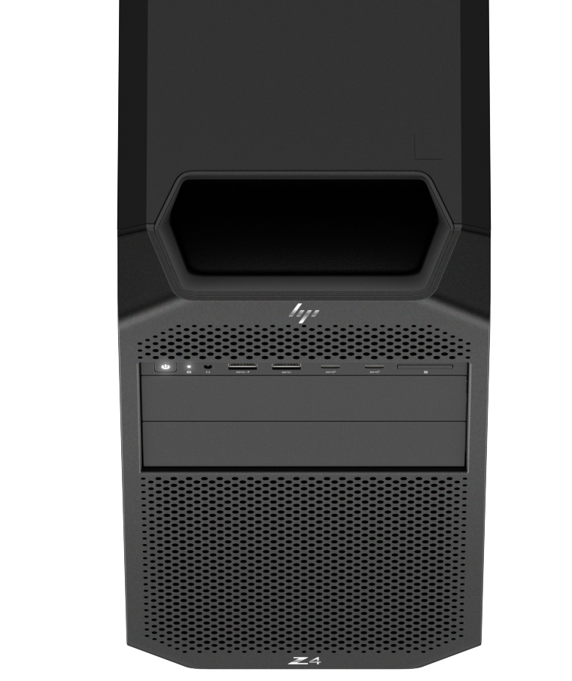





Reliability is in our DNA
The gold standard
Built for longevity with three-year lifecycle
Three-axis testing
Innovative vapor chamber solution
ISV certification
Tested to endure 1000 wipe cycles²⁹
48 I Z8 Fury G5 I HP Confidential. For use by HP or Partner with Customers under HP CDA only.
Notes:
Use of Gold
3-axis testing includes frequency, voltage, and temperature variations to push the limits on system parts.
Work with confidence knowing your desktop is certified with leading software applications to ensure peak performance even with complex projects.
DISCLAIMERS
29. Select household wipes can be safely used to clean HP Workstation PCs up to 1,000 wipes: See wipe manufacturer’s instructions for disinfecting and the HP cleaning guide for HP tested wipe solutions at How to Sanitize Your HP Device Whitepaper (https://h20195.www2.hp.com/v2/GetDocument.aspx?docname=4AA7-7610ENW).

Slide 49
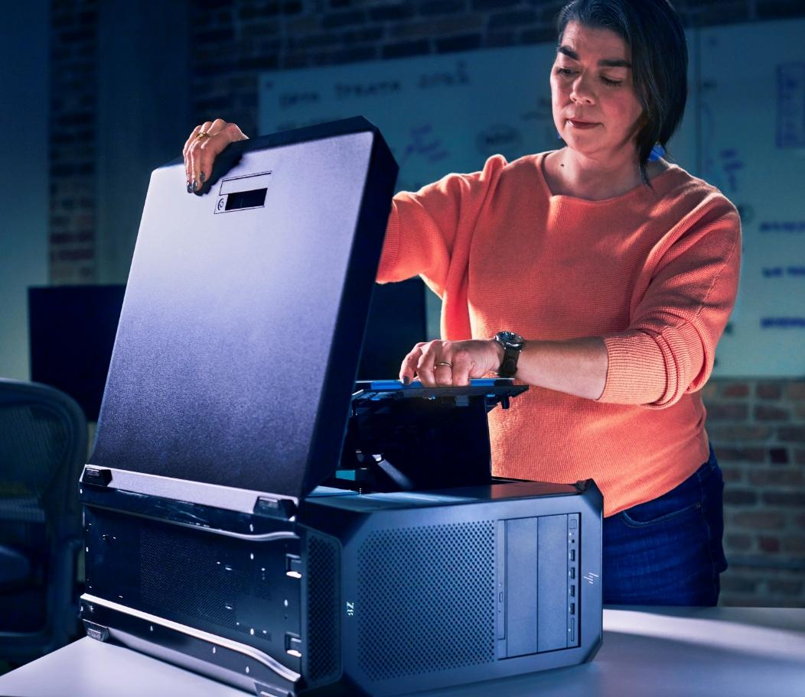
Manageability
Front hot-swappable M.2 drives with HP proprietary workstation-class manageability for convenient storage management
HP Smart Support provides support agents, secure access to device health insights, and configuration data for faster troubleshooting³⁰
Intel® vPro® for easier IT fleet management³¹
Deploy and maintain systems with HP Manageability Integration Kit³²
49 I Z8 Fury G5 I HP Confidential. For use by HP or Partner with Customers under HP CDA only.
Notes:
DISCLAIMERS
30. HP Smart Support automatically collects the telemetry necessary upon initial boot of the product to deliver device-level configuration data and health insights and is available preinstalled on select products, or it can be downloaded. For more information about how to enable HP Smart Support or to download, please visit http://www.hp.com/smart-support.
31. Intel vPro️ requires Windows 10 Pro 64 bit or higher, a vPro supported processor, vPro enabled chipset, vPro enabled wired LAN and/or Wi-Fi 6E WLAN and TPM 2.0. Some functionality requires additional third-party software in order to run. Features of vPro️ Essentials and Enterprise vary. See http://intel.com/vpro.
32. HP Manageability Integration Kit can be downloaded from http://www.hp.com/go/clientmanagement.

Slide 50

HP Anyware & Services
50 I Z8 Fury G5 I HP Confidential. For use by HP or Partner with Customers under HP CDA only.

Slide 51




Introducing HP Anyware: The future of
ZCentral Remote Boost and Teradici CAS
HP Anyware software enables secured access to your Z workstations from virtually anywhere.¹³
Two Emmy® award winning remote software solutions
One new world-class solution
Cloud Access Software
ZCentral Remote Boost
Flexibility
Security
Collaboration
Productivity
Performance
Flexibility
Security
Collaboration
Useability
51 I Z8 Fury G5 I HP Confidential. For use by HP or Partner with Customers under HP CDA only.
Notes:
DISCLAIMERS:
13.Network access required. HP Anyware supports Windows®️, Linux®️ and MacOS®️ host environments and Window, Linux, MacOS, iOS®️, Android®️, and Chrome OS®️ end-user devices. For more on the system requirements for installing HP Anyware, refer to the Admin Guides at: https://docs.teradici.com/find/product/cloud-access-software. HP Anyware is based on the Teradici CAS software and licensing platform and is available through a 1- and 3-year subscription. HP Anyware subscriptions are based on the number of concurrent PCoIP connections used (pay for the number of host connections, not the software) with a minimum order quantity of 5. HP Anyware subscriptions gives you a license key to activate a connection to a hosted desktop as well as support and updates to the PCoIP Agents, PCoIP Clients and the Anyware Manager available for download here: https://docs.teradici.com/find/product/cloud-access-software. For a limited time, an HP Anyware subscription also includes access and support for ZCentral Remote Boost and ZCentral Connect and is available for purchase through an HP Teradici seller or by contacting sales at: hp.com/Anyware.

Slide 52


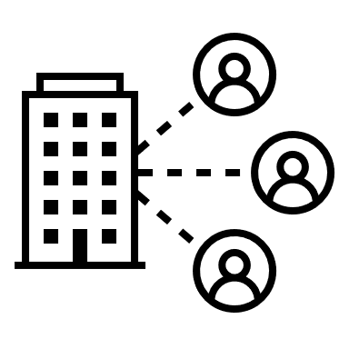

HP Anyware
Secure access to digital workspaces from any mix of infrastructure, anywhere¹
Flexibility
Security
Any device, any OS, any IT infrastructure and network
Helps keep data safe no matter where the work is accessed from
Collaboration
Productivity
Screen sharing allows teams to work together in real time
Enjoy the same amazing user experience from anywhere
Leverages the PCoIP protocol to securely deliver the ultimate user experience to any device, anywhere
52 I Z8 Fury G5 I HP Confidential. For use by HP or Partner with Customers under HP CDA only.
Notes:
DISCLAIMERS:
1. Network access required. HP Anyware supports Windows®️, Linux®️ and MacOS®️ host environments and Window, Linux, MacOS, iOS®️, Android®️, and Chrome OS®️ end-user devices. For more on the system requirements for installing HP Anyware, refer to the Admin Guides at: https://docs.teradici.com/find/product/cloud-access-software. HP Anyware is based on the Teradici CAS software and licensing platform and is available through a 1- and 3-year subscription. HP Anyware subscriptions are based on the number of concurrent PCoIP connections used (pay for the number of host connections, not the software) with a minimum order quantity of 5. HP Anyware subscriptions gives you a license key to activate a connection to a hosted desktop as well as support and updates to the PCoIP Agents, PCoIP Clients and the Anyware Manager available for download here: https://docs.teradici.com/find/product/cloud-access-software. For a limited time, an HP Anyware subscription also includes access and support for ZCentral Remote Boost and ZCentral Connect and is available for purchase through an HP Teradici seller or by contacting sales at: hp.com/Anyware.

Slide 53





HP Services¹
Complete solutions to enable your workforce—anywhere
HP TechPulse: delivering actionable insights²
Provision and deploy
Simplicity
Send devices and apps to users with ease
Monitor and manage
Proactive
Maximize uptime with proactive insights
Secure
Protection
Work securely anywhere with multi-layered protection
Support
Automation
Better experiences with automated support
Recover and renew
Sustainability
Create higher residual value, be Earth-friendly
53 I Z8 Fury G5 I HP Confidential. For use by HP or Partner with Customers under HP CDA only.
Notes:
DISCLAIMERS
1. HP Services are sold separately and are governed by the applicable HP terms and conditions of service provided or indicated to the customer at the time of purchase. Customers may have additional statutory rights according to applicable local laws, and such rights are not in any way affected by the HP terms and conditions of service or the HP limited warranty provided with your HP product.
2. HP TechPulse is a telemetry and analytics platform that provides critical data around devices and applications and is not sold as a standalone service. HP TechPulse follows stringent GDPR privacy regulations and is ISO27001, ISO27701, ISO27017, and SOC2 Type2 certified for Information Security. Internet access with connection to TechPulse portal is required. For full system requirements, please visit http://www.hpdaas.com/requirements.

Slide 54





Benefits of managed services¹
Reduce IT cost and complexity
World-class lifecycle services
AI-driven analytics
Improve the employee experience
Keep employees productive
Measure employee experience
Free up cash flow
Flexible payment terms
Flex up/flex down
Minimize security risk
Built-in security capabilities
Add-on security services
54 I Z8 Fury G5 I HP Confidential. For use by HP or Partner with Customers under HP CDA only.
Notes:
DISCLAIMERS
1. HP Services are sold separately and are governed by the applicable HP terms and conditions of service provided or indicated to the customer at the time of purchase. Customers may have additional statutory rights according to applicable local laws, and such rights are not in any way affected by the HP terms and conditions of service or the HP limited warranty provided with your HP product.

Slide 55

Sustainability
55 I Z8 Fury G5 I HP Confidential. For use by HP or Partner with Customers under HP CDA only.

Slide 56


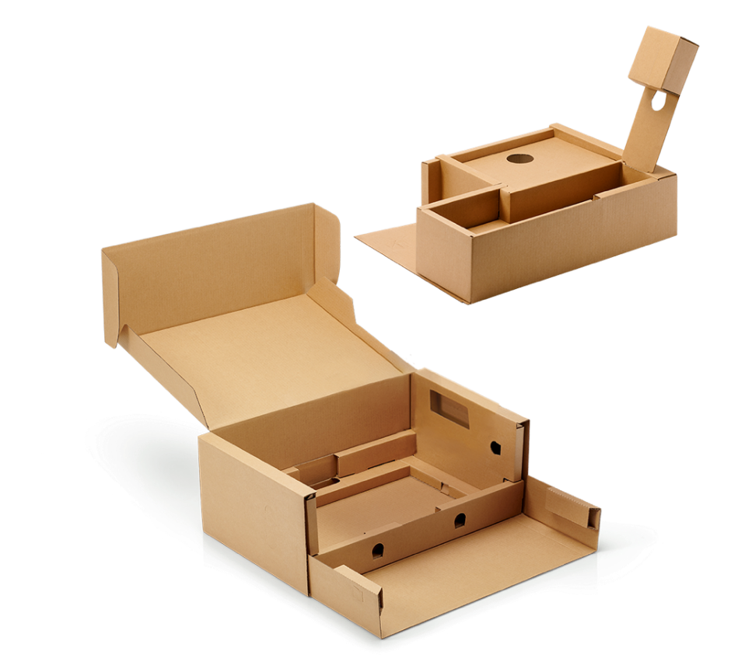
Help protect our shared future
The world’s most substainable PC portfolio³⁵
Reducing hazardous materials in our environment for a better tomorrow
Outer box and fiber cushions are 100% sustainably sourced³⁶
Bulk packaging available
Contains ocean-bound plastics
Sustainable Impact Report 2023 (hp.com)
56 I Z8 Fury G5 I HP Confidential. For use by HP or Partner with Customers under HP CDA only.
Notes:
This slide contains a superlative claim/s that cannot be used in all countries:
EMEA use restrictions:
DO NOT USE the superlative claim in the following countries:
Romania, Slovakia, Turkey, UAE, Russia, CIS countries (Armenia, Belarus, Kazakhstan, Kyrgyzstan, Moldova, Russia, Tajikistan, Turkmenistan, Ukraine, and Uzbekistan)
APJ use restrictions:
China, Vietnam, Indonesia, Malaysia—DO NOT USE
LAR use restrictions:
Brazil, Mexico—DO NOT USE
Plastic free packaging cushions (molded pulp)
Molded pulp cushions which are 100% easily recyclable vs. previous single-use plastics cushions difficult to recycle. Part of HP PS-wide commercial strategy to go to non-plastic packaging. Fiber packaging to improves the recyclability of packaging materials
Bulk packaging
So what is bulk packaging?
Bulk packaging is the packaging of two or more units in a single packaging solution. The offering is available for large costumers that order large numbers of units. Bulk packaging minimizes the amount of box needed to be open during a roll out and the amount a material that needs to be disposed of.
Why does this matter? There are benefits to HP’s bulk packaging: Bulk Packaging allows HP to employ specialized packaging solutions that use less packaging material per unit and/or take up less volume, thereby increasing shipping densities. Naturally there are environmental benefits to this increased material and/or volume efficiency. Besides using less overall natural resources, bulk packaging requires less fuel to ship the same amount of products, reducing the amount of carbon emissions emitted. Less packaging also means less for the customer to dispose of or pay to recycle.
Lastly, utilizing bulk packaging may also lead to Increased security and protection for units in storage as units are not individually packaged.
Inventory security: "Inventory—customer scans the 8 external serial number barcode labels and subsequently prints 8 asset tags. The asset tags are affixed to the outside of the box and the units are put directly into inventory awaiting deployment. Note: Pallets are not broken and boxes are not opened reducing time/money and increasing security.
Additional HP savings: Less tax for HP to pay because of less packaging materials.
DISCLAIMERS:
35. Applies to HP PCs, workstations, displays, and point of sale systems manufactured after January 2019. Based on most Gold and Silver EPEAT® registrations by meeting all required criteria and achieving 50–74% of the optional points for EPEAT® Silver and 75–100% of the optional points for EPEAT® Gold according to IEEE 1680.1-2018 EPEAT®. Status varies by country. Visit www.epeat.net for more information. Not all products available in all countries.
36. 100% outer box packaging made from sustainably source certified and recycled fibers. Fiber cushions made from 100% recycled wood fiber and organic material. Any plastic cushions are made from >90% recycled plastic.

Slide 57


By the numbers: Z4 G5
25%
Up to 25% ocean-bound plastics in fans³⁷
40%
Up to 40% of product plastics are recycled post consumer³⁸
90%
Up to 90% efficient power supply
57 I Z8 Fury G5 I HP Confidential. For use by HP or Partner with Customers under HP CDA only.
Notes:
DISCLAIMERS
37. Fans contain up to 25% ocean-bound plastic by weight.
38. Recycled plastic content percentage is based on the definition set in the IEEE 1680.1-2018 EPEAT standard.

Slide 58
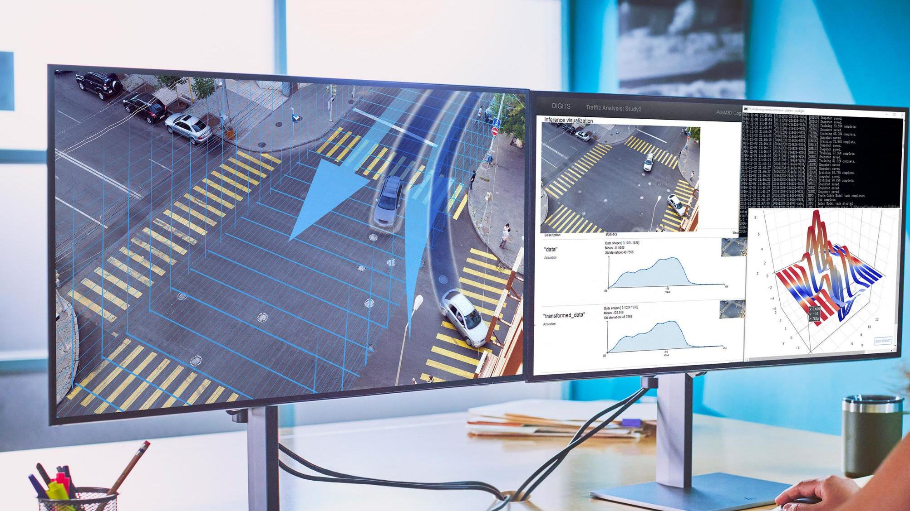
Ecosystem
58 I Z8 Fury G5 I HP Confidential. For use by HP or Partner with Customers under HP CDA only.

Slide 59
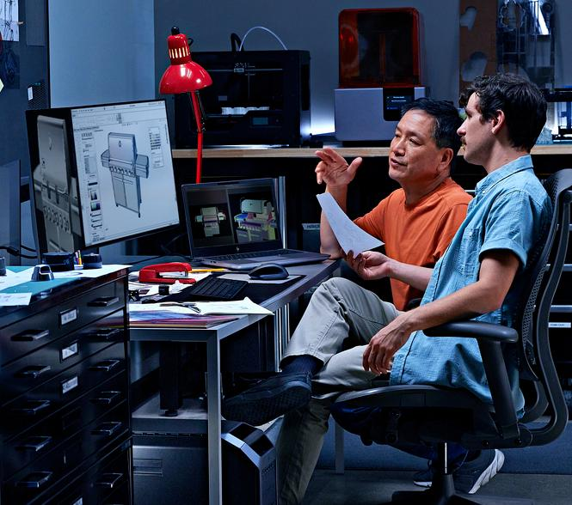
HP Series 7 Pro 732pk
4K, 31.5-inch diagonal display with Thunderbolt™ 4 and IPS Black technology
Color that rivals reality
Unleash the power of Thunderbolt™ 4³⁹
Seamless control
59 I Z8 Fury G5 I HP Confidential. For use by HP or Partner with Customers under HP CDA only.
Notes:
DISCLAIMER
39. SuperSpeed USB 20Gbps is not available with Thunderbolt™ 4.

Slide 60

Data science ecosystem
(data analyst)
HP Series 7 Pro 740pm
See and do more by immersing yourself in the brilliant, expansive views of the WUHD display
Improve productivity with easy multitasking on an ultra-wide screen that can be segmented into the equivalent of four 20-inch monitors
Integrated HP Device Bridge 2.0 lets you control two Windows and/or Mac devices from the same keyboard and mouse while maintaining network security with controlled file sharing
60 I Z8 Fury G5 I HP Confidential. For use by HP or Partner with Customers under HP CDA only.

Slide 61

Product development ecosystem
(product engineer)
HP Series 7 Pro 732pk
View every detail as if it’s true-to-life with captivating color contrast on this precise 4K, 31.5-inch diagonal display
Transform your desk into a productivity powerhouse with Thunderbolt™ 4
When you’re multi-tasking between two devices, simply use the built-in KVM switch to control both with just a single keyboard and mouse
61 I Z8 Fury G5 I HP Confidential. For use by HP or Partner with Customers under HP CDA only.

Slide 62

Architecture, engineering, and construction ecosystem (architect)
HP Pro Series 7 Pro 734pm
34" color accurate conferencing display with Zoom certification
Increase productivity with the ability to see all your projects on one expansive, sharp screen
Be confident that the color on screen matches what you see in real life with a 100% sRGB and 98% Display P3 color gamut
62 I Z8 Fury G5 I HP Confidential. For use by HP or Partner with Customers under HP CDA only.

Slide 63

Media and entertainment
(video editor)
HP Series 7 Pro 727pu
World-class grade color and design optimized for hybrid or office work
Experience every pixel and movement with the precision of reality in crisp QHD resolution and a fast 120Hz refresh rate.
Lean into realism with HDR 400 and 2000:1 contrast ratio for darker blacks and brighter whites
63 I Z8 Fury G5 I HP Confidential. For use by HP or Partner with Customers under HP CDA only.

Slide 64




Z8 Fury G5 peripherals
Graphics
Networking
NVIDIA® RTX™ 6000 Ada 48GB 4DP Graphics
HP Dual TBT4 PCIe x4 Low Profile Card
Storage
Accessories
HP QX448 removable with 185mm cable (Qty. 2) frame/carrier and HP CRU SHIPS M.2 2TB storage module
HP Creator 935 Black Wireless Mouse
64 I Z8 Fury G5 I HP Confidential. For use by HP or Partner with Customers under HP CDA only.
Notes:
SKUs
5S458AA NVIDIA RTX A4500 20GB GDDR6 4DP Graphics
6E3Y9AA Allied Telesis AT-2911T/2-901 Dual Port 1GbE NIC
56Q77AA Z Turbo 2TB 2280 PCIe 4x4 SED OPAL2 TLC M.2 Z4/Z6 Kit SSD
4R009AA HP 655 Wireless Keyboard and Mouse Combo

Slide 65

Technical details

Slide 66
Z8 Fury detailed comparisons
 | Z8 G4 | Z8 G5 | Z8 Fury G5
Chassis | 17.50"H x 8.50"W x 21.70"D | 17.50"H x 8.50"W x 21.70"D | 17.50"H x 8.50"W x 21.70"D
Graphics | Up to 2x high-end DW | Up to 2x high-end DW | Up to 4x high-end DW
PSU – 115V/230V | 1125W Gold/1450W Platinum (15A) 1450W Gold/1700W Platinum (20A) | 1125W Gold/1450W Platinum (15A) 1450W Gold/1700W Platinum (20A) | 1125W Gold / 1450W Platinum (15A) 1125W Gold / 1450W Platinum (15A) redundant, hot-swap 2250W Gold aggregate
Processor(s) | Cascade Lake, Xeon® SP Dual, up to 56C total | Sapphire Rapids, Xeon® SP Dual, up to 64C total | Sapphire Rapids, Xeon® W, up to 56C
Memory | DDR4, 1.5TB Max 12 channels, 2 DIMMs per channel (DPC) 2933MHz Intel® Optane PM 100 series | DDR5, 1TB max 16 channels, 1 DIMMs per channel (DPC) Up to 4800MHz | DDR5, 2TB max 8 channels, 2 DIMMs per channel (DPC) 4800MHz 1DPC, 4400MHz 2DPC
PCIe slots | Slot 1: x4 Gen3 Slot 2: x16 Gen3 Slot 3: x16 Gen3 Slot 4: x16 Gen3 Slot 5: x4 Gen3 Slot 6: x16 Gen3 Slot 7: x4 Gen3 | Slot 1: x16 Gen4 Slot 2: x16 Gen4 Slot 3: x4 Gen3 Slot 4: x16 Gen5 Slot 5: x8 Gen3 Slot 6: x16 Gen3 Slot 7: x4 Gen3 | Slot 1: x16 Gen5 Slot 2: x4 Gen5 Slot 3: x16 Gen5 Slot 4: x4 Gen4 Slot 5: x16 Gen4 Slot 6: x8 Gen3 Slot 7: x16 Gen4 Slot 8: x4 Gen4
NVMe, integrated | Up to 4x devices, PCIe Gen3 | Up to 4x devices, PCIe Gen4 | Up to 4x devices, PCIe Gen4
NVMe, front accessible | 1x, uses PCIe slot, PCIe Gen3 | Up to 2x devices, PCIe Gen4, hot-swap | Up to 4x devices, PCIe Gen4, hot-swap
SATA | 10 ports | 6 ports | 6 ports
Network, Ethernet | 1x AMT 1GbE, 1x 1GbE, Optional dual-10GbE module | 1 AMT 1GbE, 1GbE, Optional dual-10GbE module | 1 AMT 1GbE, 1GbE, Optional dual-10GbE module
Network, wireless | Wi-Fi 6 and 6E via PCIe slot AiC w/ external antenna | Wi-Fi 6 and 6E via PCIe slot AiC w/ external antenna | Wi-Fi 6 and 6E via PCIe slot AiC w/ external antenna
FlexIO modules | NA | NA | NA
USB 5Gb | 6 rear, 1 int, 4x entry front IO module, 2x premium front IO module | 6 rear, 1 int, 4x entry front IO module | 6 rear, 1 int, 4x entry front IO module, 2x ultra premium front IO module
USB 10/20Gb | 2x 10Gb premium front IO module | None | 2x 20Gb ultra premium front IO module
66 I Z8 Fury G5 I HP Confidential. For use by HP or Partner with Customers under HP CDA only.

Slide 67
Z8 Fury detailed comparisons
 | Z8 G4 | Z8 G5 | Z8 Fury G5
Chassis | 17.50"H x 8.50"W x 21.70"D | 17.50"H x 8.50"W x 21.70"D | 17.50"H x 8.50"W x 21.70"D
Graphics | Up to 2x high-end DW | Up to 2x high-end DW | Up to 4x high-end DW
PSU – 115V/230V | 1125W Gold/1450W Platinum (15A) 1450W Gold/1700W Platinum (20A) | 1125W Gold/1450W Platinum (15A) 1450W Gold/1700W Platinum (20A) | 1125W Gold / 1450W Platinum (15A) 1125W Gold / 1450W Platinum (15A) redundant, hot-swap 2250W Gold aggregate
Processor(s) | Cascade Lake, Xeon® SP Dual, up to 56C total | Sapphire Rapids, Xeon® SP Dual, up to 64C total | Sapphire Rapids, Xeon® W, up to 60C total
Memory | DDR4, 1.5TB Max 12 channels, 2 DIMMs per channel (DPC) 2933MHz Intel® Optane PM 100 series | DDR5, 1TB max 16 channels, 1 DIMMs per channel (DPC) Up to 5600 MHz RDIMM | DDR5, 2TB max 8 channels, 2 DIMMs per channel (DPC) 4800MHz 1DPC, 4400MHz 2DPC
PCIe slots | Slot 1: x4 Gen3 Slot 2: x16 Gen3 Slot 3: x16 Gen3 Slot 4: x16 Gen3 Slot 5: x4 Gen3 Slot 6: x16 Gen3 Slot 7: x4 Gen3 | Slot 1: x16 Gen4 Slot 2: x16 Gen4 Slot 3: x4 Gen3 Slot 4: x16 Gen5 Slot 5: x8 Gen3 Slot 6: x16 Gen3 Slot 7: x4 Gen3 | Slot 1: x16 Gen5 Slot 2: x4 Gen5 Slot 3: x16 Gen5 Slot 4: x4 Gen4 Slot 5: x16 Gen4 Slot 6: x8 Gen3 Slot 7: x16 Gen4 Slot 8: x4 Gen4
67 I Z8 Fury G5 I HP Confidential. For use by HP or Partner with Customers under HP CDA only.

Slide 68
Z8 Fury detailed comparisons
 | Z8 G4 | Z8 G5 | Z8 Fury G5
NVMe, integrated | Up to 4x devices, PCIe Gen3 | Up to 4x devices, PCIe Gen4 | Up to 4x devices, PCIe Gen4
NVMe, front accessible | 1x, uses PCIe slot, PCIe Gen3 | Up to 2x devices, PCIe Gen4, Hot-swap | Up to 4x devices, PCIe Gen4, hot-swap
SATA | 10 ports | 6 ports | 6 ports
Network, Ethernet | 1x AMT 1GbE, 1x 1GbE, optional dual-10GbE module | 1 AMT 1GbE, 1GbE, optional dual-10GbE module | 1 AMT 1GbE, 1GbE, optional dual-10GbE module
Network, wireless | Wi-Fi 6 and 6E via PCIe slot AiC w/ external antenna | Wi-Fi 6 and 6E via PCIe slot AiC w/ external antenna | Wi-Fi 6 and 6E via PCIe slot AiC w/ external antenna
FlexIO modules | NA | NA | NA
USB 5Gb | 6 rear, 1 int, 4x entry front IO module, 2x premium front IO module | 6 rear, 1 int, 4x entry front IO module | 6 rear, 1 int, 4x entry front IO module, 2x ultra premium front IO module
USB 10/20Gb | 2x 10Gb premium front IO module | None | 2x 20Gb ultra premium front IO module
68 I Z8 Fury G5 I HP Confidential. For use by HP or Partner with Customers under HP CDA only.

Slide 69


Connectivity
Front ports
Rear ports
Premium
2x USB 3.1 (5Gbps) Type-A (1 charging)
2x USB 3.2 SuperSpeed (20Gbps) Type-C®
Headset/mic
1x media card reader (optional)
Standard
4x USB 3.1 (5Gbps) Gen1 Type-A (1 charging)
Headset/mic
1x media card reader (optional)
2x 10GbE optional ports
2x 1GbE standard ports
6x 5Gbps USB 3.1 Type-A
Audio line
Additional features
Wi-Fi 6 and 6E via PCIe⁴³
69 I Z8 Fury G5 I HP Confidential. For use by HP or Partner with Customers under HP CDA only.
Notes:
DISCLAIMERS
43. Wireless access point and Internet service required and sold separately. Availability of public wireless access points limited. Wi-Fi 6 (802.11ax) is backward-compatible with prior 802.11 specs. Wi-Fi 6E requires a Wi-Fi 6E router, sold separately, and Windows 10 or higher to function in the 6GHz band. Availability of public wireless access points limited. Wi-Fi 6E is backward-compatible with prior 802.11 specs. And available in countries where Wi-Fi 6E is supported.

Slide 70


Front ports
Premium
Standard
Headset/mic
1x media card reader (optional)
4x USB 3.1 (5Gbps) Gen1 Type-A (1 charging)
2x USB 3.2 SuperSpeed (20Gbps) Type-C®
2x USB 3.1 (5Gbps) Type-A (1 charging)
1x media card reader (optional)
Headset/mic
70 I Z8 Fury G5 I HP Confidential. For use by HP or Partner with Customers under HP CDA only.

Slide 71

Rear ports and additional features
Rear ports
Additional features
Wi-Fi 6 and 6E via PCIe⁴³
Audio line
6x USB 3.1 Type-A
2x power supply connectors (aggregate/redundant)
2x 1GbE standard ports (1x AMT)
2x 10GbE optional ports
71 I Z8 Fury G5 I HP Confidential. For use by HP or Partner with Customers under HP CDA only.
Notes:
DISCLAIMERS
43. Wireless access point and Internet service required and sold separately. Availability of public wireless access points limited. Wi-Fi 6 (802.11ax) is backward-compatible with prior 802.11 specs. Wi-Fi 6E requires a Wi-Fi 6E router, sold separately, and Windows 10 or higher to function in the 6GHz band. Availability of public wireless access points limited. Wi-Fi 6E is backward-compatible with prior 802.11 specs. And available in countries where Wi-Fi 6E is supported.

Slide 72
Disclaimers
72 I Z8 Fury G5 I HP Confidential. For use by HP or Partner with Customers under HP CDA only.

Slide 73
1. Two additional GPUs supported for 100V countries; one additional GPU supported for 200V countries.
2. Based on HP’s internal analysis of workstations with a minimum three ISV certifications, configurable professional graphics, and a dedicated workstation brand.
Multicore is designed to improve performance of certain software products. Not all customers or software applications will necessarily benefit from use of this technology. Performance and clock frequency will vary depending on application workload and your hardware and software configurations. Intel’s numbering, branding, and/or naming are not measurements of higher performance.
Network access required. HP Anyware supports Windows®️, Linux®️ and MacOS®️ host environments and Window, Linux, MacOS, iOS®️, Android®️, and Chrome OS®️ end-user devices. For more on the system requirements for installing HP Anyware, refer to the Admin Guides at: https://docs.teradici.com/find/product/cloud-access-software. HP Anyware is based on the Teradici CAS software and licensing platform and is available through a 1- and 3-year subscription. HP Anyware subscriptions are based on the number of concurrent PCoIP connections used (pay for the number of host connections, not the software) with a minimum order quantity of 5. HP Anyware subscriptions gives you a license key to activate a connection to a hosted desktop as well as support and updates to the PCoIP Agents, PCoIP Clients and the Anyware Manager available for download here: https://docs.teradici.com/find/product/cloud-access-software. For a limited time, an HP Anyware subscription also includes access and support for ZCentral Remote Boost and ZCentral Connect and is available for purchase through an HP Teradici seller or by contacting sales at: hp.com/Anyware.
WSL 2 is an optional, configurable feature. WSL 2 requires Windows 10 or higher, Intel Core i5 processor or higher, and is available on select Z workstations. You must be running Windows 10 version 21H2 and higher (Build 19044 and higher) or Windows 11.
6. Z by HP Data Science Stack Manager requires Windows 10 version 21H2 (Build 19044) and higher or 64-bit Ubuntu 20.04 and is available on select Z workstations.
7. Redundant power supply is an optional, configurable feature.
Military-standard testing is not intended to demonstrate fitness of U.S. Department of Defense (DoD) contract requirements or for military use. Test results are not a guarantee of future performance under these test conditions. Accidental damage requires an optional HP Accidental Damage Protection Care Pack.
NVIDIA RTX™ 6000 and AMD Radeon™ Pro W6800 GPUs are sold separately or as an optional feature.
10. 2TB DDR5 memory is planned to be available mid-2023.
11. Storage memory is an optional, configurable feature. Two front-accessible NVMe bays require a 5.25 bay carrier. Configuration for 120TB requires separate additional purchase. For storage drives, 1GB = one billion bytes; 1TB = one trillion bytes. Actual formatted capacity is less. Up to 35GB is reserved for system recovery software.
12. Redundant and aggregate power requires configuring two 1125W power supplies at hardware purchase.
13. Select HP Workstations are available with certified Ubuntu. For detailed Linux OS/hardware support information, see: http://www.hp.com/support/linux_hardware_matrix.
14. Based on HP’s unique and comprehensive security capabilities at no additional cost and HP Manageability Integration Kit’s management of every aspect of a PC including hardware, BIOS, and software management using Microsoft System Center Configuration Manager on HP Elite PCs and HP Workstations with Windows and 8th Gen and higher Intel processors or AMD Ryzen 4000 processors and higher.
15. HP Wolf Security for Business requires Windows 10, includes various HP security features, and is available on HP Pro, Elite, and Workstation products. See product details for included security features and OS requirement.
16. HP Sure View Gen3 integrated privacy screen is an optional feature that must be configured at purchase and is designed to function in landscape orientation.
17. HP Sure View Reflect integrated privacy screen is an optional feature that must be configured at purchase and is designed to function in landscape orientation.
18. HP Privacy Camera only available PCs equipped with HD or IR camera and must be installed at the factory.
19. HP Sure Shutter only available PCs equipped with HD or IR camera and must be installed at the factory.
20. Microsoft Secured Core requires an Intel vPro®, AMD Ryzen™ PRO, or Qualcomm® processor with SD850 or higher and requires 8GB or more system memory. Secured Core PC functionality can be enabled from the factory.
21. HP Sure Click requires Windows 10 or 11 Pro or higher. See https://bit.ly/2PrLT6A_SureClick for complete details.
22. HP Sure Sense is available on select HP PCs and is not available with Windows 10 Home.
23. HP BIOSphere Gen6 requires Windows 10 or 11 Pro or higher and is available on select HP Pro, Elite PCs, and Z Workstations. Features may vary depending on the platform and configurations.
24. HP Sure Start Gen6 is available on select HP PCs and requires Windows 10 or 11 Pro or higher.
25. HP Sure Run Gen4 is available on select HP PCs and requires Windows 10 or 11 Pro or higher.
73 I Z8 Fury G5 I HP Confidential. For use by HP or Partner with Customers under HP CDA only.
73 I Z8 Fury G5 I HP Confidential. For use by HP or Partner with Customers under HP CDA only.

Slide 74
26. HP Sure Recover Gen4 is available on select HP PCs and requires Windows 10 or 11 Pro or higher and an open network connection. You must back up important files, data, photos, videos, etc. before using HP Sure Recover to avoid loss of data. Network based recovery using Wi-Fi is only available on PCs with Intel Wi-Fi Module.
27. HP Sure Recover Gen4 with Embedded Reimaging is an optional feature which requires Windows 10 or 11 Pro or higher and must be configured at purchase. You must back up important files, data, photos, videos, etc. before use to avoid loss of data. Network based recovery using Wi-Fi is only available on PCs with Intel Wi-Fi Module.
28. For the methods outlined in the National Institute of Standards and Technology Special Publication 800-88 “Clear” sanitation method. HP Secure Erase does not support platforms with Intel Optane.
29. HP Sure Admin requires Windows 10 or 11 Pro or higher, HP BIOS, HP Manageability Integration Kit from http://www.hp.com/go/clientmanagement and HP Sure Admin Local Access Authenticator smartphone app from the Android or Apple store.
30. HP TamperLock must be enabled by the customer or your administrator.
31. HP Client Security Manager Gen7 requires Windows and is available on the select HP Pro, Elite, PCs, and Z Workstations.
32. Select household wipes can be safely used to clean HP Workstation PCs up to 1,000 wipes: See wipe manufacturer’s instructions for disinfecting and the HP cleaning guide for HP tested wipe solutions at How to Sanitize Your HP Device Whitepaper (https://h20195.www2.hp.com/v2/GetDocument.aspx?docname=4AA7-7610ENW).
33. HP Smart Support automatically collects the telemetry necessary upon initial boot of the product to deliver device-level configuration data and health insights and is available preinstalled on select products, or it can be downloaded. For more information about how to enable HP Smart Support or to download, please visit http://www.hp.com/smart-support.
34. Intel vPro️ requires Windows 10 Pro 64 bit or higher, a vPro supported processor, vPro enabled chipset, vPro enabled wired LAN and/or Wi-Fi 6E WLAN and TPM 2.0. Some functionality requires additional third-party software in order to run. Features of vPro️ Essentials and Enterprise vary. See http://intel.com/vpro.
35. HP Manageability Integration Kit can be downloaded from http://www.hp.com/go/clientmanagement.
36. HP Services are sold separately and are governed by the applicable HP terms and conditions of service provided or indicated to the customer at the time of purchase. Customers may have additional statutory rights according to applicable local laws, and such rights are not in any way affected by the HP terms and conditions of service or the HP limited warranty provided with your HP product.
37. HP TechPulse is a telemetry and analytics platform that provides critical data around devices and applications and is not sold as a standalone service. HP TechPulse follows stringent GDPR privacy regulations and is ISO27001, ISO27701, ISO27017, and SOC2 Type2 certified for Information Security. Internet access with connection to TechPulse portal is required. For full system requirements, please visit http://www.hpdaas.com/requirements.
38. Applies to HP PCs, workstations, displays, and point of sale systems manufactured after January 2019. Based on most Gold and Silver EPEAT® registrations by meeting all required criteria and achieving 50–74% of the optional points for EPEAT® Silver and 75–100% of the optional points for EPEAT® Gold according to IEEE 1680.1-2018 EPEAT®. Status varies by country. Visit www.epeat.net for more information. Not all products available in all countries.
39. 100% outer box packaging made from sustainably source certified and recycled fibers. Fiber cushions made from 100% recycled wood fiber and organic material. Any plastic cushions are made from >90% recycled plastic.
40. Fans contain up to 25% ocean-bound plastic by weight.
41. Recycled plastic content percentage is based on the definition set in the IEEE 1680.1-2018 EPEAT standard.
42. SuperSpeed USB 20Gbps is not available with Thunderbolt™ 4.
Wireless access point and Internet service required and sold separately. Availability of public wireless access points limited. Wi-Fi 6 (802.11ax) is backward-compatible with prior 802.11 specs. Wi-Fi 6E requires a Wi-Fi 6E router, sold separately, and Windows 10 or higher to function in the 6GHz band. Availability of public wireless access points limited. Wi-Fi 6E is backward-compatible with prior 802.11 specs. And available in countries where Wi-Fi 6E is supported.
Z by HP AI Studio requires Windows 11 OS, Intel Core™ i5 12th gen or higher, AMD Ryzen™ 9 or higher processors, minimum 50 GB of available storage, 16GB of RAM, and Internet access. To enable GPU compute, Z by HP AI Studio requires any NVIDIA® GPU compatible with driver version 528.49 or newer. Join waitlist for access to Z by HP AI Studio early access program.
World’s most advanced remote management peripheral: Based on HPs internal Analysis of peripheral hardware IP KVMs as of Feb 2023. Most advanced based on ability to directly access the BIOS without a KVM Session, Power Button, Automated Bare Metal Imaging, Health Alerts/Diagnostics from the Host, and available Fleet Management Software when used with Z2 G9, Z4, Z6, Z8, Z8 Fury G5, and above
TOPS (Trillions of Operations Per Second) is a metric used to describe the theoretical maximum computational capability of AI accelerators. It shows relative performance in performing AI-based functions on AI accelerators like NPUs, CPUs, and GPUs. Real-world performance can be significantly lower than the theoretical TOPS.” ¹
74 I Z8 Fury G5 I HP Confidential. For use by HP or Partner with Customers under HP CDA only.

Slide 75
Fleet Management requires HP Remote System Management. Access to HP Remote System Management is included with the purchase of the HP Remote System Controller. Visit https://rsm.hp.com to open your account.
75 I Z8 Fury G5 I HP Confidential. For use by HP or Partner with Customers under HP CDA only.

