Slide 1
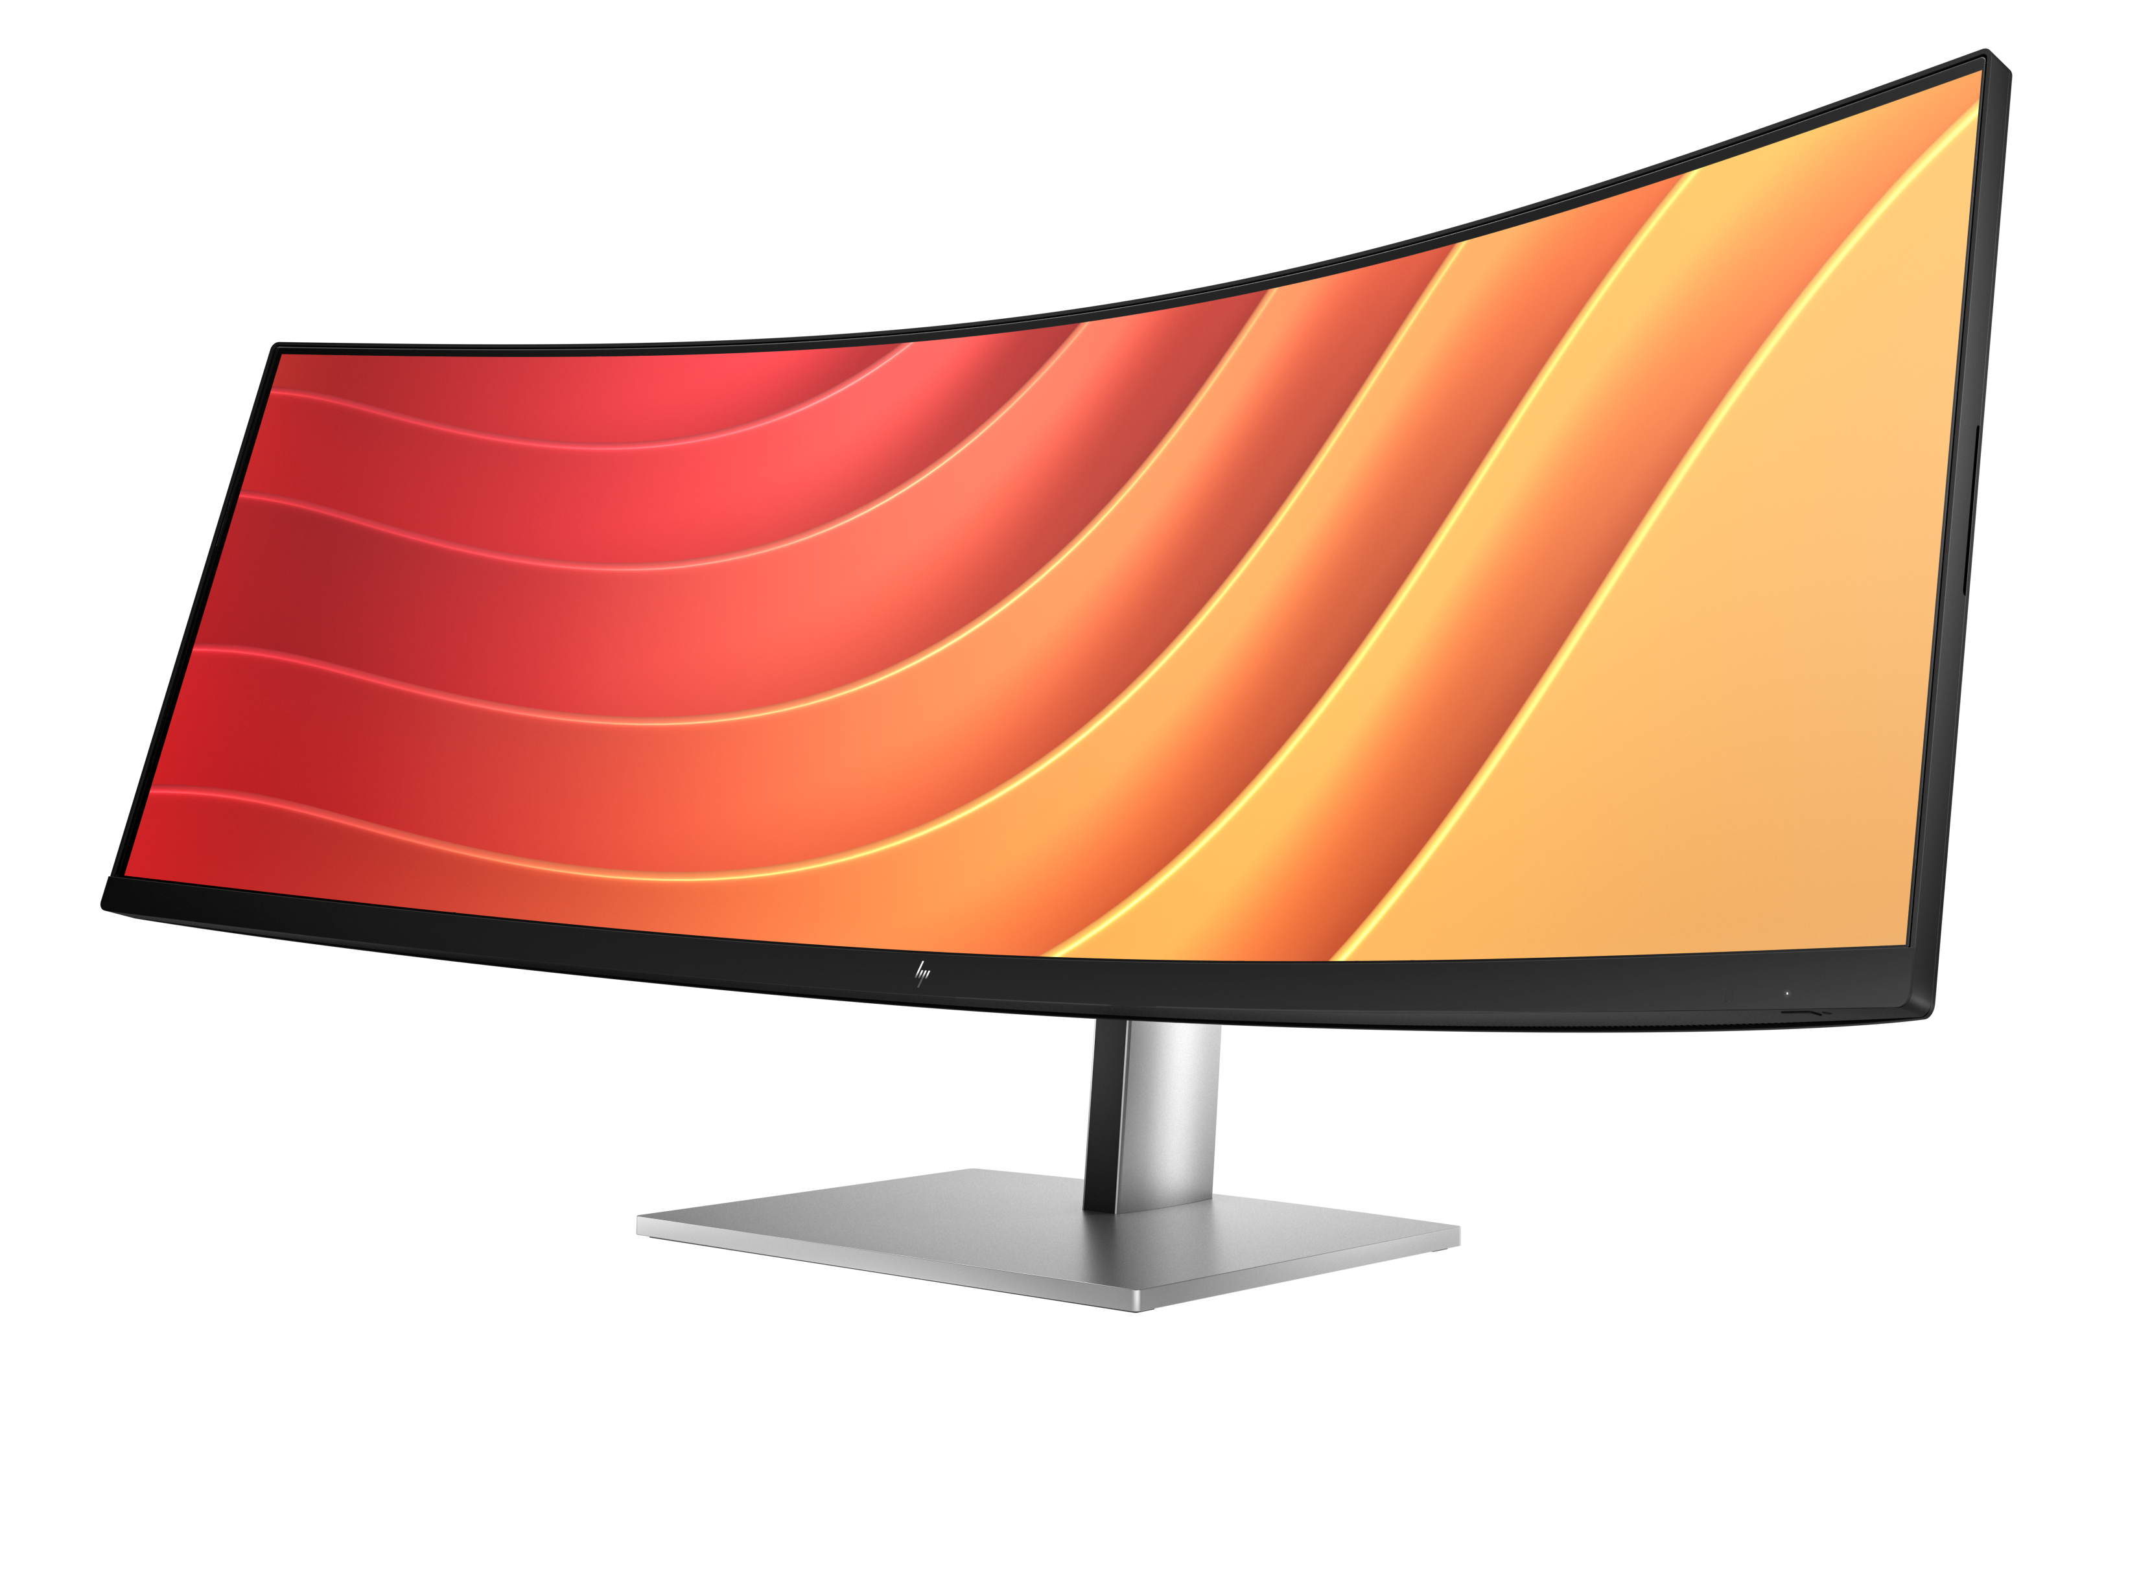
HP E45c G5
Ultra Wide Docking Display
44.5” Dual QHD 1500R VA
400 nits, 32:9, 5120x1440@165Hz
Out-Band Manageability (MAPT, WoL, PXE Boot)
Up to 100W Power Delivery via USB-C 3.2 Gen 2
Single Power On, KVM, Device Bridge and Virtual Display
Energy Star certified and EPEAT registered

Slide 2
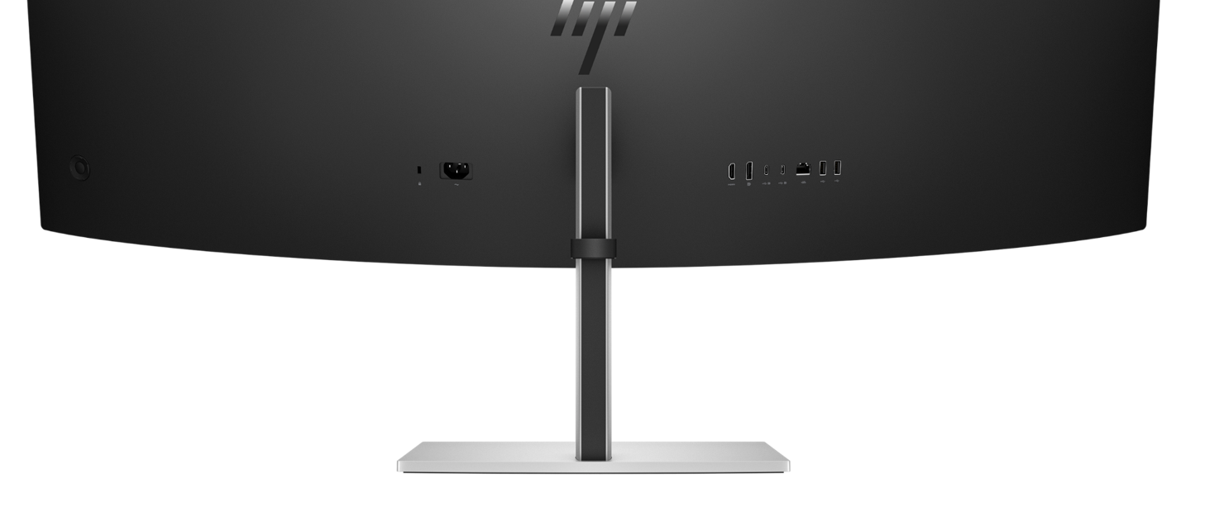
E45c G5 Connectivity
Security Lock
2x USB-A 3.2
HDMI 2.1 In
Power Connector
DisplayPort 1.4 In
RJ45 with Out-Band manageability
(PXE Boot, MAC Address Pass Through, HBMA, WoL)
2x USB-C 3.2 Alt Mode, up to 100W + 65W Power Delivery
2x USB-A 3.2 (hidden)

Slide 3
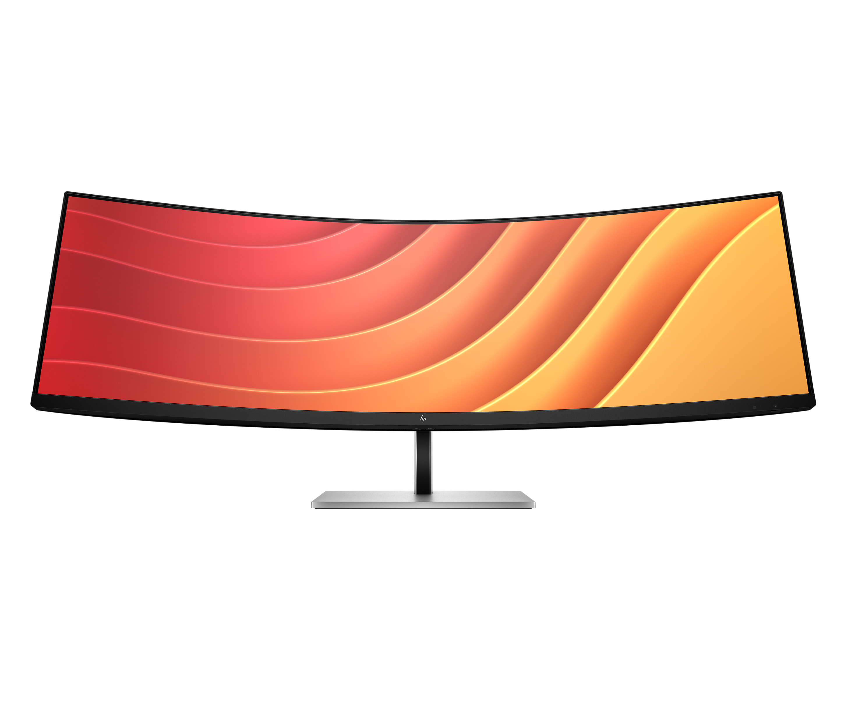


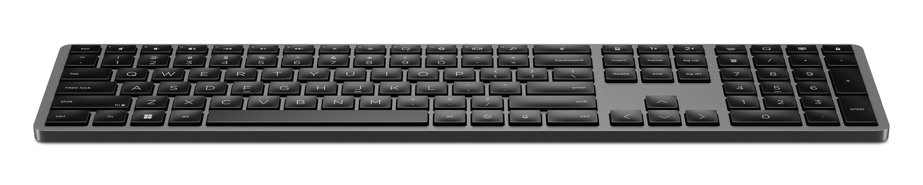

HP E45c G5
Workplace
RJ45 Out-Band Manageability
USB-C 3.2 Gen 1
with MAPT, PXE Boot and WoL support
up to 100W Power Delivery
HP 975 Wireless Keyboard
Single Power On
(Rechargeable via USB-C, Connected via Bluetooth or 2.4GHz)
Ambient Light Sensor with automatic adjustment of display brightness
HP 715 Wireless Mouse
(Rechargeable via USB-C, Connected via Bluetooth or 2.4GHz)

Slide 4
HP E45c G5
Ambient Light Sensor
Ambient Light sensor adjusts the screen brightness automatically to the light conditions of user’s environment, for higher user comfort and optimized Energy consumption

Slide 5
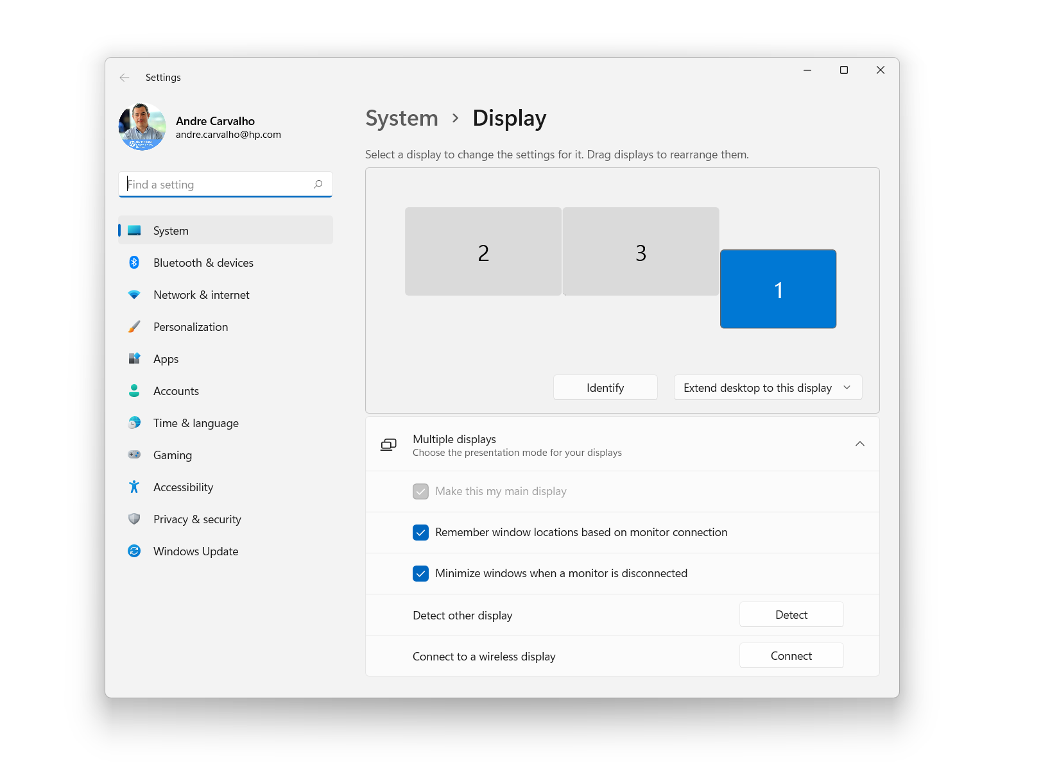
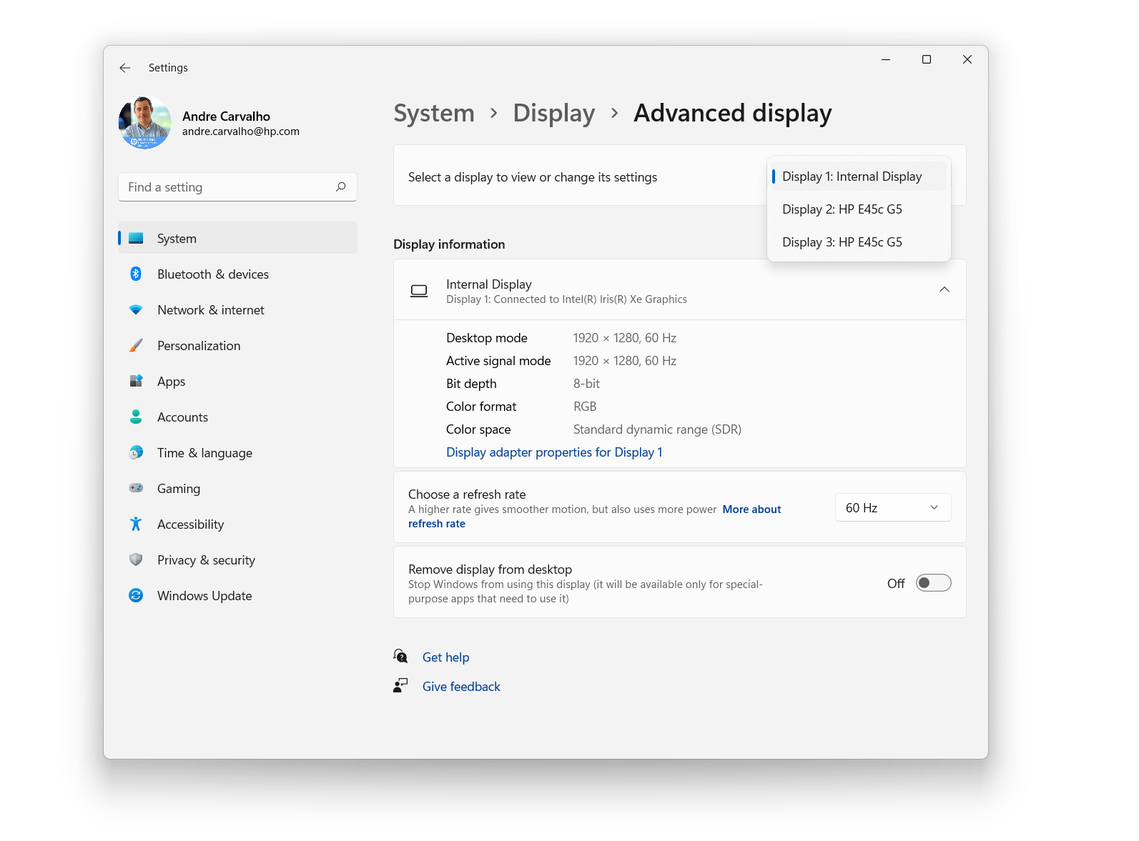
HP E45c G5
Virtual Display
E45c is connected to the notebook and the Operating System handles the E45c as 2 independent screens, making it easier to work, present, screen sharing

Slide 6
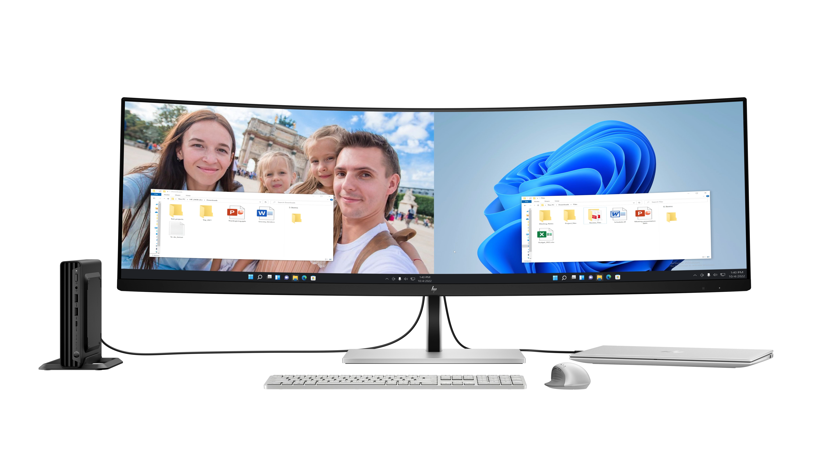
HP E45c G5
Device Bridge
Connect 2 different computers and simultaneously view and work between them. Drag and drop files from your office PC to your notebook for your client visit.

Slide 7
Manageability Overview
 | Thunderbolt Dock G4 4J0A2AA / 4J0G4AA | Thunderbolt Dock G6 9X472UT / 9X481UT /AW5M5UT | Universal Dock G2 5TW13AA | USB-C Dock G5 5TW10AA | Docking Display In-Band E24m G4, E27m G4, E34m G4, 724pu, 740pm | Docking Display Out-Band E24u G5, 524pu, 524pm, E27u G5, 527pm, 527pu, E27k G5, E32k G5, E45c G5, 727pu, 727pk, 727pm, 732pk, 734pm, 534pm, 738pu
Wake On Lan
MAPT
PXE Boot Support
Single Power On
Disable Lan
HP Lan Wireless Protection
Connected FW Update
Event Messaging
Disconnected Updates
Over-the-Air Updates
E-Tag
vPro
*
*
Full-Band Manageability
In-Band Manageability (device needs to be in Windows)
Supported
Notes:
*Feature not available for Z-Displays, 724pu, 740pm, E24m G4, E27m G4 and E34m G4.

