Slide 1
Introducing a new category of workstations: HP ZGX
WIP – NOT FINAL
HP ZGX Nano G1n AI Station
AI Supercomputing goes nano

Slide 2
WIP – NOT FINAL
HP ZGX Nano G1n AI Station
New category of local AI compute
Powered by NVIDIA® DGXTM Spark GB10: Grace Blackwell Superchip¹ with 6144 CUDA Cores, 1000 TOPS of FP4 AI performance + 20-core Arm CPU for high-performance local AI.
Portable & sleek: Lightweight, fits any desk, easy to transport.
Developer streamlined workflows: 128GB unified memory: prototype, fine-tune up to 70B, and inference models up to 200B parameters local.
Flexible deployment: Standalone workstation or networked personal AI companion; link two units for models up to 405B parameters.
Enterprise-grade stack: NVIDIA® DGXTM OS (Linux only) + accelerated AI software for seamless migration to NVIDIA DGXTM data centers or cloud.
HP ZGX Toolkit: The HP ZGX Toolkit streamlines AI workflows with open-source tools, built-in discovery, and easy export—helping teams cut friction, boost productivity, and scale results anywhere.
1. Multi-core is designed to improve performance of certain software products. Not all customers or software applications will necessarily benefit from use of this technology. Performance and clock frequency will vary depending on application workload and your hardware and software configurations.

Slide 3
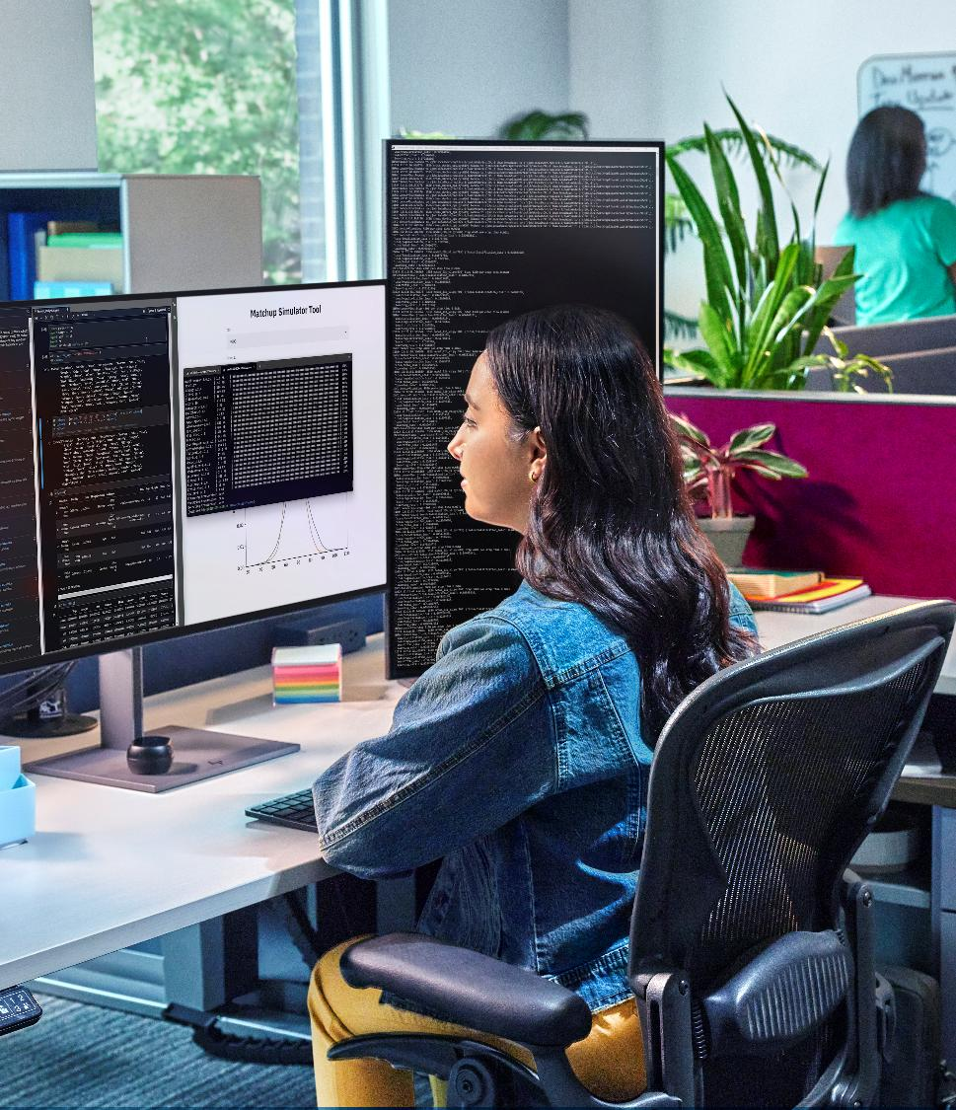
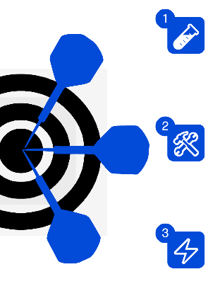


WIP – NOT FINAL
HP ZGX Nano G1n AI Station
Use cases
Core AI development use cases
Prototyping
Rapidly test new ideas and approaches.
Fine-tuning
Refine and customize AI models for business domain specific needs.
Inference
Delivering real-time value, from testing to business impact.
Domain/industry specific use cases
4
Data science
Leveraging data insights to inform strategic decisions
5
Edge applications
Robotics, Vision Language Models (VLMs), Computer Vision
Notes:
ZGX Nano supports rapid prototyping, fine-tuning, and real-time inference. It’s perfect for data science, robotics, vision language models, and computer vision across industries and domains.

Slide 4

WIP – NOT FINAL
Target users and market segments
Fast prototyping for enterprise developers
quickly build and test prototypes with local deployment, accelerating development cycles.
Students / academics / education labs / research labs
Gain hands-on experience with advanced AI tools for learning, research, and experimentation, no need for expensive cloud resources.
Cost-efficient startup iteration
Startups benefit from iterating their workflows without incurring costly cloud expenses, enabling sustainable growth.
Enthusiasts
Explore and experiment with AI models locally, making innovation accessible to anyone passionate about technology.

Slide 5
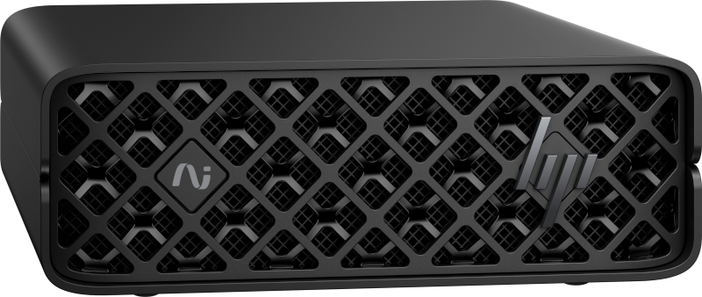
WIP – NOT FINAL
Unlock fast, cost-effective AI innovation at your desk
With HP ZGX Nano and the lightweight HP ZGX Toolkit, developers get to AI outcomes faster than ever, unlocking domain specific local AI for on-desk innovation.
Get started today, empower your team, accelerate results, and control costs.
Place your order now.

Slide 6
WIP – NOT FINAL
WIP – NOT FINAL
HP ZGX: empowering AI innovation without complexity or surprise costs.
Why choose HP ZGX Nano over other NVIDIA® DGXTM Spark-based solutions?
HP ZGX Nano delivers a complete AI solution developer-first oriented: advanced hardware + developer-focused ZGX Toolkit + HP’s broader AI portfolio for seamless, local AI development.
Worried about expensive NVIDIA AI Enterprise licenses?
No need for costly licenses HP ZGX supports open-source frameworks for flexible, cost-effective deployment.
Notes:
Objection handling slide

