Slide 1
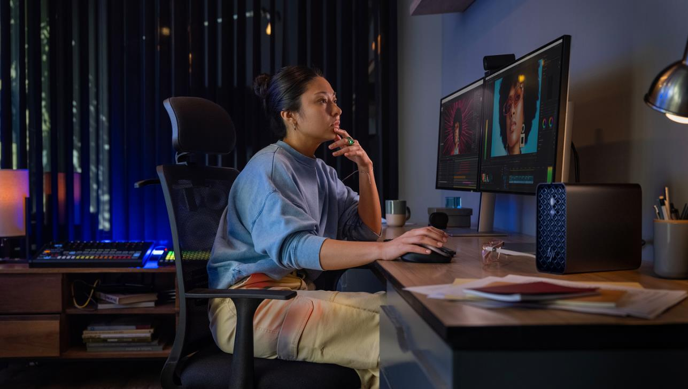

Introducing the all new
Z2 Mini G1a
Mini workstation. Transformative AI performance.
1 | Z2 Mini G1a | HP Confidential. For use by HP or Partner with Customers under HP CDA only.
Notes:
[TALK TRACK]
Thank you for joining us today, to introduce the NEW Z2 Mini G1a, just one example of how HP is working with OEMs like AMD to identify new ways to advance compute solutions, enabling our customers to lead with an innovation & vision first mindset. Helping them unlock new workflows and unleash their creative, through existing and new advanced AI workflows. With the productive power and efficiency desired for high compute workflows wrapped in a compact package.
This slide contains a superlative claim/s that cannot be used in all countries:
EMEA Use Restrictions:
DO NOT USE the superlative claim in the following countries:
Romania, Slovakia, Turkey, UAE, Russia, CIS countries (Armenia, Belarus, Kazakhstan, Kyrgyzstan, Moldova, Russia, Tajikistan, Turkmenistan, Ukraine, and Uzbekistan), Indonesia, Vietnam, Malaysia
APJ Use Restrictions:
China, Vietnam, Indonesia, Malaysia – DO NOT use
LAR Use Restrictions:
Brazil, Mexico – Do NOT use

Slide 2
Table of contents
Introducing The Z2 Mini G1a Mini Workstation
Product Highlights
Workflows | Who uses this device
Product Features
Gen to Gen Comparison
Product Experiences
Productivity Experiences
HP Services
Ecosystem Solutions
Security Experiences
Sustainability & Reliability
Portfolio
HP Z2 Mini G1a
Customer Presentation
2 | Z2 Mini G1a HP Confidential. For use by HP or Partner with Customers under HP CDA only.
Notes:
This slide contains a superlative claim/s that cannot be used in all countries:
EMEA Use Restrictions:
DO NOT USE the superlative claim in the following countries:
Romania, Slovakia, Turkey, UAE, Russia, CIS countries (Armenia, Belarus, Kazakhstan, Kyrgyzstan, Moldova, Russia, Tajikistan, Turkmenistan, Ukraine, and Uzbekistan), Indonesia, Vietnam, Malaysia
APJ Use Restrictions:
China, Vietnam, Indonesia, Malaysia – DO NOT use
LAR Use Restrictions:
Brazil, Mexico – Do NOT use
Disclaimer
4. Based on HP’s internal analysis of ISV certified mini workstations with <3L volume, at least 3 ISV certifications, configurable professional graphics and a dedicated workstation brand. Powerful based on processor, integrated graphics, memory, and power supply as of October 2024.

Slide 3
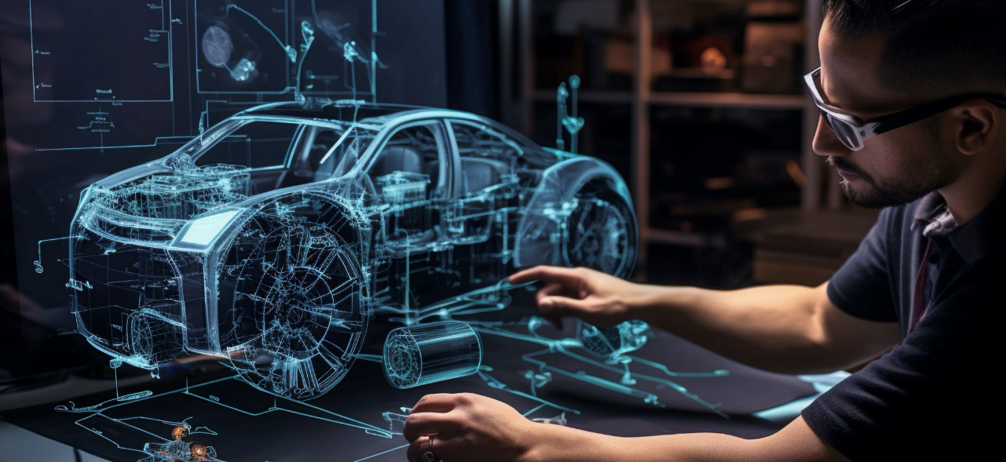


The future of high-performance workflows
Growing complexity in professional workflows is driving a need for more powerful compute.
But hybrid work requires smaller, more mobile devices.​
are delivering transformative new experiences
3 | Z2 Mini G1a | HP Confidential. For use by HP or Partner with Customers under HP CDA only.

Slide 4

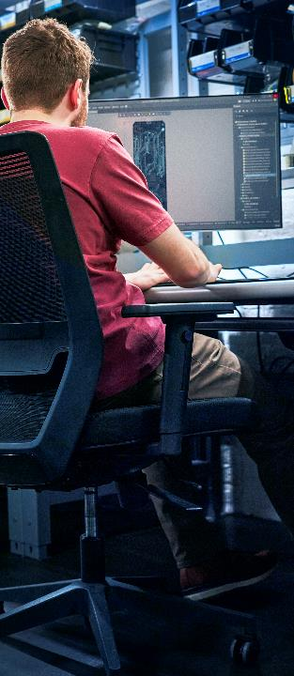
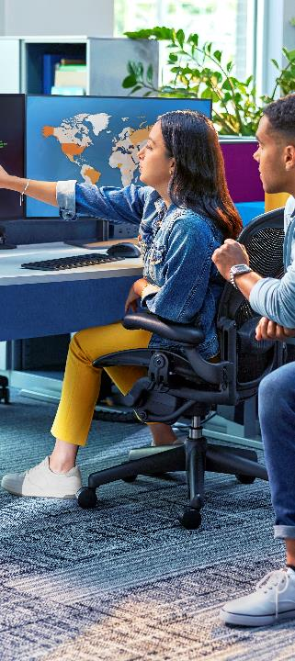
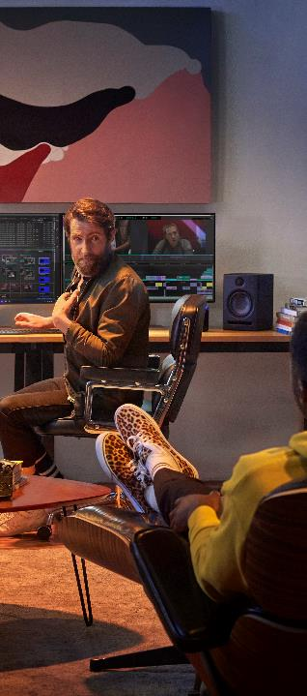
Unlock workflows previously not possible
on a mini workstation device
Visualize with Vectorworks & rapidly iterate on visual design concepts with Stable Diffusion
Simultaneously 3D model in SOLIDWORKS® and render in D5 Render
Work locally with large language models without memory bottlenecks
Simultaneously 3D model in Autodesk Maya and render in Arnold
New experience: Stable Diffusion XL
New experience: SOLIDWORKS® (4K) (>10M triangles)
New experience: Llama 2 70B
New experience: Open and run Autodesk Maya and Arnold at the same time
4 | Z2 Mini G1a | HP Confidential. For use by HP or Partner with Customers under HP CDA only.

Slide 5
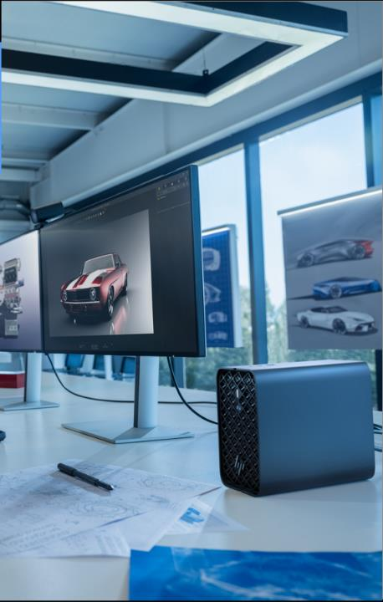
HP Z2 Mini G1a
Unlock workflows previously not possible
Take on complex AI accelerated projects—now on a mini workstation.
Simultaneously 3D design and render graphics-intensive projects or work locally with LLMs.
5 | Z2 Mini G1a HP Confidential. For use by HP or Partner with Customers under HP CDA only.
Notes:
ALL FPO IMAGES ARE VALID FOR USE TILL 11/30. NEW IMAGES ONCE READY WILL BE MADE AVAILABLE IN THE DECK -----------------------------------------------------------------------------------------------------------------------------------------
[TALK TRACK]
With the introduction of the Z2 Mini G1a, including the new Ryzen AI MAX PRO chipset architecture; with the chipset advancements from AMD, we saw an opportunity to design a new desktop mini workstation for this next generation of powerful workstation compute + AI completely from the grounds up.
It’s designed to unlock workflows previously not possible on a compact Mini desktop workstation, and now powered by AI
_________________________________
DISCLAIMERS
1. Multicore is designed to improve performance of certain software products. Not all customers or software applications will necessarily benefit from use of this technology. Performance and clock frequency will vary depending on application workload and your hardware and software configurations. AMD’s numbering, branding and/or naming is not a measurement of higher performance
2. Optional and must be purchased at time of order
3. AI applications that require an NPU may require software purchase, subscription or enablement by a software or platform provider, and third-party software may have specific configuration or compatibility requirements. Performance varies by use, configuration, and other factors.
8. The AMD Ryzen AI MAX unified memory architecture supports system configurations of up to 128GB system memory and allows memory to be flexibly assigned between the CPU and GPU. When 128GB memory is configured, up to 96GB unified memory can be used for Radeon graphics, leaving up to 32GB reserved for system memory.
9. Trillions of Operations per Second (TOPS) for an AMD Ryzen processor is the maximum number of operations per second that can be executed in an optimal scenario and may not be typical. TOPS may vary based on several factors, including the specific system configuration, AI model, and software version

Slide 6
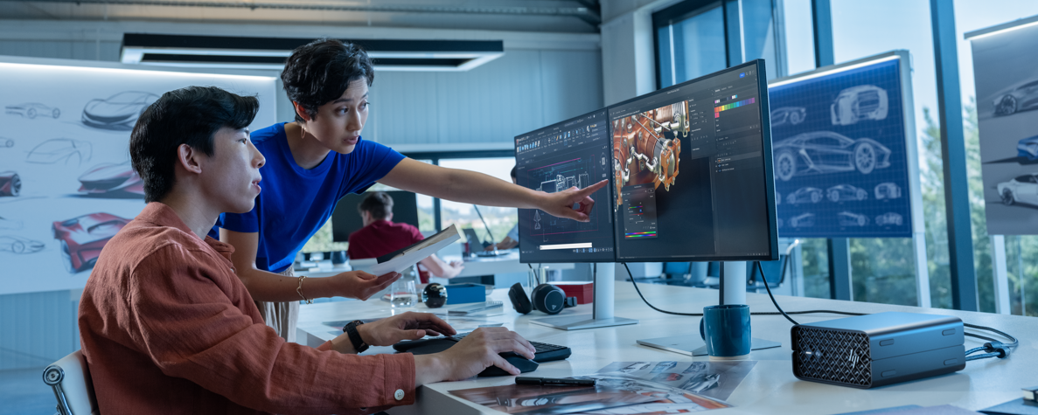

HP Z2 Mini G1a Mini Workstation
Product Highlights
6 | Z2 Mini G1a | HP Confidential. For use by HP or Partner with Customers under HP CDA only.

Slide 7
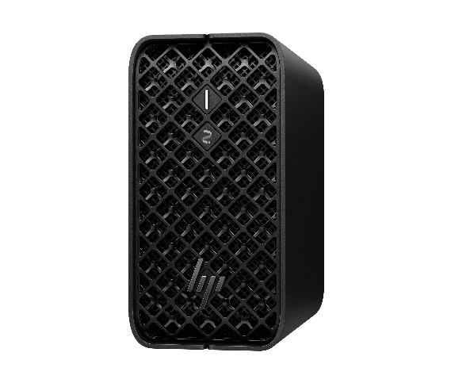

Introducing the all new Z2 Mini G1a
The World’s Most Powerful
Mini AI Workstation⁴
Cutting edge AMD Ryzen™ AI Max PRO¹ processor with up to 16 CPU cores, up to 128GB unified memory⁸ and the ability to assign up to 96GB RAM² to the GPU, handle graphics-heavy or AI-enhanced projects locally.⁶⁶
7 Z2 Mini G1a | HP Confidential. For use by HP or Partner with Customers under HP CDA only.
Notes:
[TALK TRACK]
Tackle new workflows on a mini workstation with AMD Ryzen™ AI Max PRO¹ processor, up to 16 CPU cores, 128GB unified memory and the ability to assign up to 96GB RAM to the GPU.
With this kind of power enables us to make the claim of “The World’s Most Powerful Mini Workstation”.
For workflows that demand more, the Z2 Mini G1a is equipping world-class, innovative companies to be AI future ready with up to 125 total-system TOPS.
This slide contains a superlative claim/s that cannot be used in all countries:
EMEA Use Restrictions:
DO NOT USE the superlative claim in the following countries:
Romania, Slovakia, Turkey, UAE, Russia, CIS countries (Armenia, Belarus, Kazakhstan, Kyrgyzstan, Moldova, Russia, Tajikistan, Turkmenistan, Ukraine, and Uzbekistan), Indonesia, Vietnam, Malaysia
APJ Use Restrictions:
China, Vietnam, Indonesia, Malaysia – DO NOT use LAR Use Restrictions:
Brazil, Mexico – Do NOT use
______________________________
DISCLAIMERS
Multicore is designed to improve performance of certain software products. Not all customers or software applications will necessarily benefit from use of this technology. Performance and clock frequency will vary depending on application workload and your hardware and software configurations. AMD’s numbering, branding and/or naming is not a measurement of higher performance. Features and software that require a NPU may require software purchase, subscription or enablement by a software or platform provider, and third-party software may have specific configuration or compatibility requirements. Performance varies by use, configuration, and other factors.
2. Optional and must be purchased at time of order
3. AI applications that require an NPU may require software purchase, subscription or enablement by a software or platform provider, and third-party software may have specific configuration or compatibility requirements. Performance varies by use, configuration, and other factors.
4. Based on HP’s internal analysis of ISV certified mini workstations with <3L volume, at least 3 ISV certifications, configurable professional graphics and a dedicated workstation brand. Powerful based on processor, integrated graphics, memory, and power supply as of October 2024.
3. AI applications that require an NPU may require software purchase, subscription or enablement by a software or platform provider, and third-party software may have specific configuration or compatibility requirements. Performance varies by use, configuration, and other factors.
8. The AMD Ryzen AI MAX unified memory architecture supports system configurations of up to 128GB system memory and allows memory to be flexibly assigned between the CPU and GPU. When 128GB memory is configured, up to 96GB unified memory can be used for Radeon graphics, leaving up to 32GB reserved for system memory
9. Trillions of Operations per Second (TOPS) for an AMD Ryzen processor is the maximum number of operations per second that can be executed in an optimal scenario and may not be typical. TOPS may vary based on several factors, including the specific system configuration, AI model, and software version.
66. AMD Ryzen AI Max PRO Total system TOPS is made up from a combination of NPU, GPU, and CPU TOPS.

Slide 8

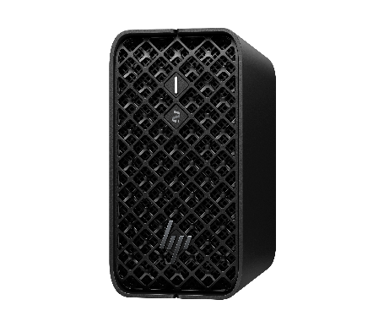


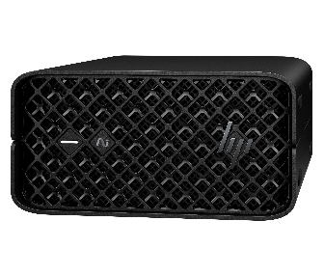



HP Z2 Mini G1a
World’s Most Powerful Mini AI Workstation⁴
AMD Ryzen™ AI MAX PRO processor¹ with scalable unified memory⁸ delivers up to 96GB graphics memory² for graphics intensive workflows
ISV certified¹¹ and supported for Z AI workstation compatibility with 125+ system-level TOPS⁶⁶ for AI accelerated workflows
High density rack⁶⁷ mount with 5 systems / 4U offering performance and security at an exceptional value
Create an ideal set-up with the compact Z2 Mini. Set it on a desk, mount it behind a monitor, or attach it under a desk.
Power to use AI locally¹⁰ with an AMD Ryzen™ AI MAX PRO processor¹ with up to 50 TOPS⁹ NPU³
8 | Z2 Mini G1a | HP Confidential. For use by HP or Partner with Customers under HP CDA only.
Notes:
[TALK TRACK]
Now, I’m excited to share with you product details for HP’s World’s most powerful Mini workstation
With an exciting new desktop Mini, comes exciting new power. The AMD Ryzen™ AI MAX PRO processor¹ with scalable unified memory delivers up to 96GB graphics memory⁸ for graphics intensive workflows and 50 TOPS NPU^{3,9} for local AI
For workstation class customers, ISV applications drive the need for more compute power, HP is dedicated to ensure this PC is ISV certified¹¹ and supported for Z AI workstation compatibility with up to 125 total-system TOPS⁶⁶ for AI accelerated workflows
With a new product design, and especially with a new chipset that takes less space and uses less power, Z2 Mini G1a is ideal for high density rack mounting that combines performance, manageability and security at an exceptional value.
_______________________________________
DISCLAIMERS
1. Multicore is designed to improve performance of certain software products. Not all customers or software applications will necessarily benefit from use of this technology. Performance and clock frequency will vary depending on application workload and your hardware and software configurations. AMD’s numbering, branding and/or naming is not a measurement of higher performance
2. Memory is an optional feature that must be purchased at time of order
3. AI applications that require an NPU may require software purchase, subscription or enablement by a software or platform provider, and third-party software may have specific configuration or compatibility requirements. Performance varies by use, configuration, and other factors.
4. Based on HP’s internal analysis of ISV certified mini workstations with <3L volume, at least 3 ISV certifications, configurable professional graphics and a dedicated workstation brand. Powerful based on processor, integrated graphics, memory, and power supply as of October 2024.
8. The AMD Ryzen AI MAX unified memory architecture supports system configurations of up to 128GB system memory and allows memory to be flexibly assigned between the CPU and GPU. When 128GB memory is configured, up to 96GB unified memory can be used for Radeon graphics, leaving up to 32GB reserved for system memory.
9. Trillions of Operations per Second (TOPS) for an AMD Ryzen processor is the maximum number of operations per second that can be executed in an optimal scenario and may not be typical. TOPS may vary based on several factors, including the specific system configuration, AI model, and software version.
10. Next Gen AI PC with 40 to 60 TOPS NPU to enable local AI processing.
11. Some software vendors do not test the exact combinations of the hardware listed here, but rather publish a minimum configuration specification they will support.​
13. Up to 128GB memory is an optional, configurable feature
66. AMD Ryzen AI Max PRO Total system TOPS is made up from a combination of NPU, GPU, and CPU TOPS.
67. Rack mounting hardware sold separately
FPO: For presentation only. Product may differ from images depicted.
This slide contains a superlative claim/s that cannot be used in all countries:
EMEA Use Restrictions:
DO NOT USE the superlative claim in the following countries:
Romania, Slovakia, Turkey, UAE, Russia, CIS countries (Armenia, Belarus, Kazakhstan, Kyrgyzstan, Moldova, Russia, Tajikistan, Turkmenistan, Ukraine, and Uzbekistan), Indonesia, Vietnam, Malaysia
APJ Use Restrictions:
China, Vietnam, Indonesia, Malaysia – DO NOT use LAR Use Restrictions:
Brazil, Mexico – Do NOT use

Slide 9

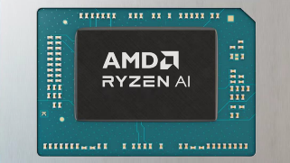




The power of unified memory
World’s highest memory capacity in a mini workstation⁶⁹
Up to
128GB
Total system memory¹³
Unified Memory Architecture⁸ (LDDR5) with assignable GPU memory
NEW scalable unified memory⁸, uses system memory to carve out up to 96GB graphics memory² unlocking new advanced workflows
Reserving up to 32GB system memory for normal system operations
Carve out up to 96GB graphics memory⁸ – 2x the memory available in the highest end discrete desktop cards
Integrated on a single chip
Up to
16
“Threadripper PRO class” CPU cores¹ (up to 112MB Cache)
Max
96GB
Memory can get allocated to the GPU⁸
Up to “Desktop Class”
40 CU
RDNATM 3.5 GPU
Up to
50 TOPS
Dedicated AI Engine (NPU) ^{3,9}
9 | Z2 Mini G1a HP Confidential. For use by HP or Partner with Customers under HP CDA only.
Notes:
GOAL OF SLIDE:
To educate customers on the new Ryzen AI MAX PRO architecture, integrating the NPU, CPU, and GPU on a single chipset. It’s redefining the possible in workflows requiring a solution for heavy graphics workflows including 3D designers and AI creators, This products unified memory is reshaping how they conquer the most daunting tasks.
[TALK TRACK]
With the introduction of the Z2 Mini G1a, including the new Ryzen AI MAX PRO chipset architecture;
With NEW scalable unified memory⁸, uses system memory to carve out up to 96GB graphics memory⁸ unlocking new advanced workflows
Reserving up to 32GB system memory¹³ for normal system operations
The up to 96GB unified graphics⁸ memory is equivalent to the memory in two NVIDIA RTX 6000 Ada desktop GPU memory and outperforms the highest end discrete graphics available
---------------------From previous slide---------------------------
This Ryzen technology integrates the CPU, GPU, and NPU on a single chip. Alongside, a higher system memory capacity.
Let’s start with what’s not on the chip.
Not on the chip:
RAM: For those who need more, you now have it! With up to 128GB LPDDR5 8000m/t series, lightening fast system memory. Powering you through your day and supporting AMD’s next generation graphics technology.
Now, what do we mean by single chip solution…? Let’s dive into the performance details.
On the chip:
CPU: The AI Max PRO chipset delivers up to 16 Desktop-class CPU Cores
NPU: To support local AI, it’s equipped with an NPU delivering up to 50 TOPS, making this a Next Gen AI PC and a CoPilot+ PC.
GPU: To enable advanced AI workflows, the Z2 Mini + Ryzen AI Max PRO is equipped with a new architecture called “unified memory”, that allows up to 96GB of the 128GB system memory to be assigned exclusively to the GPU.
More than 2x of the memory found in some current high-end graphics cards.
Enables you to work on larger engineering or creative projects or to explore the new possibilities of massively-sized AI models, like LLMs, locally.
_________________________
DISCLAIMERS 1. Multicore is designed to improve performance of certain software products. Not all customers or software applications will necessarily benefit from use of this technology. Performance and clock frequency will vary depending on application workload and your hardware and software configurations. AMD’s numbering, branding and/or naming is not a measurement of higher performance
2. Optional and must be purchased at time of order
3. AI applications that require an NPU may require software purchase, subscription or enablement by a software or platform provider, and third-party software may have specific configuration or compatibility requirements. Performance varies by use, configuration, and other factors.
8. The AMD Ryzen AI MAX unified memory architecture supports system configurations of up to 128GB system memory and allows memory to be flexibly assigned between the CPU and GPU. When 128GB memory is configured, up to 96GB unified memory can be used for Radeon graphics, leaving up to 32GB reserved for system memory.
9. Trillions of Operations per Second (TOPS) for an AMD Ryzen processor is the maximum number of operations per second that can be executed in an optimal scenario and may not be typical. TOPS may vary based on several factors, including the specific system configuration, AI model, and software version.
10. Next Gen AI PC with 40 to 60 TOPS NPU to enable local AI processing.
11. Some software vendors do not test the exact combinations of the hardware listed here, but rather publish a minimum configuration specification they will support.​
12. HP AI Companion is available preloaded on select HP next gen AI PCs or is available for download from the Microsoft store and requires a HP next gen AI PC with a NPU supporting 40-60 TOPS and requires Windows 11. Perform requires account set up within 30 days of PC boot. Some features require customer upload of local data. Five (5) library 100MB limit each and supports pdf, .txt., .docx files. HP may limit search prompts to 200 per calendar month.40. Requires Windows OS.
13. Up to 128GB memory is an optional, configurable feature
69. Based on HP’s internal analysis of ISV certified mini workstations with <3L volume, at least 3 ISV certifications, configurable professional graphics and a dedicated workstation brand. Based on the highest memory offered as of Oct 2024.

Slide 10
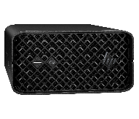
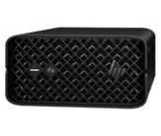
Product highlights
Performance through integration
Design
AMD Ryzen AI MAX PRO processor¹ delivers up to 16 core “Zen5” Threadripper PRO class performance with 120W TDP
Groundbreaking unified memory⁸ accesses up to 96GB graphics memory⁸ performance, to crush multiple graphic intensive workflows
Advanced AI workstation experiences
Up to 125 system level TOPS ^{9,10} for AI accelerated professional workflows⁶⁶
Next Gen AI PC 50 NPU TOPS ^{3,9,10} to run AI locally
Boost performance with up to 128 GB LPDDR5x 8000 MT/s ECC⁷⁰ lightning fast memory¹³
Small and sleek. Fits anywhere. Set it on a desk, mount it behind a monitor, attach it under a desk or fit it in a rack with support for 5 units in a 4U rack.⁶⁷
Integrated compute⁸ and power supply and provides consistent and stable power to high-demand components while completing tasks like 3D modeling, rendering or engineering simulations.
Unmatched performance-per-watt in a compact Mini form factor, delivering powerful efficiency with whisper-quiet operation
High-density rack⁶⁷ deployment The ultimate rack-based client solution offering performance, manageability, security, at an exceptional value
Z2 Mini G1a Desktop Workstation
Unlock workflows previously not possible on a mini workstation to take on complex AI accelerated work
Manageability & Solutions
Security
HP Remote System Controller for remote, out-of-band management to monitor and manage your workstation fleet from anywhere^{72,73}
Protected by HP Wolf Security¹⁴ for business creates an always-on, always acting, resilient defense.
Energy and resources conservation
Meet your sustainability goals with less energy usage with a low-powered NPU³, recycled metals, plastic, and packaging.
10 | Z2 Mini G1a | HP Confidential. For use by HP or Partner with Customers under HP CDA only.
Notes:
[TALK TRACK]
Product highlights for the Z2 Mini G1a desktop workstation, a Next Gen AI PC; a product delivering next-gen performance on a small and compact desktop workstation
Performance through integration: There’s a lot to talk about with the Z2 Mini G1a, but first and foremost is the technology built-in, and what it delivers.
AMD Ryzen AI Max PRO processor¹ delivers up to 16 cores Desktop-class performance with 120W TDP, enabling users to do more
Groundbreaking unified memory⁸ accesses up to 96GB graphics memory⁸ performance, to crush multiple graphic intensive workflows
Advanced AI workstation experiences
Up to 125 system-level TOPS for AI accelerated professional workflows⁶⁶
Next Gen AI PC up to 50 NPU TOPS^{3,9,10} to run AI locally (i.e. CoPilot+)
Boost performance with up to 128GB LPDDR5x 8000 MT/s¹³ lightening fast memory
Manageability
HP Remote system controller
Design: Going left to right, let’s jump over to the beautiful and thoughtful design elements built into the Z2 Mini G1a
Integrated compute and power supply
Unmatched performance per watt in a compact mini form factor
High Density Rack deployment
Security
Protected by HP Wolf Security for business¹⁴
Sustainability
Meet your sustainability goals with less energy usage with a low-powered NPU3, recycled metals, plastic, and packaging.
_______________________________ DISCLAIMERS
1. Multicore is designed to improve performance of certain software products. Not all customers or software applications will necessarily benefit from use of this technology. Performance and clock frequency will vary depending on application workload and your hardware and software configurations. AMD’s numbering, branding and/or naming is not a measurement of higher performance
2. Optional and must be purchased at time of order
3. AI applications that require an NPU may require software purchase, subscription or enablement by a software or platform provider, and third-party software may have specific configuration or compatibility requirements. Performance varies by use, configuration, and other factors.
8. The AMD Ryzen AI MAX unified memory architecture supports system configurations of up to 128GB system memory and allows memory to be flexibly assigned between the CPU and GPU. When 128GB memory is configured, up to 96GB unified memory can be used for Radeon graphics, leaving up to 32GB reserved for system memory.
9. Trillions of Operations per Second (TOPS) for an AMD Ryzen processor is the maximum number of operations per second that can be executed in an optimal scenario and may not be typical. TOPS may vary based on several factors, including the specific system configuration, AI model, and software version.
10. Next Gen AI PC with 40 to 60 TOPS NPU to enable local AI processing..​
13. Up to 128GB memory is an optional, configurable feature
14. HP Wolf Security for Business requires Windows 10 or 11 Pro and higher, includes various HP security features and is available on HP Pro, Elite, Workstation, and RPOS products. See product details for included security features.
16. For storage drives, GB = 1 billion bytes. Actual formatted capacity is less. Up to 30 GB (for Windows) is reserved for system recovery software
66. AMD Ryzen AI Max PRO Total system TOPS is made up from a combination of NPU, GPU, and CPU TOPS.
67. Rack mounting hardware sold separately
70. All memory configurations support ECC. ECC can be enabled or disabled via the F10 BIOS menu.
72. Internet access required.
73. Internet access required. Fleet management requires HP Remote System Management.

Slide 11
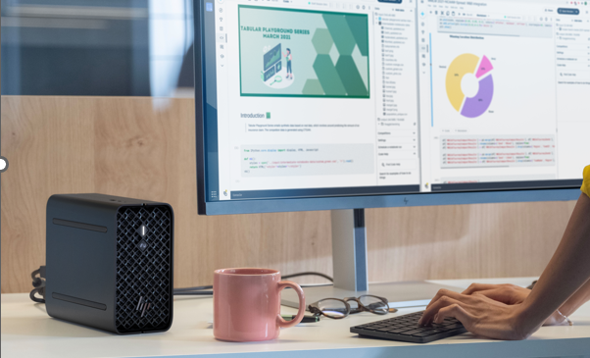
HP Z2 Mini G1a Mini Workstation
Who uses this device?
11 | Z2 Mini G1a | HP Confidential. For use by HP or Partner with Customers under HP CDA only.

Slide 12
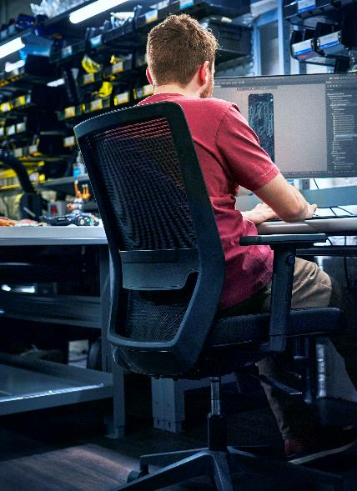




Product Designers
Product Development & Manufacturing (PD&M)
From 3D modeling and simulation to visualization and more, product designers need high-performance workstations for their increasingly demanding and complex workflows
Key pain points:
Performance issues during multi-software usage
Graphic intensive software performance lags
Inability to work comfortably when bulky high-performance PCs don’t easily fit in my workspace
Why Z2 Mini for product designers
Uncompromised Performance: With up to 96GB unified graphics memory,⁸ equivalent to the memory in two NVIDIA RTX™ 6000 Ada GPUs make this PC ideal for modeling and speeding up the rendering process for better interactivity
Accelerate Ray Tracing and Simulation : Fast multi-threaded performance with 16 desktop-class CPU cores¹ and 32 threads¹ to accelerate apps like SOLIDWORKS⁷⁷
Massive Memory: With up to 128GB RAM¹³ seamlessly work with large models and assemblies across applications—without having to wait while apps open and close
AI-ready: Up to 50 TOPS NPU^{3,9} and hyper efficient integrated GPU give creators the tools they need to take advantage of their software’s latest AI features
Workflows
New! Use Case: simultaneously 3D model in Revit and render in D5 Render
3D Design and Modelling, Visualization, Real time rendering, Simulation
Software⁷⁷
Dassault Systemes CATIA, SOLIDWORKS, SOLIDWORKS Visualize, AutoCAD, Inventor, Siemens NX, PTC Creo + Flow Analysis Extension, Fusion 360, SOLIDWORKS Simulation
12 | Z2 Mini G1a | HP Confidential. For use by HP or Partner with Customers under HP CDA only.
Notes:
GOAL OF SLIDE:
To educate customers, within the PD&M industry, why Z2 Mini is the ideal device for product designers
DISCLAIMERS
1. Multicore is designed to improve performance of certain software products. Not all customers or software applications will necessarily benefit from use of this technology. Performance and clock frequency will vary depending on application workload and your hardware and software configurations. AMD’s numbering, branding and/or naming is not a measurement of higher performance
3. AI applications that require an NPU may require software purchase, subscription or enablement by a software or platform provider, and third-party software may have specific configuration or compatibility requirements. Performance varies by use, configuration, and other factors.
8. The AMD Ryzen AI MAX unified memory architecture supports system configurations of up to 128GB system memory and allows memory to be flexibly assigned between the CPU and GPU. When 128GB memory is configured, up to 96GB unified memory can be used for Radeon graphics, leaving up to 32GB reserved for system memory.
9. Trillions of Operations per Second (TOPS) for an AMD Ryzen processor is the maximum number of operations per second that can be executed in an optimal scenario and may not be typical. TOPS may vary based on several factors, including the specific system configuration, AI model, and software version.
13. Up to 128GB memory is an optional, configurable feature
15. Actual battery Watt-hours (Wh) will vary from design capacity. Battery capacity will naturally decrease with shelf life, time, usage, environment, temperature, system configuration, loaded apps, features, power management settings and other factors.
16. For storage drives, GB = 1 billion bytes. Actual formatted capacity is less. Up to 30 GB (for Windows) is reserved for system recovery software
77. Third party software sold separately

Slide 13
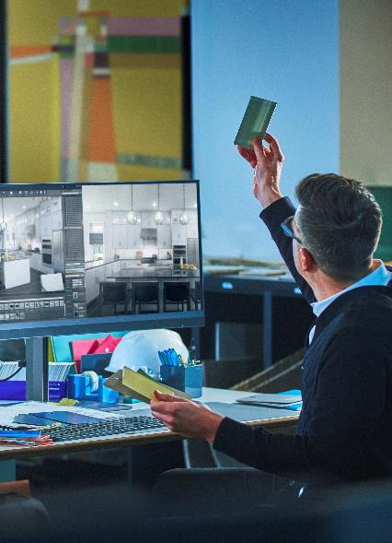
Design & Visualization Specialists
Architecture, Engineering & Construction (AEC)
Design and simulation can scale from the simple to the complex, and engineers need tools to enable their workflows up and down the complexity stack.
Key pain points:
Performance issues during multi-software usage
Graphic intensive software performance lags
Inability to work comfortably when bulky high-performance PCs don’t easily fit in my workspace
Why Z2 Mini G1a for design & visualization specialists
Multi-multi tasking: With up to 8TB of storage¹⁶ and 128GB RAM¹³ work simultaneously with different data types and multiple instances of apps
Full GPU solution: The new HP Z2 Mini G1a gives users the efficiency of an integrated⁸ GPU combined with GPU performance that beats even the most powerful discrete GPUs available today in similar form factors to mix and match 3D renders, 2D drawings, scanned data and point clouds in real time
Large 3D models on a compact device: With a revolutionary unified memory architecture,⁸ engineers can work on massive models that would previously have required a much larger workstation
Workflows
New! Use Case: visualize with Vectorworks & rapidly iterate on visual design concepts with Stable Diffusion
CAD Design/BIM, Plant Design & Analysis, Urban and Civil Planning, Construction Project Collaboration, Visualization
Software⁷⁷
Autodesk Revit, Navisworks, Bentley MicroStation, ALL Plan, AutoCAD, AutoCAD Civil, ESRI ArcGIS, Bluebeam Revu, Chaos V-Ray, Vectorworks, D5 Render, Twinmotion
13 | Z2 Mini G1a | HP Confidential. For use by HP or Partner with Customers under HP CDA only.
Notes:
GOAL OF SLIDE:
To educate customers, within the AEC industry, why Z2 Mini is the ideal device for design & visualization specialists
DISCLAIMERS
8. The AMD Ryzen AI MAX unified memory architecture supports system configurations of up to 128GB system memory and allows memory to be flexibly assigned between the CPU and GPU. When 128GB memory is configured, up to 96GB unified memory can be used for Radeon graphics, leaving up to 32GB reserved for system memory.
13. Up to 128GB memory is an optional, configurable feature
15. Actual battery Watt-hours (Wh) will vary from design capacity. Battery capacity will naturally decrease with shelf life, time, usage, environment, temperature, system configuration, loaded apps, features, power management settings and other factors.
16. For storage drives, GB = 1 billion bytes. Actual formatted capacity is less. Up to 30 GB (for Windows) is reserved for system recovery software
77. Third party software sold separately

Slide 14
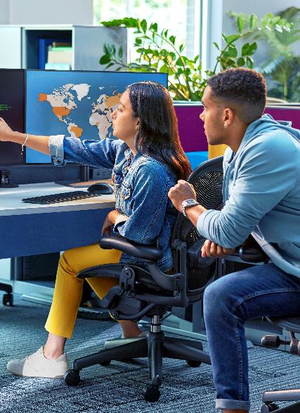
Data pros & developers
Software development (SW Dev)
Working with large language models requires not only advanced computational power, but also the ability to manage massive data sets for local AI inferencing
Key pain points:
Slow processing times for large data sets
Insufficient memory and processing power for running multiple dev tasks
Inability to work comfortably when bulky high-performance PCs don’t easily fit in my workspace
Why Z2 Mini G1a for data pros and developers
Large Models—Small Package: With unified memory architecture⁸ and next gen compute performance, developers can now run LLM software like Meta’s Llama 70B and Mistral AI’s Mixtral 8x7B on a mini workstation rather than a large tower
Cost Effective AI Performance: Unified memory architecture⁸ allows developers to work with models that would previously have required multiple high-end discrete graphics cards
Compatible with Z by HP Boost: access idle GPUs in workstations to accelerate AI development cycles⁷⁸
Workflows
NEW! Use Case: work locally with large language models
Write and test code, connect and work with databases, debug and optimize, build and deploy
Software⁷⁷
Meta Llama, Mistral AI, Open AI
Stable Diffusion
14 | Z2 Mini G1a | HP Confidential. For use by HP or Partner with Customers under HP CDA only.
Notes:
GOAL OF SLIDE:
To educate customers, within the software development industry, why Z2 Mini is the ideal device for data pros and developers
DISCLAIMERS
8. The AMD Ryzen AI MAX unified memory architecture supports system configurations of up to 128GB system memory and allows memory to be flexibly assigned between the CPU and GPU. When 128GB memory is configured, up to 96GB unified memory can be used for Radeon graphics, leaving up to 32GB reserved for system memory.
77. Third party software sold separately
78. Z by HP Boost requires client device with Windows 10 or Windows 11 OS and Vulkan Runtime for devices without a GPU, or Ubuntu 22.04 LT or greater, Debian 11 or greater with libatomic1 or libnuma1 packages installed. Host device for sharing GPU(s) must be a Z by HP workstation with NVIDIA professional grade workstation GPU(s) of Pascal architecture of later with an installed driver version 535 or greater, and a CUDA driver version 11.2 through 12.3, Windows 10 or Windows 11 OS, or Ubuntu 22.04 LT or greater or Debian 11 or greater with libatomic1, libnumal1, libvulkan1, libgl1, libgilb2.0-0 packages installed. Network connection required. Join waitlist to be considered for selection for early access.

Slide 15
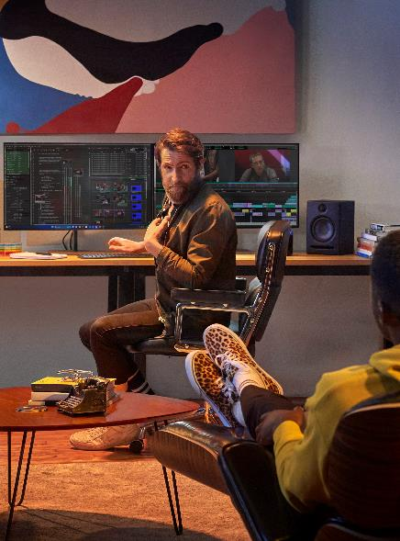
Video Editors
Media and Entertainment
Today, video editors are working in higher resolution, with more camera feeds, and mixed formats. They’re also taking on more of the workflow – creating assets themselves – and are accelerating their workflows with AI.
Key pain points:
Inadequate memory for working in high res or for using multiple apps simultaneously
Inability to work comfortably when bulky high-performance PCs don’t easily fit in my workspace
Why Z2 Mini G1a for video editors
Powerful compute: graphics hardware acceleration of popular codecs e.g. HEVC, H.264 and AV1, plus up to 16 desktop-class CPU cores¹ and 32 threads¹
Unified memory: with 128GB of unified memory across the chipset:
Data is not transferring between the CPU and GPU, making editing and effects faster.
Editors can run multiple apps simultaneously instead of having to open and close each app due to system memory constraints.
Editors can assign up to 96GB to graphics for complex effects and asset creation.
AI Workstation PC: Up to 50 TOPS NPU^{3,9} and hyper efficient integrated GPU give creators the tools they need to take advantage of their software’s latest AI features
Workflows
NEW! Use Case: asset creation, video editing and motion graphics all at once
Asset creation such as graphic elements, titles, and dynamic transitions
Video editing, compositing and application of effects
Software⁷⁷
Adobe Premiere Pro, Adobe After Effects, Frame.io, DaVinci Resolve, Avid Media Composer, Maxon Cinema 4D, Blender, Sora
15 | Z2 Mini G1a | HP Confidential. For use by HP or Partner with Customers under HP CDA only.
Notes:
GOAL OF SLIDE:
To educate customers, within the M&E industry, why Z2 Mini is the ideal devices for Video Editors
DISCLAIMERS
1. Multicore is designed to improve performance of certain software products. Not all customers or software applications will necessarily benefit from use of this technology. Performance and clock frequency will vary depending on application workload and your hardware and software configurations. AMD’s numbering, branding and/or naming is not a measurement of higher performance
2. Optional and must be configured at purchase
3. AI applications that require an NPU may require software purchase, subscription or enablement by a software or platform provider, and third-party software may have specific configuration or compatibility requirements. Performance varies by use, configuration, and other factors.
8. The AMD Ryzen AI MAX unified memory architecture supports system configurations of up to 128GB system memory and allows memory to be flexibly assigned between the CPU and GPU. When 128GB memory is configured, up to 96GB unified memory can be used for Radeon graphics, leaving up to 32GB reserved for system memory.
9. Trillions of Operations per Second (TOPS) for an AMD Ryzen processor is the maximum number of operations per second that can be executed in an optimal scenario and may not be typical. TOPS may vary based on several factors, including the specific system configuration, AI model, and software version.
13. Up to 128GB memory is an optional, configurable feature
16. For storage drives, GB = 1 billion bytes. Actual formatted capacity is less. Up to 30 GB (for Windows) is reserved for system recovery software
77. Third party software sold separately

Slide 16
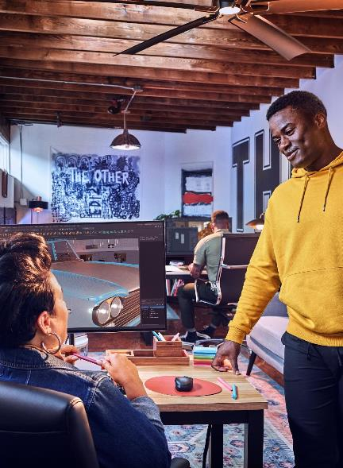
3D Artists & Animators
Media and Entertainment
Content creators are working with more complex models, higher resolution assets and real-time workflows – and are accelerating their workflows with AI. They’re also experimenting with Gen AI tools.
Key pain points:
Inadequate memory and graphics for a) high res rendering, b) large, complex models, and c) running multiple apps simultaneously, unless on a high-end desktop
Inability to work comfortably when bulky high-performance PCs don’t easily fit in my workspace
Why Z2 Mini G1a for 3D Artists & Animators
Powerful compute: up to 16 desktop-class CPU cores¹ and 32 threads¹ for modelling and mid-level graphics for rendering
Unified memory: with 128GB of unified memory across the chipset:
Data is not transferring between the CPU and GPU, making animations and effects faster.
Artists can run multiple apps simultaneously instead of having to open and close each app due to system memory constraints.
Artists can assign up to 96GB to graphics for complex asset creation and scenes.
AI Workstation PC: Up to 50 TOPS NPU^{3,9} and hyper efficient integrated GPU give creators the tools they need to take advantage of their software’s latest AI features
Workflows
NEW! Use Case: asset creation, animation and rendering all at once
3D modelling, rigging and texturing
Real-time ray tracing & lighting
Compositing & effects
Software⁷⁷
Adobe Photoshop, Illustrator & After Effects, Autodesk 3ds Max, Maya & Arnold, Maxon Cinema 4D & Redshift, DaVinci Resolve, Foundry Nuke, Unreal Engine, Runway, Midjourney, Dall E, Comfy UI, Wonder Dynamics
16 | Z2 Mini G1a | HP Confidential. For use by HP or Partner with Customers under HP CDA only.
Notes:
GOAL OF SLIDE:
To educate customers, within the M&E industry, why Z2 Mini is the ideal devices for 3D artists and animators
DISCLAIMERS
1. Multicore is designed to improve performance of certain software products. Not all customers or software applications will necessarily benefit from use of this technology. Performance and clock frequency will vary depending on application workload and your hardware and software configurations. AMD’s numbering, branding and/or naming is not a measurement of higher performance
2. Optional and must be configured at purchase
3. AI applications that require an NPU may require software purchase, subscription or enablement by a software or platform provider, and third-party software may have specific configuration or compatibility requirements. Performance varies by use, configuration, and other factors.
8. The AMD Ryzen AI MAX unified memory architecture supports system configurations of up to 128GB system memory and allows memory to be flexibly assigned between the CPU and GPU. When 128GB memory is configured, up to 96GB unified memory can be used for Radeon graphics, leaving up to 32GB reserved for system memory.
9. Trillions of Operations per Second (TOPS) for an AMD Ryzen processor is the maximum number of operations per second that can be executed in an optimal scenario and may not be typical. TOPS may vary based on several factors, including the specific system configuration, AI model, and software version.
13. Up to 128GB memory is an optional, configurable feature
16. For storage drives, GB = 1 billion bytes. Actual formatted capacity is less. Up to 30 GB (for Windows) is reserved for system recovery software
77. Third party software sold separately

Slide 17
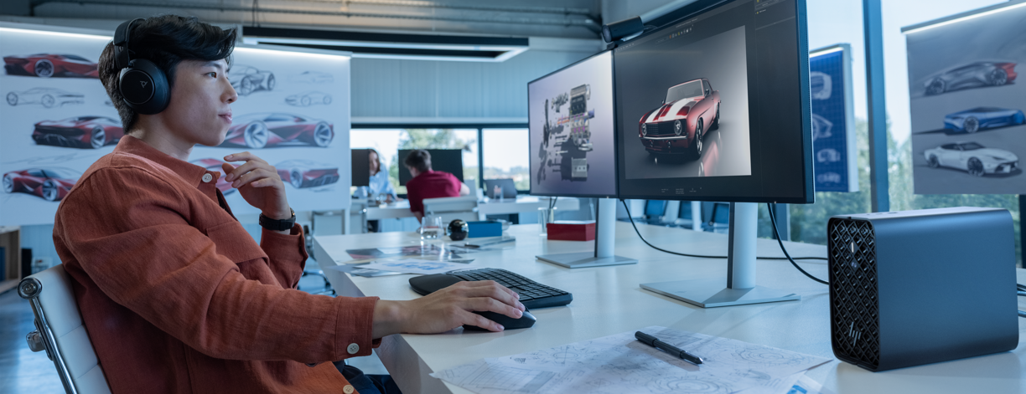
HP Z2 Mini G1a Desktop Workstation
Product features
17 | Z2 Mini G1a HP Confidential. For use by HP or Partner with Customers under HP CDA only.
HP Confidential. For HP and Partner use with Customers under HP CDA only.

Slide 18



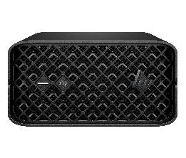









HP Z2 Mini G1a
Mini workstation.
Transformative AI performance.
Next level performance redefining possibilities.
Small and sleek.
Fits anywhere.
Supercharged AI PC mini workstation.
Tackle new workflows on a mini workstation with AMD Ryzen™ AI Max PRO¹ processor, up to 16 CPU cores, 128GB unified memory and the ability to assign up to 96GB RAM⁸ to the GPU.
Create an ideal set-up with the compact Z2 Mini. Set it on a desk, mount it behind a monitor, attach it under a desk or fit it in a rack with support for 5 units in a 4U rack.⁶⁷
Hardware AI accelerators power advanced workloads. Offload and run productivity tasks locally with up to 50 TOPS NPU^{3,9} while tackling new AI-enhanced workflows.
Tackle workflows previously not possible on a mini workstation
50 TOPS NPU^{3,9}
Unified memory architecture¹³
The world’s most sustainable PC portfolio²⁴ welcomes AI PCs.
Complete the ecosystem.
Up to
sustainably sourced outer- box packaging¹⁹
20%
recycled steel²⁰
100%
Poly Voyager Focus 2 USB-A Headset
HP 965 Ergonomic Wireless Keyboard
HP 925 Ergonomic Wireless Mouse
HP 965 4K Webcam
HP Series 7 Pro 31.5" 4K Thunderbolt 4 Monitor
HP E14 G4 Portable Monitor
18 | Z2 Mini G1a | HP Confidential. For use by HP or Partner with Customers under HP CDA only.
Notes:
This slide contains a superlative claim/s that cannot be used in all countries:
EMEA Use Restrictions:
DO NOT USE the superlative claim in the following countries:
Romania, Slovakia, Turkey, UAE, Russia, CIS countries (Armenia, Belarus, Kazakhstan, Kyrgyzstan, Moldova, Russia, Tajikistan, Turkmenistan, Ukraine, and Uzbekistan), Indonesia, Vietnam, Malaysia
APJ Use Restrictions:
China, Vietnam, Indonesia, Malaysia – DO NOT use
LAR Use Restrictions:
Brazil, Mexico – Do NOT use
________________
DISCLAIMERS
1. Multicore is designed to improve performance of certain software products. Not all customers or software applications will necessarily benefit from use of this technology. Performance and clock frequency will vary depending on application workload and your hardware and software configurations. AMD’s numbering, branding and/or naming is not a measurement of higher performance
3. AI applications that require an NPU may require software purchase, subscription or enablement by a software or platform provider, and third-party software may have specific configuration or compatibility requirements. Performance varies by use, configuration, and other factors.
6. On some devices, Copilot+ PC experiences require free updates available starting later this year and continuing into 2025. Timing varies by device and region. See aka.ms/copilotpluspcs
8. The AMD Ryzen AI MAX unified memory architecture supports system configurations of up to 128GB system memory and allows memory to be flexibly assigned between the CPU and GPU. When 128GB memory is configured, up to 96GB unified memory can be used for Radeon graphics, leaving up to 32GB reserved for system memory.
9. Trillions of Operations per Second (TOPS) for an AMD Ryzen processor is the maximum number of operations per second that can be executed in an optimal scenario and may not be typical. TOPS may vary based on several factors, including the specific system configuration, AI model, and software version.
13. Up to 128GB memory is an optional, configurable feature
16. For storage drives, GB = 1 billion bytes. Actual formatted capacity is less. Up to 30 GB (for Windows) is reserved for system recovery software
18. Battery life will vary depending on the product model, configuration, loaded applications, features, use, wireless functionality and power management settings. The maximum capacity of the battery will naturally decrease with time and usage. See MobileMark25 battery benchmark https://bapco.com/products/mobilemark-2018/https://bapco.com/products/mobilemark-25/ for additional details
19. 100% outer box packaging made from sustainably sourced certified and recycled fibers. Fiber cushions made from 100% recycled wood fiber and organic material. Any plastic cushions are made from >90% recycled plastic.
20. Recycled metal is expressed as a percentage of the total weight of the metal according to ISO 14021 definitions for metal parts over 25 grams. Percent of recycled material varies by product.
24. Applies to HP PCs, Workstations, and Displays manufactured after January 2019. Based on most Gold and Silver (including Climate+) EPEAT® registrations and according to IEEE 1680.1-2018 EPEAT®. Status varies by country. Visit www.epeat.net for more information.
66. AMD Ryzen AI Max PRO Total system TOPS is made up from a combination of NPU, GPU, and CPU TOPS.
67. Rack mounting hardware sold separately

Slide 19












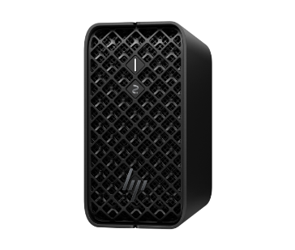
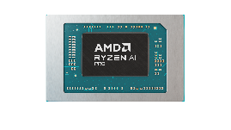
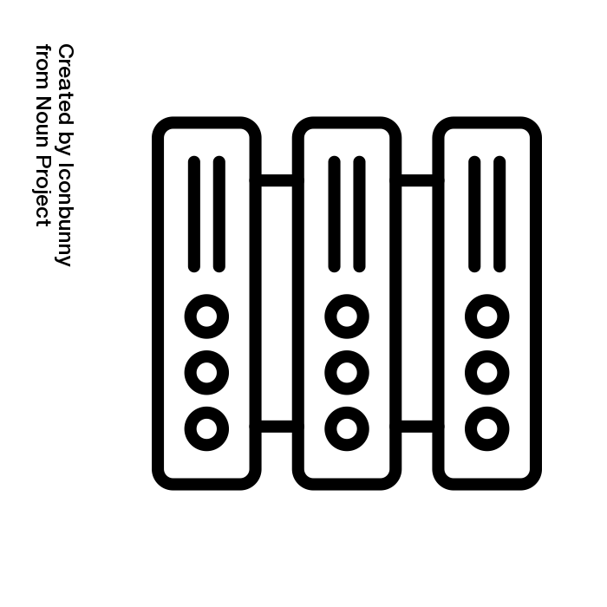


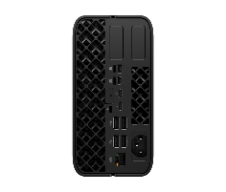



HP Z2 Mini G1a: Mini workstation.​Transformative AI performance.
Next level performance
Boost performance, save space, and maximize efficiency
Integrated AMD Radeon Graphics
Up to 96GB dedicated graphics memory⁴
NEW
NEW
Integrated on a single chip
HP Z2 Mini G1a
New AMD Ryzen AI MAX PRO¹
A world of opportunities
NEW
More powerful, smaller footprint.
Rack deployment
Compact
Ultra-fast RAM
NEW
NEW
RYZEN AI MAX PRO 380/385/390/395
Customized Connections
AI Enhanced CPU
Neural Processing Unit (NPU)³ for real-time AI enhancements without sacrificing CPU resources
2x Flex IO
2x Mini DP
Easy-access latch
2x USB2-A
2x USB3-A 10Gbps
USB4-C 40Gbps
1x 2.5GbE AMT
USB-C 10Gb/alt DP
mode​
USB-A 10Gb​​
TBT4
AI
NEW
Wi-Fi 7⁹
Bluetooth5.4
2.5GbE –
AMT & DASH
connectivity
NEW
Network
19 | HP Z2 Mini G1a | HP Confidential. For use by HP or Partner with Customers under HP CDA only.
Notes:
DISCLAIMERS:
. Multicore is designed to improve performance of certain software products. Not all customers or software applications will necessarily benefit from use of this technology. Performance and clock frequency will vary depending on application workload and your hardware and software configurations. AMD numbering, branding and/or naming is not a measurement of higher performance. Features and software that require a NPU may require software purchase, subscription or enablement by a software or platform provider, and third-party software may have specific configuration or compatibility requirements. Performance varies by use, configuration, and other factors.
2. Optional feature that must be configured at purchase
3. AI applications that require an NPU may require software purchase, subscription or enablement by a software or platform provider, and third-party software may have specific configuration or compatibility requirements. Performance varies by use, configuration, and other factors.
4. The AMD Ryzen AI MAX unified memory architecture supports system configurations of up to 128GB system memory and allows memory to be flexibly assigned between the CPU and GPU. When 128GB memory is configured, up to 96GB unified memory can be used for Radeon graphics, leaving up to 32GB reserved for system memory.
5. Actual battery Watt-hours (Wh) will vary from design capacity. Battery capacity will naturally decrease with shelf life, time, usage, environment, temperature, system configuration, loaded apps, features, power management settings and other factors.​
6. Battery life will vary depending on the product model, configuration, loaded applications, features, use, wireless functionality and power management settings. The maximum capacity of the battery will naturally decrease with time and usage. See MobileMark25 battery benchmark https://bapco.com/products/mobilemark-2018/https://bapco.com/products/mobilemark-25/ for additional details
7. Up to 128GB memory is an optional, configurable feature. ​
8. Microsoft Copilot requires Windows 11. Some features require an NPU. Timing of feature delivery and availability varies by market and device. Requires Microsoft account to log in. Where the Copilot app is not available, the Copilot key will lead to the Bing search engine. Not available in all countries or regions Learn more. Some features of Copilot may require a paid subscription from Microsoft.
9. Wireless access point and Internet service required and sold separately. Availability of public wireless access points limited. Wi-Fi 7 (802.11BE) functionality requires Windows 11 24H2, select Intel® processor, and a Wi-Fi 7 router, sold separately. Wi-Fi 7 is backwards compatible with prior 802.11 specs. Available in countries where Wi-Fi 7 is supported. The specification for 802.11BE is a draft specification and is not final. If the final specification differs from the draft specification, it may affect the ability of the device to communicate with other 802.11BE devices.
10. Trillions of Operations per Second (TOPS) for an AMD Ryzen processor is the maximum number of operations per second that can be executed in an optimal scenario and may not be typical. TOPS may vary based on several factors, including the specific system configuration, AI model, and software version.
11. Rack mounting hardware sold separately

Slide 20




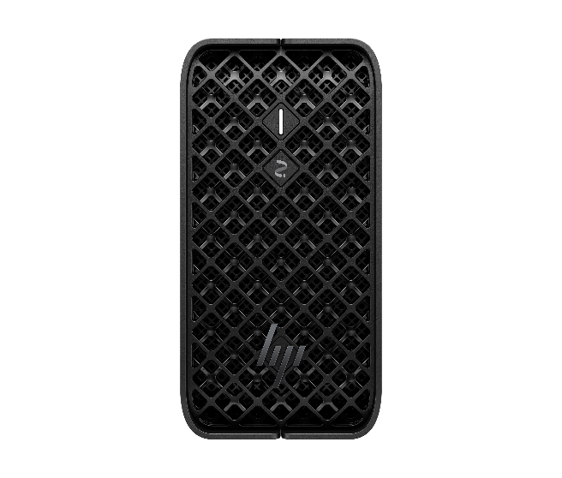






Z2 Mini G1a Desktop Mini
RTP Apr 14 ‘25
Next gen AMD®Ryzen^{(TM)} AI MAX PRO processor¹, up to 96GB GPU memory⁸ and up to 50 TOPS⁹ NPU³
Up to 128GB LPDDDR5x 8000 MT/s ultra fast RAM
Rack⁶⁷ deployment with density <1U
Protected by HP Wolf Security¹⁴
Windows 11, Ubuntu preinstall, RHEL certified¹⁷
Cutting edge performance to accelerate workflows
AMD Ryzen® AI MAX PRO 300 series¹ integrated CPU & GPU on a single chip delivers up to 96GB unified graphics memory⁸, equivalent to two NVIDIA RTX 6000 Ada desktop GPU cards making the Z2 Mini G1a ideal for 3D modeling and manipulating renders
Ultra performance for agile, advanced AI workflows
The compact and powerful Z2 G1a Mini Workstation delivers up to 125 system TOPS⁶⁶ making it ideal for product designers, developers and data professionals and is designed with ultra fast 128GB LPDDRx 8000 MT/s memory¹³ to quickly power through complex workflows simultaneously.
Designed for advanced workflows
Pro ISV¹¹ applications are the foundation for workflows requiring workstation grade performance, HP partners with ISVs¹¹ early in the development cycle to perform the right level of testing and ensure every HP Z2 Mini G1a is certified to deliver optimal performance and high-quality user experience.
Small and sleek. Fits anywhere
Create an ideal set-up with the compact Z2 Mini. Set it on a desk, mount it behind a monitor, or attach it under a desk. With an internal power supply, this PC cleanly fits in a rack, and its small size allows for 5 units across a 4U rack.⁶⁷
Help protect our shared future
Responsibly crafted with 100% recycled rare earth elements in speaker magnet, up to 20% recycled steel, 60% recycled plastics, and 100% sustainable materials on the packaging ^{19,20,23,24}.
Built for today’s IT security & manageability needs Experience peace of mind with HP's advanced security suite, offering unparalleled resilience against external attacks and future cyber threats, including those from evolving quantum cryptography¹⁴
20 | Z2 Mini G1a HP Confidential. For use by HP or Partner with Customers under HP CDA only.
Notes:
Cutting edge performance to accelerate workflows
AMD Ryzen® AI Max_ PRO 300 series system on a chip enables combines CPU, GPU, and NPU for up to XX% better performance per watt vs discrete graphics for professional app experiences previously not possible on a mobile workstation, without slowdowns
Working with AMD’s NPU, the Ultra’s next-level integrated graphics performance with groundbreaking unified memory architecture accesses CPU/GPU data simultaneously on up to 64GB capacity LPDDR5x-8000MT/s RAM reducing latency for 14% faster gen AI response and faster image processing in near real-time
Run SOLIDWORKS (4K) >10M triangles (24GB graphics memory)
Run SOLIDWORKS Visualize (16GB graphics memory)
Ultra performance for agile, advanced workflows
Compact and powerful and ideal for product designers, developers and data pros to breeze through complex workflows simultaneously.
Advanced AI experiences
Microsoft certified AI capable PC to run next-gen AI locally, with Copilot+, Windows 11, and up to 50 TOPS NPU.
Slim and sleek. Fits anywhere
Set it on a desk, mount it behind a monitor, attach it under a desk, or fit it cleanly in a rack.
Part of the world’s most sustainable PC portfolio*
EPEAT Gold with Climate+ meets the most demanding set of criteria for sustainability leadership in electronics with outstanding accomplishments in 100% rare earth metals in speaker magnet as well as recycled steel and recycled plastics.
Protected by HP Wolf Security
HP Wolf Security for Business creates a hardware-enforced, always-on, resilient defense. From the BIOS to the browser, above, in, and below the OS, these constantly evolving solutions help protect your PC from modern threats.⁵
__________________ DISCLAIMERS
1. Multicore is designed to improve performance of certain software products. Not all customers or software applications will necessarily benefit from use of this technology. Performance and clock frequency will vary depending on application workload and your hardware and software configurations. AMD’s numbering, branding and/or naming is not a measurement of higher performance
2. Optional and must be purchased at time of order
3. AI applications that require an NPU may require software purchase, subscription or enablement by a software or platform provider, and third-party software may have specific configuration or compatibility requirements. Performance varies by use, configuration, and other factors.
8. The AMD Ryzen AI MAX unified memory architecture supports system configurations of up to 128GB system memory and allows memory to be flexibly assigned between the CPU and GPU. When 128GB memory is configured, up to 96GB unified memory can be used for Radeon graphics, leaving up to 32GB reserved for system memory.
9. Trillions of Operations per Second (TOPS) for an AMD Ryzen processor is the maximum number of operations per second that can be executed in an optimal scenario and may not be typical. TOPS may vary based on several factors, including the specific system configuration, AI model, and software version.
10. Next Gen AI PC with 40 to 60 TOPS NPU to enable local AI processing.
11. Some software vendors do not test the exact combinations of the hardware listed here, but rather publish a minimum configuration specification they will support.​
12. HP AI Companion is available preloaded on select HP next gen AI PCs or is available for download from the Microsoft store and requires a HP next gen AI PC with a NPU supporting 40-60 TOPS and requires Windows 11. Perform requires account set up within 30 days of PC boot. Some features require customer upload of local data. Five (5) library 100MB limit each and supports pdf, .txt., .docx files. HP may limit search prompts to 200 per calendar month.40. Requires Windows OS.
13. Up to 128GB memory is an optional, configurable feature
14. HP Wolf Security for Business requires Windows 10 or 11 Pro and higher, includes various HP security features and is available on HP Pro, Elite, Workstation, and RPOS products. See product details for included security features.
16. For storage drives, GB = 1 billion bytes. Actual formatted capacity is less. Up to 30 GB (for Windows) is reserved for system recovery software
19. 100% outer box packaging made from sustainably sourced certified and recycled fibers. Fiber cushions made from 100% recycled wood fiber and organic material. Any plastic cushions are made from >90% recycled plastic.
20. Recycled metal is expressed as a percentage of the total weight of the metal according to ISO 14021 definitions for metal parts over 25 grams. Percent of recycled material varies by product.
43. Based on US EPEAT® registration according to IEEE 1680.1-2018 EPEAT®. EPEAT® status varies by country. Visit www.epeat.net for more information.
21. Percentage of ocean-bound plastic contained in each component varies by product. Ocean Bound plastic is expressed as a percentage of the total weight plastic. Ocean Bound plastic is based on the definition set by the UL2809 standard.
23. Applies to HP PCs, Workstations, and Displays manufactured after January 2019. Based on most Gold and Silver (including Climate+) EPEAT® registrations and according to IEEE 1680.1-2018 EPEAT®. Status varies by country. Visit www.epeat.net for more information.
24. Recycled plastic is expressed as a percentage of the total weight plastic. Post-consumer recycled is based on the definition set in the EPEAT standard for computers, IEEE 1680.1-2018 standard. Percent of recycled material varies by product.
25. Wireless access point and Internet service required and sold separately. Availability of public wireless access points limited. Wi-Fi 7 (802.11BE) functionality requires compatible Windows 11 OS, compatible processor, and separately purchased Wi-Fi 7 router to support backwards compatibility with prior 802.11 specs. Available in countries where Wi-Fi 7 is supported. The specification for 802.11BE is a draft specification and is not final. If the final specification differs from the draft specification, it may affect the ability of the device to communicate with other 802.11BE devices.
67. Rack mounting hardware sold separately
This slide contains a superlative claim/s that cannot be used in all countries:
EMEA Use Restrictions:
DO NOT USE the superlative claim in the following countries:
Romania, Slovakia, Turkey, UAE, Russia, CIS countries (Armenia, Belarus, Kazakhstan, Kyrgyzstan, Moldova, Russia, Tajikistan, Turkmenistan, Ukraine, and Uzbekistan), Indonesia, Vietnam, Malaysia
APJ Use Restrictions:
China, Vietnam, Indonesia, Malaysia – DO NOT use
LAR Use Restrictions:
Brazil, Mexico – Do NOT use
HP EMEA Region
France – Yes, but must publish substantiation report, translated if required locally; should have local country url leading to the posted report added to the disclaimer;
Rest of EU countries – Yes. No report required to be posted. Do not post substantiation reports.
Netherlands, Serbia, Switzerland, Israel, MEMA- Yes; no reports required to be published; MEMA countries: Yes, may use claims with caution.
Do NOT publish substantiation reports containing competitor names in MEMA countries; Romania, CIS Countries, Turkmenistan, Russia, Turkey, UAE, Saudi Arabia-No
_________________________
Disclaimers

Slide 21


Product walkaround
Weight²⁶
2.4 kg
5.29 lbs
Dimensions
8.55 cm (H) x 16.8 cm (W) x 20.0 cm (D) 3.4 in (H) x 6.6 in (W) x 7.9 in (D)
HP Z2 G1a Mini
Stellar power and performance with AI PC, ^{3,9,10} AMD® Ryzen™ AI MAX PRO processor¹ and integrated graphics with 50 TOPS NPU^{3,9,}
Game-changing power efficiency enabled by 4nm technology that delivers more effective energy use while minimizing heat dissipation and fan noise.
Configuration Options
AMD Ryzen™ AI MAX+ PRO 395 with AMD Radeon Graphics (3.0 GHz base clock, up to 5.10 GHz max boost clock, 64MB L3 cache, 16 cores, 32 threads)
AMD Ryzen™ AI MAX PRO 390 with AMD Radeon Graphics (5.00 GHz base clock, up to 5.00 GHz max boost clock, 64MB L3 cache, 12 cores, 24 threads)
AMD Ryzen™ AI MAX PRO 385 with AMD Radeon Graphics (3.60 GHz base clock, up to 5.00 GHz max boost clock, 32MB L3 cache, 8 cores, 16 threads)
AMD Ryzen™ AI MAX PRO 380 with AMD Radeon Graphics (3.60 GHz base clock, up to 4.90 GHz max boost clock, 16MB L3 cache, 6 cores, 12 threads)
Lattice design to enable airflow intake with cooling of product with mesh design
High speed memory for near real-time responsiveness
Up to 8000 MT/s, up to 128 GB¹³
Storage¹⁶ for performance users
Up to 8TB (2x4TB NVMe modules) PCIe Gen4 speed. *
Responsibly crafted with 100% recycled rare earth elements in speaker magnet, up to 20% recycled steel, 60% recycled plastics, and 100% sustainable materials on the packaging. ^{19,20,23,24}
Rack Solution
High density rack mount with support for 5 minis in a 4U⁶⁷ rack, now without external power bricks
Manageability
HP Remote System Controller^{72,73}
Compact design
Small and sleek. Fits anywhere.
Connectivity Upgrade Wi-Fi 7⁷¹, Bluetooth 5.4 and internal antenna provides lightning-fast connectivity.
Stay protected with HP Wolf Security¹⁴
21 | Z2 Mini G1a HP Confidential. For use by HP or Partner with Customers under HP CDA only.
Notes:
_____________________________________
DISCLAIMERS
1. Multicore is designed to improve performance of certain software products. Not all customers or software applications will necessarily benefit from use of this technology. Performance and clock frequency will vary depending on application workload and your hardware and software configurations. AMD’s numbering, branding and/or naming is not a measurement of higher performance
2. Optional and must be purchased at time of order
3. AI applications that require an NPU may require software purchase, subscription or enablement by a software or platform provider, and third-party software may have specific configuration or compatibility requirements. Performance varies by use, configuration, and other factors.
8. The AMD Ryzen AI MAX unified memory architecture supports system configurations of up to 128GB system memory and allows memory to be flexibly assigned between the CPU and GPU. When 128GB memory is configured, up to 96GB unified memory can be used for Radeon graphics, leaving up to 32GB reserved for system memory.
9. Trillions of Operations per Second (TOPS) for an AMD Ryzen processor is the maximum number of operations per second that can be executed in an optimal scenario and may not be typical. TOPS may vary based on several factors, including the specific system configuration, AI model, and software version.
10. Next Gen AI PC with 40 to 60 TOPS NPU to enable local AI processing.
11. Some software vendors do not test the exact combinations of the hardware listed here, but rather publish a minimum configuration specification they will support.​
12. HP AI Companion is available preloaded on select HP next gen AI PCs or is available for download from the Microsoft store and requires a HP next gen AI PC with a NPU supporting 40-60 TOPS and requires Windows 11. Perform requires account set up within 30 days of PC boot. Some features require customer upload of local data. Five (5) library 100MB limit each and supports pdf, .txt., .docx files. HP may limit search prompts to 200 per calendar month.40. Requires Windows OS.
13. Up to 128GB memory is an optional, configurable feature
14. HP Wolf Security for Business requires Windows 10 or 11 Pro and higher, includes various HP security features and is available on HP Pro, Elite, Workstation, and RPOS products. See product details for included security features.
16. For storage drives, GB = 1 billion bytes. Actual formatted capacity is less. Up to 30 GB (for Windows) is reserved for system recovery software
19. 100% outer box packaging made from sustainably sourced certified and recycled fibers. Fiber cushions made from 100% recycled wood fiber and organic material. Any plastic cushions are made from >90% recycled plastic.
20. Recycled metal is expressed as a percentage of the total weight of the metal according to ISO 14021 definitions for metal parts over 25 grams. Percent of recycled material varies by product.
43. Based on US EPEAT® registration according to IEEE 1680.1-2018 EPEAT®. EPEAT® status varies by country. Visit www.epeat.net for more information.
21. Percentage of ocean-bound plastic contained in each component varies by product. Ocean Bound plastic is expressed as a percentage of the total weight plastic. Ocean Bound plastic is based on the definition set by the UL2809 standard.
23. Applies to HP PCs, Workstations, and Displays manufactured after January 2019. Based on most Gold and Silver (including Climate+) EPEAT® registrations and according to IEEE 1680.1-2018 EPEAT®. Status varies by country. Visit www.epeat.net for more information.
24. Recycled plastic is expressed as a percentage of the total weight plastic. Post-consumer recycled is based on the definition set in the EPEAT standard for computers, IEEE 1680.1-2018 standard. Percent of recycled material varies by product.
25. Wireless access point and Internet service required and sold separately. Availability of public wireless access points limited. Wi-Fi 7 (802.11BE) functionality requires compatible Windows 11 OS, compatible processor, and separately purchased Wi-Fi 7 router to support backwards compatibility with prior 802.11 specs. Available in countries where Wi-Fi 7 is supported. The specification for 802.11BE is a draft specification and is not final. If the final specification differs from the draft specification, it may affect the ability of the device to communicate with other 802.11BE devices.
26. Actual weight will vary by configuration.
27. Requires the myHP application and Windows OS.
66. AMD Ryzen AI Max PRO Total system TOPS is made up from a combination of NPU, GPU, and CPU TOPS.
67. Rack mounting hardware sold seperately
70. All memory configurations support ECC. ECC can be enabled or disabled via the F10 BIOS menu.
71. Wireless access point and Internet service required and sold separately. Availability of public wireless access points limited. Wi-Fi 7 (802.11BE) functionality requires compatible Windows 11 OS, compatible processor, and separately purchased Wi-Fi 7 router to support backwards compatibility with prior 802.11 specs. Available in countries where Wi-Fi 7 is supported. The specification for 802.11BE is a draft specification and is not final. If the final specification differs from the draft specification, it may affect the ability of the device to communicate with other 802.11BE devices.
72. Internet access required.
73. Internet access required. Fleet management requires HP Remote System Management.
.
This slide contains a superlative claim/s that cannot be used in all countries:
EMEA Use Restrictions:
DO NOT USE the superlative claim in the following countries:
Romania, Slovakia, Turkey, UAE, Russia, CIS countries (Armenia, Belarus, Kazakhstan, Kyrgyzstan, Moldova, Russia, Tajikistan, Turkmenistan, Ukraine, and Uzbekistan), Indonesia, Vietnam, Malaysia
APJ Use Restrictions:
China, Vietnam, Indonesia, Malaysia – DO NOT use
LAR Use Restrictions:
Brazil, Mexico – Do NOT use
HP EMEA Region
France – Yes, but must publish substantiation report, translated if required locally; should have local country url leading to the posted report added to the disclaimer;
Rest of EU countries – Yes. No report required to be posted. Do not post substantiation reports.
Netherlands, Serbia, Switzerland, Israel, MEMA- Yes; no reports required to be published; MEMA countries: Yes, may use claims with caution.
Do NOT publish substantiation reports containing competitor names in MEMA countries; Romania, CIS Countries, Turkmenistan, Russia, Turkey, UAE, Saudi Arabia-No

Slide 22

Default Dedicate VRAM (Frame Buffer) Size
Physical Memory
System Memory
Shared Memory
F10 Options
Processor
OPN1 | 128GB | 32GB | 96GB | 48GB | 96GB, 64GB, 32GB, 16GB, 8GB, 4GB, 0.5GB
OPN1, OPN2 | 64GB | 16GB | 48GB | 24GB | 48GB, 32GB, 16GB, 8GB, 4GB, 0.5GB
OPN3 | 64GB | 16GB | 48GB | 24GB | 48GB, 32GB, 16GB, 8GB, 4GB, 0.5GB
OPN 1, OPN2 | 32GB | 8GB | 24GB | 12GB | 24GB, 16GB, 8GB, 4GB, 0.5GB
OPN3 | 32GB | 8GB | 24GB | 12GB | 24GB, 16GB, 8GB, 4GB, 0.5GB
OPN4 | 32GB | 8GB | 24GB | 12GB | 24GB, 16GB, 8GB, 4GB, 0.5GB
22 | Z2 Mini G1a | HP Confidential. For use by HP or Partner with Customers under HP CDA only.
Notes:
________________________ DISCLAIMERS
1. Multicore is designed to improve performance of certain software products. Not all customers or software applications will necessarily benefit from use of this technology. Performance and clock frequency will vary depending on application workload and your hardware and software configurations. AMD’s numbering, branding and/or naming is not a measurement of higher performance
8. The AMD Ryzen AI MAX unified memory architecture supports system configurations of up to 128GB system memory and allows memory to be flexibly assigned between the CPU and GPU. When 128GB memory is configured, up to 96GB unified memory can be used for Radeon graphics, leaving up to 32GB reserved for system memory.
13. Up to 128GB memory is an optional, configurable feature
70. All memory configurations support ECC. ECC can be enabled or disabled via the F10 BIOS menu.

Slide 23
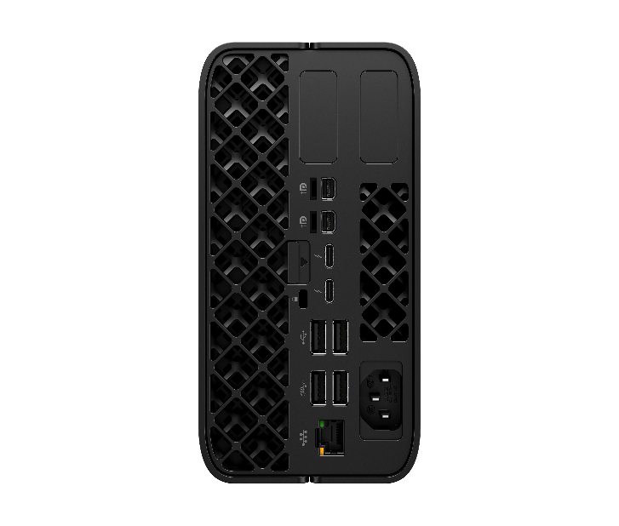
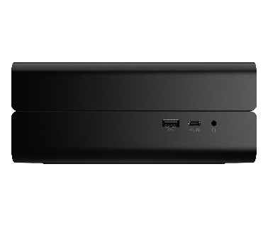
Customized Connections
HP Z2 Mini G1a
2x Flex IO
Supports up to 4 x 4K displays
2x Mini DP 2.1 UHBR10
Audio: UAJ Headset
Easy-access latch
USB-C 10Gb/alt DP mode
USB4-C 40Gbps /TBT4
USB-A 10Gb
Security lock
2x USB2-A
2x USB3-A 10Gbps
Power Supply
1x 2.5GbE AMT
23 | Z2 Mini G1a | HP Confidential. For use by HP or Partner with Customers under HP CDA only.
Notes:
____________________________
DISCLAIMER
*Optional features that must be configured at purchase or are sold separately.

Slide 24
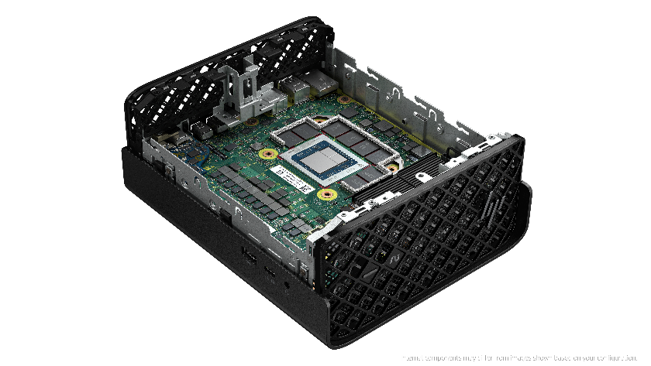
Supercharged AI PC mini workstation
Enhance productivity and foster creativity
with up to 50 TOPS NPU^{3,9} and Microsoft Copilot AI experiences⁵
Free update to Copilot+ PC experiences
when available from Microsoft.⁶
24 Z2 Mini G1a | HP Confidential. For use by HP or Partner with Customers under HP CDA only.
Notes:
[TALK TRACK]
Tackle new workflows on a mini workstation with AMD Ryzen™ AI Max PRO¹ processor, up to 16 CPU cores, 128GB unified memory and the ability to assign up to 96GB RAM to the GPU.
With this kind of power enables us to make the claim of “The World’s Most Powerful Mini Workstation”.
For workflows that demand more, the Z2 Mini G1a is equipping world-class, innovative companies to be AI future ready with up to 125 total-system TOPS.
This slide contains a superlative claim/s that cannot be used in all countries:
EMEA Use Restrictions:
DO NOT USE the superlative claim in the following countries:
Romania, Slovakia, Turkey, UAE, Russia, CIS countries (Armenia, Belarus, Kazakhstan, Kyrgyzstan, Moldova, Russia, Tajikistan, Turkmenistan, Ukraine, and Uzbekistan), Indonesia, Vietnam, Malaysia
APJ Use Restrictions:
China, Vietnam, Indonesia, Malaysia – DO NOT use LAR Use Restrictions:
Brazil, Mexico – Do NOT use
______________________________
DISCLAIMERS
Multicore is designed to improve performance of certain software products. Not all customers or software applications will necessarily benefit from use of this technology. Performance and clock frequency will vary depending on application workload and your hardware and software configurations. AMD’s numbering, branding and/or naming is not a measurement of higher performance. Features and software that require a NPU may require software purchase, subscription or enablement by a software or platform provider, and third-party software may have specific configuration or compatibility requirements. Performance varies by use, configuration, and other factors.
2. Optional and must be purchased at time of order
3. AI applications that require an NPU may require software purchase, subscription or enablement by a software or platform provider, and third-party software may have specific configuration or compatibility requirements. Performance varies by use, configuration, and other factors.
4. Based on HP’s internal analysis of ISV certified mini workstations with <3L volume, at least 3 ISV certifications, configurable professional graphics and a dedicated workstation brand. Powerful based on processor, integrated graphics, memory, and power supply as of October 2024.
5. Microsoft Copilot requires Windows 11. Some features require an NPU. Timing of feature delivery and availability varies by market and device. Requires Microsoft account to log in. Where the Copilot app is not available, the Copilot key will lead to the Bing search engine. scription from Microsoft.
6. On some devices, Copilot+ PC experiences require free updates available starting later this year and continuing into 2025. Timing varies by device and region. See aka.ms/copilotpluspcs
8. The AMD Ryzen AI MAX unified memory architecture supports system configurations of up to 128GB system memory and allows memory to be flexibly assigned between the CPU and GPU. When 128GB memory is configured, up to 96GB unified memory can be used for Radeon graphics, leaving up to 32GB reserved for system memory
9. Trillions of Operations per Second (TOPS) for an AMD Ryzen processor is the maximum number of operations per second that can be executed in an optimal scenario and may not be typical. TOPS may vary based on several factors, including the specific system configuration, AI model, and software version.
66. AMD Ryzen AI Max PRO Total system TOPS is made up from a combination of NPU, GPU, and CPU TOPS.

Slide 25
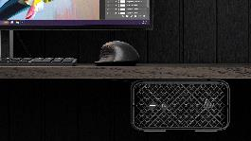
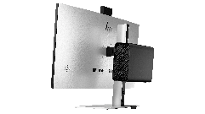
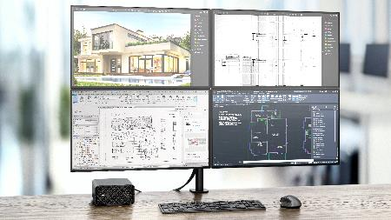
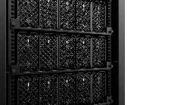
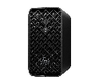

More power, smaller footprint
Create an ideal set-up with the compact Z2 Mini.
Attach it under a desk
Mount it behind a monitor
FPO
Set it on a desk, vertically or horizontally
Fits cleanly in a rack. Allows for 5 units across a 4U rack.³
25 | Z2 Mini G1a HP Confidential. For use by HP or Partner with Customers under HP CDA only.
Notes:
______________________ DISCLAIMER
67. Rack mounting hardware sold separately according to applicable local laws, and such rights are not in any way affected by the HP terms and conditions of service or the HP limited warranty provided with your HP product.

Slide 26
Z2 Mini Gen-to-gen spec comparison*
*No AMD predecessor so comparison is with Intel Mini
 | Z2 Mini G9 | Z2 Mini G1a
Processor | Intel Alder Lake, Raptor Lake, RPL-2, up to 24 Core (8+16) 125W (i9K, i7K, i5K) - limited to 90W TDP 65W (i9, i7, i5, i3) | AMD® Ryzen™ AI MAX PRO processor^{1,2}, up to 96 GPU memory⁸ (CPU & GPU SOC)
Graphics | 1x PCIe Gen4 x8 (electrical) supporting Low-profile HP graphics Nvidia T400, T600, T1000 Nvidia A400, A600, A1000 Nvidia RTX A2000, 2000 Ada, 4000 SFF Ada | Integrated Graphics up to 4 ports Performance range per OPN, up to >Nvidia A2000-next, up to >4000 SFF Ada Note: no Discrete Graphics option
Memory | DDR5, up to 96GB Max ECC and nECC 2 channels 1 DIMMs per channel (DPC) Up to 5600 MT/s | LPDDR5, up to 128GB ¹³Max ECC and nECC (user selectable) ⁷⁰ 256-bit bus; Soldered, not expandable Up to 8000 MT/s
Power supply | External (brick) 180W 89% Efficiency External (brick) 280W 89% Efficiency | Internal (no brick) 300W 92% Efficiency
26 | Z2 Mini G1a | HP Confidential. For use by HP or Partner with Customers under HP CDA only.
Notes:
________________________ DISCLAIMERS
1. Multicore is designed to improve performance of certain software products. Not all customers or software applications will necessarily benefit from use of this technology. Performance and clock frequency will vary depending on application workload and your hardware and software configurations. AMD’s numbering, branding and/or naming is not a measurement of higher performance
8. The AMD Ryzen AI MAX unified memory architecture supports system configurations of up to 128GB system memory and allows memory to be flexibly assigned between the CPU and GPU. When 128GB memory is configured, up to 96GB unified memory can be used for Radeon graphics, leaving up to 32GB reserved for system memory.
13. Up to 128GB memory is an optional, configurable feature
70. All memory configurations support ECC. ECC can be enabled or disabled via the F10 BIOS menu.

Slide 27
Detailed Z2 Mini Gen-to-gen spec comparison*
*No AMD predecessor so comparison is with Intel Mini
 | Z2 G9 | Z2 G1a
Chassis | 2.7"H x 8.3"W x 8.6"D (69 x 211 x 218mm) (~3.2L) | 3.4"H x 6.6"W x 7.9"D (85.5 x 168 x 200mm) (2.9L)
Processor(s) | Intel Alder Lake, Raptor Lake, RPL-2, up to 24 Core (8+16) 125W (i9K, i7K, i5K) - limited to 90W TDP 65W (i9, i7, i5, i3) | AMD® Ryzen™ AI MAX PRO processor,⁸ up to 96 GPU memory ³(CPU & GPU SOC)
Graphics | 1x PCIe Gen4 x8 (electrical) supporting Low-profile HP graphics Nvidia T400, T600, T1000 Nvidia A400, A600, A1000 Nvidia RTX A2000, 2000 Ada, 4000 SFF Ada | Integrated Graphics, up to 4 ports Performance range per OPN, up to >Nvidia A2000-next, up to > Nvidia 4000 SFF Ada Note: no Discrete Graphics option
Performance Modes | High Performance Mode (default) Performance Mode Quiet Mode | High Performance Mode (default) Performance Mode Quiet Mode Rack Mode
PSU | External 180W 89% Efficiency External 280W 89% Efficiency | Internal 300W 92% Efficiency
Memory | DDR5, up to 96GB Max, ECC and nECC 2 channels, 1 DIMMs per channel (DPC) Up to 5600 MT/s | LPDDR5, up to 128GB Max, ECC and nECC (user selectable) ⁷⁰ 256-bit bus; Soldered, not expandable Up to 8000 MT/s
Storage - NVMe | Up to 8TB (2x4TB NVMe modules) PCIe Gen4 speed, | Up to 8TB (2x4TB NVMe modules) PCIe Gen4 speed¹⁶
Rear IO (integrated) | Network: 1GbE - AMT Display: 2x DP 1.4 HBR3 USB: 3x USB-A 10Gb | Network: 2.5GbE - AMT & DASH Display-capable: 2x mDP 2.1 latching, 2x USB4-C/TBT4 Other USB: 2x USB3-A 10Gb, 2x USB2-A
Side IO (integrated) | USB: USB-A 10Gb, 2x USB-C 20Gb Audio: UAJ Headset | USB: USB-A 10Gb, USB-C 10Gb/alt DP mode Audio: UAJ Headset
FlexIO (optional, pick 1) | Network: 1GbE LAN, 2.5GbE LAN, 10GBase-T, 1GbE Fiber LC Display-capable: HDMI, DP, VGA, USB-C 10Gb Alt-DP, TBT3 Other USB: USB-C 10Gb, 2x USB-A 5Gb Other IO: Serial | Network: 1GbE LAN, 2.5GbE LAN, 10GBase-T, 1GbE Fiber LC Display-capable: none Other USB: USB-C 10Gb, 2x USB-A 5Gb Other IO: Serial
Wireless Network (optional) | Wi-Fi 7 & BT5.4, internal antenna | Up to Wi-Fi 7²⁵ & BT5.4, internal antenna
Manageability / Rack | External Remote System Controller 6 Systems / 5U | External Remote System Controller 5 Systems / 4U ⁶⁷
Maximum USB | Up to 10 ports: 8 USB-A + 2 USB-C | Up to 10 ports: 7 USB-A + 3 USB-C
Notes:
_______________________________
DISCLAIMER :
70. All memory configurations support ECC. ECC can be enabled or disabled via the F10 BIOS menu.
16. For storage drives, GB = 1 billion bytes. Actual formatted capacity is less. Up to 30 GB (for Windows) is reserved for system recovery software
25. Wireless access point and Internet service required and sold separately. Availability of public wireless access points limited. Wi-Fi 7 (802.11BE) functionality requires compatible Windows 11 OS, compatible processor, and separately purchased Wi-Fi 7 router to support backwards compatibility with prior 802.11 specs. Available in countries where Wi-Fi 7 is supported. The specification for 802.11BE is a draft specification and is not final. If the final specification differs from the draft specification, it may affect the ability of the device to communicate with other 802.11BE devices.
67. Rack mounting hardware sold separately

Slide 28

HP Z2 Mini G1a
Product Experiences
28 | Z2 Mini G1a HP Confidential. For use by HP or Partner with Customers under HP CDA only.

Slide 29



Introducing
High-speed AI processing
With High-speed Memory
Groundbreaking memory architecture developed with
Revolutionizing on-device AI
Near real-time responsiveness
Improved user experiences
Enables on-device generative AI to run efficiently despite PC constraints such as limited space and power.
Up to 8000 MT/s, up to 128 GB¹³
Quick response on-device AI
Fast image processing
Smoother workflows for power users who need high-performance computing for content creation, data analysis, and AI-driven applications.
29 | Z2 Mini G1a | HP Confidential. For use by HP or Partner with Customers under HP CDA only.
Notes:
DISCLAIMERS:
13. Up to 128GB memory is an optional, configurable feature

Slide 30
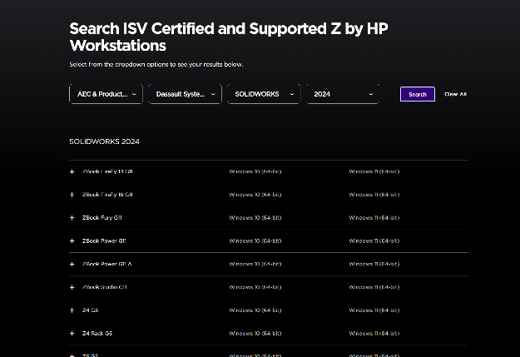
Extensive ISV testing and certification¹¹
Ensures peak performance
and reliability from
professional applications
HP works closely with ISVs¹¹ from the beginning – both in the development of new hardware and in the design of new software or a software revision.
Ensures optimized performance and a high-quality user experience.
Tested and certified across an array of industries and applications.
Experience the confidence and productivity of total compatibility between your hardware and software.
For more information or to search for ISV compatibility visit:
https://www.hp.com/us-en/workstations/isv-certifications/mcad-isv-certification.html
30 | Lead with Z | HP Confidential. For use by HP or Partner with Customers under HP CDA only.
Notes:
[TALK TRACK]
For workflows requiring workstation level performance, ISV applications are the foundation for workflows requiring the power of a workstation PC. HP works closely with ISVs starting early in the development cycle to perform the right level of testing and ensure every HP Z and Zbook workstation is certified. We understand the importance of ISVs and are dedicated to making the device selection and fleet deployment as seamless as possible.
DISCLAIMERS:
11. Some software vendors do not test the exact combinations of the hardware listed here, but rather publish a minimum configuration specification they will support.​

Slide 31
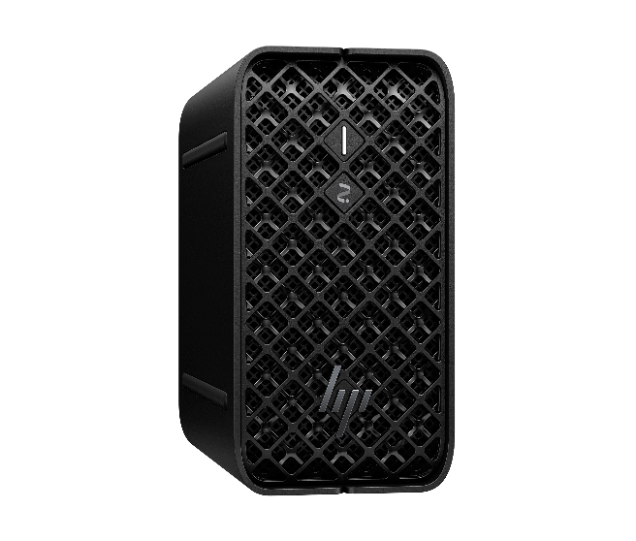

Custom Performance Modes
Choose from 4 pre-set modes from the BIOS customized for your needs & environment.
High Performance Mode – set as default for taking on your toughest workflows
Performance Mode – balance between performance and acoustics
Rack Mode - increases system fan speeds to enable dense rack populations
Quiet Mode – when you want to prioritize acoustics over performance
31 I Z6 G5 I HP Confidential. For use by HP or Partner with Customers under HP CDA only.
31 | Z2 Mini G1a HP Confidential. For use by HP or Partner with Customers under HP CDA only.
Notes:
Talk track (need to update to AMD solution):
HP’s High-Performance Mode utilizes Intel® Adaptix™ Technology (including Intel® Dynamic Tuning Technology or DTT framework)
HP has taken Intel’s innovation to the next level leveraging our proprietary thermal solution, maximizing CPU clock speed to provide performance gains. User will experience increased performance in multi threaded applications and work flows.
High Performance Mode kicks in before the job starts, adjusting to the rapid increase in CPU usage that comes with heavy work loads and starts cooling immediate in advance of higher temperatures that come with heavy workloads.
Intel® Adaptix™ Technology requires Windows 10 and BIOS set to High Performance Mode.

Slide 32
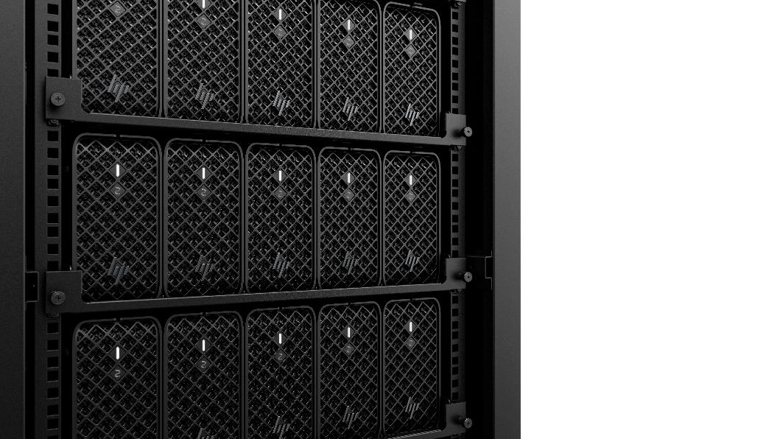
Rack Solution
Ideally designed to fit in a rack, maximize density with support for 5 minis in 4U⁶⁷, now without external power bricks.
Internal PSU enables better cable management and clean deployment.
32 | Z2 Mini G1a | HP Confidential. For use by HP or Partner with Customers under HP CDA only.
Notes:
67. Rack mounting hardware sold separately

Slide 33



Rack Use cases for
Z2 Mini G1a
Compact Powerhouse
Complex 3D & Visual Effect Rendering
Accelerate production and rendering of complex animations, visual effects, or 3D models by distributing computing power across multiple machines, eliminating the need for individual high-power systems.
Boost Performance.
Save Space.
Maximize Efficiency.
Distributed Development Environments
Software developers can assign dedicated mini workstations in a rack⁶⁷ to different development pipelines, ensuring smooth testing, debugging, and code builds while supporting seamless continuous integration and deployment in distributed environments.
Creative Workflows for Media Production
Video editors and graphic designers, who need high-performance systems for short bursts, can use racked⁶⁷ mini workstations to streamline workflows and optimize resource management in collaborative environments.
33 | Z2 Mini G1a | HP Confidential. For use by HP or Partner with Customers under HP CDA only.
Notes:
(Talk Track)
The Z2 Mini G1a is a powerful rack solution offer a flexible solution for businesses requiring multiple high-performance machines while conserving physical space and power.
___________________________ DISCLAIMER
67. Rack mounting hardware sold separately

Slide 34
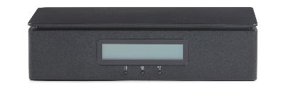
Complete out of Band Remote Workstation Management
WORKSTATION FLEET MANAGEMENT – FROM ANYWHERE
Manage and monitor your fleet of workstations from any location.⁷²
ONE CONSOLE. ALL ACCESS.
Perform out of band management tasks through a single interface—remotely.⁷³
MULTIPLE OPTIONS FOR EASY DEPLOYMENT ³
Unleash your ability to deploy distributed workstations with an easy to deploy solution.⁷⁴
HP Remote System Controller
SECURITY YOU NEED. CONTROL YOU WANT.
Based on a zero-trust model with extensive testing, HP Remote System Controller is a secure, browser based remote IT management access to workstations.
34 | Z2 Mini G1a | HP Confidential. For use by HP or Partner with Customers under HP CDA only.
Notes:
________________________ DISCLAIMERS
72. Internet access required.
73. Internet access required. Fleet management requires HP Remote System Management.
3. HP Integrated Remote System Controller not compatible with Z2 Mini platforms and not recommended for non-Z devices.
74. HP service and support not available for non-Z devices.

Slide 35
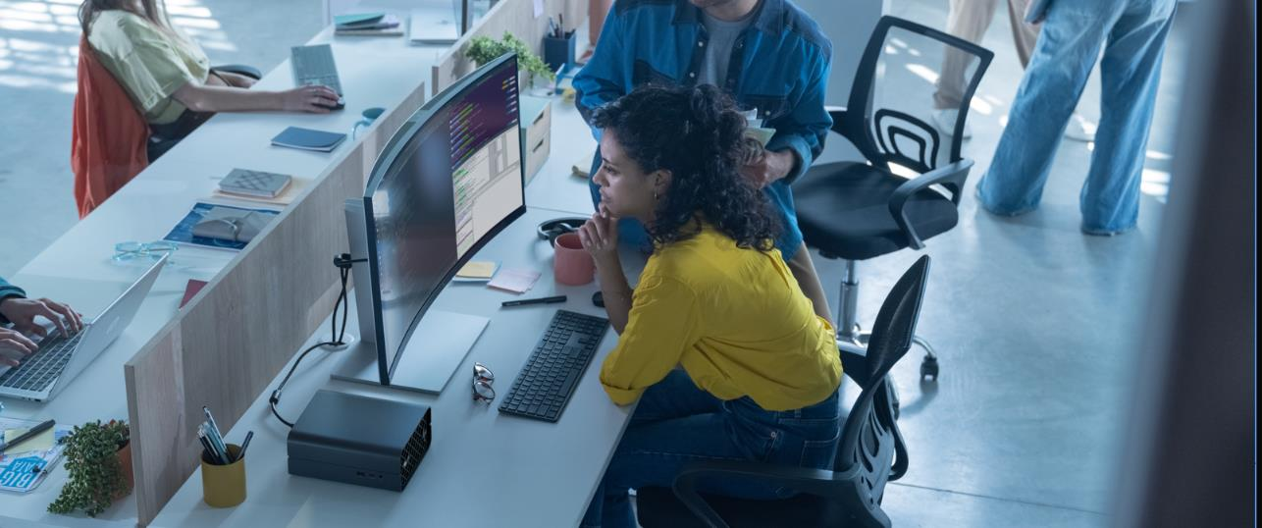
HP Z2 Mini G1a Mini Workstation
Productivity Experiences
35 | Z2 Mini G1a | HP Confidential. For use by HP or Partner with Customers under HP CDA only.

Slide 36

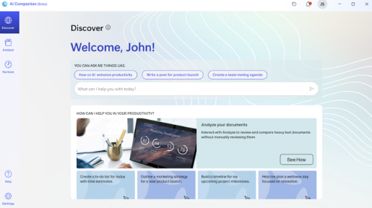



AI Companion
AI at your fingertips
Your personal built-in AI Companion¹² elevates everyday tasks to keep you performing your best.
HP AI Companion user interface shown for example only and is subject to change.
NEW
Ask, discover, and get intelligent assistance
Analyze and query your personal files
Perform at your best with an HP settings and support assistant⁷⁵
36 | Z2 Mini G1a | HP Confidential. For use by HP or Partner with Customers under HP CDA only.
Notes:
Disclaimer
12. HP AI Companion is available preloaded on select HP next gen AI PCs or is available for download from the Microsoft store and requires a HP next gen AI PC with a NPU supporting 40-60 TOPS and requires Windows 11. Perform requires account set up within 30 days of PC boot. Some features require customer upload of local data. Five (5) library 100MB limit each and supports pdf, .txt., .docx files. HP may limit search prompts to 200 per calendar month.
75. Planned feature availability in early 2025.

Slide 37


AI Companion
Enhanced by cloud-based AI
Ask, discover, and get intelligent assistance
Experience the power of knowledge at your fingertips.
Learning made easy with AI
Seamlessly explore new topics and find answers to anything you need, leveraging web content.
Boost your AI-first mindset
Try asking AI Companion¹² for information, advice, creative ideas or simply start a conversation to learn more about AI.
HP AI Companion user interface shown for example only and is subject to change.
37 | Z2 Mini G1a | HP Confidential. For use by HP or Partner with Customers under HP CDA only.
Notes:
Disclaimer
12. HP AI Companion is available preloaded on select HP next gen AI PCs or is available for download from the Microsoft store and requires a HP next gen AI PC with a NPU supporting 40-60 TOPS and requires Windows 11. Perform requires account set up within 30 days of PC boot. Some features require customer upload of local data. Five (5) library 100MB limit each and supports pdf, .txt., .docx files. HP may limit search prompts to 200 per calendar month.

Slide 38
AI Companion
Enhanced by cloud-based AI
Analyze and query your personal files
Take CTRL+F to the next level. Interact with your documents.
Secure & personal⁷⁶
Compare information, summarize key points, and filter specific data from documents within your private file library.
NEW Now analyze more file types
Analyze your images, diagrams, PDFs, PPT slides and more.⁷⁵
HP AI Companion user interface shown for example only and is subject to change.
38 | Z2 Mini G1a | HP Confidential. For use by HP or Partner with Customers under HP CDA only.
Notes:
DISCLAIMERS
12. HP AI Companion is available preloaded on select HP next gen AI PCs or is available for download from the Microsoft store and requires a HP next gen AI PC with a NPU supporting 40-60 TOPS and requires Windows 11. Perform requires account set up within 30 days of PC boot. Some features require customer upload of local data. Five (5) library 100MB limit each and supports pdf, .txt., .docx files. HP may limit search prompts to 200 per calendar month.
75. Planned feature availability in early 2025.
76. A vectorized summary of the document text is created and is temporarily processed in a cloud-based GPT to generate a response and then deleted. The vectorized document summaries are saved locally on the device.

Slide 39
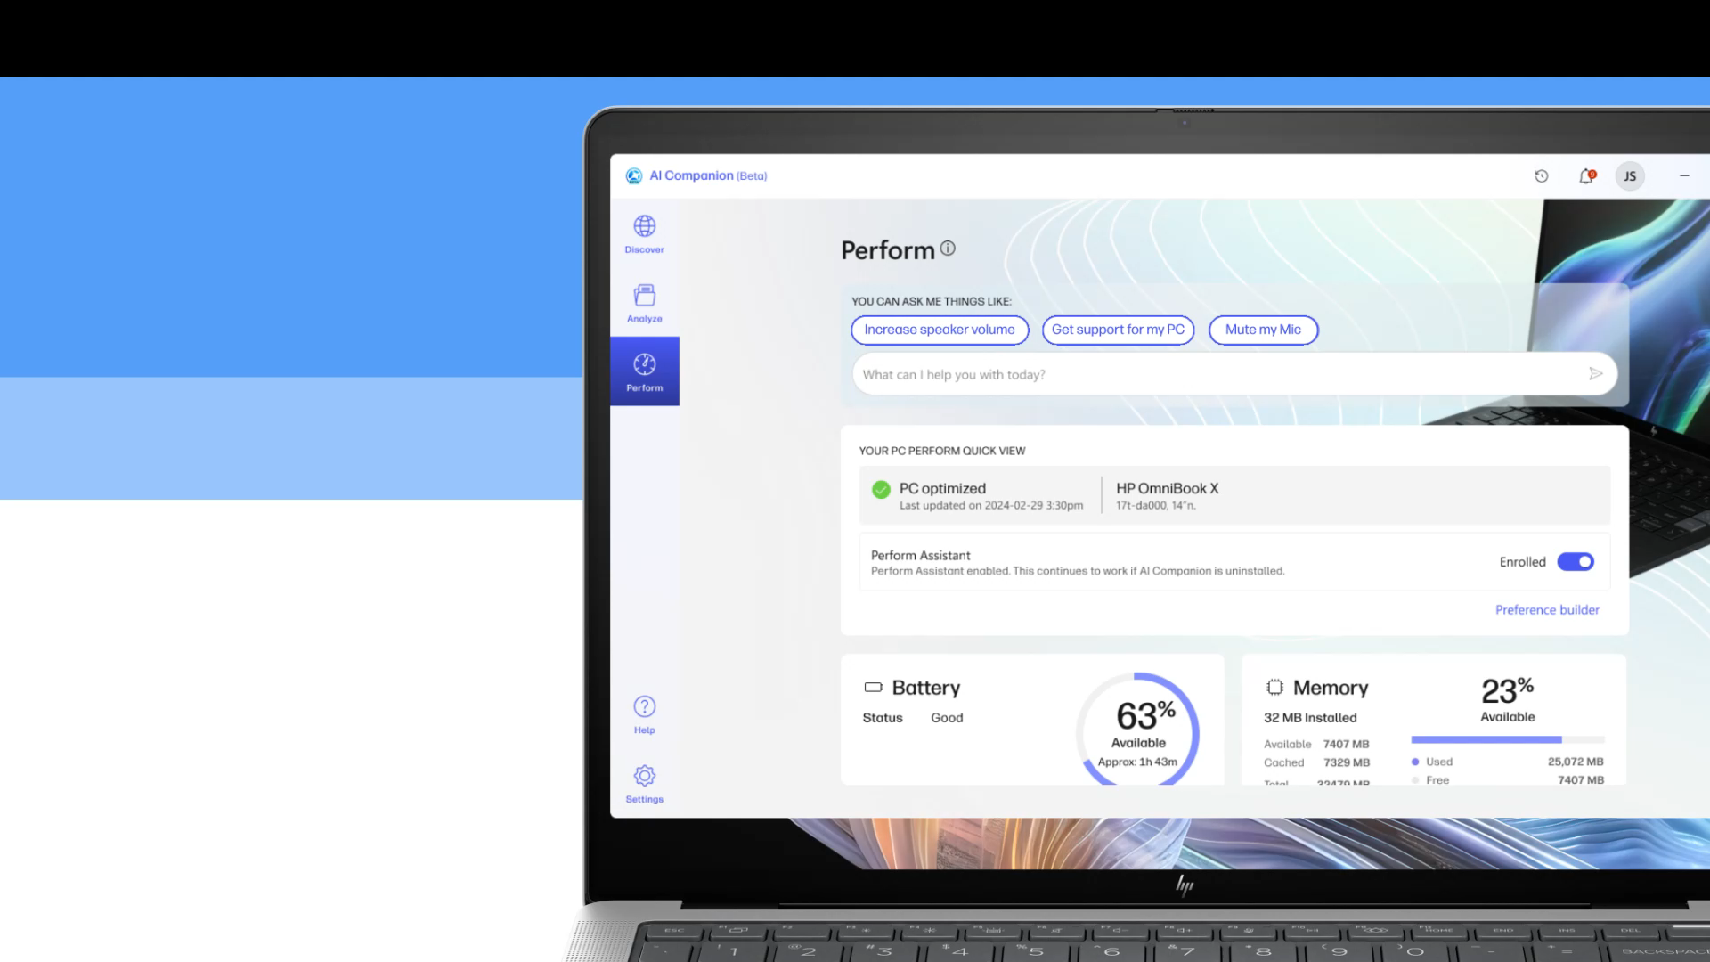

AI Companion
Enhanced by cloud-based AI
Planned availability in early 2025
AI-powered HP settings and support assistant
VIEW IN PRESENTATION MODE TO WATCH THE VIDEO
Explore the NEW Perform⁷⁵ tab in HP AI Companion¹²
Settings
Type a command to adjust your PC’s settings
Support
Get conversational help for all your HP products with a support assistant that scours more than 100,000 product manuals
HP AI Companion user interface shown for example only and is subject to change.
39 | Z2 Mini G1a | HP Confidential. For use by HP or Partner with Customers under HP CDA only.
Notes:
DISCLAIMERS
12. HP AI Companion is available preloaded on select HP next gen AI PCs or is available for download from the Microsoft store and requires a HP next gen AI PC with a NPU supporting 40-60 TOPS and requires Windows 11. Perform requires account set up within 30 days of PC boot. Some features require customer upload of local data. Five (5) library 100MB limit each and supports pdf, .txt., .docx files. HP may limit search prompts to 200 per calendar month.
75. Planned feature availability in early 2025.

Slide 40


HP Services
FPO
40 | Z2 Mini G1a HP Confidential. For use by HP or Partner with Customers under HP CDA only.

Slide 41





HP Services⁷⁶
Complete solutions to enable your workforce—anywhere
HP TechPulse: delivering actionable insights⁷⁷
Provision and deploy
Simplicity
Send devices and apps to users with ease
Monitor and manage
Proactive
Maximize uptime with proactive insights
Secure
Protection
Work securely anywhere with multi-layered protection
Support
Automation
Better experiences with automated support
Recover and renew
Sustainability
Create higher residual value, be Earth-friendly
41 | Z2 Mini G1a HP Confidential. For use by HP or Partner with Customers under HP CDA only.
Notes:
________________________________ DISCLAIMERS
76. HP Services are sold separately and are governed by the applicable HP terms and conditions of service provided or indicated to the customer at the time of purchase. Customers may have additional statutory rights according to applicable local laws, and such rights are not in any way affected by the HP terms and conditions of service or the HP limited warranty provided with your HP product.
77. HP TechPulse is a telemetry and analytics platform that provides critical data around devices and applications and is not sold as a standalone service. HP TechPulse follows stringent GDPR privacy regulations and is ISO27001, ISO27701, ISO27017, and SOC2 Type2 certified for Information Security. Internet access with connection to TechPulse portal is required. For full system requirements, please visit http://www.hpdaas.com/requirements.

Slide 42




Benefits of managed services⁷⁶
Reduce IT cost and complexity
World-class lifecycle services
AI-driven analytics
Improve the employee experience
Keep employees productive
Measure employee experience
Free up cash flow
Flexible payment terms
Flex up/flex down
Minimize security risk
Built-in security capabilities
Add-on security services
42 | Z2 Mini G1a HP Confidential. For use by HP or Partner with Customers under HP CDA only.
Notes:
______________________ DISCLAIMER
76. HP Services are sold separately and are governed by the applicable HP terms and conditions of service provided or indicated to the customer at the time of purchase. Customers may have additional statutory rights according to applicable local laws, and such rights are not in any way affected by the HP terms and conditions of service or the HP limited warranty provided with your HP product.

Slide 43
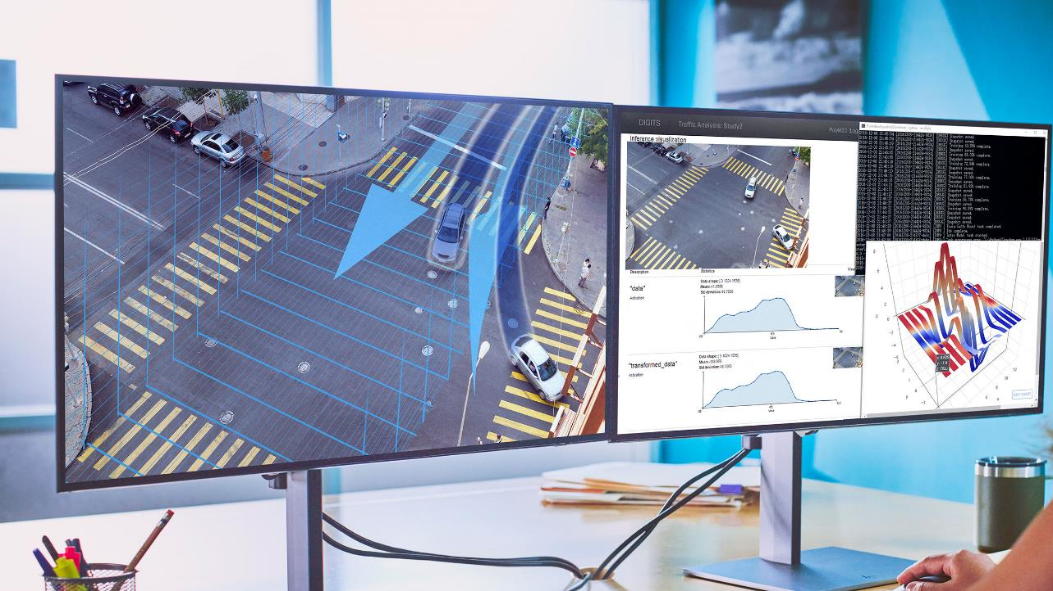
Ecosystem
43 | Z2 Mini G1a HP Confidential. For use by HP or Partner with Customers under HP CDA only.

Slide 44

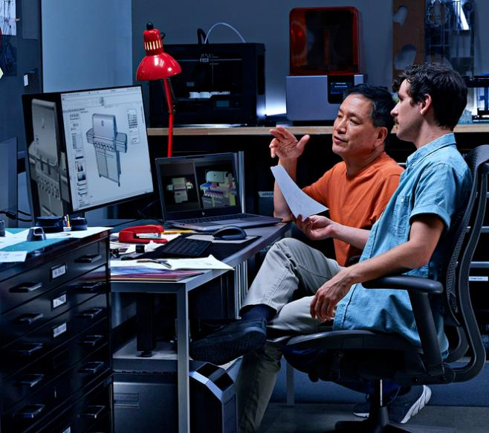
HP Series 7 Pro 732pk
4K, 31.5-inch diagonal display with Thunderbolt™ 4 and IPS Black technology
Color that rivals reality
Unleash the power of Thunderbolt™ 4⁷⁸
Seamless control
FPO
44 | Z2 Mini G1a HP Confidential. For use by HP or Partner with Customers under HP CDA only.
Notes:
________________________________ DISCLAIMER
78. SuperSpeed USB 20Gbps is not available with Thunderbolt™ 4.

Slide 45
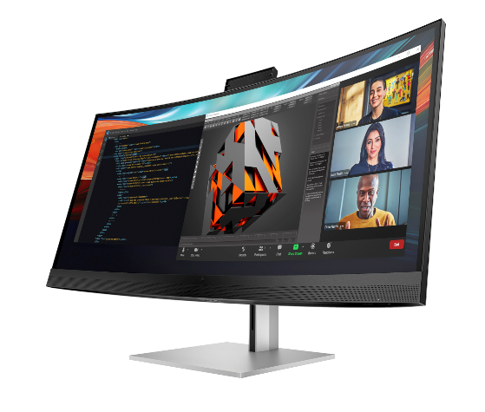
Data science ecosystem
(data analyst)
See and do more by immersing yourself in the brilliant, expansive views of the WUHD display
Improve productivity with easy multitasking on an ultra-wide screen that can be segmented into the equivalent of four 20-inch monitors
Integrated HP Device Bridge 2.0 lets you control two Windows and/or Mac devices from the same keyboard and mouse while maintaining network security with controlled file sharing
HP Series 7 Pro 740pm
FPO
45 | Z1 Tower G1i | HP Confidential. For use by HP or Partner with Customers under HP CDA only.
Notes:
__________________________________
DISCLAIMER

Slide 46
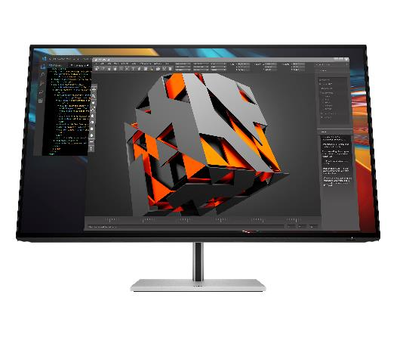
Product development ecosystem
(product engineer)
HP Series 7 Pro 732pk
View every detail as if it’s true-to-life with captivating color contrast on this precise 4K, 31.5-inch diagonal display
Transform your desk into a productivity powerhouse with Thunderbolt™ 4
When you’re multi-tasking between two devices, simply use the built-in KVM switch to control both with just a single keyboard and mouse
46 | Z1 Tower G1i | HP Confidential. For use by HP or Partner with Customers under HP CDA only.
Notes:
__________________________________ DISCLAIMER

Slide 47
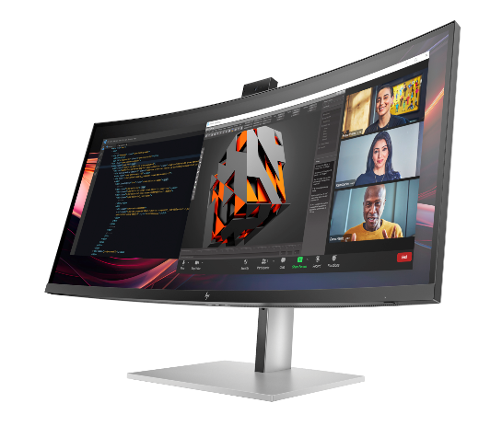
Architecture, engineering, and construction ecosystem (architect)
34" color accurate conferencing display with Zoom certification
Increase productivity with the ability to see all your projects on one expansive, sharp screen
Be confident that the color on screen matches what you see in real life with a 100% sRGB and 98% Display P3 color gamut
HP Pro Series 7 Pro 734pm
47 | Z1 Tower G1i | HP Confidential. For use by HP or Partner with Customers under HP CDA only.
Notes:
FPO: For presentation only. Product may differ from images depicted.

Slide 48
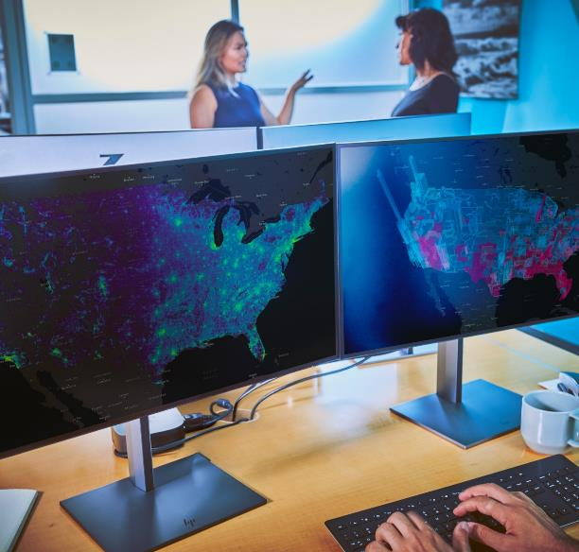
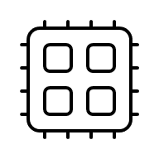

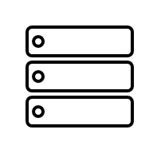
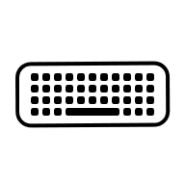

Z2 Mini G1a AMO
Rack & Mounting Kits⁶⁷
Audio
Mini Rail Rack Kit
Z Display B600 PC Mounting Bracket
HP 965 4K Streaming Webcam
Poly Voyager Focus 2 Headset
Poly Blackwire 8202 Stereo Headset
Storage
Accessories
Z Turbo 4TB 2280 PCIe-4x4 TLC M.2 MINI Kit SSD
HP Creator 935 Black Wireless Mouse
HP 655 Wireless Keyboard and Mouse Combo
48 | Z2 Tower G1i | HP Confidential. For use by HP or Partner with Customers under HP CDA only.
Notes:
FPO: For presentation only. Product may differ from images depicted.
________________________
DISCLAIMER
67. Rack mounting hardware sold separately

Slide 49
Security experiences
49 | Z2 Mini G1a HP Confidential. For use by HP or Partner with Customers under HP CDA only.

Slide 50




Protected by HP Wolf Security
83
⁹⁸
Part of the world’s most secure and manageable PC portfolio
NEW Reinforced endpoint security controller⁵⁴future-proofs your device and protects against evolving threats.
Built with quantum hack protection.⁹⁵
Above the OS
HP Management Integration Kit³⁵
HP Privacy Camera⁸²
In the OS
HP Client Security Manager ⁸⁷
HP Sure Sense²⁹ HP Sure Click²⁸
Advanced security options
HP Wolf Pro Security Edition⁹²
HP Wolf Enterprise Security⁹³
HP Protect and Trace⁸⁴ with HP Platform Certificate⁹⁷
Below the OS
HP BIOSphere³⁰
HP Sure Start³¹
HP Sure Admin⁹¹
HP Sure Run ³³
HP Tamper Lock³²
HP Sure Recover³⁴
50 | Z2 Mini G1a HP Confidential. For use by HP or Partner with Customers under HP CDA only.
Notes:
This slide contains a superlative claim/s that cannot be used in all countries:
EMEA Use Restrictions:
DO NOT USE the superlative claim in the following countries:
Romania, Slovakia, Turkey, UAE, Russia, CIS countries (Armenia, Belarus, Kazakhstan, Kyrgyzstan, Moldova, Russia, Tajikistan, Turkmenistan, Ukraine, and Uzbekistan), Indonesia, Vietnam, Malaysia
APJ Use Restrictions:
China, Vietnam, Indonesia, Malaysia – DO NOT use LAR Use Restrictions:
Brazil, Mexico – Do NOT use
__________
HP Wolf Security provides world class security outcomes helping organizations’ PC endpoints reduce risks; increase IT and security efficiencies; and provide a better user experience without downtime.​
​
HP has long been a leader in security and has been driving PC security innovation for over 20 years. ​
First next-gen AI PC with quantum hack protection*.
Incorporates a quantum-resistant cryptographic scheme to protect the integrity of UEFI BIOS firmware as of August 2024
Above the OS
HP Management Integration Kit
A client-management-console-agnostic solution that extends management aspects to HP hardware, BIOS, and software capabilities.
HP MIK helps speed up the basics of management—reduce the number of steps needed to create, deploy, and manage images, BIOS, and system security; protect data— secure BIOS settings, set authentication and credentials requirements, enable Device Guard, and manage Trusted Platform Module(TPM) firmware updates; and manage software—enable IT administrators to remotely manage features supported by the software, such as HP Client Security.
HP Sure Shutter
Physically block the camera lens with a single click for added peace-of-mind and protection from hackers spying on user.
In the OS
HP Client Security Manager Gen7
HP Sure Sense
A next-generation antivirus that uses AI to help prevent known and never-before-seen malware attacks.
HP Sure Click
Opens websites, read-only Microsoft Office and PDF attachments in isolation (hardware-enforced virtual machine) to stop malware attacks from infecting the OS.
HP Sure Click Enterprise and Sure Access Enterprise provide enterprise-class threat containment and credential protection (SCE) and privileged activity protection (SAE)
HP Wolf Pro Security Edition
Provides simple yet effective protection for small and mid-sized organizations which includes threat containment, malware prevention, and identity protection. Best fit for organization with 25 devices or less. Preinstalled on select PCs or software installable on HP and non-HP PCs
HP Protect and Trace⁸⁴
Locate, lock, and erase PC.
PC Platform Security to reduce cyber supply chain risks:
Built-in hardware enforced security drives resiliency and availability
Self-healing BIOS, hardware supply chain assurance with HP Platform Certificate**^{#coming}, and secure OS recovery. See FAQ link in disclaimer.
Below the OS
HP BIOSphere Gen6
Enhanced firmware protection automatically from the moment the PC is first booted up, guarding against malicious attacks and accidental errors that can compromise the BIOS.
HP Sure Start Gen6
HP’s self-healing BIOS automatically recovers from firmware attacks or corruption by restarting with a safe copy of the BIOS.
HP Sure Admin
Creates a digital signature that allows IT administrators to securely manage BIOS settings over the network.
HP Sure Run Gen4
Creates a digital signature that allows IT administrators to securely manage BIOS settings over the network.
HP Tamper Lock
Tamper detection sensors located on the bottom cover of the PC and on internal storage are triggered when the cover of the PC is opened.
​HP Sure Recover Gen4
Allows the user to restore the operating system when the hard drive has been compromised or corrupted without IT intervention.
This slide’s notes contains a superlative claim/s that cannot be used in all countries:
EMEA Use Restrictions:
DO NOT USE the superlative claim in the following countries:
Romania, Slovakia, Turkey, UAE, Russia, CIS countries (Armenia, Belarus, Kazakhstan, Kyrgyzstan, Moldova, Russia, Tajikistan, Turkmenistan, Ukraine, and Uzbekistan), Indonesia, Vietnam, Malaysia
APJ Use Restrictions:
China, Vietnam, Indonesia, Malaysia – DO NOT use
LAR Use Restrictions:
Brazil, Mexico – Do NOT use
​
Additional resources​ for sales
For Sales: All New Manageability customer presentation and other manageability documents can be found: https://hp.sharepoint.com/teams/CoE-Hesion/SitePages/Manageability.aspx
_____________________________
DISCLAIMERS
28. HP Sure Click requires Windows 10. See https://bit.ly/2PrLT6A_SureClick for complete details.
29. HP Sure Sense is available on select HP PCs and is not available with Windows10 Home.
30. HP BIOSphere Gen6 requires Windows 10 and is available on select HP Pro and Elite PCs. Features may vary depending on the platform and configurations.
31. HP Sure Start Gen7 is available on select HP PCs and requires Windows 10.
32. HP Tamper Lock requires a supervisor password be established prior to use.
33. HP Sure Run Gen5 is available on select HP PCs and requires Windows 10.
34. HP Sure Recover Gen5 is available on select HP PCs and requires Windows 10 and an open network connection. You must back up important files, data, photos, videos, etc. before using HP Sure Recover to avoid loss of data. Network based recovery using Wi-Fi is only available on PCs with Intel Wi-Fi Module.
35. HP Manageability Integration Kit can be downloaded from hp.com/go/clientmanagement. Please see the user guide for HP MIK’s full system requirements. HP Manageability Integration Kit infosheet - http://www8.hp.com/h20195/v2/GetPDF.aspx/4AA7-3086ENW.pdf.
54. Requires Windows 10 or higher. For supported HP PCs with the latest HP Endpoint Security Controller (Gen 5). See https://h20195.www2.hp.com/v2/GetDocument.aspx?docname=4AA8-3644ENW.
87. HP Client Security Manager Gen6/Gen7 requires Windows and is available on the select HP Elite and Pro PCs.
82. HP Privacy Camera only available PCs equipped with HD or IR camera and must be installed at the factory.​
83. HP Wolf Security for Business requires Windows 10 and higher, includes various HP security features and is available on HP Pro, Elite, Workstation, and RPOS products. See product details for included security features.
84. HP Wolf Protect & Trace with Wolf Connect is available on select HP commercial G10 and higher laptops and mobile workstation devices. Customer activation required. Devices with Cat-M module do not support Internet access. Internet service for devices with 4G LTE and 5G modules is not included and must be purchased separately. Wolf Connect Service not available in all countries. Other restrictions limitations apply, please see data sheet for complete details.
91. HP Sure Admin requires Windows 10 or higher, HP BIOS, and HP Manageability Integration Kit from http://www.hp.com/go/clientmanagement and HP Sure Admin Local Access Authenticator smartphone app from the Android or Apple store.
92. HP Wolf Pro Security Edition (including HP Sure Click Pro and HP Sure Sense Pro) is available preloaded on select SKUs and, depending on the HP product purchased, includes a paid 1-year or 3-year license. The HP Wolf Pro Security Edition software is licensed under the license terms of the HP Wolf Security Software - End-User license Agreement (EULA) that can be found at: https://support.hp.com/us-en/document/ish_3875769-3873014-16 as that EULA is modified by the following: “7. Term. Unless otherwise terminated earlier pursuant to the terms contained in this EULA, the license for the HP Wolf Pro Security Edition (HP Sure Sense Pro and HP Sure Click Pro) is effective upon activation and will continue for either a twelve (12) month or thirty-six (36) month license term (“Initial Term”). At the end of the Initial Term you may either (a) purchase a renewal license for the HP Wolf Pro Security Edition from HP.com, HP Sales or an HP Channel Partner, or (b) continue using the standard versions of HP Sure Click and HP Sure Sense at no additional cost with no future software updates or HP Support.
93. HP Wolf Enterprise Security is sold separately and requires Windows 10 or 11 PRO or higher and Microsoft Internet Explorer, Google Chrome, Chromium or Firefox are supported. Supported attachments include Microsoft Office (Word, Excel, PowerPoint) and PDF files, when Microsoft Office or Adobe Acrobat are installed.
95. Based on HP’s internal analysis of next gen AI PCs with a 40-60 TOPS NPU with a quantum-resistant cryptographic scheme to protect the integrity of UEFI BIOS firmware as of August 2024
97. HP Platform Certificate - a verifiable artifact of PC authenticity and integrity reflecting that PC components have not changed since leaving the factory. HP’s Platform Certificate FAQ: https://h20195.www2.hp.com/v2/GetDocument.aspx?docname=4AA8-3108ENW
98: Based on HP’s Manageability Integration Kit’s management of every aspect of a PC including hardware, BIOS and software management using Microsoft System Center Configuration Manager on HP Elite PCs.​

Slide 51




HP Wolf Pro Security NGAV¹⁵
Stay protected from known & new malware with AI-powered antivirus
Behavioral Analysis
Identifying and blocking malicious behavior
AI: Machine Learning
trained to recognize common features of malware
AI: Deep Learning
AI trained on raw data to instinctively recognize even unknown malware
51 | Z2 Mini G1a HP Confidential. For use by HP or Partner with Customers under HP CDA only.
Notes:
FPO: For presentation only. Product may differ from images depicted.
Sure Sense Pro is a comprehensive NGAV like leading solutions in the market (NGAV - next-gen antivirus)
Sure Sense Pro protects the host OS from known and unknown malware – powered by mature behavioral analysis, AI/deep learning and broader techniques based static analysis
Provides industry-leading protection with very high detection rates and low false-positive rates comparable to leading paid NGAV software providers
Behavioral analysis techniques include looking for unauthorized behavior:
1. Looking for code injection behavior
2. Script-based attacks
3. Fileless malware and living-off-the-land behaviors
4. Heuristics-based detection
5. Unauthorized registry access
Deep learning of known and unknown malware, recognizing 99% of malware
Lightweight agent, means faster run time and detection time, working in 20ms on average
Protects your PC by quarantining malware and other known or unknown threats
Best of all, minimal updates are required, and only requires 1% PC load while in idle.
_________________
DISCLAIMERS
15.HP Wolf Pro Security NGAV one (1) year license is included on HP EliteBook Ultra G1q. The HP Wolf Pro Security NGAV software is licensed under the license terms of the HP Wolf Security Software - End-User license Agreement (EULA) that can be found at: https://support.hp.com/us-en/document/ish_3875769-3873014-16 as that EULA is modified by the following:
Term. Unless otherwise terminated earlier pursuant to the terms contained in this EULA, the license for the HP Wolf Pro Security NGAV is effective upon 4 months after the date the HP Product was shipped by HP and will continue for the term communicated to you at purchase and in your order confirmation email (“Initial Term”). At the end of the Initial Term you may either (a) purchase a renewal license for the HP Wolf Pro Security Edition from HP.com, HP Sales or an HP Channel Partner, or (b) continue using the standard versions of HP Wolf Pro Security at no additional cost with no future software updates or HP Support. Notwithstanding the foregoing, the license shall expire no later than one year after the fixed term the subject license ends.

Slide 52
Sustainability & Reliability
HP Z2 Mini G1a
52 | Z2 Mini G1a HP Confidential. For use by HP or Partner with Customers under HP CDA only.
Notes:
FPO: For presentation only. Product may differ from images depicted.

Slide 53




Designed with reliability in mind
360k
Hours
Included in the total HP test process**
Starting with durable construction
Undergoes mil-std 810h tests¹⁸
40C testing to endure the toughest environments²⁸
Checking components through functional & system integration testing
53 | Z2 Mini G1a HP Confidential. For use by HP or Partner with Customers under HP CDA only.
Notes:
______________________
DISCLAIMER
18. MIL STD testing is not intended to demonstrate fitness for U.S. Department of Defense contract requirements or for military use. Test results are not a guarantee of future performance under these test conditions. Accidental Damage or damage under these test conditions requires an optional HP Accidental Damage Protection Care Pack.

Slide 54








The world’s most sustainable PC portfolio
EPEAT® Climate+ Gold Registered in US⁴³
63
Z2 Mini G1a
NEW!!
NEW!!
Speaker magnet made with
Decrease carbon footprint
Fans made with
100% sustainably sourced packaging⁴⁷
100% recycled rare earth element
Advanced power monitoring dashboard
60% post-consumer recycled plastic⁴⁶
25% ocean-bound plastics⁵²
20% post-industrial recycled steel⁴⁵
54 | Z2 Mini G1a HP Confidential. For use by HP or Partner with Customers under HP CDA only.
Notes:
This slide contains a superlative claim/s that cannot be used in all countries:
EMEA Use Restrictions:
DO NOT USE the superlative claim in the following countries:
Romania, Slovakia, Turkey, UAE, Russia, CIS countries (Armenia, Belarus, Kazakhstan, Kyrgyzstan, Moldova, Russia, Tajikistan, Turkmenistan, Ukraine, and Uzbekistan), Indonesia, Vietnam, Malaysia
APJ Use Restrictions:
China, Vietnam, Indonesia, Malaysia – DO NOT use LAR Use Restrictions:
Brazil, Mexico – Do NOT use
____________________________
DISCLAIMERS
16. HP paper and fiber based packaging for PCs, displays, home and office print, and supplies is reported by suppliers as recycled or certified, with a minimum of 97% by volume verified by HP. Packaging is the box that comes with the product and all paper-based materials inside the box. Packaging for commercial, personal systems accessories, and spare parts is not included.
45. Recycled metal is expressed as a percentage of the total weight of the metal according to ISO 14021 definitions for metal parts over 25 grams. Percent of recycled material varies by product.
46. Recycled plastic is expressed as a percentage of the total weight plastic. Post-consumer recycled is based on the definition set in the EPEAT standard for computers, IEEE 1680.1-2018 standard
47. 100% outer box packaging made from sustainably sourced certified and recycled fibers. Fiber cushions made from 100% recycled wood fiber and organic material. Any plastic cushions are made from >90% recycled plastic.
43. Based on US EPEAT® registration according to IEEE 1680.1-2018 EPEAT®. EPEAT® status varies by country. Visit www.epeat.net for more information.
52. Percentage of ocean-bound plastic contained in each component varies by product. Ocean Bound plastic is expressed as a percentage of the total weight plastic. Ocean Bound plastic is based on the definition set by the UL2809 standard.
63. Applies to HP PCs, Workstations, and Displays manufactured after January 2019. Based on most Gold and Silver (including Climate+) EPEAT® registrations and according to IEEE 1680.1-2018 EPEAT®. Status varies by country. Visit www.epeat.net for more information.

Slide 55




Help protect our shared future
Before use | NEW 100% recycled rare earth elements in the speaker magnet¹⁰¹ | 
 | Up to 60% recycled plastics¹⁰¹ | 
 | Up to 20% recycled steel⁴⁵ | 
 | 100% sustainably sourced packaging¹⁰² | 
 | See power usage and get recommendations to reduce energy use with Power Consumption Measurement dashboard in myHP⁵⁰ | 
During use | Advanced Power Monitoring for end users and IT¹⁰³ | 
 | Digital Passport | 
 | Platinum Power PSU efficiency | 
During use | EPEAT® Climate+ Gold Registered in US^{43,63} | 
 | ENERGY STAR® Certified | 
 | TCO Certified | 
 | Undergoes 19 MIL-STD 810 tested for durability¹⁸ | 
 | Sanitizable¹⁰⁴ | 
After use | HP IT Asset Disposition Service¹⁰⁵ | 
 | HP Device Life Extension¹⁰⁶ | 
 | HOPE Recycling Futures | 
Part of the world's most sustainable PC portfolio.⁶³
View the 2023 HP Sustainable Impact Report to see how we’re making a difference.
Z2 G1a Mini
55 | Z2 Mini G1a HP Confidential. For use by HP or Partner with Customers under HP CDA only.
Notes:
This slide contains a superlative claim/s that cannot be used in all countries:
EMEA Use Restrictions:
DO NOT USE the superlative claim in the following countries:
Romania, Slovakia, Turkey, UAE, Russia, CIS countries (Armenia, Belarus, Kazakhstan, Kyrgyzstan, Moldova, Russia, Tajikistan, Turkmenistan, Ukraine, and Uzbekistan), Indonesia, Vietnam, Malaysia
APJ Use Restrictions:
China, Vietnam, Indonesia, Malaysia – DO NOT use LAR Use Restrictions:
Brazil, Mexico – Do NOT use
____________________________
DISCLAIMERS
102. 100% outer box packaging made from sustainably sourced certified and recycled fibers. Fiber cushions made from 100% recycled wood fiber and organic material. Any plastic cushions are made from >90% recycled plastic.
45. Recycled metal is expressed as a percentage of the total weight of the metal according to ISO 14021 definitions for metal parts over 25 grams. Percent of recycled material varies by product.
46. Recycled plastic content percentage is based on the definition set in the IEEE 1680.1-2018 EPEAT standard.
101. Recycled metal is expressed as a percentage of the total weight of the metal according to ISO 14021 definitions for metal parts over 25 grams. Percent of recycled material varies by product.
43. Based on US EPEAT® registration according to IEEE 1680.1-2018 EPEAT®. EPEAT® status varies by country. Visit www.epeat.net for more information.
103. Power Consumption Measurement with real-time total power usage tracking will release in 2024 on our commercial notebook line. The energy consumption data is planned to be available to end users within myHP and ITDMs via HP Proactive Insights in May 2024. Fleet management within HP Proactive Insights requires Windows 10 or higher and registration for the Workforce Experience platform at https://admin.hp.com. Some features and capabilities may require additional purchase of HP services and/or commercial hardware capable of supporting the HP Insights agent for Windows, Mac, & Android. Activation and restrictions may apply. Select HP Workforce Solutions require an HP Insights agent for Windows, Mac, & Android, available for download at https://admin.hp.com/software. For full system requirements and services that require the agent, please visit https://admin.hp.com/requirements. The agent collects telemetry and analytics around devices and applications that integrate into the Workforce Experience platform and is not sold as a standalone service. Internet access with connection to the Workforce Experience platform is required. HP follows stringent GDPR privacy regulations, and the platform is ISO27001, ISO27701, ISO27017 and SOC2 Type2 certified for Information Security.
52. Percentage of ocean-bound plastic contained in each component varies by product. Ocean Bound plastic is expressed as a percentage of the total weight plastic. Ocean Bound plastic is based on the definition set by the UL2809 standard.
60. Recycled plastic is expressed as a percentage of the total weight plastic. Post-consumer recycled is based on the definition set in the EPEAT standard for computers, IEEE 1680.1-2018 standard. Percent of recycled material varies by product.
18. MIL STD 810H testing is not intended to demonstrate fitness for U.S. Department of Defense contract requirements or for military use.
62. Test results are not a guarantee of future performance under these test conditions. Accidental damage requires an optional HP Accidental Damage Protection Care Pack.
63. Applies to HP PCs, Workstations, and Displays manufactured after January 2019. Based on most Gold and Silver (including Climate+) EPEAT® registrations and according to IEEE 1680.1-2018 EPEAT®. Status varies by country. Visit www.epeat.net for more information
104. Select household wipes can be safely used to clean HP Elite and Workstation, and HP ProBook 635 Aero PCs up to 1,000 wipes: See wipe manufacturer’s instructions for disinfecting and the HP cleaning guide for HP tested wipe solutions at How to Sanitize Your HP Device Whitepaper (http://h20195.www.2.hp.com/v2/GetDocument.aspx?docname=4AA7-7610ENW) not applicable to HP Elite c1030 Chromebook.
105. HP Services are governed by the applicable HP terms and conditions of service provided or indicated to Customer at the time of purchase. Customer may have additional statutory rights according to applicable local laws, and such rights are not in any way affected by the HP terms and conditions of service or the HP Limited Warranty provided with your HP Product.
106. The HP Device Life Extension capability is for HP commercial PCs. HP-certified partners will perform functional diagnostics, data removal, interior and exterior cleaning, enhance device performance, reimaging, and conduct platform updates. This service is available as a Care Pack when it is sold with new hardware or within 120 days of the original Care Pack expiration date.

Slide 56













2025 Desktop Workstation Portfolio
Z1
Z2
Z4
Z6
Z8
FPO
FPO
FPO
Z2 Mini G1a
Z4 Rack G5
Z2 Mini G1i
Z2 SFF G1i
Z6 G5
Z1 Tower G1i
Z2 Tower G1i
Z4 G5
Z6 G5 A
Z8 G5
Z8 Fury G5
Step into professional performance
Professional performance in 4 sizes
Workhorses of expandability and rack-ability
Extreme graphics performance
Take on intense workloads with extreme performance.
2D & light 3D workflows, data science model building/AI
2D & light 3D workflows, data science model building/AI
+Medium 3D workflows, 1080P video editing, light rendering / simulation/data analysis
+Multiple heavy workflows simultaneously, VFX & compositing
+Heavy 3D workflows, 4K+ video editing, medium rendering / simulation/data analysis
Best for large AI modeling and training when equipped with high-end graphics
High-frequency, single threaded applications
Applications
Multi-threaded CPU applications & parallel GPU compute
Workflows
Increasing dataset and model size/complexity
Benefits
More iterations, faster time to completion with greater accuracy
56 | Z2 Mini G1a HP Confidential. For use by HP or Partner with Customers under HP CDA only.
Notes:
FPO: For presentation only. Product may differ from images depicted.

Slide 57
Under press embargo until January 6, 2025 and sales embargo until February 25, 2025
Thank you.
HP Confidential. For use by HP or Partner with Customers under HP CDA only.
57 | Z2 Mini G1a HP Confidential. For use by HP or Partner with Customers under HP CDA only.

Slide 58
Disclaimers
1. Multicore is designed to improve performance of certain software products. Not all customers or software applications will necessarily benefit from use of this technology. Performance and clock frequency will vary depending on application workload and your hardware and software configurations. AMD’s numbering, branding and/or naming is not a measurement of higher performance
2. Optional and must be purchased at time of order
3. AI applications that require an NPU may require software purchase, subscription or enablement by a software or platform provider, and third-party software may have specific configuration or compatibility requirements. Performance varies by use, configuration, and other factors.
4. Based on HP’s internal analysis of ISV certified mini workstations with <3L volume, at least 3 ISV certifications, configurable professional graphics and a dedicated workstation brand. Powerful based on processor, integrated graphics, memory, and power supply as of October 2024.
Not available in all countries or regions Learn more. Some features of Copilot may require a paid sub
5. Microsoft Copilot requires Windows 11. Some features require an NPU. Timing of feature delivery and availability varies by market and device. Requires Microsoft account to log in. Where the Copilot app is not available, the Copilot key will lead to the Bing search engine. scription from Microsoft.
6. On some devices, Copilot+ PC experiences require free updates available starting later this year and continuing into 2025. Timing varies by device and region. See aka.ms/copilotpluspcs
7. Based on HP’s internal analysis of ISV certified mini workstations with <3L volume, at least 3 ISV certifications, configurable professional graphics and a dedicated workstation brand. Includes all next Gen AI PCs with over 40 NPU TOPS
8. The AMD Ryzen AI MAX unified memory architecture supports system configurations of up to 128GB system memory and allows memory to be flexibly assigned between the CPU and GPU. When 128GB memory is configured, up to 96GB unified memory can be used for Radeon graphics, leaving up to 32GB reserved for system memory.
9. Trillions of Operations per Second (TOPS) for an AMD Ryzen processor is the maximum number of operations per second that can be executed in an optimal scenario and may not be typical. TOPS may vary based on several factors, including the specific system configuration, AI model, and software version
10. Next Gen AI PC with 40 to 60 TOPS NPU to enable local AI processing.
11. Some software vendors do not test the exact combinations of the hardware listed here, but rather publish a minimum configuration specification they will support.​
12. HP AI Companion is available preloaded on select HP next gen AI PCs or is available for download from the Microsoft store and requires a HP next gen AI PC with a NPU supporting 40-60 TOPS and requires Windows 11. Perform requires account set up within 30 days of PC boot. Some features require customer upload of local data. Five (5) library 100MB limit each and supports pdf, .txt., .docx files. HP may limit search prompts to 200 per calendar month.40. Requires Windows OS.
13. Up to 128GB memory is an optional, configurable feature
14. HP Wolf Security for Business requires Windows 10 or 11 Pro and higher, includes various HP security features and is available on HP Pro, Elite, Workstation, and RPOS products. See product details for included security features.
15.HP Wolf Pro Security NGAV one (1) year license is included on HP EliteBook Ultra G1q. The HP Wolf Pro Security NGAV software is licensed under the license terms of the HP Wolf Security Software - End-User license Agreement (EULA) that can be found at: https://support.hp.com/us-en/document/ish_3875769-3873014-16 as that EULA is modified by the following:
Term. Unless otherwise terminated earlier pursuant to the terms contained in this EULA, the license for the HP Wolf Pro Security NGAV is effective upon 4 months after the date the HP Product was shipped by HP and will continue for the term communicated to you at purchase and in your order confirmation email (“Initial Term”). At the end of the Initial Term you may either (a) purchase a renewal license for the HP Wolf Pro Security Edition from HP.com, HP Sales or an HP Channel Partner, or (b) continue using the standard versions of HP Wolf Pro Security at no additional cost with no future software updates or HP Support. Notwithstanding the foregoing, the license shall expire no later than one year after the fixed term the subject license ends.
16. For storage drives, GB = 1 billion bytes. Actual formatted capacity is less. Up to 30 GB (for Windows) is reserved for system recovery software
16. HP paper and fiber based packaging for PCs, displays, home and office print, and supplies is reported by suppliers as recycled or certified, with a minimum of 97% by volume verified by HP. Packaging is the box that comes with the product and all paper-based materials inside the box. Packaging for commercial, personal systems accessories, and spare parts is not included. 18. MIL STD testing is not intended to demonstrate fitness for U.S. Department of Defense contract requirements or for military use. Test results are not a guarantee of future performance under these test conditions. Accidental Damage or damage under these test conditions requires an optional HP Accidental Damage Protection Care Pack.
19. 100% outer box packaging made from sustainably sourced certified and recycled fibers. Fiber cushions made from 100% recycled wood fiber and organic material. Any plastic cushions are made from >90% recycled plastic.
20. Recycled metal is expressed as a percentage of the total weight of the metal according to ISO 14021 definitions for metal parts over 25 grams. Percent of recycled material varies by product.
21. Percentage of ocean-bound plastic contained in each component varies by product. Ocean Bound plastic is expressed as a percentage of the total weight plastic. Ocean Bound plastic is based on the definition set by the UL2809 standard.
23. Applies to HP PCs, Workstations, and Displays manufactured after January 2019. Based on most Gold and Silver (including Climate+) EPEAT® registrations and according to IEEE 1680.1-2018 EPEAT®. Status varies by country. Visit www.epeat.net for more information.
24. Recycled plastic is expressed as a percentage of the total weight plastic. Post-consumer recycled is based on the definition set in the EPEAT standard for computers, IEEE 1680.1-2018 standard. Percent of recycled material varies by product.
25. Wireless access point and Internet service required and sold separately. Availability of public wireless access points limited. Wi-Fi 7 (802.11BE) functionality requires compatible Windows 11 OS, compatible processor, and separately purchased Wi-Fi 7 router to support backwards compatibility with prior 802.11 specs. Available in countries where Wi-Fi 7 is supported. The specification for 802.11BE is a draft specification and is not final. If the final specification differs from the draft specification, it may affect the ability of the device to communicate with other 802.11BE devices.
26. Actual weight will vary by configuration.
27. Requires the myHP application and Windows OS.
28. HP Sure Click requires Windows 10. See https://bit.ly/2PrLT6A_SureClick for complete details.
29. HP Sure Sense is available on select HP PCs and is not available with Windows10 Home.
30. HP BIOSphere Gen6 requires Windows 10 and is available on select HP Pro and Elite PCs. Features may vary depending on the platform and configurations.
31. HP Sure Start Gen7 is available on select HP PCs and requires Windows 10.
32. HP Tamper Lock requires a supervisor password be established prior to use.
33. HP Sure Run Gen5 is available on select HP PCs and requires Windows 10.
34. HP Sure Recover Gen5 is available on select HP PCs and requires Windows 10 and an open network connection. You must back up important files, data, photos, videos, etc. before using HP Sure Recover to avoid loss of data. Network based recovery using Wi-Fi is only available on PCs with Intel Wi-Fi Module.
35. HP Manageability Integration Kit can be downloaded from hp.com/go/clientmanagement. Please see the user guide for HP MIK’s full system requirements. HP Manageability Integration Kit infosheet - http://www8.hp.com/h20195/v2/GetPDF.aspx/4AA7-3086ENW.pdf.
43. Based on US EPEAT® registration according to IEEE 1680.1-2018 EPEAT®. EPEAT® status varies by country. Visit www.epeat.net for more information.
45. Recycled metal is expressed as a percentage of the total weight of the metal according to ISO 14021 definitions for metal parts over 25 grams. Percent of recycled material varies by product.
46. Recycled plastic is expressed as a percentage of the total weight plastic. Post-consumer recycled is based on the definition set in the EPEAT standard for computers, IEEE 1680.1-2018 standard
47. 100% outer box packaging made from sustainably sourced certified and recycled fibers. Fiber cushions made from 100% recycled wood fiber and organic material. Any plastic cushions are made from >90% recycled plastic.
58 | Z2 Mini G1a HP Confidential. For use by HP or Partner with Customers under HP CDA only.

Slide 59
Disclaimers
52. Percentage of ocean-bound plastic contained in each component varies by product. Ocean Bound plastic is expressed as a percentage of the total weight plastic. Ocean Bound plastic is based on the definition set by the UL2809 standard.
54. Requires Windows 10 or higher. For supported HP PCs with the latest HP Endpoint Security Controller (Gen 5). See https://h20195.www2.hp.com/v2/GetDocument.aspx?docname=4AA8-3644ENW.
60. Recycled plastic is expressed as a percentage of the total weight plastic. Post-consumer recycled is based on the definition set in the EPEAT standard for computers, IEEE 1680.1-2018 standard. Percent of recycled material varies by product.
62. Test results are not a guarantee of future performance under these test conditions. Accidental damage requires an optional HP Accidental Damage Protection Care Pack.
63. Applies to HP PCs, Workstations, and Displays manufactured after January 2019. Based on most Gold and Silver (including Climate+) EPEAT® registrations and according to IEEE 1680.1-2018 EPEAT®. Status varies by country. Visit www.epeat.net for more information
66. AMD Ryzen AI Max PRO Total system TOPS is made up from a combination of NPU, GPU, and CPU TOPS.
67. Rack mounting hardware sold separately
68. Based on HP’s internal analysis of ISV certified mini workstations with <3L volume, at least 3 ISV certifications, configurable professional graphics and a dedicated workstation brand as of October 2024
69. Based on HP’s internal analysis of ISV certified mini workstations with <3L volume, at least 3 ISV certifications, configurable professional graphics and a dedicated workstation brand. Based on the highest memory offered as of Oct 2024.
70. All memory configurations support ECC. ECC can be enabled or disabled via the F10 BIOS menu.
71. Wireless access point and Internet service required and sold separately. Availability of public wireless access points limited. Wi-Fi 7 (802.11BE) functionality requires compatible Windows 11 OS, compatible processor, and separately purchased Wi-Fi 7 router to support backwards compatibility with prior 802.11 specs. Available in countries where Wi-Fi 7 is supported. The specification for 802.11BE is a draft specification and is not final. If the final specification differs from the draft specification, it may affect the ability of the device to communicate with other 802.11BE devices.
72. Internet access required.
73. Internet access required. Fleet management requires HP Remote System Management.
3. HP Integrated Remote System Controller not compatible with Z2 Mini platforms and not recommended for non-Z devices.
74. HP service and support not available for non-Z devices.
76. HP Services are sold separately and are governed by the applicable HP terms and conditions of service provided or indicated to the customer at the time of purchase. Customers may have additional statutory rights according to applicable local laws, and such rights are not in any way affected by the HP terms and conditions of service or the HP limited warranty provided with your HP product.
77. HP TechPulse is a telemetry and analytics platform that provides critical data around devices and applications and is not sold as a standalone service. HP TechPulse follows stringent GDPR privacy regulations and is ISO27001, ISO27701, ISO27017, and SOC2 Type2 certified for Information Security. Internet access with connection to TechPulse portal is required. For full system requirements, please visit http://www.hpdaas.com/requirements.
78. SuperSpeed USB 20Gbps is not available with Thunderbolt™ 4.
82. HP Privacy Camera only available PCs equipped with HD or IR camera and must be installed at the factory.​
83. HP Wolf Security for Business requires Windows 10 and higher, includes various HP security features and is available on HP Pro, Elite, Workstation, and RPOS products. See product details for included security features.
84. HP Wolf Protect & Trace with Wolf Connect is available on select HP commercial G10 and higher laptops and mobile workstation devices. Customer activation required. Devices with Cat-M module do not support Internet access. Internet service for devices with 4G LTE and 5G modules is not included and must be purchased separately. Wolf Connect Service not available in all countries. Other restrictions limitations apply, please see data sheet for complete details 87. HP Client Security Manager Gen6/Gen7 requires Windows and is available on the select HP Elite and Pro PCs.
91. HP Sure Admin requires Windows 10 or higher, HP BIOS, and HP Manageability Integration Kit from http://www.hp.com/go/clientmanagement and HP Sure Admin Local Access Authenticator smartphone app from the Android or Apple store.
92. HP Wolf Pro Security Edition (including HP Sure Click Pro and HP Sure Sense Pro) is available preloaded on select SKUs and, depending on the HP product purchased, includes a paid 1-year or 3-year license. The HP Wolf Pro Security Edition software is licensed under the license terms of the HP Wolf Security Software - End-User license Agreement (EULA) that can be found at: https://support.hp.com/us-en/document/ish_3875769-3873014-16 as that EULA is modified by the following: “7. Term. Unless otherwise terminated earlier pursuant to the terms contained in this EULA, the license for the HP Wolf Pro Security Edition (HP Sure Sense Pro and HP Sure Click Pro) is effective upon activation and will continue for either a twelve (12) month or thirty-six (36) month license term (“Initial Term”). At the end of the Initial Term you may either (a) purchase a renewal license for the HP Wolf Pro Security Edition from HP.com, HP Sales or an HP Channel Partner, or (b) continue using the standard versions of HP Sure Click and HP Sure Sense at no additional cost with no future software updates or HP Support.
93. HP Wolf Enterprise Security is sold separately and requires Windows 10 or 11 PRO or higher and Microsoft Internet Explorer, Google Chrome, Chromium or Firefox are supported. Supported attachments include Microsoft Office (Word, Excel, PowerPoint) and PDF files, when Microsoft Office or Adobe Acrobat are installed.
95. Based on HP’s internal analysis of next gen AI PCs with a 40-60 TOPS NPU with a quantum-resistant cryptographic scheme to protect the integrity of UEFI BIOS firmware as of August 2024
97. HP Platform Certificate - a verifiable artifact of PC authenticity and integrity reflecting that PC components have not changed since leaving the factory. HP’s Platform Certificate FAQ: https://h20195.www2.hp.com/v2/GetDocument.aspx?docname=4AA8-3108ENW
98: Based on HP’s Manageability Integration Kit’s management of every aspect of a PC including hardware, BIOS and software management using Microsoft System Center Configuration Manager on HP Elite PCs.​
101. Recycled metal is expressed as a percentage of the total weight of the metal according to ISO 14021 definitions for metal parts over 25 grams. Percent of recycled material varies by product.
102. 100% outer box packaging made from sustainably sourced certified and recycled fibers. Fiber cushions made from 100% recycled wood fiber and organic material. Any plastic cushions are made from >90% recycled plastic.
103. Power Consumption Measurement with real-time total power usage tracking will release in 2024 on our commercial notebook line. The energy consumption data is planned to be available to end users within myHP and ITDMs via HP Proactive Insights in May 2024. Fleet management within HP Proactive Insights requires Windows 10 or higher and registration for the Workforce Experience platform at https://admin.hp.com. Some features and capabilities may require additional purchase of HP services and/or commercial hardware capable of supporting the HP Insights agent for Windows, Mac, & Android. Activation and restrictions may apply. Select HP Workforce Solutions require an HP Insights agent for Windows, Mac, & Android, available for download at https://admin.hp.com/software. For full system requirements and services that require the agent, please visit https://admin.hp.com/requirements. The agent collects telemetry and analytics around devices and applications that integrate into the Workforce Experience platform and is not sold as a standalone service. Internet access with connection to the Workforce Experience platform is required. HP follows stringent GDPR privacy regulations, and the platform is ISO27001, ISO27701, ISO27017 and SOC2 Type2 certified for Information Security.
104. Select household wipes can be safely used to clean HP Elite and Workstation, and HP ProBook 635 Aero PCs up to 1,000 wipes: See wipe manufacturer’s instructions for disinfecting and the HP cleaning guide for HP tested wipe solutions at How to Sanitize Your HP Device Whitepaper (http://h20195.www.2.hp.com/v2/GetDocument.aspx?docname=4AA7-7610ENW) not applicable to HP Elite c1030 Chromebook.
105. HP Services are governed by the applicable HP terms and conditions of service provided or indicated to Customer at the time of purchase. Customer may have additional statutory rights according to applicable local laws, and such rights are not in any way affected by the HP terms and conditions of service or the HP Limited Warranty provided with your HP Product.
106. The HP Device Life Extension capability is for HP commercial PCs. HP-certified partners will perform functional diagnostics, data removal, interior and exterior cleaning, enhance device performance, reimaging, and conduct platform updates. This service is available as a Care Pack when it is sold with new hardware or within 120 days of the original Care Pack expiration date.
.
59 | Z2 Mini G1a HP Confidential. For use by HP or Partner with Customers under HP CDA only.

