Slide 1


Under press embargo until March 17, 2025
Introducing the all new
Z2 Tower G1i
Mainstream workstation performance—reimagined
January 2025 – Version 1.0
1 | Z2 Tower G1i | HP Confidential. For use by HP or Partner with Customers under HP CDA only.

Slide 2
Table of contents
Introducing Z2 Tower G1i Workstation
Naming strategy
Announcement narrative
What’s new
Workflows/Who uses this device
Gen to gen comparison
Product features
HP Services
Ecosystem
Security Experiences
Sustainability & Reliability
2025 Desktop Workstation Portfolio
HP Z2 Tower G1i
Customer Presentation
2 | Z2 Tower G1i | HP Confidential. For use by HP or Partner with Customers under HP CDA only.

Slide 3
Naming - what is changing?
Generations: Generations are resetting at G1 for all ZBooks and Z1/Z2 desktop workstations in 2025.
Silicon representation: All silicon options will be represented with a lowercase letter attached to the generation without a space in between.
AMD à G1a
Intel à G1i
Putting it together – long name examples:
HP Z2 Tower G1i Desktop Workstation PC
HP Z2 SFF G1i Desktop Workstation PC
HP Z2 Mini G1i Desktop Workstation PC
HP Z2 Mini G1a Desktop Workstation PC
HP Z1 Tower G1i Desktop PC
3 | Z2 Tower G1i | HP Confidential. For use by HP or Partner with Customers under HP CDA only.

Slide 4

Transforming the future of high-performance workflows
HP delivers innovative technology that drives growth and fulfillment
Increasing complexity of advanced workflows requires more powerful compute.
Work locally with the ability to tackle multiple professional applications simultaneously.
4 | HP Z2 Tower G1i | HP Confidential. For use by HP or Partner with Customers under HP CDA only.

Slide 5
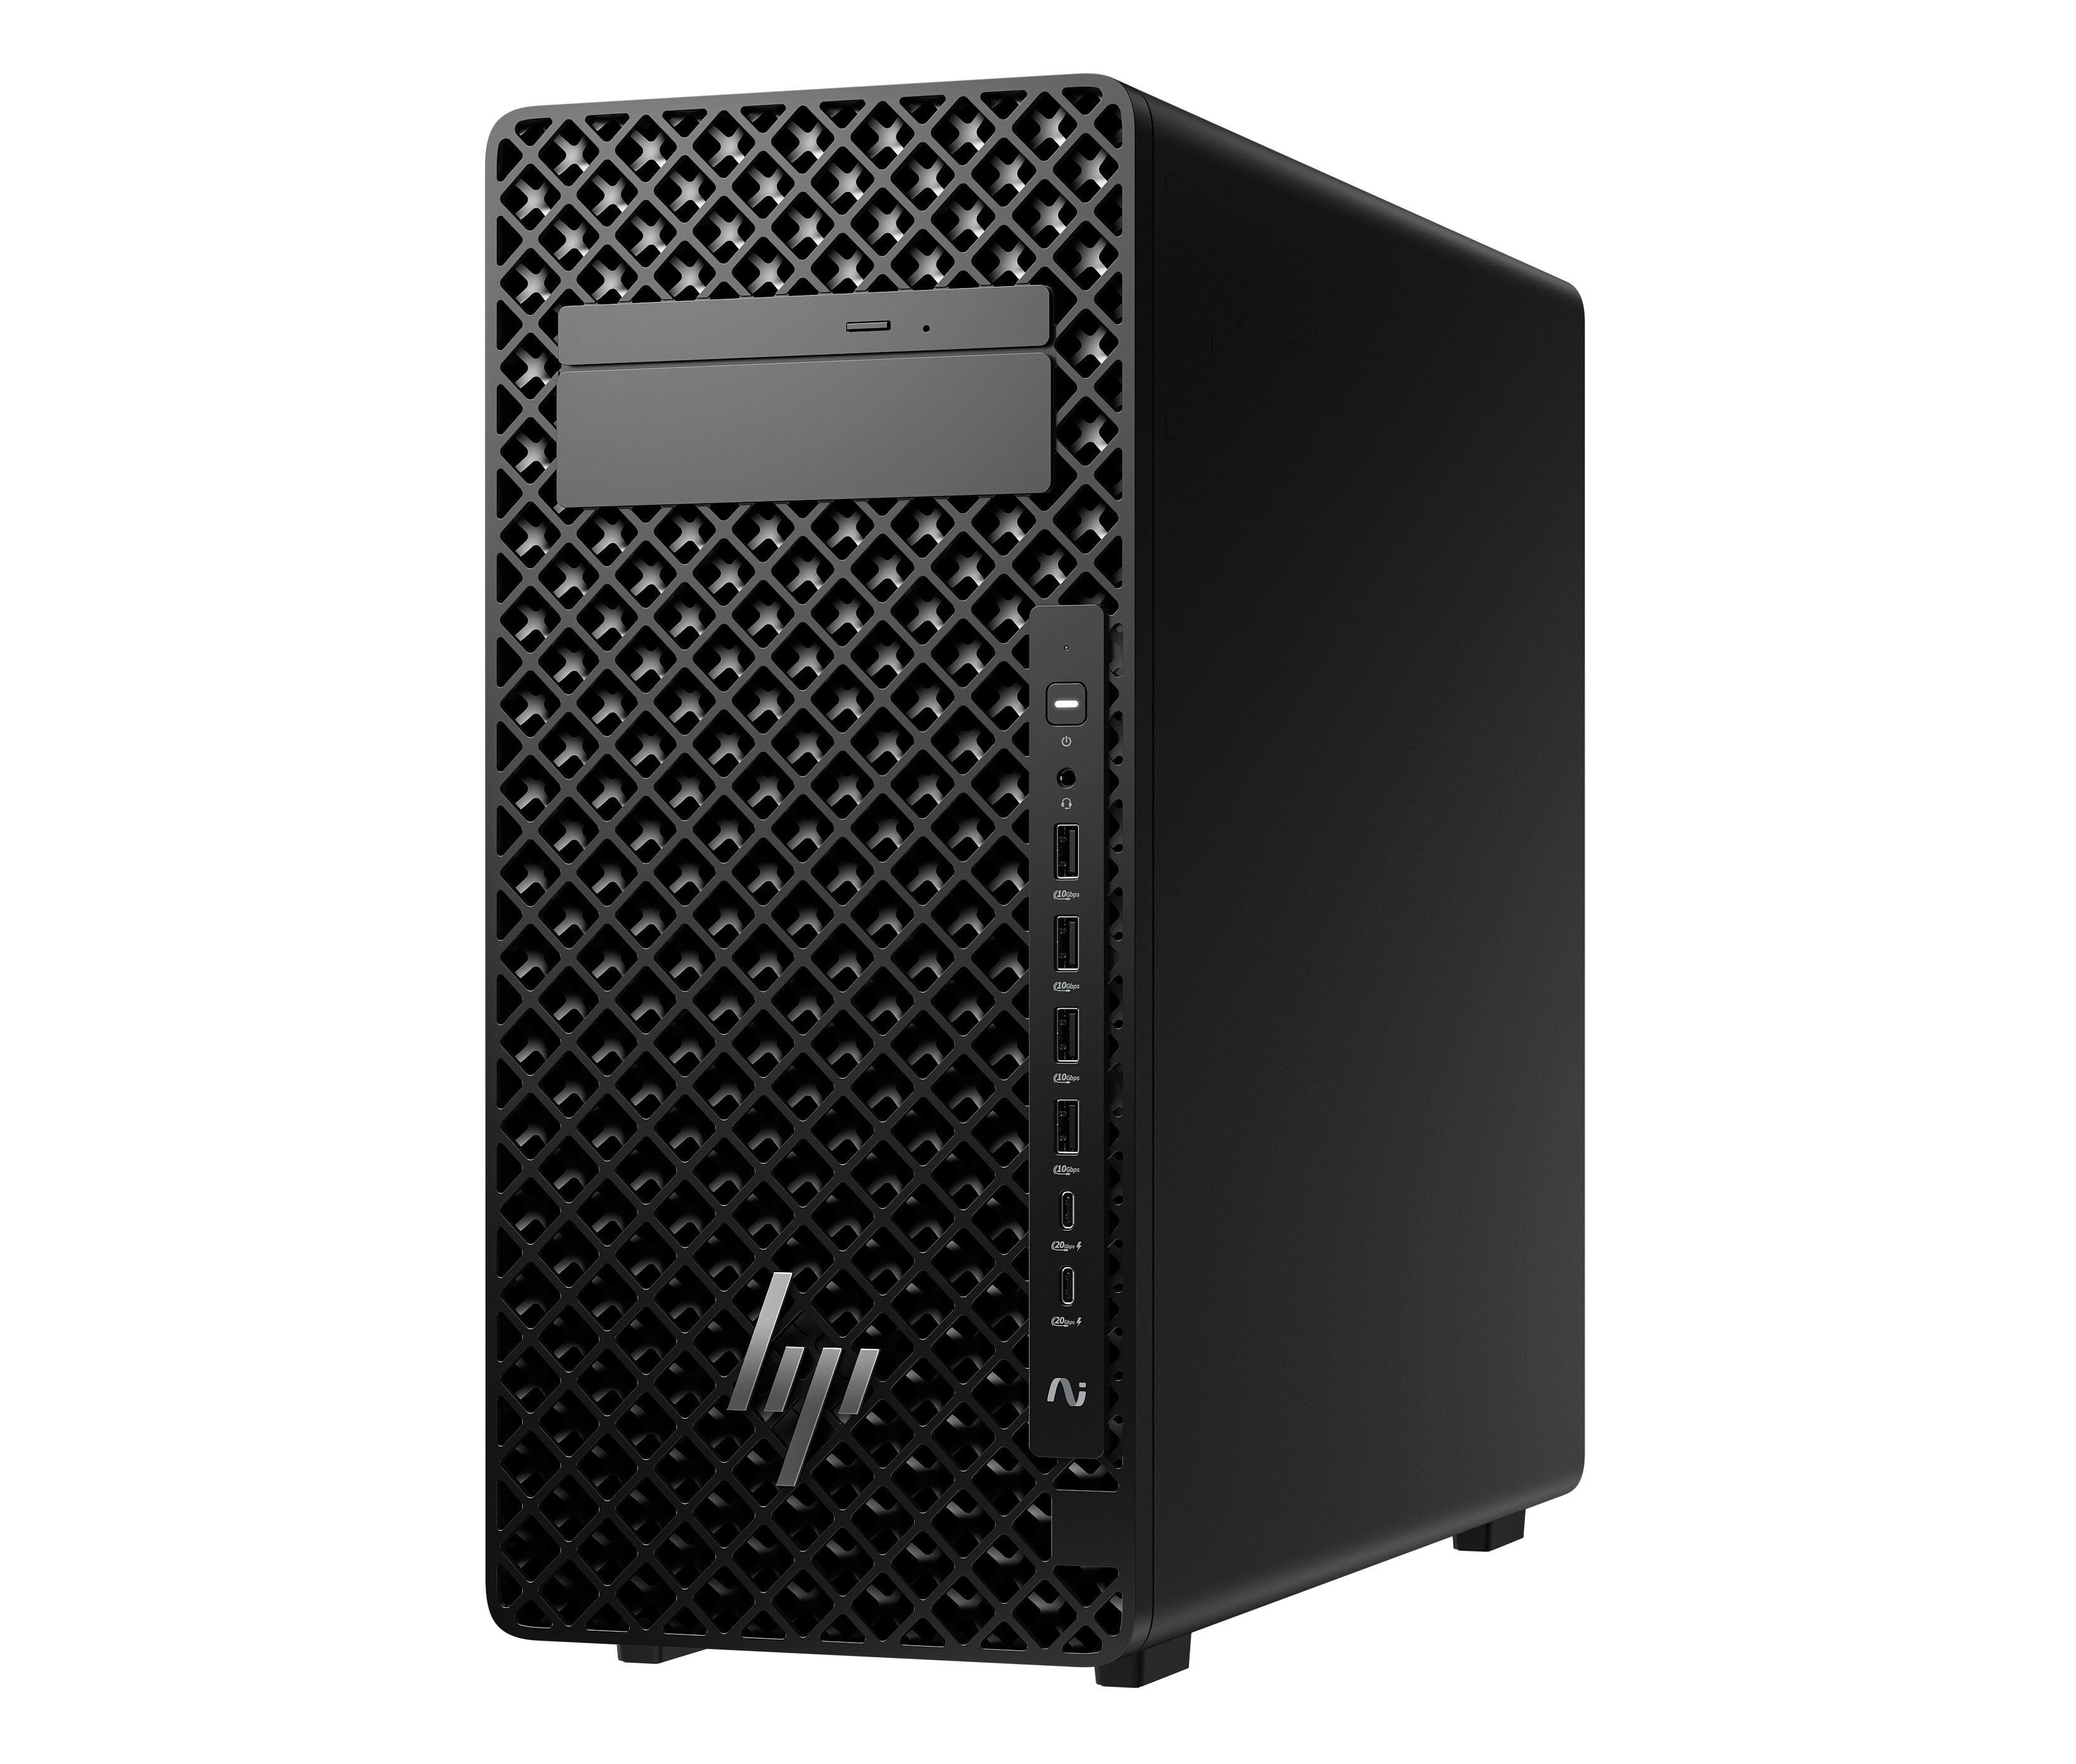
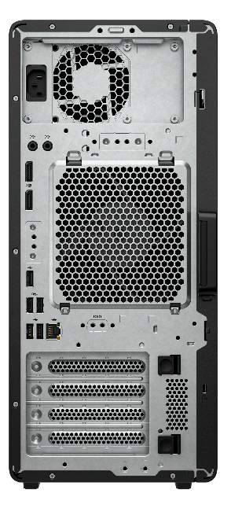
Introducing the
Z2 Tower G1i
Mainstream workstation performance —reimagined
Experience new levels of performance for professional workflows. The Z2 Tower AI workstation is reengineered to support high-end graphics and seamlessly run both single and multi-threaded apps for fast modeling, simulation, and rendering, including real-time ray tracing. Enjoy easy expandability to upgrade, when needs evolve.
5 | Z2 Tower G1i | HP Confidential. For use by HP or Partner with Customers under HP CDA only.

Slide 6


Powerful AI workstation performance
New size. Greater expandability
What’s new
Better performance with up to Intel® CoreTM Ultra 9 processors¹
Choose optional K-Series for powerful added performance
Z2 G1i supports 250W sustained TDP with K-series CPUs, enabled by redesigned thermals and power delivery
Powerful support for triple wide and 600W graphics – up to NVIDIA RTXTM 6000-series graphics²
Provide fast access for large datasets and AI models with PCIe Gen 5² high speed bandwidth
Fuel a more responsive system with up to 36 TB system storage¹⁶ and 256¹⁰⁷ GB DDR5 memory²
Provide consistent and stable power to high-demand components while completing tasks like 3D modeling, rendering or engineering simulations with up to 1200W Platinum² internal power supply
New design advancements. New design engineering with a 22% larger chassis supports triple wide and 600W graphics² for intensive workflows
Expandability to grow with workflow needs Tackle high-performance workflows without a hitch with a product built for today with future-proof expandability
Latest DDR5 memory transfer speed with up to 5600 MT/s, delivering powerful efficiency
Lattice mesh venting design for whisper-quiet operation and to enable airflow intake for cooling
Rack deployment The ultimate rack-based client solution offering performance, manageability, security, at an exceptional value. Well suited for rack environments, now fit 1 unit in a 4U rack.⁶⁷
Z2 Tower G1i
Desktop Workstation
Reengineered performance. Refined cooling.
Unleash the power of up to 600W, triple-wide graphics and a 24 core Intel® Core™ Ultra 9 processor ¹, including K-Series, on intense multi-threaded apps. Smart fan control tunes fan speeds in real-time. New lattice venting optimizes airflow intake.
Advanced AI Experiences
AI-enhanced CPU with dedicated NPU^{3,9} not only unlocks a new level of performance for heavy workflows, but brings AI to Intel based desktop and mainstream workstation platforms
36 base system TOPS, 13 NPU TOPS, 3 AI accelerators built in – up to 1,457 AI TOPS (NVIDIA 6000 Ada Generation GPU)^{3.9}
6 | Z2 Tower G1i | HP Confidential. For use by HP or Partner with Customers under HP CDA only.
Notes:
*Up to 192 GB memory is available at launch. Up to 256 GB memory is planned to be available in the second half of 2025.
______________________________ DISCLAIMERS
1. Multicore is designed to improve performance of certain software products. Not all customers or software applications will necessarily benefit from use of this technology. Performance and clock frequency will vary depending on application workload and your hardware and software configurations. Intel’s numbering, branding and/or naming is not a measurement of higher performance. Features and software that require a NPU may require software purchase, subscription or enablement by a software or platform provider, and third-party software may have specific configuration or compatibility requirements. Performance varies by use, configuration, and other factors.
2. Optional feature that must be configured at purchase
3. AI applications that require an NPU may require software purchase, subscription or enablement by a software or platform provider, and third-party software may have specific configuration or compatibility requirements. Performance varies by use, configuration, and other factors.
9. Trillions of Operations per Second (TOPS) for an Intel processor is the maximum number of operations per second that can be executed in an optimal scenario and may not be typical. TOPS may vary based on several factors, including the specific system configuration, AI model, and software version.
16. For storage drives, GB = 1 billion bytes. Actual formatted capacity is less. Up to 30 GB (for Windows) is reserved for system recovery software
67. Rack mounting hardware sold separately
107. Up to 192 GB memory is available at launch. Up to 256 GB memory is planned to be available in the second half of 2025.

Slide 7








2025 | Mainstream Desktop Workstations
Segment | Target | Top ISVs & Applications | Mainstream workstation performance—reimagined
AEC PD&M M&E Data Science | Product Designers Engineers & Architects Video Editors 3D artists Software developers Data analysts |  | Experience a new level of performance for professional workflows. The Z2 Tower AI workstation is reengineered to support high-end graphics and seamlessly run both single and multi-threaded apps for fast modeling, simulation, and rendering, including real-time ray tracing. When your demands change, enjoy easy expandability to upgrade.
NEXT GEN
New Features | Benefits
Up to Intel® Core™ Ultra 9 CPUs¹, including optional K-series, with NPU^{3,9} Support for triple wide/ 600w graphics², up to NVIDIA® RTX 6000-series PCIe Gen 5² Up to 256¹⁰⁷ GB DDR5 memory² & 5600 MT/s 1200W² Platinum power supply Wi-Fi 7⁷¹ Enhanced lattice mesh venting design Rack deployment (1 unit in a 4U rack)⁶⁷ | Unlock a new level of performance for heavy workflows Faster GPU to tackle more complex tasks & leverage AI tools Provide fast access for large datasets and AI models Fuel a more responsive system Provide consistent & stable power to high-end components Fast, reliable and secure connectivity Increases air intake for optimal cooling & quiet operations Well suited for rack environments
Z2
TOWER G1i
NEW 2025
7 | HP Z2 Tower G1i | HP Confidential. For use by HP or Partner with Customers under HP CDA only.
Notes:
PD&M/AEC: Product designers, engineers & architects
Key software: Autodesk Inventor, Autodesk Revit, D5 Render, V-Ray, SOLIDWORKS, Siemens NX, Twinmotion
M&E: Video editors, 3D artists
Key software: Avid Media Composer, Adobe Premiere Pro, Adobe After Effects , DaVinci Resolve, Blender, Autodesk Maya, Cinema 4D, Unreal Engine
DISCLAIMERS
1. Multicore is designed to improve performance of certain software products. Not all customers or software applications will necessarily benefit from use of this technology. Performance and clock frequency will vary depending on application workload and your hardware and software configurations. Intel’s numbering, branding and/or naming is not a measurement of higher performance. Features and software that require a NPU may require software purchase, subscription or enablement by a software or platform provider, and third-party software may have specific configuration or compatibility requirements. Performance varies by use, configuration, and other factors.
2. Optional feature that must be configured at purchase
3. AI applications that require an NPU may require software purchase, subscription or enablement by a software or platform provider, and third-party software may have specific configuration or compatibility requirements. Performance varies by use, configuration, and other factors.
9. Trillions of Operations per Second (TOPS) for an Intel processor is the maximum number of operations per second that can be executed in an optimal scenario and may not be typical. TOPS may vary based on several factors, including the specific system configuration, AI model, and software version.
67. Rack mounting hardware sold separately
71. Wireless access point and Internet service required and sold separately. Availability of public wireless access points limited. Wi-Fi 7 (802.11BE) functionality requires compatible Windows 11 OS, compatible processor, and separately purchased Wi-Fi 7 router to support backwards compatibility with prior 802.11 specs. Available in countries where Wi-Fi 7 is supported. The specification for 802.11BE is a draft specification and is not final. If the final specification differs from the draft specification, it may affect the ability of the device to communicate with other 802.11BE devices.
107. Up to 192 GB memory is available at launch. Up to 256 GB memory is planned to be available in the second half of 2025.

Slide 8
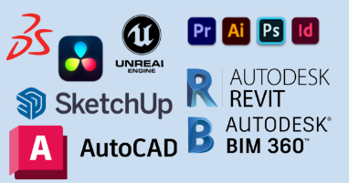
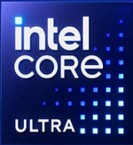
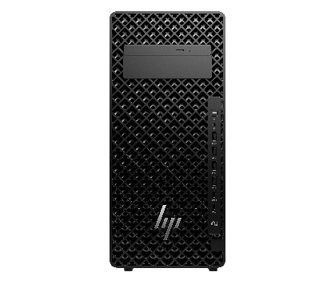
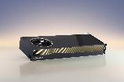


Z2 Tower G1i
Next Gen Intel® Core™ Ultra Processor¹
Game-changing power efficiency
More effective energy use while minimizing heat dissipation and fan noise
Up to 1200W², 92% platinum efficiency in all PSUs
Up to an Intel® Core™ Ultra 9 CPU
Optional K-Series for powerful added performance
HP Z2 Tower G1i
Fuel a more responsive system
Next Gen NVIDIA GPU
Up to 36 TB system storage¹⁶
Up to NVIDIA RTXTM 6000-series graphics²
Support for triple wide and 600W graphics
High speed memory
AI Enhanced CPU
Neural Processing Unit (NPU)^{3,9}
For real-time AI enhancements without sacrificing CPU resources
Up to 256 GB¹⁰⁷ DDR5 memory²
Latest DDR5 memory transfer speed with up to 5600 MT/s
AI
Fast access for large datasets and AI models
Wi-Fi 7
connectivity⁷¹
PCIe Gen 5² high speed bandwidth
8 | HP Z2 Tower G1i | HP Confidential. For use by HP or Partner with Customers under HP CDA only.
Notes:
1. Multicore is designed to improve performance of certain software products. Not all customers or software applications will necessarily benefit from use of this technology. Performance and clock frequency will vary depending on application workload and your hardware and software configurations. Intel’s numbering, branding and/or naming is not a measurement of higher performance. Features and software that require a NPU may require software purchase, subscription or enablement by a software or platform provider, and third-party software may have specific configuration or compatibility requirements. Performance varies by use, configuration, and other factors.
2. Optional feature that must be configured at purchase
3. AI applications that require an NPU may require software purchase, subscription or enablement by a software or platform provider, and third-party software may have specific configuration or compatibility requirements. Performance varies by use, configuration, and other factors.
9. Trillions of Operations per Second (TOPS) for an Intel processor is the maximum number of operations per second that can be executed in an optimal scenario and may not be typical. TOPS may vary based on several factors, including the specific system configuration, AI model, and software version.
14. HP Wolf Security for Business requires Windows 10 or 11 Pro and higher, includes various HP security features and is available on HP Pro, Elite, Workstation, and RPOS products. See product details for included security features.
16. For storage drives, GB = 1 billion bytes. Actual formatted capacity is less. Up to 30 GB (for Windows) is reserved for system recovery software
71. Wireless access point and Internet service required and sold separately. Availability of public wireless access points limited. Wi-Fi 7 (802.11BE) functionality requires compatible Windows 11 OS, compatible processor, and separately purchased Wi-Fi 7 router to support backwards compatibility with prior 802.11 specs. Available in countries where Wi-Fi 7 is supported. The specification for 802.11BE is a draft specification and is not final. If the final specification differs from the draft specification, it may affect the ability of the device to communicate with other 802.11BE devices.
107. Up to 192 GB memory is available at launch. Up to 256 GB memory is planned to be available in the second half of 2025.

Slide 9
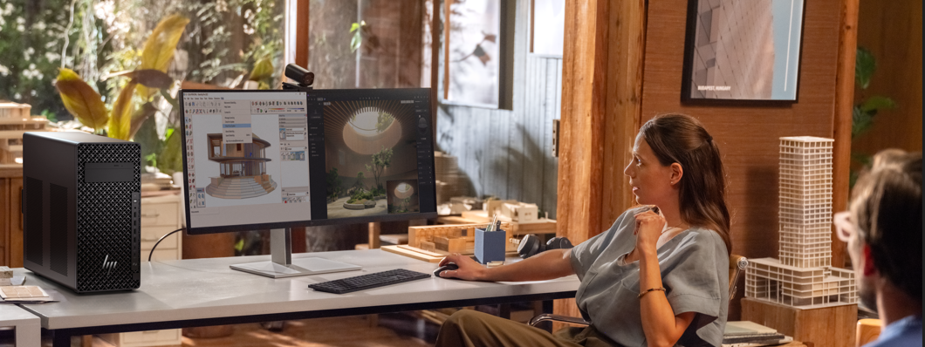
HP Z2 Tower G1i Workstation
Who uses this device?
9 | Z2 Tower G1i | HP Confidential. For use by HP or Partner with Customers under HP CDA only.

Slide 10
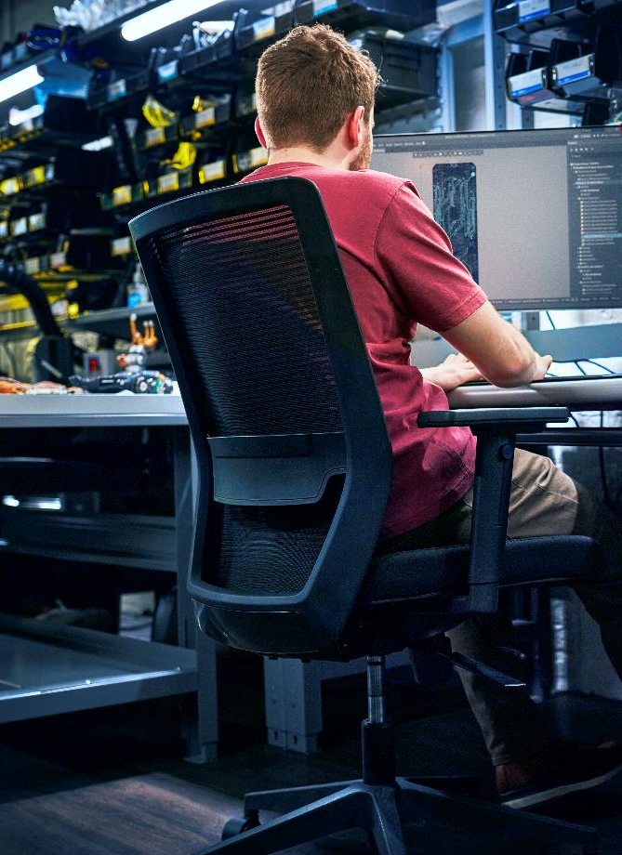




Product Designers
Product Development & Manufacturing (PD&M)
From 3D modeling and simulation to visualization and more, product designers need high-performance workstations for their increasingly demanding and complex workflows.
Key pain points:
Performance issues during multi-software usage
Graphic intensive software performance lags
Project-critical workflows require high standard compute with wide expandability for 600W high end graphics
In single-threaded environments, AutoCAD users need to model and quickly adapt to the demands of fast paced product development and environments.
Why Z2 Tower G1i for product designers
Uncompromised Performance: Up to 24-core Intel® Core™ Ultra 9 processors and powerful support for 600W, triple wide graphics (up to NVIDIA RTX 6000-series graphics) make this PC ideal for 3D modeling and speeding up the rendering process. Add optional K-Series for added performance.
High speed memory for near real-time responsiveness: With up to 12TB system storage, 256GB DDR5 memory, and 5600 MT/s, seamlessly work with large models and assemblies across applications—without having to wait while apps open and close.
Thermal solution to help complete high-performance tasks simultaneously: Smart fan control tunes fan speeds in real-time, and new lattice venting enables airflow intake.
Future-proofed: NPU allows AI tasks to be offloaded from the CPU and GPU to give creators the tools they need to take advantage of their software’s latest AI features.
Workflows
3D design and modelling, visualization, real time rendering, simulation
Software⁷⁷
Autodesk Inventor, Autodesk AutoCAD, Autodesk Fusion 360, V-Ray, SOLIDWORKS, Siemens NX
Notes:
Fast multi-threaded performance: Accelerate ray tracing and simulation in apps like SOLIDWORKS77 with up to 24-core Intel® Core™ Ultra 9 processors1
GOAL OF SLIDE:
To educate customers, within the PD&M industry, why Z2 Mini is the ideal device for product designers
DISCLAIMERS
1. Multicore is designed to improve performance of certain software products. Not all customers or software applications will necessarily benefit from use of this technology. Performance and clock frequency will vary depending on application workload and your hardware and software configurations. AMD’s numbering, branding and/or naming is not a measurement of higher performance
3. AI applications that require an NPU may require software purchase, subscription or enablement by a software or platform provider, and third-party software may have specific configuration or compatibility requirements. Performance varies by use, configuration, and other factors.
8. The AMD Ryzen AI MAX unified memory architecture supports system configurations of up to 128GB system memory and allows memory to be flexibly assigned between the CPU and GPU. When 128GB memory is configured, up to 96GB unified memory can be used for Radeon graphics, leaving up to 32GB reserved for system memory.
9. Trillions of Operations per Second (TOPS) for an AMD Ryzen processor is the maximum number of operations per second that can be executed in an optimal scenario and may not be typical. TOPS may vary based on several factors, including the specific system configuration, AI model, and software version.
13. Up to 128GB memory is an optional, configurable feature
15. Actual battery Watt-hours (Wh) will vary from design capacity. Battery capacity will naturally decrease with shelf life, time, usage, environment, temperature, system configuration, loaded apps, features, power management settings and other factors.
16. For storage drives, GB = 1 billion bytes. Actual formatted capacity is less. Up to 30 GB (for Windows) is reserved for system recovery software
77. Third party software sold separately

Slide 11
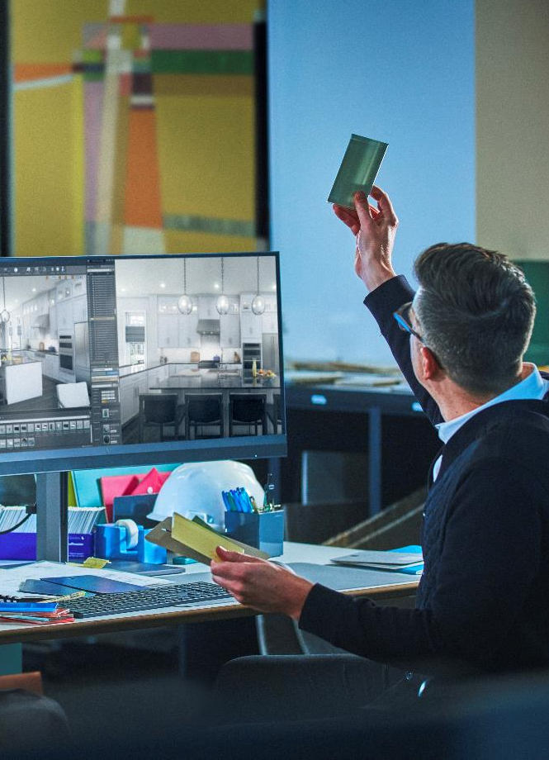
Design & Visualization Specialists
Architecture, Engineering & Construction (AEC)
Design and simulation can scale from the simple to the complex, and engineers need tools to enable their workflows up and down the complexity stack.
Key pain points:
Performance issues during multi-software usage
Graphic intensive software performance lags
Project-critical workflows require high standard compute with wide expandability for 600W high end graphics
Why Z2 Tower G1i for design & visualization specialists
Uncompromised Performance: Up to 24-core Intel® Core™ Ultra 9 processors and powerful support for 600W, triple wide graphics (up to NVIDIA RTX 6000-series graphics) make this PC ideal for 3D modeling and speeding up the rendering process. Add optional K-Series for added performance.
High speed memory for near real-time responsiveness: With up to 12TB system storage, 256GB DDR5 memory, and 5600 MT/s, work simultaneously with different data types and multiple instances of apps.
Thermal solution to help complete high-performance tasks simultaneously: Smart fan control tunes fan speeds in real-time, and new lattice venting enables airflow intake.
Future-proofed: NPU allows AI tasks to be offloaded from the CPU and GPU to give creators the tools they need to take advantage of their software’s latest AI features.
Workflows
3D design and modelling, visualization, real time rendering, simulation
Software⁷⁷
Autodesk AutoCAD, Autodesk Revit, D5 Render, Enscape V-Ray, Rhino, SketchUp, Bentley Microstation, Twinmotion
Notes:
GOAL OF SLIDE:
To educate customers, within the AEC industry, why Z2 Mini is the ideal device for design & visualization specialists
DISCLAIMERS
8. The AMD Ryzen AI MAX unified memory architecture supports system configurations of up to 128GB system memory and allows memory to be flexibly assigned between the CPU and GPU. When 128GB memory is configured, up to 96GB unified memory can be used for Radeon graphics, leaving up to 32GB reserved for system memory.
13. Up to 128GB memory is an optional, configurable feature
15. Actual battery Watt-hours (Wh) will vary from design capacity. Battery capacity will naturally decrease with shelf life, time, usage, environment, temperature, system configuration, loaded apps, features, power management settings and other factors.
16. For storage drives, GB = 1 billion bytes. Actual formatted capacity is less. Up to 30 GB (for Windows) is reserved for system recovery software
77. Third party software sold separately

Slide 12
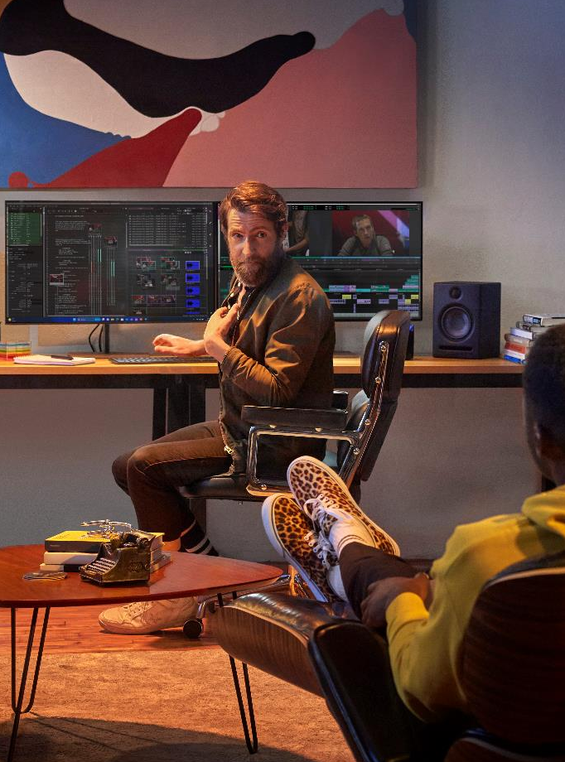
3D Artists & Animators
Media and Entertainment
Digitally model, manipulate and render realistic – or fantastical – 3D objects, environments, and characters.
Key pain points:
Inadequate memory and graphics for a) high-res rendering, b) large, complex models, and c) running multiple apps simultaneously
Why Z2 Tower G1i for 3D artists & animators
3D modeling tasks in applications like Autodesk Maya and Maxon Cinema 4D tend to be single-threaded and therefore favor CPU clock speed over number of cores⁴, so choose a high-frequency (at least 3.5GHz) 6- or 8-core processor.
Rendering applications like Autodesk Arnold and Pixar RenderMan are multi-threaded so can scale with higher CPU core counts – so if rendering on the same machine, choose maximum core options (up to 24 cores) or consider a more powerful machine.
When choosing a GPU, consider whether the renderer has GPU-accelerated features (Arnold, V-Ray) or is a GPU-only renderer (Redshift). Either way, most can take advantage of two GPUs while some, like SideFX Houdini’s Karma, can take advantage of multiple GPUs, so if rendering is a priority, the Z4 or higher might be a better option.
Workflows
Model, rig & animate – build a 3D polygon mesh of the character; apply a skeleton hierarchy of bone joints and bring characters to life by applying (retargeting) motion capture (mocap) data
Materials, paint and texture – add depth, dimension and realism with cloth, hair and other effects
Render – final step of the production process
Software⁷⁷
Model/rig/animate: Autodesk Maya, Autodesk 3ds Max, Maxon Cinema 4D, Adobe Substance 3D Collection & After Effects, Blender
Render: Autodesk Arnold, Maxon RedShift, Chaos Group V-Ray, Pixar RenderMan, Unreal Engine
Notes:
GOAL OF SLIDE:
To educate customers, within the M&E industry, why Z2 Mini is the ideal devices for Video Editorssorry
DISCLAIMERS
1. Multicore is designed to improve performance of certain software products. Not all customers or software applications will necessarily benefit from use of this technology. Performance and clock frequency will vary depending on application workload and your hardware and software configurations. AMD’s numbering, branding and/or naming is not a measurement of higher performance
2. Optional and must be configured at purchase
3. AI applications that require an NPU may require software purchase, subscription or enablement by a software or platform provider, and third-party software may have specific configuration or compatibility requirements. Performance varies by use, configuration, and other factors.
8. The AMD Ryzen AI MAX unified memory architecture supports system configurations of up to 128GB system memory and allows memory to be flexibly assigned between the CPU and GPU. When 128GB memory is configured, up to 96GB unified memory can be used for Radeon graphics, leaving up to 32GB reserved for system memory.
9. Trillions of Operations per Second (TOPS) for an AMD Ryzen processor is the maximum number of operations per second that can be executed in an optimal scenario and may not be typical. TOPS may vary based on several factors, including the specific system configuration, AI model, and software version.
13. Up to 128GB memory is an optional, configurable feature
16. For storage drives, GB = 1 billion bytes. Actual formatted capacity is less. Up to 30 GB (for Windows) is reserved for system recovery software
77. Third party software sold separately

Slide 13

Z2 Tower – Gen to Gen
 | Z2 Tower G9 | Z2 Tower G1i
Chassis | 20.4"H x 7.8"W x 19.3"D (384 x 100 x 308mm) (~23L) | 426D x 175W x 388H (xxx x xxx x xxxmm) (~28L) Enlarged chassis size +22%, to accommodate higher power Graphics
Processor(s) | Intel Alder Lake, Raptor Lake, RPL-2, up to 24 Core (8+16) 125W (i9K, i7K, i5K) 65W (i9, i7, i5, i3) | Intel® Core™ Ultra processors, up to 24 Core (8+16) 125W (Intel® Core™ Ultra 9 K, Intel® Core™ Ultra 7 K, Intel® Core™ Ultra 5 K ) 65W (Intel® Core™ Ultra 9, Intel® Core™ Ultra 7, Intel® Core™ Ultra 5 ) (No i3 CPU)
Graphics | 1x PCIe Gen5 x16 supporting up to Double Wide/350W graphics, 2x SW up to 55W Nvidia T400, T1000, RTX A2000, A4000, A5000, A6000 Geforce 3070, 3080, 3090, 4070, 4080 (up to 350W) | 1x PCIe Gen5 x16 supporting up to Triple Wide/600W graphics, 2x SW up to 55W Nvidia T400, T1000, RTX A2000, A4000, A5000, A6000 Geforce x070, x080, x090 + (up to 600W)
Performance Modes | High Performance Mode (default with RPL-2) Performance Mode Quiet Mode | High Performance Mode (default) – accelerated up to 250W Performance Mode Quiet Mode
PSU | Internal PSU 260W, 450W, 550W xx% Efficiency | Internal PSU 500W, 700W, 1200W Platinum (92% Efficiency)
Memory | DDR5, up to 128GB Max, ECC and nECC 2 channels, 2 DIMMs per channel (DPC) Up to 4800 MT/s | DDR5, up to 256GB Max, ECC and nECC (separate DIMMs) 2 channels, 2 DIMMs per channel (DPC) Up to 5600 MT/s
Storage | Up to 12TB (3x4TB NVMe modules, (3x PCIe Gen4), RAID 0,1 Front Removeable NVMe 1x (QX118) or Slim ODD HDD: 2x 3.5”, 1x 2.5” | Up to 12TB (3x4TB NVMe modules, 1x PCIe Gen5, 2x PCIe Gen4), RAID 0.1,5 Front Removeable NVMe 2x (QX328) or 1x (QX118), or Slim ODD Up to 2x3.5” HDD (RAID 0,1)
Rear IO (integrated) | Network: 1GbE - AMT Display: 2x DP 1.4 USB: 4x USB-A 10Gb, 2x USB-A 5Gb | Network: 1GbE - AMT (2.5GbE) Display: 2x DP 1.4 (HBR3) USB: 3x USB-A 10Gb, 2x USB-A 5Gb
Front IO (integrated) | USB: 2x USB3-A 10Gb, 2x USB-C 20Gb Audio: UAJ Headset | USB: 4x USB3-A 10Gb, 2x USB-C 20Gb Audio: UAJ Headset
FlexIO (optional, pick 1) | Network: 1GbE LAN, 2.5GbE LAN, 10GBase-T, 1GbE Fiber LC Display-capable: HDMI, DP 1.4, VGA, USB-C 10Gb Alt-DP, TBT3 Other USB: 1x USB-C 10Gb, 2x USB-A 5Gb Other IO: Serial | Network: 1GbE LAN, 2.5GbE LAN, 10GBase-T, 1GbE Fiber LC Display-capable: HDMI, DP 2.1, VGA, USB-C Alt-DP, TBT4 (TBT5 coming second half 2025) Other USB: USB-C 10Gb, 2x USB-A 5Gb Other IO: Serial
Wireless Network (optional) | Wi-Fi 6e & BT5.3, internal antenna | Wi-Fi 7 & BT5.4, internal antenna
Manageability / Rack | External/Internal Remote System Controller No Rack Solution | External/Internal Remote System Controller New Rack solution, horizontal alignment, 1 system/4U
13 I Z2 Tower G1i I HP Confidential. For use by HP or Partner with Customers under HP CDA only.
Notes:
Processor: Multicore is designed to improve performance of certain software products. Not all customers or software applications will necessarily benefit from use of this technology. Performance and clock frequency will vary depending on application workload and your hardware and software configurations. AMD’s numbering, branding and/or naming is not a measurement of higher performance
Memory: Optional and must be purchased at time of order
Graphics: Optional and must be purchased at time of order
Storage: For storage drives, GB = 1 billion bytes. Actual formatted capacity is less. Up to 30 GB (for Windows) is reserved for system recovery software
Power: Power Consumption Measurement with real-time total power usage tracking will release in 2024 on our commercial notebook line. The energy consumption data is planned to be available to end users within myHP and ITDMs via HP Proactive Insights in May 2024. Fleet management within HP Proactive Insights requires Windows 10 or higher and registration for the Workforce Experience platform at https://admin.hp.com. Some features and capabilities may require additional purchase of HP services and/or commercial hardware capable of supporting the HP Insights agent for Windows, Mac, & Android. Activation and restrictions may apply. Select HP Workforce Solutions require an HP Insights agent for Windows, Mac, & Android, available for download at https://admin.hp.com/software. For full system requirements and services that require the agent, please visit https://admin.hp.com/requirements. The agent collects telemetry and analytics around devices and applications that integrate into the Workforce Experience platform and is not sold as a standalone service. Internet access with connection to the Workforce Experience platform is required. HP follows stringent GDPR privacy regulations, and the platform is ISO27001, ISO27701, ISO27017 and SOC2 Type2 certified for Information Security.
Wi-Fi: Wireless access point and Internet service required and sold separately. Availability of public wireless access points limited. Wi-Fi 7 (802.11BE) functionality requires compatible Windows 11 OS, compatible processor, and separately purchased Wi-Fi 7 router to support backwards compatibility with prior 802.11 specs. Available in countries where Wi-Fi 7 is supported. The specification for 802.11BE is a draft specification and is not final. If the final specification differs from the draft specification, it may affect the ability of the device to communicate with other 802.11BE devices.
Sustainability:
18. MIL STD testing is not intended to demonstrate fitness for U.S. Department of Defense contract requirements or for military use. Test results are not a guarantee of future performance under these test conditions. Accidental Damage or damage under these test conditions requires an optional HP Accidental Damage Protection Care Pack.
43. Based on US EPEAT® registration according to IEEE 1680.1-2018 EPEAT®. EPEAT® status varies by country. Visit www.epeat.net for more information.
45. Recycled metal is expressed as a percentage of the total weight of the metal according to ISO 14021 definitions for metal parts over 25 grams. Percent of recycled material varies by product.
47. 100% outer box packaging made from sustainably sourced certified and recycled fibers. Fiber cushions made from 100% recycled wood fiber and organic material. Any plastic cushions are made from >90% recycled plastic.
63. Applies to HP PCs, Workstations, and Displays manufactured after January 2019. Based on most Gold and Silver (including Climate+) EPEAT® registrations and according to IEEE 1680.1-2018 EPEAT®. Status varies by country. Visit www.epeat.net for more information
101. Recycled metal is expressed as a percentage of the total weight of the metal according to ISO 14021 definitions for metal parts over 25 grams. Percent of recycled material varies by product.
102. HP paper and fiber based packaging for PCs, displays, home and office print, and supplies is reported by suppliers as recycled or certified, with a minimum of 97% by volume verified by HP. Packaging is the box that comes with the product and all paper-based materials inside the box. Packaging for personal systems accessories and spare parts is not included.
104. Select household wipes can be safely used to clean HP Elite and Workstation, and HP ProBook 635 Aero PCs up to 1,000 wipes: See wipe manufacturer’s instructions for disinfecting and the HP cleaning guide for HP tested wipe solutions at How to Sanitize Your HP Device Whitepaper (http://h20195.www.2.hp.com/v2/GetDocument.aspx?docname=4AA7-7610ENW) not applicable to HP Elite c1030 Chromebook.
105. HP Services are governed by the applicable HP terms and conditions of service provided or indicated to Customer at the time of purchase. Customer may have additional statutory rights according to applicable local laws, and such rights are not in any way affected by the HP terms and conditions of service or the HP Limited Warranty provided with your HP Product.
106. The HP Device Life Extension capability is for HP commercial PCs. HP-certified partners will perform functional diagnostics, data removal, interior and exterior cleaning, enhance device performance, reimaging, and conduct platform updates. This service is available as a Care Pack when it is sold with new hardware or within 120 days of the original Care Pack expiration date.
108. HP’s Total Test Process is not a guarantee of future performance under these test conditions. Accidental damage or damage under these test conditions requires an optional HP Accidental Damage Protection Care Pack.

Slide 14
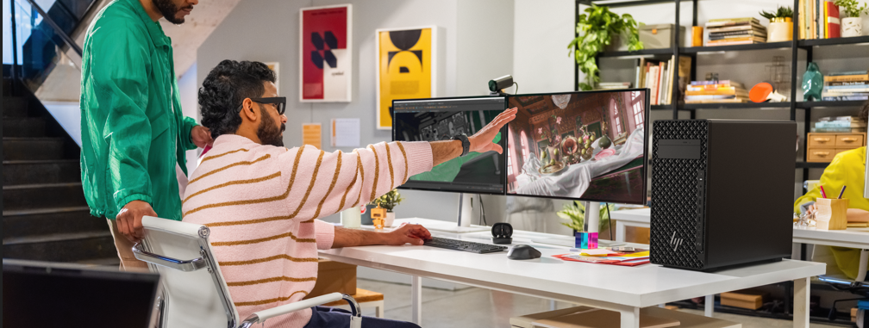
HP Z2 Tower G1i Desktop Workstation
Product features
14 | Z2 Tower G1i HP Confidential. For use by HP or Partner with Customers under HP CDA only.
HP Confidential. For HP and Partner use with Customers under HP CDA only.

Slide 15












Z2 Tower G1i
RTP March 2025
Windows 11 Pro,⁴⁸ WSL2 or Linux® operating systems
Up to next gen desktop class Intel® Core™ Ultra 9 processor¹
NVIDIA RTX™ GPU²
Protected by HP Wolf Security¹⁴
Up to Wi-Fi 7^{71,}
Leading performance for Low CPU Core count applications
High Single Thread CPU performance in our portfolio with K-series CPUs and High Performance mode to optimize speed for many applications (esp. in PD&M & AEC).
AI-enhanced CPU with dedicated NPU^{3,9} not only unlocks a new level of performance for heavy workflows, but brings AI to Intel based desktop and mainstream workstation platforms.
New levels of Graphics performance and Memory
Run large models and assemblies with up to 256GB¹⁰⁷ memory² and fast memory data transfer speeds of up to 5600 MT/s.
Redefined Cooling
Smart fan control tunes fan speeds in real-time and new lattice venting enables airflow intake.
High Performance Mode
Take on the toughest workflows with High Performance Mode set as the default. Easily change to Performance Mode, Quiet Mode, or Rack Mode with a BIOS setting.
Rack Deployment solutions and Manageability,
The most compelling rack-based client solution for performance, manageability, security and value.
HP Anyware Ease of Use
New levels of Ease of use to bring amazing compute performance for hybrid work.
15 | Z2 Tower G1i | HP Confidential. For use by HP or Partner with Customers under HP CDA only.
Notes:
DISCLAIMERS
1. Multicore is designed to improve performance of certain software products. Not all customers or software applications will necessarily benefit from use of this technology. Performance and clock frequency will vary depending on application workload and your hardware and software configurations. Intel’s numbering, branding and/or naming is not a measurement of higher performance. Features and software that require a NPU may require software purchase, subscription or enablement by a software or platform provider, and third-party software may have specific configuration or compatibility requirements. Performance varies by use, configuration, and other factors.
2. Memory is an optional feature that must be configured at purchase
3. AI applications that require an NPU may require software purchase, subscription or enablement by a software or platform provider, and third-party software may have specific configuration or compatibility requirements. Performance varies by use, configuration, and other factors.
5. Trillions of Operations per Second (TOPS) for an Intel processor is the maximum number of operations per second that can be executed in an optimal scenario and may not be typical. TOPS may vary based on several factors, including the specific system configuration, AI model, and software version
14. HP Wolf Security for Business requires Windows 10 or 11 Pro and higher, includes various HP security features and is available on HP Pro, Elite, Workstation, and RPOS products. See product details for included security features.
48. Not all features are available in all editions or versions of Windows. Systems may require upgraded and/or separately purchased hardware, drivers, software or BIOS update to take full advantage of Windows functionality. Windows 11 Pro is automatically updated, which is always enabled. ISP fees may apply and additional requirements may apply over time for updates. See http://www.windows.com.
71. Wireless access point and Internet service required and sold separately. Availability of public wireless access points limited. Wi-Fi 7 (802.11BE) functionality requires compatible Windows 11 OS, compatible processor, and separately purchased Wi-Fi 7 router to support backwards compatibility with prior 802.11 specs. Available in countries where Wi-Fi 7 is supported. The specification for 802.11BE is a draft specification and is not final. If the final specification differs from the draft specification, it may affect the ability of the device to communicate with other 802.11BE devices.
107. Up to 192 GB memory is available at launch. Up to 256 GB memory is planned to be available in the second half of 2025.

Slide 16


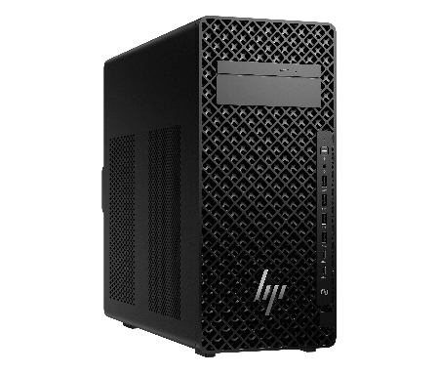
Product Highlights
Weight²⁶
Starting at 8.8 kg (19 lbs.)
Volume
29L
Dimensions
426mm D x 175mm W x 388mm H
16.77” x 6.89” x 15.28”
HP Z2 Tower G1i
Powerful AI workstation performance
Up to 24-core Intel® Core™ Ultra 9 processors¹ , with 13 TOPS NPU^{3,9}
Optional K-Series for added performance
Game-changing power efficiency enabled by 4nm technology that delivers more effective energy use while minimizing heat dissipation and fan noise.
Up to 1200W², 92% platinum efficiency
Lattice mesh design to enable airflow intake for cooling of product
Power to grow with 22% enlarged chassis
Up to triple wide/600W graphics²
Up to NVIDIA RTX™ 6000-series GPU, delivering 1,457 AI TOPS
High speed memory for near real-time responsiveness
Up to 5600 MT/s, up to 256 GB ¹⁰⁷
Storage¹⁶ for performance users
Up to 12TB (3 x 4TB NVMe modules - 1x PCIe Gen5, 2x PCIe Gen4)
Up to 2x 12TB HDD
High Performance Mode
Take on the toughest workflows with High Performance Mode set as the default. Easily change to Performance Mode, Quiet Mode, or Rack Mode with a BIOS setting.
Connectivity Upgrade Wi-Fi 7⁷¹, Bluetooth 5.4 and internal antenna provides lightning-fast connectivity. Dual-port Thunderbolt 5 provides up to 80Gb/s data bandwidth for peripherals and up to 120Gb/s display bandwidth.¹¹¹
Rack Solution
High density rack mount with support for 1 unit in a 4U⁶⁷ rack
Responsibly crafted with 100% recycled rare earth elements in speaker magnet, up to 20% recycled steel, 60% recycled plastics, and 100% sustainable materials on the packaging. ^{19,20,23,24}
Security
Stay protected with HP Wolf Security¹⁴
Manageability
Optional HP Remote System Controller^{72,73}
16 | Z2 Tower G1i | HP Confidential. For use by HP or Partner with Customers under HP CDA only.
Notes:
_____________________________________
DISCLAIMERS
1. Multicore is designed to improve performance of certain software products. Not all customers or software applications will necessarily benefit from use of this technology. Performance and clock frequency will vary depending on application workload and your hardware and software configurations. Intel’s numbering, branding and/or naming is not a measurement of higher performance
2. Optional and must be purchased at time of order
3. AI applications that require an NPU may require software purchase, subscription or enablement by a software or platform provider, and third-party software may have specific configuration or compatibility requirements. Performance varies by use, configuration, and other factors.
9. Trillions of Operations per Second (TOPS) for an Intel processor is the maximum number of operations per second that can be executed in an optimal scenario and may not be typical. TOPS may vary based on several factors, including the specific system configuration, AI model, and software version.
14. HP Wolf Security for Business requires Windows 10 or 11 Pro and higher, includes various HP security features and is available on HP Pro, Elite, Workstation, and RPOS products. See product details for included security features.
16. For storage drives, GB = 1 billion bytes. Actual formatted capacity is less. Up to 30 GB (for Windows) is reserved for system recovery software
19. 100% outer box packaging made from sustainably sourced certified and recycled fibers. Fiber cushions made from 100% recycled wood fiber and organic material. Any plastic cushions are made from >90% recycled plastic.
20. Recycled metal is expressed as a percentage of the total weight of the metal according to ISO 14021 definitions for metal parts over 25 grams. Percent of recycled material varies by product.
21. Percentage of ocean-bound plastic contained in each component varies by product. Ocean Bound plastic is expressed as a percentage of the total weight plastic. Ocean Bound plastic is based on the definition set by the UL2809 standard.
23. Applies to HP PCs, Workstations, and Displays manufactured after January 2019. Based on most Gold and Silver (including Climate+) EPEAT® registrations and according to IEEE 1680.1-2018 EPEAT®. Status varies by country. Visit www.epeat.net for more information.
24. Recycled plastic is expressed as a percentage of the total weight plastic. Post-consumer recycled is based on the definition set in the EPEAT standard for computers, IEEE 1680.1-2018 standard. Percent of recycled material varies by product.
26. Actual weight will vary by configuration.
67. Rack mounting hardware sold separately
71. Wireless access point and Internet service required and sold separately. Availability of public wireless access points limited. Wi-Fi 7 (802.11BE) functionality requires compatible Windows 11 OS, compatible processor, and separately purchased Wi-Fi 7 router to support backwards compatibility with prior 802.11 specs. Available in countries where Wi-Fi 7 is supported. The specification for 802.11BE is a draft specification and is not final. If the final specification differs from the draft specification, it may affect the ability of the device to communicate with other 802.11BE devices.
72. Internet access required.
73. Internet access required. Fleet management requires HP Remote System Management.
.
This slide contains a superlative claim/s that cannot be used in all countries:
EMEA Use Restrictions:
DO NOT USE the superlative claim in the following countries:
Romania, Slovakia, Turkey, UAE, Russia, CIS countries (Armenia, Belarus, Kazakhstan, Kyrgyzstan, Moldova, Russia, Tajikistan, Turkmenistan, Ukraine, and Uzbekistan), Indonesia, Vietnam, Malaysia
APJ Use Restrictions:
China, Vietnam, Indonesia, Malaysia – DO NOT use
LAR Use Restrictions:
Brazil, Mexico – Do NOT use
HP EMEA Region
France – Yes, but must publish substantiation report, translated if required locally; should have local country url leading to the posted report added to the disclaimer;
Rest of EU countries – Yes. No report required to be posted. Do not post substantiation reports.
Netherlands, Serbia, Switzerland, Israel, MEMA- Yes; no reports required to be published; MEMA countries: Yes, may use claims with caution.
Do NOT publish substantiation reports containing competitor names in MEMA countries; Romania, CIS Countries, Turkmenistan, Russia, Turkey, UAE, Saudi Arabia-No

Slide 17
Z2 Tower G1i - Reengineered performance. Refined cooling.
Unleash the power of up to 600W, triple-wide graphics plus a 24 core Intel® Core™ Ultra 9 processor¹, including K-Series. New lattice venting optimizes airflow intake.
Up to 24-core Intel® Core™ Ultra 9 processors¹
Intel K-Series CPUs
Z2 G1i supports 250W sustained TDP with K-series CPUs, enabled by redesigned thermals and power delivery.
Power to grow with 22% bigger chassis
Up to triple wide/600W graphics²
Up to NVIDIA RTXTM 6000 Ada Generation GPUs
AI-enhanced CPU with a dedicated NPU^{3,9}
Up to 1200W² power supply for expandability
Fast data transfer speeds up to 5600 MT/s
Smart fan control tunes fan speeds in real-time. New lattice venting optimizes airflow intake.
17 | Z2 Tower G1i | HP Confidential. For use by HP or Partner with Customers under HP CDA only.
Notes:
1. Multicore is designed to improve performance of certain software products. Not all customers or software applications will necessarily benefit from use of this technology. Performance and clock frequency will vary depending on application workload and your hardware and software configurations. Intel’s numbering, branding and/or naming is not a measurement of higher performance
2. Memory is an optional feature that must be configured at purchase
3. AI applications that require an NPU may require software purchase, subscription or enablement by a software or platform provider, and third-party software may have specific configuration or compatibility requirements. Performance varies by use, configuration, and other factors.
9. Trillions of Operations per Second (TOPS) for an Intel processor is the maximum number of operations per second that can be executed in an optimal scenario and may not be typical. TOPS may vary based on several factors, including the specific system configuration, AI model, and software version.

Slide 18

Enhance your workloads and productivity with K-Series
HP Z2 Tower G1i
Choose optional K-Series skus for premium performance and productivity
The K-Series is an optional 125W processor¹ and contributes to users gaining more power for multi-threaded workflows.
Z2 G1i supports 250W sustained TDP with K-Series CPUs, enabled by redesigned thermals and power delivery.
In multi-threaded workflows like rendering and simulation, the Intel® K-Series processor provides a performance advantage over the standard.
With K-Series, even when using all cores, turbo frequency is maintained.
K-Series provides all core active turbo frequency that enhances multi-threaded performance.
18 | Z2 Tower G1i | HP Confidential. For use by HP or Partner with Customers under HP CDA only.
Notes:
_______________________
DISCLAIMERS
1. Multicore is designed to improve performance of certain software products. Not all customers or software applications will necessarily benefit from use of this technology. Performance and clock frequency will vary depending on application workload and your hardware and software configurations. Intel’s numbering, branding and/or naming is not a measurement of higher performance

Slide 19



Z2 Tower G1i – Built to expand. Power to grow.
Need to upgrade graphics? Increase memory or storage? Add specialized PCIe cards²? With room to expand and tool-less access, you can easily upgrade and add components as needs evolve.
Customize to fit your workflow
With up to 36TB total system storage¹⁶
12TB storage (3 x 4TB NVMe modules - 1x PCIe Gen5, 2x PCIe Gen4)
2 x 12TB HDD
Focus on the future
With PCIe Gen 5 high speed bandwidth
Fast data transfer speeds of up to 5600 MT/s and up to 256 GB ¹⁰⁷ DDR5 memory
Power for possibilities
With up to 1200W², 92% Platinum efficiency in all PSUs
19 | Z2 Tower G1i | HP Confidential. For use by HP or Partner with Customers under HP CDA only.
Notes:
2. Optional and must be purchased at time of order
16. For storage drives, GB = 1 billion bytes. Actual formatted capacity is less. Up to 30 GB (for Windows) is reserved for system recovery software
107. Up to 192 GB memory is available at launch. Up to 256 GB memory is planned to be available in the second half of 2025.

Slide 20
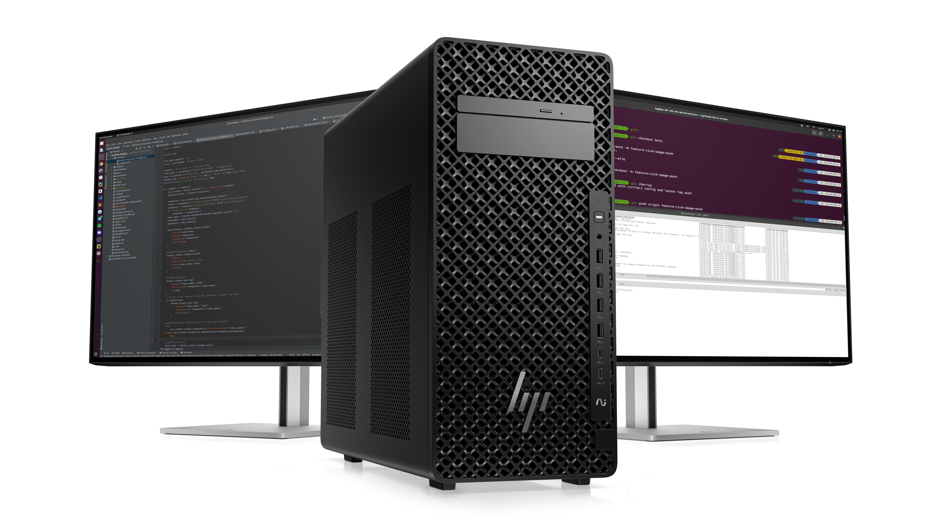
Advanced AI Experiences
HP Z2 Tower G1i
Power AI-accelerated workflows in-house Ai innovation
Accelerate AI inferencing and development. Iterate and problem solve faster on your local device with up to an NVIDIA RTX™ 6000 Ada Generation GPU delivering up to 1,457 AI TOPS. A built-in NPU^{3,9} efficiently takes on productivity tasks.
AI-enhanced CPU with dedicated NPU^{3,9} not only unlocks a new level of performance for heavy workflows, but brings AI to Intel based desktop and mainstream workstation platforms
36 base system TOPS, 13 NPU TOPS, 3 AI accelerators built in
Up to 1,457 AI TOPS (with NVIDIA 6000 Ada Generation GPU)^{3.9}
20 | Z2 Tower G1i | HP Confidential. For use by HP or Partner with Customers under HP CDA only.
Notes:
3. AI applications that require an NPU may require software purchase, subscription or enablement by a software or platform provider, and third-party software may have specific configuration or compatibility requirements. Performance varies by use, configuration, and other factors.
9. Trillions of Operations per Second (TOPS) for an Intel processor is the maximum number of operations per second that can be executed in an optimal scenario and may not be typical. TOPS may vary based on several factors, including the specific system configuration, AI model, and software version.

Slide 21
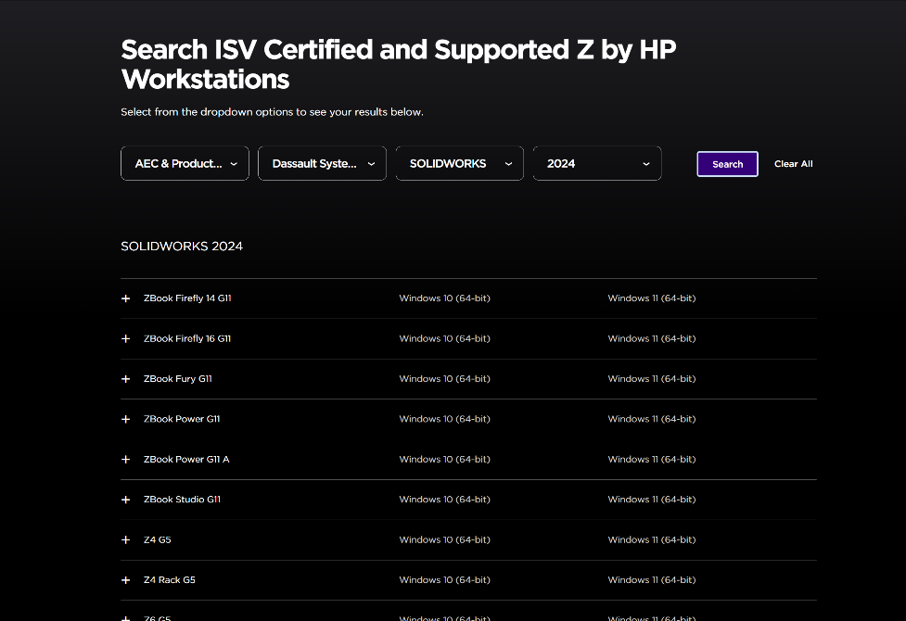
Extensive ISV testing and certification¹¹
Ensures peak performance
and reliability from
professional applications
HP works closely with ISVs¹¹ from the beginning – both in the development of new hardware and in the design of new software or a software revision.
Provides the confidence and productivity of total compatibility between your hardware and software.
Tested and certified across an array of industries and applications.
For more information or to search for ISV compatibility visit: https://www.hp.com/us-en/workstations/isv-certifications/mcad-isv-certification.html
21 | HP Z2 Tower G1i | HP Confidential. For use by HP or Partner with Customers under HP CDA only.
Notes:
[TALK TRACK]
For workflows requiring workstation level performance, ISV applications are the foundation for workflows requiring the power of a workstation PC. HP works closely with ISVs starting early in the development cycle to perform the right level of testing and ensure every HP Z and Zbook workstation is certified. We understand the importance of ISVs and are dedicated to making the device selection and fleet deployment as seamless as possible.
DISCLAIMERS:
11. Some software vendors do not test the exact combinations of the hardware listed here, but rather publish a minimum configuration specification they will support.​

Slide 22


Custom Performance Modes
Choose from 4 pre-set modes from the BIOS customized for your needs & environment.
High Performance Mode – set as default for taking on your toughest workflows
Performance Mode – balance between performance and acoustics
Rack Mode - increases system fan speeds to enable dense rack populations
Quiet Mode – when you want to prioritize acoustics over performance
22 I Z6 G5 I HP Confidential. For use by HP or Partner with Customers under HP CDA only.
22 | Z2 Tower G1i | HP Confidential. For use by HP or Partner with Customers under HP CDA only.
Notes:
Talk track (need to update to AMD solution):
HP’s High-Performance Mode utilizes Intel® Adaptix™ Technology (including Intel® Dynamic Tuning Technology or DTT framework)
HP has taken Intel’s innovation to the next level leveraging our proprietary thermal solution, maximizing CPU clock speed to provide performance gains. User will experience increased performance in multi threaded applications and work flows.
High Performance Mode kicks in before the job starts, adjusting to the rapid increase in CPU usage that comes with heavy work loads and starts cooling immediate in advance of higher temperatures that come with heavy workloads.
Intel® Adaptix™ Technology requires Windows 10 and BIOS set to High Performance Mode.

Slide 23

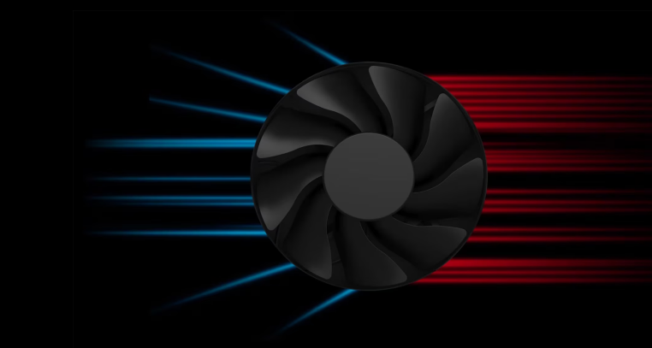
Thermals – Keep Cool Under Any Workload
Phase Change Cooling
Phase change CPU cooling optimizes heat transfer, enabling better performance and greater reliability than traditional liquid cooling solutions.
Fans and Venting
Sensors and proprietary algorithms detect when your system is about to heat up, activating the fans to prevent overheating during your toughest projects. New lattice venting optimizes airflow intake.
Unthrottled Performance
HP Z2 Tower's thermal technology keeps the processor and graphics card consistently cool, so they can run at max performance without throttling.
23 | Z2 Tower G1i | HP Confidential. For use by HP or Partner with Customers under HP CDA only.
Notes:
_______________________
DISCLAIMERS
26. Wireless access point and Internet service required and sold separately. Availability of public wireless access points limited. Wi-Fi 7 (802.11BE) functionality requires Windows 11 24H2, select Intel® processor, and a Wi-Fi 7 router, sold separately. Wi-Fi 7 is backwards compatible with prior 802.11 specs. Available in countries where Wi-Fi 7 is supported. The specification for 802.11BE is a draft specification and is not final. If the final specification differs from the draft specification, it may affect the ability of the device to communicate with other 802.11BE devices.
46. Wi-Fi® supporting gigabit data rate is achievable with Wi-Fi 7 (802.11BE) when transferring files between two devices connected to the same router. Requires a wireless router, sold separately, that supports 160MHz channels.

Slide 24
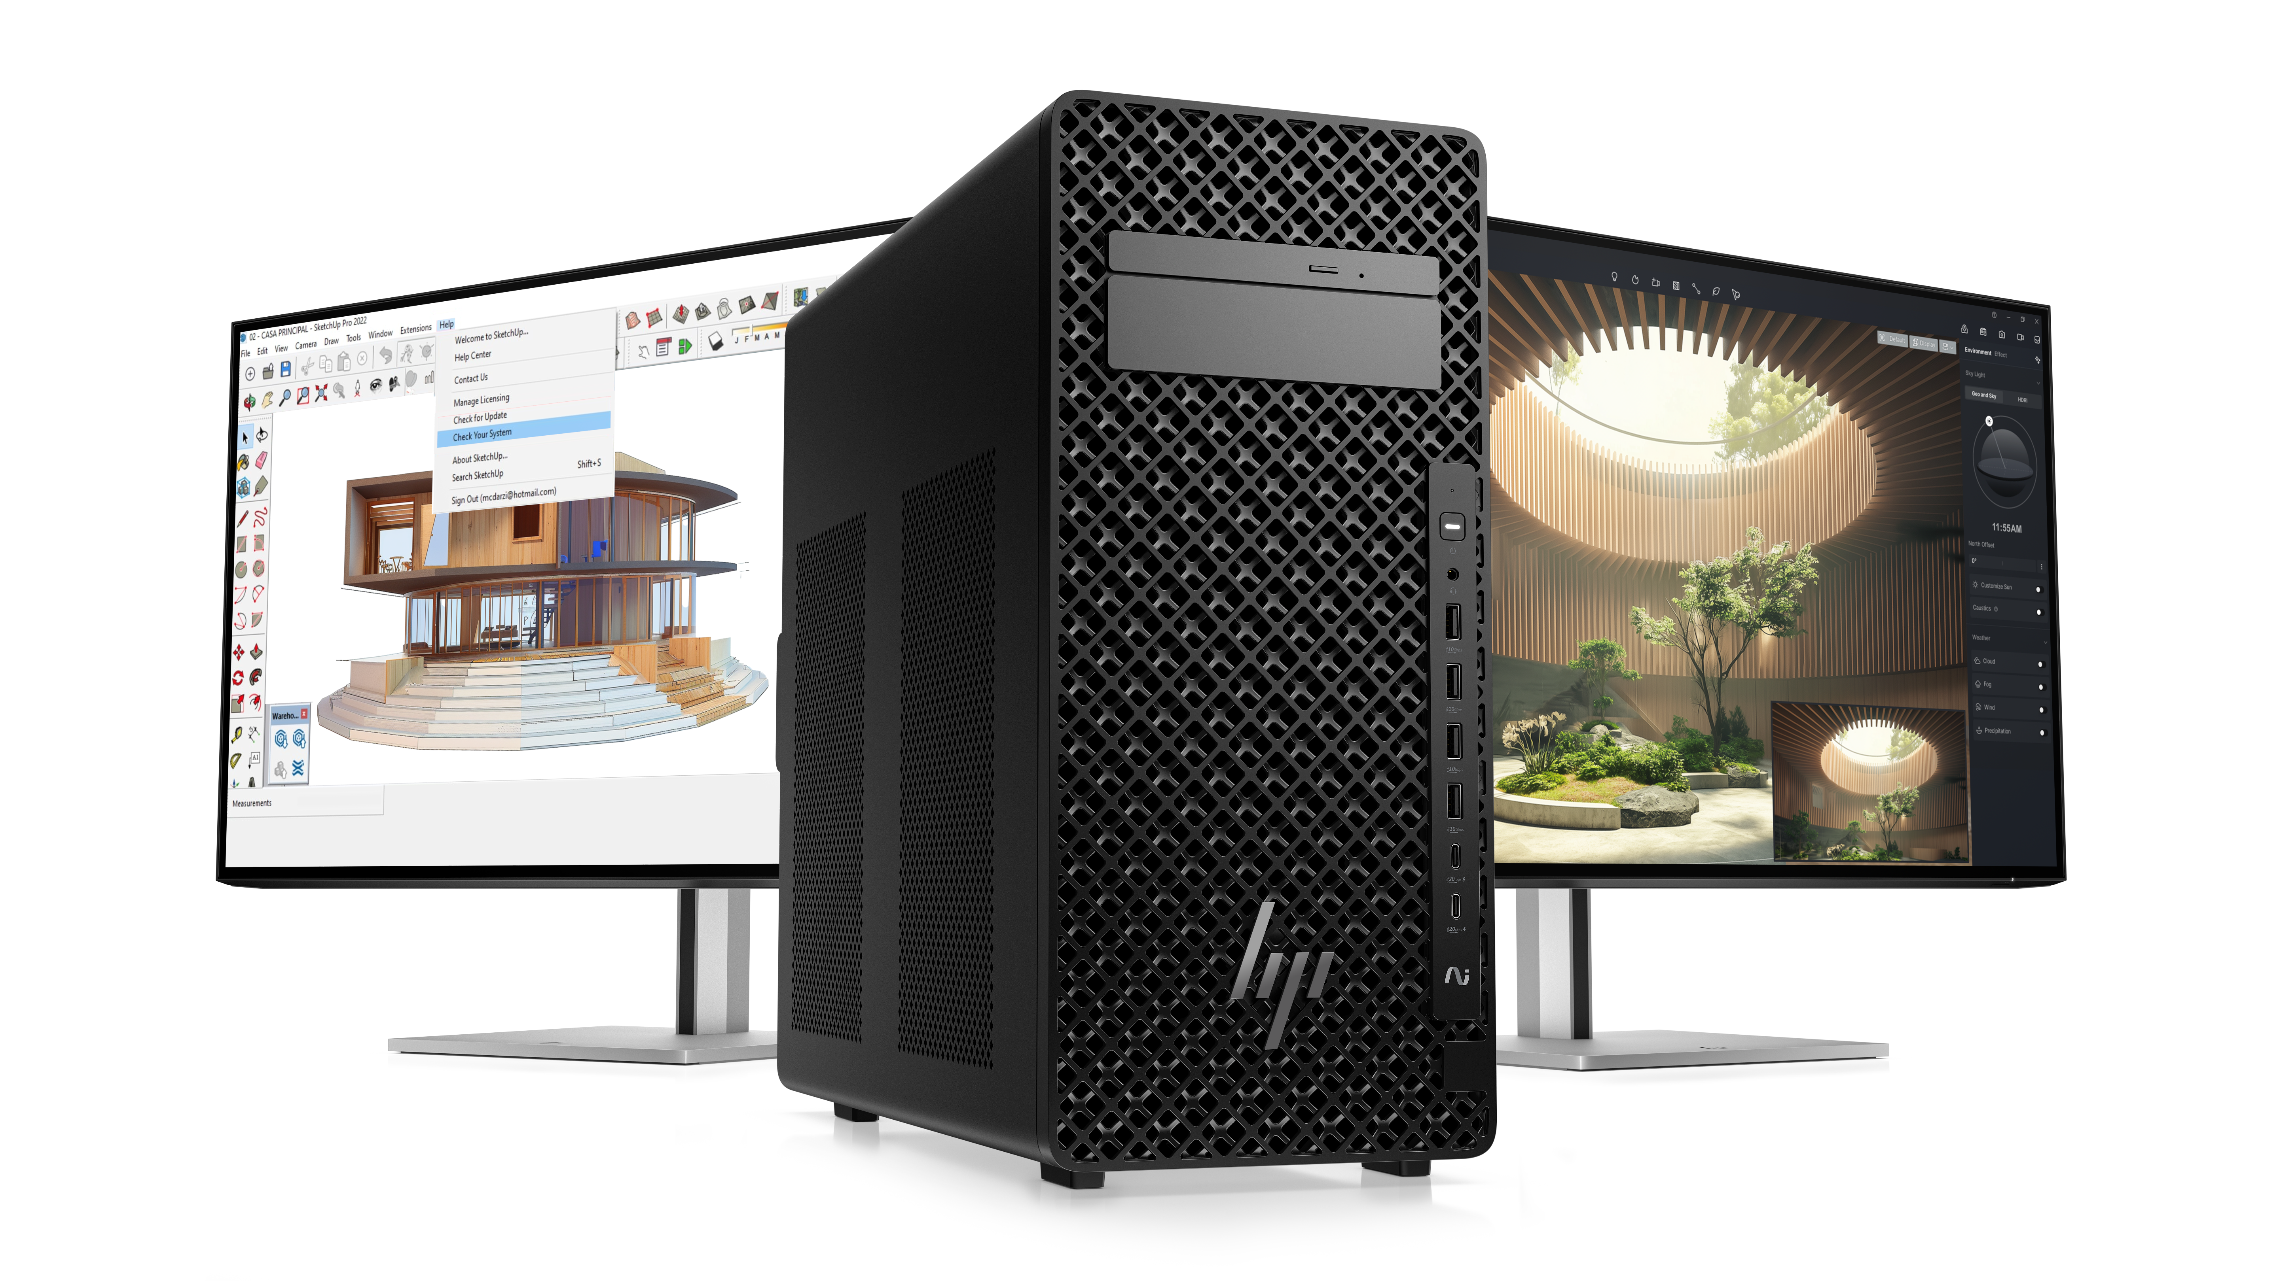
Easy connectivity
HP Z2 Tower G1i
7
Fast and efficient Wi-Fi 7
Get a fast and reliable connection in dense wireless environments with gigabit data rate Wi-Fi 7.^{26,46}
Dual-port Thunderbolt 5 provides up to 80Gb/s data bandwidth for peripherals and up to 120Gb/s display bandwidth.¹¹¹
24 | Z2 Tower G1i | HP Confidential. For use by HP or Partner with Customers under HP CDA only.
Notes:
_______________________
DISCLAIMERS
26. Wireless access point and Internet service required and sold separately. Availability of public wireless access points limited. Wi-Fi 7 (802.11BE) functionality requires Windows 11 24H2, select Intel® processor, and a Wi-Fi 7 router, sold separately. Wi-Fi 7 is backwards compatible with prior 802.11 specs. Available in countries where Wi-Fi 7 is supported. The specification for 802.11BE is a draft specification and is not final. If the final specification differs from the draft specification, it may affect the ability of the device to communicate with other 802.11BE devices.
46. Wi-Fi® supporting gigabit data rate is achievable with Wi-Fi 7 (802.11BE) when transferring files between two devices connected to the same router. Requires a wireless router, sold separately, that supports 160MHz channels.

Slide 25
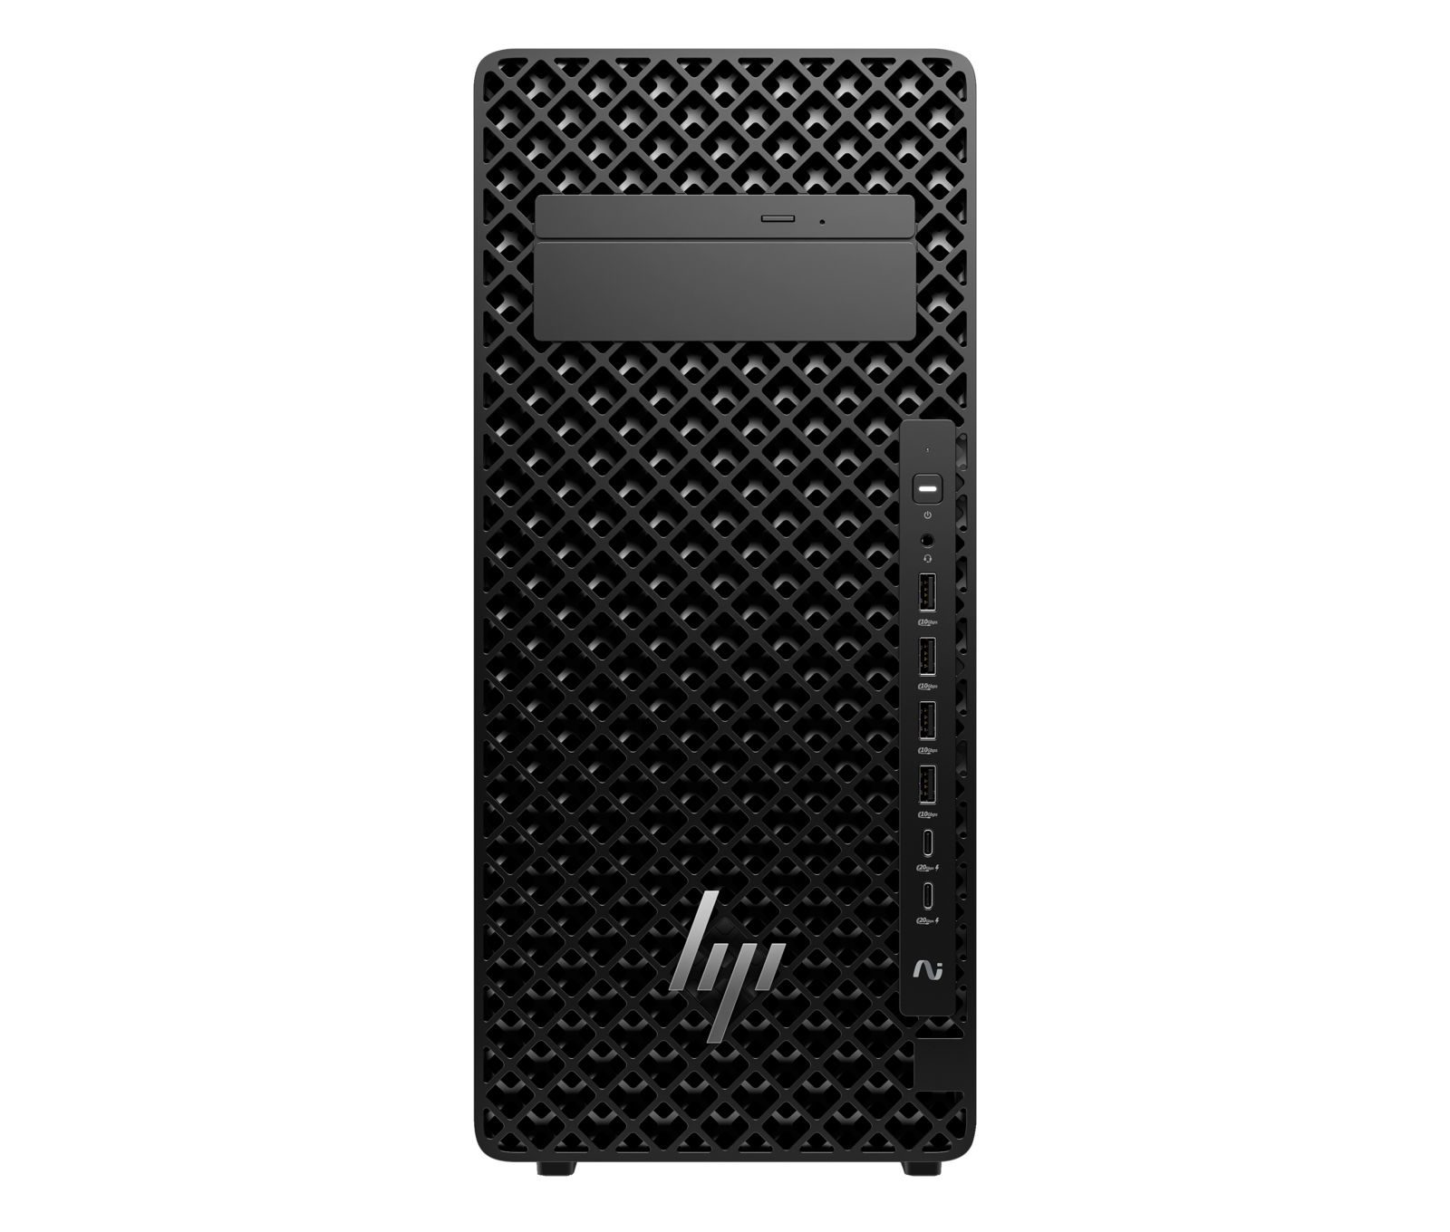
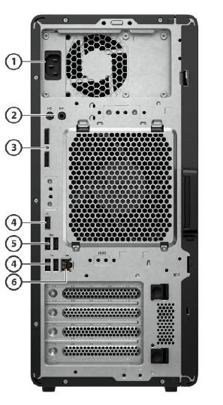
Customized connections
HP Z2 Tower G1i
Slim ODD Bay
1
Power Connector
External 5.25” Bay
1 Audio Line-in jack
1 Audio Line-out jack
2
Power Button
3
2 DisplayPort 1.4 ports
Headphone/mic combo
4
3 Hi-Speed USB-A 480Mbps ports
4 USB-A 10Gbps ports
5
2 USB-A 10Gbps ports
2 USB-C 20Gbps ports (charge supports
6
1 1Gb LAN
25 | Z1 SFF G1i | HP Confidential. For use by HP or Partner with Customers under HP CDA only.
Notes:
_______________________
DISCLAIMERS
26. Wireless access point and Internet service required and sold separately. Availability of public wireless access points limited. Wi-Fi 7 (802.11BE) functionality requires Windows 11 24H2, select Intel® processor, and a Wi-Fi 7 router, sold separately. Wi-Fi 7 is backwards compatible with prior 802.11 specs. Available in countries where Wi-Fi 7 is supported. The specification for 802.11BE is a draft specification and is not final. If the final specification differs from the draft specification, it may affect the ability of the device to communicate with other 802.11BE devices.
46. Wi-Fi® supporting gigabit data rate is achievable with Wi-Fi 7 (802.11BE) when transferring files between two devices connected to the same router. Requires a wireless router, sold separately, that supports 160MHz channels.

Slide 26
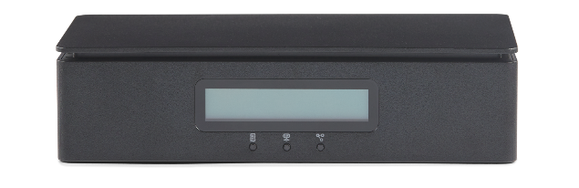
Complete out of Band Remote Workstation Management
WORKSTATION FLEET MANAGEMENT – FROM ANYWHERE
Manage and monitor your fleet of workstations from any location.⁷²
ONE CONSOLE. ALL ACCESS.
Perform out of band management tasks through a single interface—remotely.⁷³
HP Remote System Controller
MULTIPLE OPTIONS FOR EASY DEPLOYMENT ¹⁰⁹
Unleash your ability to deploy distributed workstations with an easy to deploy solution.⁷⁴
SECURITY YOU NEED. CONTROL YOU WANT.
Based on a zero-trust model with extensive testing, HP Remote System Controller is a secure, browser based remote IT management access to workstations.
26 | Z2 Tower G1i | HP Confidential. For use by HP or Partner with Customers under HP CDA only.
Notes:
________________________ DISCLAIMERS
72. Internet access required.
73. Internet access required. Fleet management requires HP Remote System Management.
3. HP Integrated Remote System Controller not compatible with Z2 Mini platforms and not recommended for non-Z devices.
74. HP service and support not available for non-Z devices.

Slide 27


HP Services
FPO
27 | Z2 Tower G1i | HP Confidential. For use by HP or Partner with Customers under HP CDA only.

Slide 28





HP Services⁷⁶
Complete solutions to enable your workforce—anywhere
HP TechPulse: delivering actionable insights⁷⁷
Provision and deploy
Simplicity
Send devices and apps to users with ease
Monitor and manage
Proactive
Maximize uptime with proactive insights
Secure
Protection
Work securely anywhere with multi-layered protection
Support
Automation
Better experiences with automated support
Recover and renew
Sustainability
Create higher residual value, be Earth-friendly
28 | Z2 Tower G1i | HP Confidential. For use by HP or Partner with Customers under HP CDA only.
Notes:
________________________________ DISCLAIMERS
76. HP Services are sold separately and are governed by the applicable HP terms and conditions of service provided or indicated to the customer at the time of purchase. Customers may have additional statutory rights according to applicable local laws, and such rights are not in any way affected by the HP terms and conditions of service or the HP limited warranty provided with your HP product.
77. HP TechPulse is a telemetry and analytics platform that provides critical data around devices and applications and is not sold as a standalone service. HP TechPulse follows stringent GDPR privacy regulations and is ISO27001, ISO27701, ISO27017, and SOC2 Type2 certified for Information Security. Internet access with connection to TechPulse portal is required. For full system requirements, please visit http://www.hpdaas.com/requirements.

Slide 29





Benefits of managed services⁷⁶
Reduce IT cost and complexity
World-class lifecycle services
AI-driven analytics
Improve the employee experience
Keep employees productive
Measure employee experience
Free up cash flow
Flexible payment terms
Flex up/flex down
Minimize security risk
Built-in security capabilities
Add-on security services
29 | Z2 Tower G1i | HP Confidential. For use by HP or Partner with Customers under HP CDA only.
Notes:
______________________ DISCLAIMER
76. HP Services are sold separately and are governed by the applicable HP terms and conditions of service provided or indicated to the customer at the time of purchase. Customers may have additional statutory rights according to applicable local laws, and such rights are not in any way affected by the HP terms and conditions of service or the HP limited warranty provided with your HP product.

Slide 30
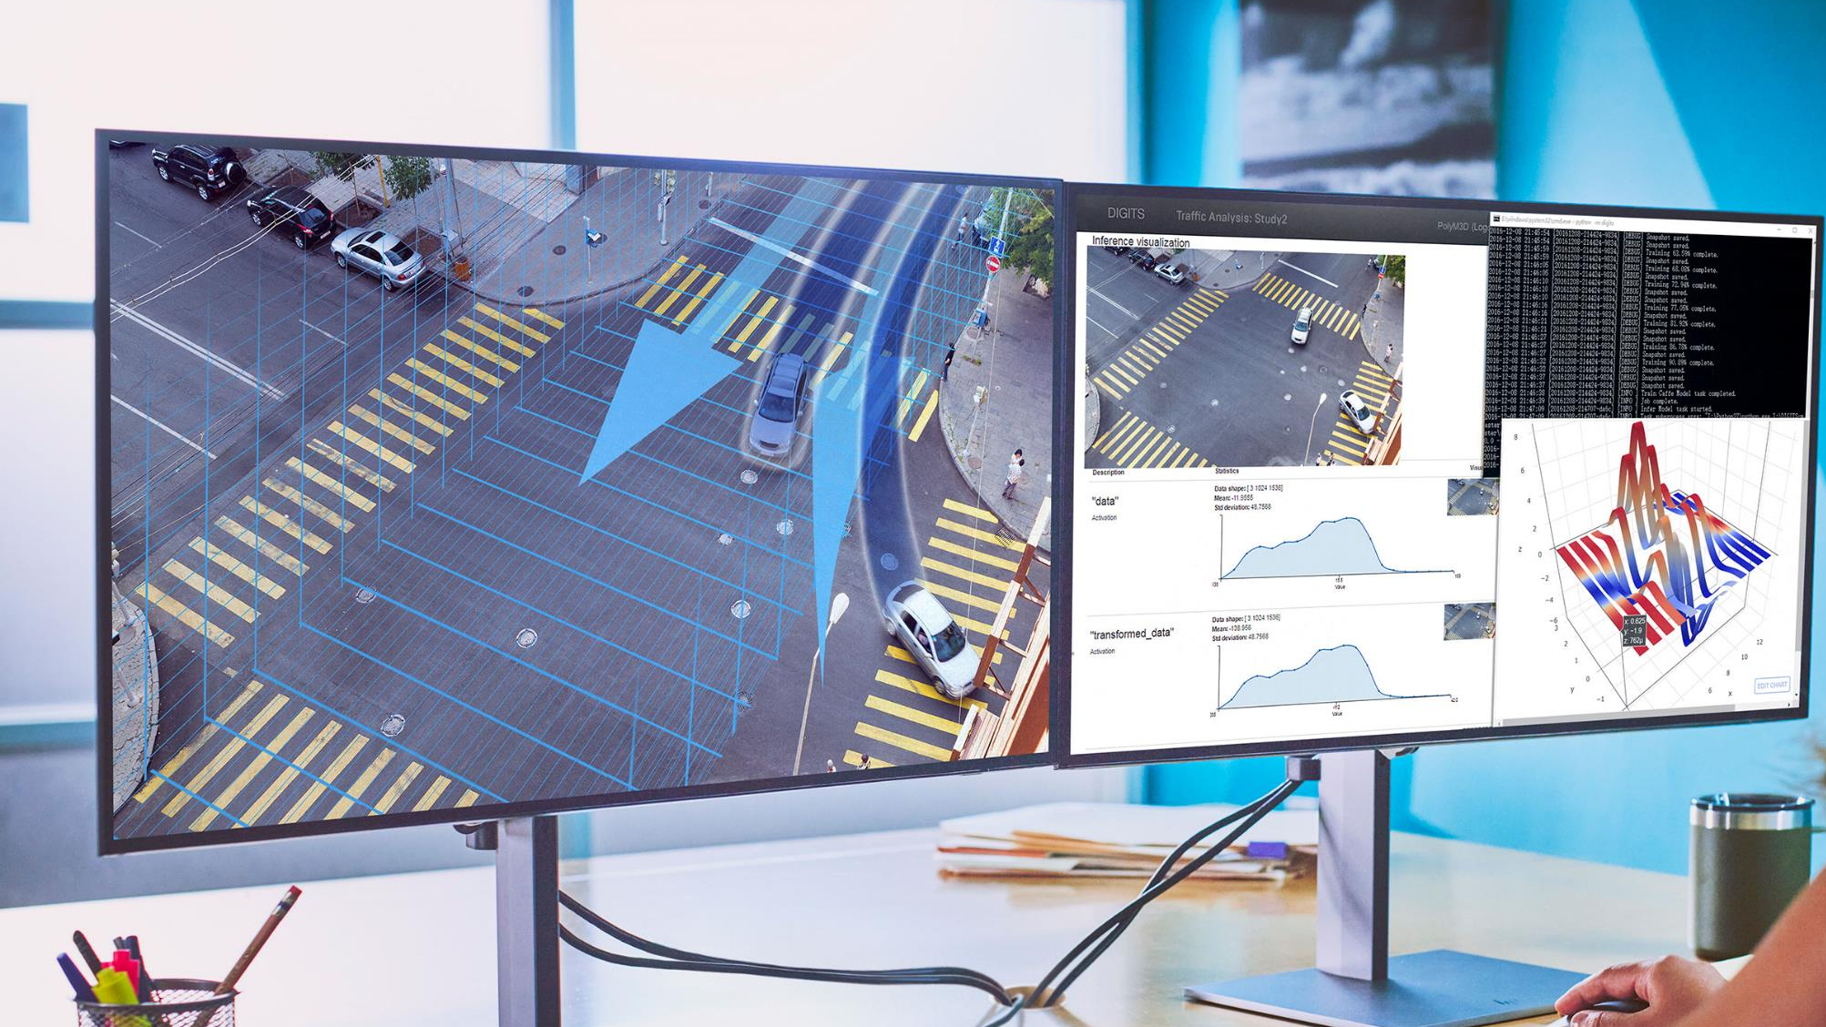
Ecosystem
30 | Z2 Tower G1i | HP Confidential. For use by HP or Partner with Customers under HP CDA only.

Slide 31
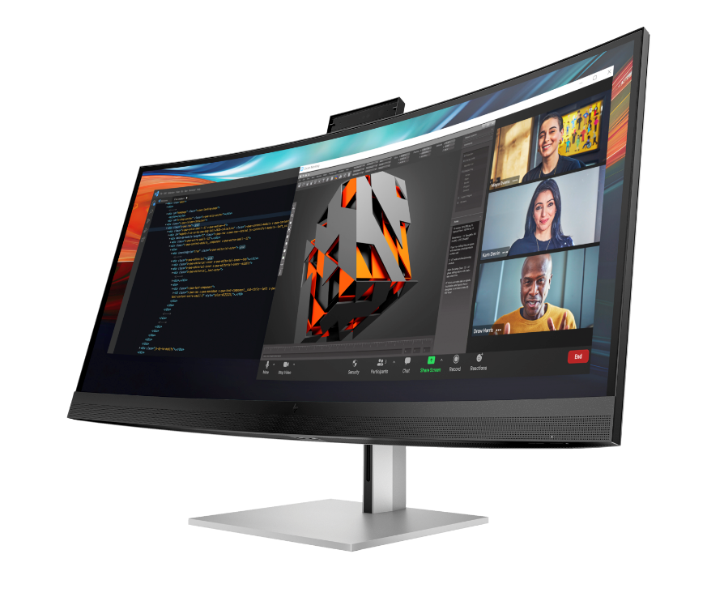
Data science ecosystem
(data analyst)
See and do more by immersing yourself in the brilliant, expansive views of the WUHD display
Improve productivity with easy multitasking on an ultra-wide screen that can be segmented into the equivalent of four 20-inch monitors
Integrated HP Device Bridge 2.0 lets you control two Windows and/or Mac devices from the same keyboard and mouse while maintaining network security with controlled file sharing
HP Series 7 Pro 740pm
FPO
31 | Z1 Tower G1i | HP Confidential. For use by HP or Partner with Customers under HP CDA only.
Notes:
__________________________________
DISCLAIMER

Slide 32
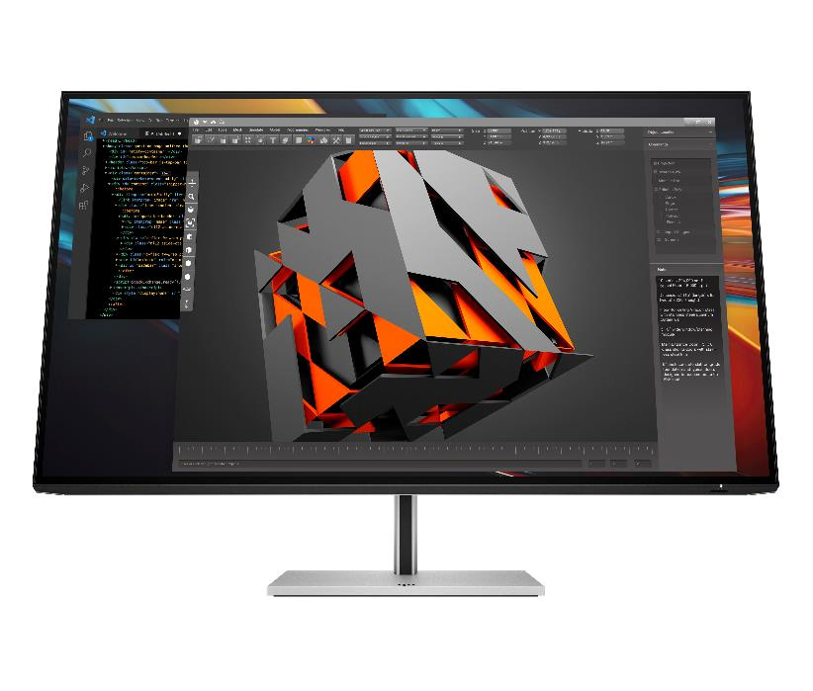
Product development ecosystem
(product engineer)
HP Series 7 Pro 732pk
View every detail as if it’s true-to-life with captivating color contrast on this precise 4K, 31.5-inch diagonal display
Transform your desk into a productivity powerhouse with Thunderbolt™ 4
When you’re multi-tasking between two devices, simply use the built-in KVM switch to control both with just a single keyboard and mouse
32 | Z1 Tower G1i | HP Confidential. For use by HP or Partner with Customers under HP CDA only.
Notes:
__________________________________ DISCLAIMER

Slide 33
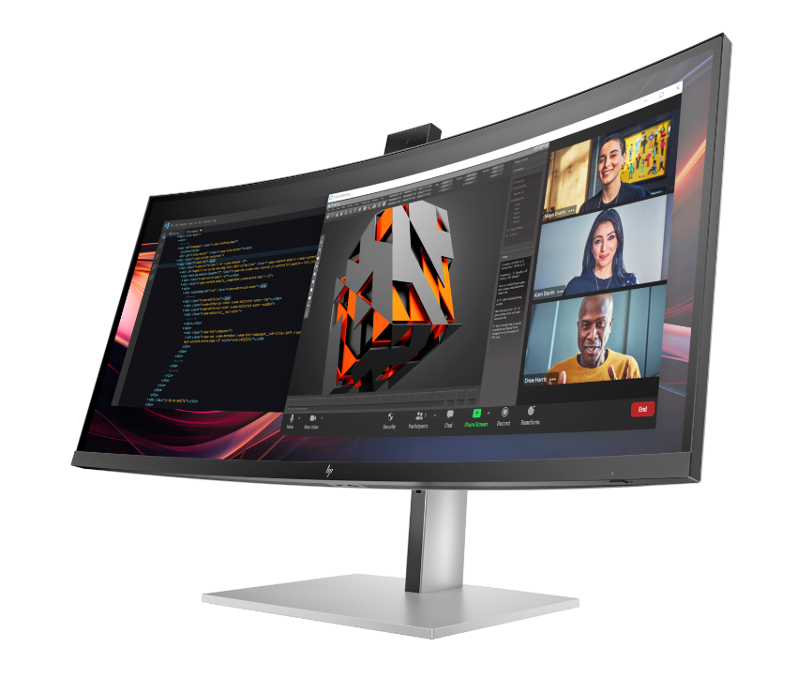
Architecture, engineering, and construction ecosystem (architect)
34" color accurate conferencing display with Zoom certification
Increase productivity with the ability to see all your projects on one expansive, sharp screen
Be confident that the color on screen matches what you see in real life with a 100% sRGB and 98% Display P3 color gamut
HP Pro Series 7 Pro 734pm
33 | Z1 Tower G1i | HP Confidential. For use by HP or Partner with Customers under HP CDA only.
Notes:
FPO: For presentation only. Product may differ from images depicted.

Slide 34



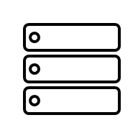

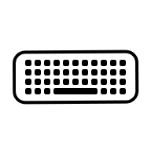




Z2 Tower G1i AMO
Rack & Mounting Kits⁶⁷
Audio
HP 965 4K Streaming Webcam
Poly Voyager Focus 2 Headset
Poly Blackwire 5220 Stereo USB-C Headset
Accessories
HP Creator 935 Black Wireless Mouse
HP 975 Dual-Mode Wireless Keyboard
HP 685 Comfort Dual-Mode Keyboard and Mouse Combo
Storage Memory
Graphics Flex I/O
FPO
34 | Z2 Tower G1i | HP Confidential. For use by HP or Partner with Customers under HP CDA only.
Notes:
*AMO items sold separately
FPO: For presentation only. Product may differ from images depicted.
________________________
DISCLAIMER
67. Rack mounting hardware sold separately

Slide 35
Security experiences
35 | Z2 Tower G1i | HP Confidential. For use by HP or Partner with Customers under HP CDA only.

Slide 36





Protected by HP Wolf Security
83
⁹⁸
Part of the world’s most secure and manageable PC portfolio
NEW Reinforced endpoint security controller⁵⁴future-proofs your device and protects against evolving threats.
Built with quantum hack protection.⁹⁵
Above the OS
HP Management Integration Kit³⁵
HP Privacy Camera⁸²
In the OS
HP Client Security Manager ⁸⁷
HP Sure Sense²⁹ HP Sure Click²⁸
Advanced security options
HP Wolf Pro Security Edition⁹²
HP Wolf Enterprise Security⁹³
HP Protect and Trace⁸⁴ with HP Platform Certificate⁹⁷
Below the OS
HP BIOSphere³⁰
HP Sure Start³¹
HP Sure Admin⁹¹
HP Sure Run ³³
HP Tamper Lock³²
HP Sure Recover³⁴
36 | Z2 Tower G1i | HP Confidential. For use by HP or Partner with Customers under HP CDA only.
Notes:
This slide contains a superlative claim/s that cannot be used in all countries:
EMEA Use Restrictions:
DO NOT USE the superlative claim in the following countries:
Romania, Slovakia, Turkey, UAE, Russia, CIS countries (Armenia, Belarus, Kazakhstan, Kyrgyzstan, Moldova, Russia, Tajikistan, Turkmenistan, Ukraine, and Uzbekistan), Indonesia, Vietnam, Malaysia
APJ Use Restrictions:
China, Vietnam, Indonesia, Malaysia – DO NOT use LAR Use Restrictions:
Brazil, Mexico – Do NOT use
__________
HP Wolf Security provides world class security outcomes helping organizations’ PC endpoints reduce risks; increase IT and security efficiencies; and provide a better user experience without downtime.​
​
HP has long been a leader in security and has been driving PC security innovation for over 20 years. ​
First next-gen AI PC with quantum hack protection*.
Incorporates a quantum-resistant cryptographic scheme to protect the integrity of UEFI BIOS firmware as of August 2024
Above the OS
HP Management Integration Kit
A client-management-console-agnostic solution that extends management aspects to HP hardware, BIOS, and software capabilities.
HP MIK helps speed up the basics of management—reduce the number of steps needed to create, deploy, and manage images, BIOS, and system security; protect data— secure BIOS settings, set authentication and credentials requirements, enable Device Guard, and manage Trusted Platform Module(TPM) firmware updates; and manage software—enable IT administrators to remotely manage features supported by the software, such as HP Client Security.
HP Sure Shutter
Physically block the camera lens with a single click for added peace-of-mind and protection from hackers spying on user.
In the OS
HP Client Security Manager Gen7
HP Sure Sense
A next-generation antivirus that uses AI to help prevent known and never-before-seen malware attacks.
HP Sure Click
Opens websites, read-only Microsoft Office and PDF attachments in isolation (hardware-enforced virtual machine) to stop malware attacks from infecting the OS.
HP Sure Click Enterprise and Sure Access Enterprise provide enterprise-class threat containment and credential protection (SCE) and privileged activity protection (SAE)
HP Wolf Pro Security Edition
Provides simple yet effective protection for small and mid-sized organizations which includes threat containment, malware prevention, and identity protection. Best fit for organization with 25 devices or less. Preinstalled on select PCs or software installable on HP and non-HP PCs
HP Protect and Trace⁸⁴
Locate, lock, and erase PC.
PC Platform Security to reduce cyber supply chain risks:
Built-in hardware enforced security drives resiliency and availability
Self-healing BIOS, hardware supply chain assurance with HP Platform Certificate**^{#coming}, and secure OS recovery. See FAQ link in disclaimer.
Below the OS
HP BIOSphere Gen6
Enhanced firmware protection automatically from the moment the PC is first booted up, guarding against malicious attacks and accidental errors that can compromise the BIOS.
HP Sure Start Gen6
HP’s self-healing BIOS automatically recovers from firmware attacks or corruption by restarting with a safe copy of the BIOS.
HP Sure Admin
Creates a digital signature that allows IT administrators to securely manage BIOS settings over the network.
HP Sure Run Gen4
Creates a digital signature that allows IT administrators to securely manage BIOS settings over the network.
HP Tamper Lock
Tamper detection sensors located on the bottom cover of the PC and on internal storage are triggered when the cover of the PC is opened.
​HP Sure Recover Gen4
Allows the user to restore the operating system when the hard drive has been compromised or corrupted without IT intervention.
This slide’s notes contains a superlative claim/s that cannot be used in all countries:
EMEA Use Restrictions:
DO NOT USE the superlative claim in the following countries:
Romania, Slovakia, Turkey, UAE, Russia, CIS countries (Armenia, Belarus, Kazakhstan, Kyrgyzstan, Moldova, Russia, Tajikistan, Turkmenistan, Ukraine, and Uzbekistan), Indonesia, Vietnam, Malaysia
APJ Use Restrictions:
China, Vietnam, Indonesia, Malaysia – DO NOT use
LAR Use Restrictions:
Brazil, Mexico – Do NOT use
​
Additional resources​ for sales
For Sales: All New Manageability customer presentation and other manageability documents can be found: https://hp.sharepoint.com/teams/CoE-Hesion/SitePages/Manageability.aspx
_____________________________
DISCLAIMERS
28. HP Sure Click requires Windows 10. See https://bit.ly/2PrLT6A_SureClick for complete details.
29. HP Sure Sense is available on select HP PCs and is not available with Windows10 Home.
30. HP BIOSphere Gen6 requires Windows 10 and is available on select HP Pro and Elite PCs. Features may vary depending on the platform and configurations.
31. HP Sure Start Gen7 is available on select HP PCs and requires Windows 10.
32. HP Tamper Lock requires a supervisor password be established prior to use.
33. HP Sure Run Gen5 is available on select HP PCs and requires Windows 10.
34. HP Sure Recover Gen5 is available on select HP PCs and requires Windows 10 and an open network connection. You must back up important files, data, photos, videos, etc. before using HP Sure Recover to avoid loss of data. Network based recovery using Wi-Fi is only available on PCs with Intel Wi-Fi Module.
35. HP Manageability Integration Kit can be downloaded from hp.com/go/clientmanagement. Please see the user guide for HP MIK’s full system requirements. HP Manageability Integration Kit infosheet - http://www8.hp.com/h20195/v2/GetPDF.aspx/4AA7-3086ENW.pdf.
54. Requires Windows 10 or higher. For supported HP PCs with the latest HP Endpoint Security Controller (Gen 5). See https://h20195.www2.hp.com/v2/GetDocument.aspx?docname=4AA8-3644ENW.
87. HP Client Security Manager Gen6/Gen7 requires Windows and is available on the select HP Elite and Pro PCs.
82. HP Privacy Camera only available PCs equipped with HD or IR camera and must be installed at the factory.​
83. HP Wolf Security for Business requires Windows 10 and higher, includes various HP security features and is available on HP Pro, Elite, Workstation, and RPOS products. See product details for included security features.
84. HP Wolf Protect & Trace with Wolf Connect is available on select HP commercial G10 and higher laptops and mobile workstation devices. Customer activation required. Devices with Cat-M module do not support Internet access. Internet service for devices with 4G LTE and 5G modules is not included and must be purchased separately. Wolf Connect Service not available in all countries. Other restrictions limitations apply, please see data sheet for complete details.
91. HP Sure Admin requires Windows 10 or higher, HP BIOS, and HP Manageability Integration Kit from http://www.hp.com/go/clientmanagement and HP Sure Admin Local Access Authenticator smartphone app from the Android or Apple store.
92. HP Wolf Pro Security Edition (including HP Sure Click Pro and HP Sure Sense Pro) is available preloaded on select SKUs and, depending on the HP product purchased, includes a paid 1-year or 3-year license. The HP Wolf Pro Security Edition software is licensed under the license terms of the HP Wolf Security Software - End-User license Agreement (EULA) that can be found at: https://support.hp.com/us-en/document/ish_3875769-3873014-16 as that EULA is modified by the following: “7. Term. Unless otherwise terminated earlier pursuant to the terms contained in this EULA, the license for the HP Wolf Pro Security Edition (HP Sure Sense Pro and HP Sure Click Pro) is effective upon activation and will continue for either a twelve (12) month or thirty-six (36) month license term (“Initial Term”). At the end of the Initial Term you may either (a) purchase a renewal license for the HP Wolf Pro Security Edition from HP.com, HP Sales or an HP Channel Partner, or (b) continue using the standard versions of HP Sure Click and HP Sure Sense at no additional cost with no future software updates or HP Support.
93. HP Wolf Enterprise Security is sold separately and requires Windows 10 or 11 PRO or higher and Microsoft Internet Explorer, Google Chrome, Chromium or Firefox are supported. Supported attachments include Microsoft Office (Word, Excel, PowerPoint) and PDF files, when Microsoft Office or Adobe Acrobat are installed.
95. Based on HP’s internal analysis of next gen AI PCs with a 40-60 TOPS NPU with a quantum-resistant cryptographic scheme to protect the integrity of UEFI BIOS firmware as of August 2024
97. HP Platform Certificate - a verifiable artifact of PC authenticity and integrity reflecting that PC components have not changed since leaving the factory. HP’s Platform Certificate FAQ: https://h20195.www2.hp.com/v2/GetDocument.aspx?docname=4AA8-3108ENW
98: Based on HP’s Manageability Integration Kit’s management of every aspect of a PC including hardware, BIOS and software management using Microsoft System Center Configuration Manager on HP Elite PCs.​

Slide 37



HP Wolf Pro Security NGAV¹⁵
Stay protected from known & new malware with AI-powered antivirus
Behavioral Analysis
Identifying and blocking malicious behavior
FPO
AI: Machine Learning
trained to recognize common features of malware
AI: Deep Learning
AI trained on raw data to instinctively recognize even unknown malware
37 | Z2 Tower G1i | HP Confidential. For use by HP or Partner with Customers under HP CDA only.
Notes:
FPO: For presentation only. Product may differ from images depicted.
Sure Sense Pro is a comprehensive NGAV like leading solutions in the market (NGAV - next-gen antivirus)
Sure Sense Pro protects the host OS from known and unknown malware – powered by mature behavioral analysis, AI/deep learning and broader techniques based static analysis
Provides industry-leading protection with very high detection rates and low false-positive rates comparable to leading paid NGAV software providers
Behavioral analysis techniques include looking for unauthorized behavior:
1. Looking for code injection behavior
2. Script-based attacks
3. Fileless malware and living-off-the-land behaviors
4. Heuristics-based detection
5. Unauthorized registry access
Deep learning of known and unknown malware, recognizing 99% of malware
Lightweight agent, means faster run time and detection time, working in 20ms on average
Protects your PC by quarantining malware and other known or unknown threats
Best of all, minimal updates are required, and only requires 1% PC load while in idle.
_________________
DISCLAIMERS
15.HP Wolf Pro Security NGAV one (1) year license is included on HP EliteBook Ultra G1q. The HP Wolf Pro Security NGAV software is licensed under the license terms of the HP Wolf Security Software - End-User license Agreement (EULA) that can be found at: https://support.hp.com/us-en/document/ish_3875769-3873014-16 as that EULA is modified by the following:
Term. Unless otherwise terminated earlier pursuant to the terms contained in this EULA, the license for the HP Wolf Pro Security NGAV is effective upon 4 months after the date the HP Product was shipped by HP and will continue for the term communicated to you at purchase and in your order confirmation email (“Initial Term”). At the end of the Initial Term you may either (a) purchase a renewal license for the HP Wolf Pro Security Edition from HP.com, HP Sales or an HP Channel Partner, or (b) continue using the standard versions of HP Wolf Pro Security at no additional cost with no future software updates or HP Support. Notwithstanding the foregoing, the license shall expire no later than one year after the fixed term the subject license ends.

Slide 38
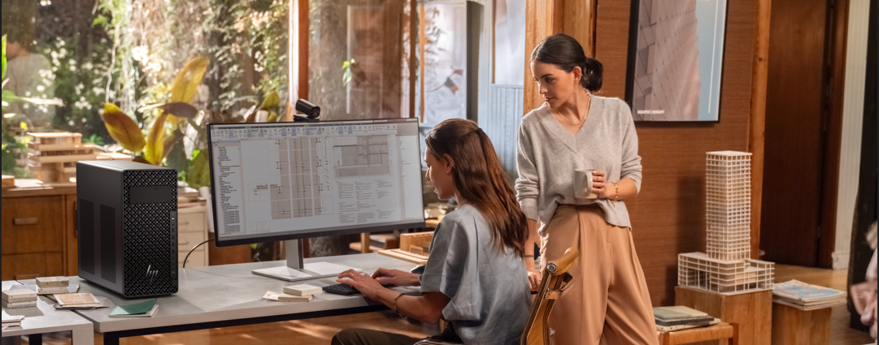
Sustainability & Reliability
HP Z2 Tower G1i
38 | Z2 Tower G1i HP Confidential. For use by HP or Partner with Customers under HP CDA only.
Notes:
FPO: For presentation only. Product may differ from images depicted.

Slide 39




Designed with reliability in mind
Starting with durable construction
360k
Undergoes mil-std 810h tests¹⁸
40C testing to endure the toughest environments¹⁰⁸
Checking components through functional & system integration testing
Hours
Included in the total HP test process¹⁰⁸
39 | Z1 Tower G1i HP Confidential. For use by HP or Partner with Customers under HP CDA only.
39 | Z1 Tower G1i HP Confidential. For use by HP or Partner with Customers under HP CDA only.
Notes:
______________________
DISCLAIMER
18. MIL STD testing is not intended to demonstrate fitness for U.S. Department of Defense contract requirements or for military use. Test results are not a guarantee of future performance under these test conditions. Accidental Damage or damage under these test conditions requires an optional HP Accidental Damage Protection Care Pack.
108. HP’s Total Test Process is not a guarantee of future performance under these test conditions. Accidental damage or damage under these test conditions requires an optional HP Accidental Damage Protection Care Pack.

Slide 40


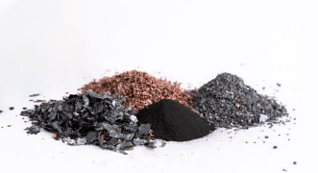

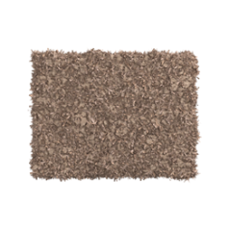


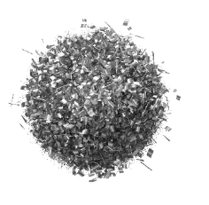
The world’s most sustainable PC portfolio
EPEAT® Climate+ Gold Registered in US⁴³
63
Z2 Tower G1i
NEW!!
NEW!!
Speaker magnet made with
Decrease carbon footprint
Fans made with
100% sustainably sourced packaging^{47, 102}
100% recycled rare earth element
Advanced power monitoring dashboard¹⁰³
60% post-consumer recycled plastic⁴⁶
25% ocean-bound plastics⁵²
20% post-industrial recycled steel⁴⁵
40 | Z2 Tower G1i HP Confidential. For use by HP or Partner with Customers under HP CDA only.
Notes:
This slide contains a superlative claim/s that cannot be used in all countries:
EMEA Use Restrictions:
DO NOT USE the superlative claim in the following countries:
Romania, Slovakia, Turkey, UAE, Russia, CIS countries (Armenia, Belarus, Kazakhstan, Kyrgyzstan, Moldova, Russia, Tajikistan, Turkmenistan, Ukraine, and Uzbekistan), Indonesia, Vietnam, Malaysia
APJ Use Restrictions:
China, Vietnam, Indonesia, Malaysia – DO NOT use LAR Use Restrictions:
Brazil, Mexico – Do NOT use
____________________________
DISCLAIMERS
45. Recycled metal is expressed as a percentage of the total weight of the metal according to ISO 14021 definitions for metal parts over 25 grams. Percent of recycled material varies by product.
46. Recycled plastic is expressed as a percentage of the total weight plastic. Post-consumer recycled is based on the definition set in the EPEAT standard for computers, IEEE 1680.1-2018 standard
47. 100% outer box packaging made from sustainably sourced certified and recycled fibers. Fiber cushions made from 100% recycled wood fiber and organic material. Any plastic cushions are made from >90% recycled plastic.
52. Percentage of ocean-bound plastic contained in each component varies by product. Ocean Bound plastic is expressed as a percentage of the total weight plastic. Ocean Bound plastic is based on the definition set by the UL2809 standard.
102. HP paper and fiber based packaging for PCs, displays, home and office print, and supplies is reported by suppliers as recycled or certified, with a minimum of 97% by volume verified by HP. Packaging is the box that comes with the product and all paper-based materials inside the box. Packaging for personal systems accessories and spare parts is not included.
103. Power Consumption Measurement with real-time total power usage tracking will release in 2024 on our commercial notebook line. The energy consumption data is planned to be available to end users within myHP and ITDMs via HP Proactive Insights in May 2024. Fleet management within HP Proactive Insights requires Windows 10 or higher and registration for the Workforce Experience platform at https://admin.hp.com. Some features and capabilities may require additional purchase of HP services and/or commercial hardware capable of supporting the HP Insights agent for Windows, Mac, & Android. Activation and restrictions may apply. Select HP Workforce Solutions require an HP Insights agent for Windows, Mac, & Android, available for download at https://admin.hp.com/software. For full system requirements and services that require the agent, please visit https://admin.hp.com/requirements. The agent collects telemetry and analytics around devices and applications that integrate into the Workforce Experience platform and is not sold as a standalone service. Internet access with connection to the Workforce Experience platform is required. HP follows stringent GDPR privacy regulations, and the platform is ISO27001, ISO27701, ISO27017 and SOC2 Type2 certified for Information Security.

Slide 41


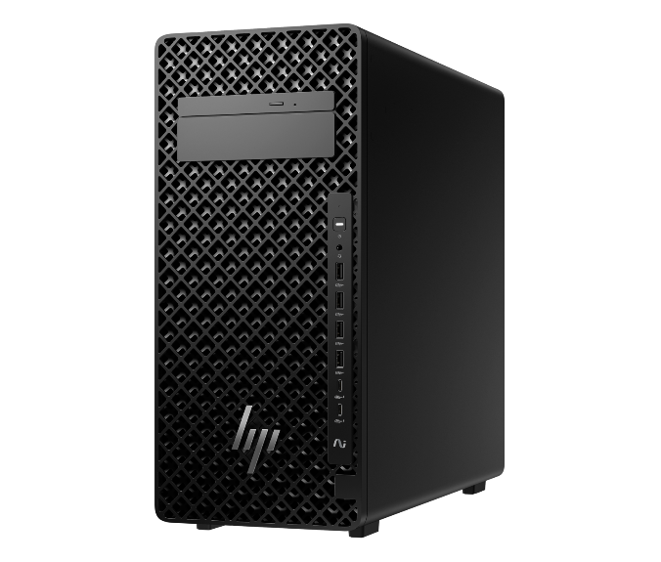



Help protect our shared future
Before use | NEW 100% recycled rare earth elements in the speaker magnet¹⁰¹ | 
 | Up to 60% recycled plastics¹⁰¹ | 
 | Up to 20% recycled steel⁴⁵ | 
 | 100% sustainably sourced packaging^{47, 102} | 
 | See power usage and get recommendations to reduce energy use with Power Consumption Measurement dashboard in myHP¹⁰³ | 
During use | Advanced Power Monitoring for end users and IT¹⁰³ | 
 | Digital Passport | 
 | Platinum power efficiency in all PSUs | 
During use | EPEAT® Climate+ Gold Registered in US⁴³ | 
 | ENERGY STAR® Certified | 
 | TCO Certified | 
 | Undergoes 19 MIL-STD 810 tested for durability¹⁸ | 
 | Sanitizable¹⁰⁴ | 
After use | HP IT Asset Disposition Service¹⁰⁵ | 
 | HP Device Life Extension¹⁰⁶ | 
 | HOPE Recycling Futures | 
Part of the world's most sustainable PC portfolio.⁶³
View the 2023 HP Sustainable Impact Report to see how we’re making a difference.
Z2 Tower G1i
41 | Z2 Tower G1i HP Confidential. For use by HP or Partner with Customers under HP CDA only.
Notes:
This slide contains a superlative claim/s that cannot be used in all countries:
EMEA Use Restrictions:
DO NOT USE the superlative claim in the following countries:
Romania, Slovakia, Turkey, UAE, Russia, CIS countries (Armenia, Belarus, Kazakhstan, Kyrgyzstan, Moldova, Russia, Tajikistan, Turkmenistan, Ukraine, and Uzbekistan), Indonesia, Vietnam, Malaysia
APJ Use Restrictions:
China, Vietnam, Indonesia, Malaysia – DO NOT use LAR Use Restrictions:
Brazil, Mexico – Do NOT use
____________________________
DISCLAIMERS 18. MIL STD 810H testing is not intended to demonstrate fitness for U.S. Department of Defense contract requirements or for military use.
43. Based on US EPEAT® registration according to IEEE 1680.1-2018 EPEAT®. EPEAT® status varies by country. Visit www.epeat.net for more information.
45. Recycled metal is expressed as a percentage of the total weight of the metal according to ISO 14021 definitions for metal parts over 25 grams. Percent of recycled material varies by product.
47. 100% outer box packaging made from sustainably sourced certified and recycled fibers. Fiber cushions made from 100% recycled wood fiber and organic material. Any plastic cushions are made from >90% recycled plastic.
63. Applies to HP PCs, Workstations, and Displays manufactured after January 2019. Based on most Gold and Silver (including Climate+) EPEAT® registrations and according to IEEE 1680.1-2018 EPEAT®. Status varies by country. Visit www.epeat.net for more information
101. Recycled metal is expressed as a percentage of the total weight of the metal according to ISO 14021 definitions for metal parts over 25 grams. Percent of recycled material varies by product.
102. HP paper and fiber based packaging for PCs, displays, home and office print, and supplies is reported by suppliers as recycled or certified, with a minimum of 97% by volume verified by HP. Packaging is the box that comes with the product and all paper-based materials inside the box. Packaging for personal systems accessories and spare parts is not included.
103. Power Consumption Measurement with real-time total power usage tracking will release in 2024 on our commercial notebook line. The energy consumption data is planned to be available to end users within myHP and ITDMs via HP Proactive Insights in May 2024. Fleet management within HP Proactive Insights requires Windows 10 or higher and registration for the Workforce Experience platform at https://admin.hp.com. Some features and capabilities may require additional purchase of HP services and/or commercial hardware capable of supporting the HP Insights agent for Windows, Mac, & Android. Activation and restrictions may apply. Select HP Workforce Solutions require an HP Insights agent for Windows, Mac, & Android, available for download at https://admin.hp.com/software. For full system requirements and services that require the agent, please visit https://admin.hp.com/requirements. The agent collects telemetry and analytics around devices and applications that integrate into the Workforce Experience platform and is not sold as a standalone service. Internet access with connection to the Workforce Experience platform is required. HP follows stringent GDPR privacy regulations, and the platform is ISO27001, ISO27701, ISO27017 and SOC2 Type2 certified for Information Security.
104. Select household wipes can be safely used to clean HP Elite and Workstation, and HP ProBook 635 Aero PCs up to 1,000 wipes: See wipe manufacturer’s instructions for disinfecting and the HP cleaning guide for HP tested wipe solutions at How to Sanitize Your HP Device Whitepaper (http://h20195.www.2.hp.com/v2/GetDocument.aspx?docname=4AA7-7610ENW) not applicable to HP Elite c1030 Chromebook.
105. HP Services are governed by the applicable HP terms and conditions of service provided or indicated to Customer at the time of purchase. Customer may have additional statutory rights according to applicable local laws, and such rights are not in any way affected by the HP terms and conditions of service or the HP Limited Warranty provided with your HP Product.
106. The HP Device Life Extension capability is for HP commercial PCs. HP-certified partners will perform functional diagnostics, data removal, interior and exterior cleaning, enhance device performance, reimaging, and conduct platform updates. This service is available as a Care Pack when it is sold with new hardware or within 120 days of the original Care Pack expiration date.

Slide 42
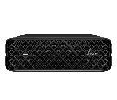
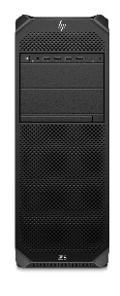
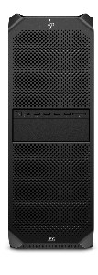
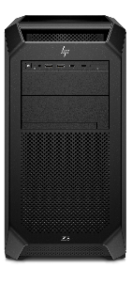
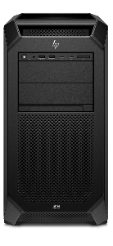
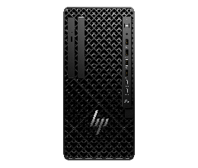
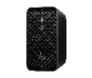
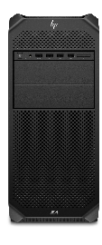
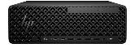
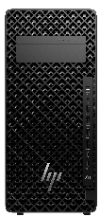
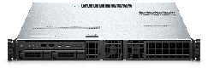


2025 Desktop Workstation Portfolio*
Z1
Z2
Z4
Z6
Z8
FPO
Z2 Mini G1a
Z2 Mini G1i, Z2 SFF G1i, Z2 Tower G1i
Z4 Rack G5
Z1 Tower G1i
Z4 Tower G5
Z6 G5
Z6 G5a
Z8 G5
Z8 Fury G5
Step into professional performance
Professional performance in 4 sizes
Workhorses of expandability and rack-ability
Extreme graphics performance
Take on intense workloads with extreme performance.
2D & light 3D workflows, data science model building/AI
2D & light 3D workflows, data science model building/AI
+Medium 3D workflows, 1080P video editing, light rendering / simulation/data analysis
+Multiple heavy workflows simultaneously, VFX & compositing
+Heavy 3D workflows, 4K+ video editing, medium rendering / simulation/data analysis
Best for large AI modeling and training when equipped with high-end graphics
High-frequency, single threaded applications
Applications
Multi-threaded CPU applications & parallel GPU compute
Workflows
Increasing dataset and model size/complexity
Benefits
More iterations, faster time to completion with greater accuracy
42 | Z2 Tower G1i HP Confidential. For use by HP or Partner with Customers under HP CDA only.
Notes:
FPO: For presentation only. Product may differ from images depicted.

Slide 43
43 | 2 Tower G1i | HP Confidential. For use by HP or Partner with Customers under HP CDA only.

Slide 44
Discalimers
1. Multicore is designed to improve performance of certain software products. Not all customers or software applications will necessarily benefit from use of this technology. Performance and clock frequency will vary depending on application workload and your hardware and software configurations. Intel’s numbering, branding and/or naming is not a measurement of higher performance. Features and software that require a NPU may require software purchase, subscription or enablement by a software or platform provider, and third-party software may have specific configuration or compatibility requirements. Performance varies by use, configuration, and other factors.
2. Memory is an optional feature that must be configured at purchase
3. AI applications that require an NPU may require software purchase, subscription or enablement by a software or platform provider, and third-party software may have specific configuration or compatibility requirements. Performance varies by use, configuration, and other factors.
4. Based on HP’s internal analysis of ISV certified mini workstations with <3L volume, at least 3 ISV certifications, configurable professional graphics and a dedicated workstation brand. Powerful based on processor, integrated graphics, memory, and power supply as of October 2024.
5. Microsoft Copilot requires Windows 11. Some features require an NPU. Timing of feature delivery and availability varies by market and device. Requires Microsoft account to log in. Where the Copilot app is not available, the Copilot key will lead to the Bing search engine. Not available in all countries or regions Learn more. Some features of Copilot may require a paid subscription from Microsoft.
6. Copilot+ PC experiences are coming. Requires free updates available starting late November 2024. Timing varies by device and region. See aka.ms/copilotpluspcs
7. Based on HP’s internal analysis of ISV certified mini workstations with <3L volume, at least 3 ISV certifications, configurable professional graphics and a dedicated workstation brand. Includes all next Gen AI PCs with over 40 NPU TOPS
8. The AMD Ryzen AI MAX unified memory architecture supports ystem configurations of up to 128GB system memory and allows memory to be flexibly assigned between the CPU and GPU. When 128GB memory is configured, up to 96GB unified memory can be used for Radeon graphics, leaving up to 32GB reserved for system memory.
9. Trillions of Operations per Second (TOPS) for an Intel processor is the maximum number of operations per second that can be executed in an optimal scenario and may not be typical. TOPS may vary based on several factors, including the specific system configuration, AI model, and software version
10. Next Gen AI PC with 40 to 60 TOPS NPU to enable local AI processing.
11. Some software vendors do not test the exact combinations of the hardware listed here, but rather publish a minimum configuration specification they will support.​
12. HP AI Companion is available preloaded on select HP next gen AI PCs or is available for download from the Microsoft store and requires a HP next gen AI PC with a NPU supporting 40-60 TOPS and requires Windows 11. Perform requires account set up within 30 days of PC boot. Some features require customer upload of local data. Five (5) library 100MB limit each and supports pdf, .txt., .docx files. HP may limit search prompts to 200 per calendar month.40. Requires Windows OS.
13. Up to 128GB memory is an optional, configurable feature
14. HP Wolf Security for Business requires Windows 10 or 11 Pro and higher, includes various HP security features and is available on HP Pro, Elite, Workstation, and RPOS products. See product details for included security features.
15.HP Wolf Pro Security NGAV one (1) year license is included on HP EliteBook Ultra G1q. The HP Wolf Pro Security NGAV software is licensed under the license terms of the HP Wolf Security Software - End-User license Agreement (EULA) that can be found at: https://support.hp.com/us-en/document/ish_3875769-3873014-16 as that EULA is modified by the following:
Term. Unless otherwise terminated earlier pursuant to the terms contained in this EULA, the license for the HP Wolf Pro Security NGAV is effective upon 4 months after the date the HP Product was shipped by HP and will continue for the term communicated to you at purchase and in your order confirmation email (“Initial Term”). At the end of the Initial Term you may either (a) purchase a renewal license for the HP Wolf Pro Security Edition from HP.com, HP Sales or an HP Channel Partner, or (b) continue using the standard versions of HP Wolf Pro Security at no additional cost with no future software updates or HP Support. Notwithstanding the foregoing, the license shall expire no later than one year after the fixed term the subject license ends.
16. For storage drives, GB = 1 billion bytes. Actual formatted capacity is less. Up to 30 GB (for Windows) is reserved for system recovery software
17. HP paper and fiber based packaging for PCs, displays, home and office print, and supplies is reported by suppliers as recycled or certified, with a minimum of 97% by volume verified by HP. Packaging is the box that comes with the product and all paper-based materials inside the box. Packaging for commercial, personal systems accessories, and spare parts is not included. 18. MIL STD testing is not intended to demonstrate fitness for U.S. Department of Defense contract requirements or for military use. Test results are not a guarantee of future performance under these test conditions. Accidental Damage or damage under these test conditions requires an optional HP Accidental Damage Protection Care Pack.
19. 100% outer box packaging made from sustainably sourced certified and recycled fibers. Fiber cushions made from 100% recycled wood fiber and organic material. Any plastic cushions are made from >90% recycled plastic.
20. Recycled metal is expressed as a percentage of the total weight of the metal according to ISO 14021 definitions for metal parts over 25 grams. Percent of recycled material varies by product.
21. Percentage of ocean-bound plastic contained in each component varies by product. Ocean Bound plastic is expressed as a percentage of the total weight plastic. Ocean Bound plastic is based on the definition set by the UL2809 standard.
23. Applies to HP PCs, Workstations, and Displays manufactured after January 2019. Based on most Gold and Silver (including Climate+) EPEAT® registrations and according to IEEE 1680.1-2018 EPEAT®. Status varies by country. Visit www.epeat.net for more information.
24. Recycled plastic is expressed as a percentage of the total weight plastic. Post-consumer recycled is based on the definition set in the EPEAT standard for computers, IEEE 1680.1-2018 standard. Percent of recycled material varies by product.
25. Wireless access point and Internet service required and sold separately. Availability of public wireless access points limited. Wi-Fi 7 (802.11BE) functionality requires compatible Windows 11 OS, compatible processor, and separately purchased Wi-Fi 7 router to support backwards compatibility with prior 802.11 specs. Available in countries where Wi-Fi 7 is supported. The specification for 802.11BE is a draft specification and is not final. If the final specification differs from the draft specification, it may affect the ability of the device to communicate with other 802.11BE devices.
26. Actual weight will vary by configuration.
27. Requires the myHP application and Windows OS.
28. HP Sure Click requires Windows 10. See https://bit.ly/2PrLT6A_SureClick for complete details.
29. HP Sure Sense is available on select HP PCs and is not available with Windows10 Home.
30. HP BIOSphere Gen6 requires Windows 10 and is available on select HP Pro and Elite PCs. Features may vary depending on the platform and configurations.
31. HP Sure Start Gen7 is available on select HP PCs and requires Windows 10.
32. HP Tamper Lock requires a supervisor password be established prior to use.
33. HP Sure Run Gen5 is available on select HP PCs and requires Windows 10.
34. HP Sure Recover Gen5 is available on select HP PCs and requires Windows 10 and an open network connection. You must back up important files, data, photos, videos, etc. before using HP Sure Recover to avoid loss of data. Network based recovery using Wi-Fi is only available on PCs with Intel Wi-Fi Module.
35. HP Manageability Integration Kit can be downloaded from hp.com/go/clientmanagement. Please see the user guide for HP MIK’s full system requirements. HP Manageability Integration Kit infosheet - http://www8.hp.com/h20195/v2/GetPDF.aspx/4AA7-3086ENW.pdf.
43. Based on US EPEAT® registration according to IEEE 1680.1-2018 EPEAT®. EPEAT® status varies by country. Visit www.epeat.net for more information.
45. Recycled metal is expressed as a percentage of the total weight of the metal according to ISO 14021 definitions for metal parts over 25 grams. Percent of recycled material varies by product.
46. Recycled plastic is expressed as a percentage of the total weight plastic. Post-consumer recycled is based on the definition set in the EPEAT standard for computers, IEEE 1680.1-2018 standard
47. 100% outer box packaging made from sustainably sourced certified and recycled fibers. Fiber cushions made from 100% recycled wood fiber and organic material. Any plastic cushions are made from >90% recycled plastic.
48. Not all features are available in all editions or versions of Windows. Systems may require upgraded and/or separately purchased hardware, drivers, software or BIOS update to take full advantage of Windows functionality. Windows 11 Pro is automatically updated, which is always enabled. ISP fees may apply and additional requirements may apply over time for updates. See http://www.windows.com.

Slide 45
Disclaimers
52. Percentage of ocean-bound plastic contained in each component varies by product. Ocean Bound plastic is expressed as a percentage of the total weight plastic. Ocean Bound plastic is based on the definition set by the UL2809 standard.
54. Requires Windows 10 or higher. For supported HP PCs with the latest HP Endpoint Security Controller (Gen 5). See https://h20195.www2.hp.com/v2/GetDocument.aspx?docname=4AA8-3644ENW.
60. Recycled plastic is expressed as a percentage of the total weight plastic. Post-consumer recycled is based on the definition set in the EPEAT standard for computers, IEEE 1680.1-2018 standard. Percent of recycled material varies by product.
62. Test results are not a guarantee of future performance under these test conditions. Accidental damage requires an optional HP Accidental Damage Protection Care Pack.
63. Applies to HP PCs, Workstations, and Displays manufactured after January 2019. Based on most Gold and Silver (including Climate+) EPEAT® registrations and according to IEEE 1680.1-2018 EPEAT®. Status varies by country. Visit www.epeat.net for more information
66. AMD Ryzen AI Max PRO Total system TOPS is made up from a combination of NPU, GPU, and CPU TOPS.
67. Rack mounting hardware sold separately
68. Based on HP’s internal analysis of ISV certified mini workstations with <3L volume, at least 3 ISV certifications, configurable professional graphics and a dedicated workstation brand as of October 2024
69. Based on HP’s internal analysis of ISV certified mini workstations with <3L volume, at least 3 ISV certifications, configurable professional graphics and a dedicated workstation brand. Based on the highest memory offered as of Oct 2024.
70. All memory configurations support ECC. ECC can be enabled or disabled via the F10 BIOS menu.
71. Wireless access point and Internet service required and sold separately. Availability of public wireless access points limited. Wi-Fi 7 (802.11BE) functionality requires compatible Windows 11 OS, compatible processor, and separately purchased Wi-Fi 7 router to support backwards compatibility with prior 802.11 specs. Available in countries where Wi-Fi 7 is supported. The specification for 802.11BE is a draft specification and is not final. If the final specification differs from the draft specification, it may affect the ability of the device to communicate with other 802.11BE devices.
72. Internet access required.
73. Internet access required. Fleet management requires HP Remote System Management.
74. HP service and support not available for non-Z devices.
76. HP Services are sold separately and are governed by the applicable HP terms and conditions of service provided or indicated to the customer at the time of purchase. Customers may have additional statutory rights according to applicable local laws, and such rights are not in any way affected by the HP terms and conditions of service or the HP limited warranty provided with your HP product.
77. HP TechPulse is a telemetry and analytics platform that provides critical data around devices and applications and is not sold as a standalone service. HP TechPulse follows stringent GDPR privacy regulations and is ISO27001, ISO27701, ISO27017, and SOC2 Type2 certified for Information Security. Internet access with connection to TechPulse portal is required. For full system requirements, please visit http://www.hpdaas.com/requirements.
78. SuperSpeed USB 20Gbps is not available with Thunderbolt™ 4.
82. HP Privacy Camera only available PCs equipped with HD or IR camera and must be installed at the factory.​
83. HP Wolf Security for Business requires Windows 10 and higher, includes various HP security features and is available on HP Pro, Elite, Workstation, and RPOS products. See product details for included security features.
84. HP Wolf Protect & Trace with Wolf Connect is available on select HP commercial G10 and higher laptops and mobile workstation devices. Customer activation required. Devices with Cat-M module do not support Internet access. Internet service for devices with 4G LTE and 5G modules is not included and must be purchased separately. Wolf Connect Service not available in all countries. Other restrictions limitations apply, please see data sheet for complete details 87. HP Client Security Manager Gen6/Gen7 requires Windows and is available on the select HP Elite and Pro PCs.
91. HP Sure Admin requires Windows 10 or higher, HP BIOS, and HP Manageability Integration Kit from http://www.hp.com/go/clientmanagement and HP Sure Admin Local Access Authenticator smartphone app from the Android or Apple store.
92. HP Wolf Pro Security Edition (including HP Sure Click Pro and HP Sure Sense Pro) is available preloaded on select SKUs and, depending on the HP product purchased, includes a paid 1-year or 3-year license. The HP Wolf Pro Security Edition software is licensed under the license terms of the HP Wolf Security Software - End-User license Agreement (EULA) that can be found at: https://support.hp.com/us-en/document/ish_3875769-3873014-16 as that EULA is modified by the following: “7. Term. Unless otherwise terminated earlier pursuant to the terms contained in this EULA, the license for the HP Wolf Pro Security Edition (HP Sure Sense Pro and HP Sure Click Pro) is effective upon activation and will continue for either a twelve (12) month or thirty-six (36) month license term (“Initial Term”). At the end of the Initial Term you may either (a) purchase a renewal license for the HP Wolf Pro Security Edition from HP.com, HP Sales or an HP Channel Partner, or (b) continue using the standard versions of HP Sure Click and HP Sure Sense at no additional cost with no future software updates or HP Support.
93. HP Wolf Enterprise Security is sold separately and requires Windows 10 or 11 PRO or higher and Microsoft Internet Explorer, Google Chrome, Chromium or Firefox are supported. Supported attachments include Microsoft Office (Word, Excel, PowerPoint) and PDF files, when Microsoft Office or Adobe Acrobat are installed.
95. Based on HP’s internal analysis of next gen AI PCs with a 40-60 TOPS NPU with a quantum-resistant cryptographic scheme to protect the integrity of UEFI BIOS firmware as of August 2024
97. HP Platform Certificate - a verifiable artifact of PC authenticity and integrity reflecting that PC components have not changed since leaving the factory. HP’s Platform Certificate FAQ: https://h20195.www2.hp.com/v2/GetDocument.aspx?docname=4AA8-3108ENW
98: Based on HP’s Manageability Integration Kit’s management of every aspect of a PC including hardware, BIOS and software management using Microsoft System Center Configuration Manager on HP Elite PCs.​
101. Recycled metal is expressed as a percentage of the total weight of the metal according to ISO 14021 definitions for metal parts over 25 grams. Percent of recycled material varies by product.
102. 100% outer box packaging made from sustainably sourced certified and recycled fibers. Fiber cushions made from 100% recycled wood fiber and organic material. Any plastic cushions are made from >90% recycled plastic.
103. Power Consumption Measurement with real-time total power usage tracking will release in 2024 on our commercial notebook line. The energy consumption data is planned to be available to end users within myHP and ITDMs via HP Proactive Insights in May 2024. Fleet management within HP Proactive Insights requires Windows 10 or higher and registration for the Workforce Experience platform at https://admin.hp.com. Some features and capabilities may require additional purchase of HP services and/or commercial hardware capable of supporting the HP Insights agent for Windows, Mac, & Android. Activation and restrictions may apply. Select HP Workforce Solutions require an HP Insights agent for Windows, Mac, & Android, available for download at https://admin.hp.com/software. For full system requirements and services that require the agent, please visit https://admin.hp.com/requirements. The agent collects telemetry and analytics around devices and applications that integrate into the Workforce Experience platform and is not sold as a standalone service. Internet access with connection to the Workforce Experience platform is required. HP follows stringent GDPR privacy regulations, and the platform is ISO27001, ISO27701, ISO27017 and SOC2 Type2 certified for Information Security.
104. Select household wipes can be safely used to clean HP Elite and Workstation, and HP ProBook 635 Aero PCs up to 1,000 wipes: See wipe manufacturer’s instructions for disinfecting and the HP cleaning guide for HP tested wipe solutions at How to Sanitize Your HP Device Whitepaper (http://h20195.www.2.hp.com/v2/GetDocument.aspx?docname=4AA7-7610ENW) not applicable to HP Elite c1030 Chromebook.
105. HP Services are governed by the applicable HP terms and conditions of service provided or indicated to Customer at the time of purchase. Customer may have additional statutory rights according to applicable local laws, and such rights are not in any way affected by the HP terms and conditions of service or the HP Limited Warranty provided with your HP Product.
106. The HP Device Life Extension capability is for HP commercial PCs. HP-certified partners will perform functional diagnostics, data removal, interior and exterior cleaning, enhance device performance, reimaging, and conduct platform updates. This service is available as a Care Pack when it is sold with new hardware or within 120 days of the original Care Pack expiration date.
107. Up to 192 GB memory is available at launch. Up to 256 GB memory is planned to be available in the second half of 2025.
45 | Z2 Mini G1a HP Confidential. For use by HP or Partner with Customers under HP CDA only.

Slide 46
Disclaimers
108. HP’s Total Test Process is not a guarantee of future performance under these test conditions. Accidental damage or damage under these test conditions requires an optional HP Accidental Damage Protection Care Pack.
109. HP Integrated Remote System Controller not compatible with Z2 Mini platforms and not recommended for non-Z devices.
110. Third party software sold separately.
111. Up to 80Gb/s data bandwidth for peripherals and up to 120Gb/s display bandwidth is planned to be available in the second half of 2025.

